Slide 1


Code Converter
Sep 2023
Varun Bohara Analyst, Bangalore

Slide 2

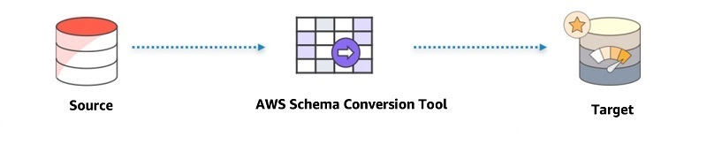

Code Converter
Overview
Automate MicroStrategy TSQL cube conversion to Redshift
Approach to Automation will resolve following challenges:
Automated code conversion from T-SQL to Redshift
Re-map existing DW fields and tables to Redshift
Adhere to the design changes based on the Redshift
Limited conversion timeline and high number of cubes
Solution
ISTES
Step 1:
AWS
Step 2:
</>
</>
(Microsoft SQL server)
(AWS Redshift)
AWS SCT is a client application that can be installed on a workstation, laptop, or EC2 instance
Convert schema and code with AWS SCT. This automates much of the conversion process
SCT generates a report that helps identify any issues/limitations & actions to be taken for unsupported features
Python code remaps fields and tables per the Redshift model. It works on 3 inputs -
Converted SQL
Mapping document
Column Metadata export from source database
ASSUMPTIONS
PREREQUISITES
LIMITATIONS
AWS SCT supports all the features’ conversions between SQL server and Redshift
Existing tables/attributes not modelled as part of redesigned Redshift model would be default.
Access and required configuration would be provided to source and target databases
An exhaustive mapping document with lineage details between the existing DW and Redshift DataMart
Column level metadata export from the existing DW database server
DDL export of the T-SQLs and all the underlying objects
.
Source schema would be replicated (without data) on the target server
Any corner case scenarios not covered as part of testing would need additional effort to analyze, debug and enhance the solution

Slide 3
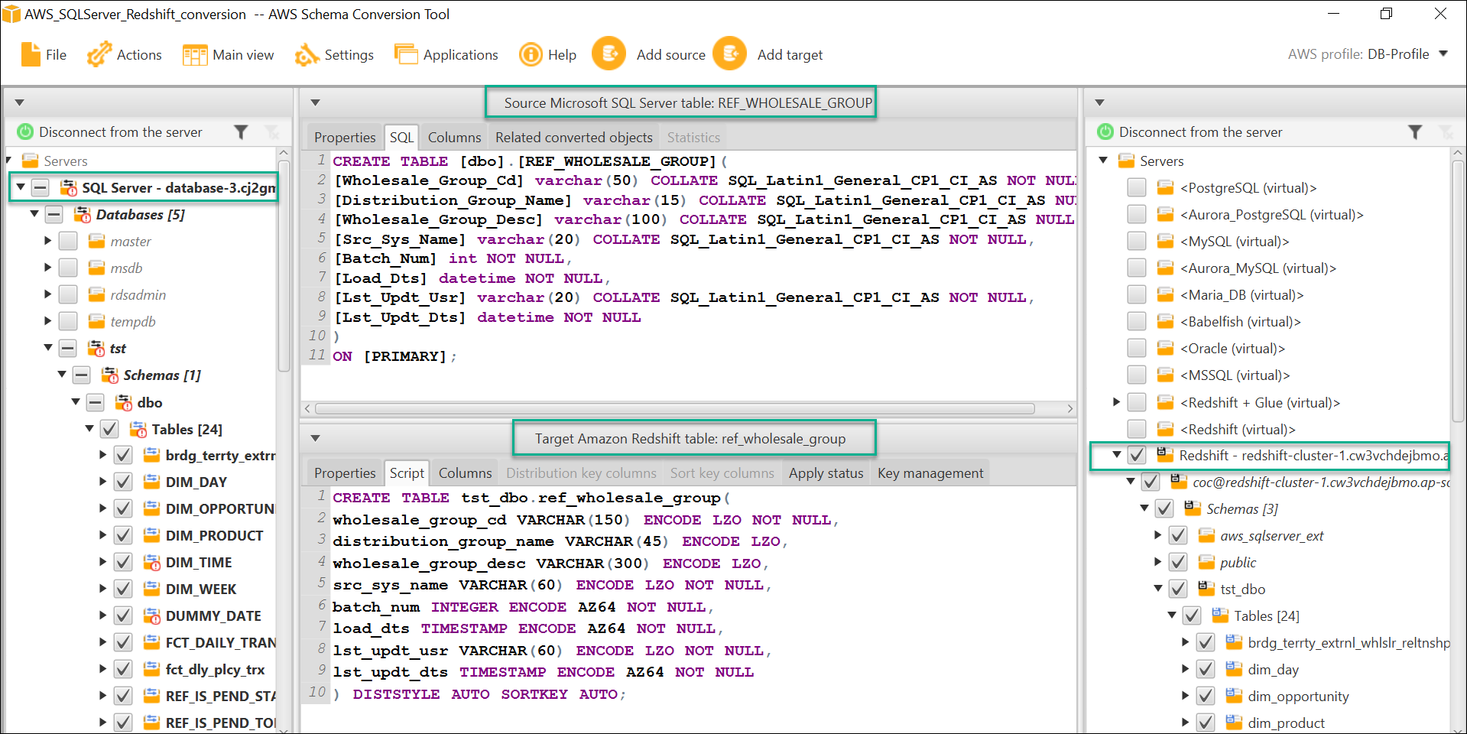
Step 1: Schema Conversion

Slide 4
Step 2: Remapping of Columns and Tables
Source Table | Source Column | Target Table | Target Column
RPT_DIM_ADVISOR | CURR_ADDRESS_LINE1 | DIM_ADVSR | CURRNT_ADDR_LN_1
RPT_DIM_ADVISOR | CURR_ZIP_CD | DIM_ADVSR | CURRNT_ZIP_CD
RPT_DIM_ADVISOR | CURR_STATE | DIM_ADVSR | CURRNT_STATE_CD
1. Updating Table and Column Names
Input | Output
select concat( curr_address_line1, curr_zip_cd, curr_state) as 'full address' from rpt_dim_advisor as rda | select concat( currnt_addr_ln_1, currnt_zip_cd, currnt_state_cd) as 'full address' from dim_advsr as rda

Slide 5
Source Table | Source Column | Target Table | Target Column
RPT_DIM_SAS_OFFICE | - | DIM_SAC_OFC | -
RPT_DIM_SAS_OFFICE | ACTV_IND | DIM_SAC_OFC | ACTIVE_IND
2 .Source Column dropped
Input | Output
select concat( curr_address_line1, curr_address_line2, curr_city , curr_zip_cd, curr_state) as 'full address' from rpt_dim_advisor as rda where curr_zip_cd in (select sas_zip_cd from rpt_dim_sas_office where actv_ind=1); | select concat( currnt_addr_ln_1, currnt_addr_ln_2, currnt_city_nm , currnt_zip_cd, currnt_state_cd) as 'full address' from dim_advsr as rda where currnt_zip_cd in (select '' as sas_zip_cd from dim_sas_ofc where active_ind =1);

Slide 6
Source Table | Source Column | Target Table | Target Column
REF_IS_PEND_STATUS_CODE | STATUS_CD | REF_PENDING_ST_CODE | -
REF_IS_PEND_STATUS_CODE | STATUS_CD_DESC | REF_PENDING_ST_CODE | -
3. Target Column dropped
Input | Output
select status_cd as 'status code', status_cd_desc as 'desciption' from ref_is_pend_status_code as ripsc | select '' as 'status code', '' as 'desciption' from ref_pending_st_code as ripsc

Slide 7
Input | Output
select status_cd as 'status code', status_cd_desc as 'desciption' from ref_is_pend_status_code as ripsc | with ref_is_pend_status_code as ( select 1 as status_cd_key_id, '' as status_cd, '' as status_cd_desc, '' as status_type, '' as display_ind, '' as src_sys_name, 1 as batch_num, 1 as load_dts, '' as lst_updt_usr, 1 as lst_updt_dts ) select status_cd as 'status code', status_cd_desc as 'desciption' from ref_is_pend_status_code as ripsc
4. Source/Target Table dropped

Slide 8
Source Table | Source Column | Target Table | Target Column
RPT_DIM_ADVISOR | Advisor_Key_Id | DIM_ADVSR | ADVSR_MDM_ID
FCT_DAILY_TRANS_SMRY | Advisor_Key_Id | FCT_DLY_PLCY_TRX | DIM_ADVSR_ID
5. Table with Alias
Input | Output
with advice as (select * from fct_daily_trans_smry as fdts left join rpt_dim_advisor as rda on fdts.advisor_key_id =rda.advisor_key_id) | with advice as (select * from fct_dly_plcy_trx as fdts left join dim_advsr as rda on fdts.advsr_mdm_id = rda.dim_advsr_id)

