Slide 1

DMA Course Project(18ECSC301)
2020-21
Title 5DMACP17
Hostile Post Detection In Hindi
Team 4: Members
Varun Bohara 01fe18bcs278
Madhurika G 01fe18bcs284
Sakshi Tahlani 01fe18bcs271
Abhishek Rao 01fe18bcs297

Slide 2
Hostile Post Detection in Hindi
Problem Statement
Our goal is to label a variety of posts in Hindi Devanagari script collected from Twitter and Facebook.
The categories are fake news, hate speech, offensive, defamation, and non-hostile posts. It is a multi-label multi-class classification problem. Post can belong to one or more of these hostile classes but the non-hostile posts cannot be grouped with any other class.
Input
Hostile Post Detection Model
Output
['defamation', 'offensive']

Slide 3
Data Description
Training Dataset: Constraint_Hindi_Train.xlsx
Size : 5728 x 3
List Attributes : Unique Id, Post, Label Set
Constituents of Post : Links ,Special Characters (@,/,:,#),Alpha numerical, Emoji.
Format : Excel
Validation Dataset: Constraint_Hindi_Train.xlsx
Size : 811 x 3
List Attributes : Unique Id ,Post, Label Set
Constituents of Post : Links ,Special Characters (@,/,:,#),Alpha numerical, Emoji.
Format : Excel

Slide 4
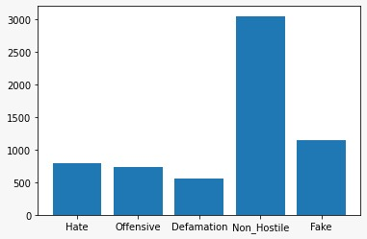
Highlights from previous review
Problem of data imbalance .
Solution for solving the problem of data imbalance :
  Using SVM model as classifier

Slide 5
Literature Survey

Slide 6
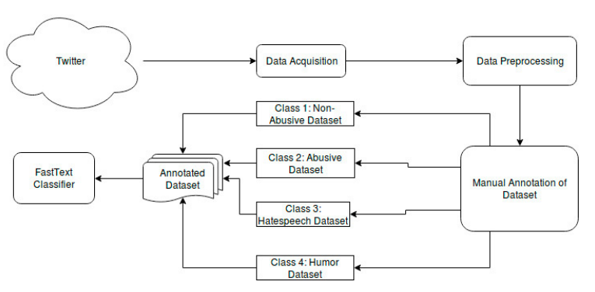
DHOT-Repository and Classification of Offensive Tweets in the Hindi Language[1]

Slide 7
Hostility Detection Dataset in Hindi[2]
Model for word embeddings : m-BERT
Models for Classification :
Support Vector Machine(SVM)
Decision Tree (DT)
Random Forest (RF)
Logistic Regression (LR).

Slide 8
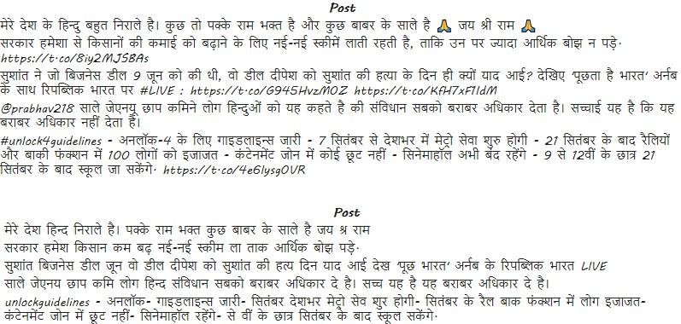
Data-Preprocessing
Data preprocessing techniques
[1] Removing Noise from the data:
Emoji
User Handles
URL
Punctuations
Numbers
[2] Tokenization.
[3] Lemmatization.
Before
After

Slide 9
Proposed Methodology
Post
PREPROCESSING
EMBEDDINGS
Classifier
Fast -Text
SVM
Labels
['defamation', 'offensive']

Slide 10
References
[1] Vikas Kumar Jha, Hrudya P, Vinu P N, Vishnu Vijayana, Prabaharan P:DHOT-Repository and Classification of Offensive Tweets in the Hindi Language, Third International Conference on Computing and Network Communications ,2020
[2] Mohit Bhardwaj, Md Shad Akhtar, Asif Ekbal, Amitava Das, Tanmoy Chakraborty - Hostility Detection Dataset in Hindi ,IIIT Delhi, India. IIT Patna, India, Wipro Research, India,2020.
[3] Kumar Saurav, Kumar Saunack, Diptesh Kanojia, and Pushpak Bhattacharyya-“A Passage to India”: Pre-trained Word Embeddings for Indian Languages,Language Resources and Evaluation Conference (LREC 2020), Marseille, 11–16 May 2020

