Slide 1
What are we doing ?
Problem statement
Given the MMHS which is having 6 labels , after performing certain methodology we should be able to predict among the 6 labels to the facebook dataset .
Once the meme is given as an input the output will be 3 labels among those 6 labels which are:
0 - NotHate, 1 - Racist, 2 - Sexist, 3 - Homophobe, 4 - Religion, 5 - OtherHate

Slide 2
Self supervised Learning
Pre-training step:
Neural Network to perform an Auxiliary task
Source Data
Feature of source data A
Prediction on Auxiliary task
Fine-Tuning step:
Neural Network for Target Data
Class Labels of Target Data
Target Data
Features of Target Data
Predictive task on Target data

Slide 3
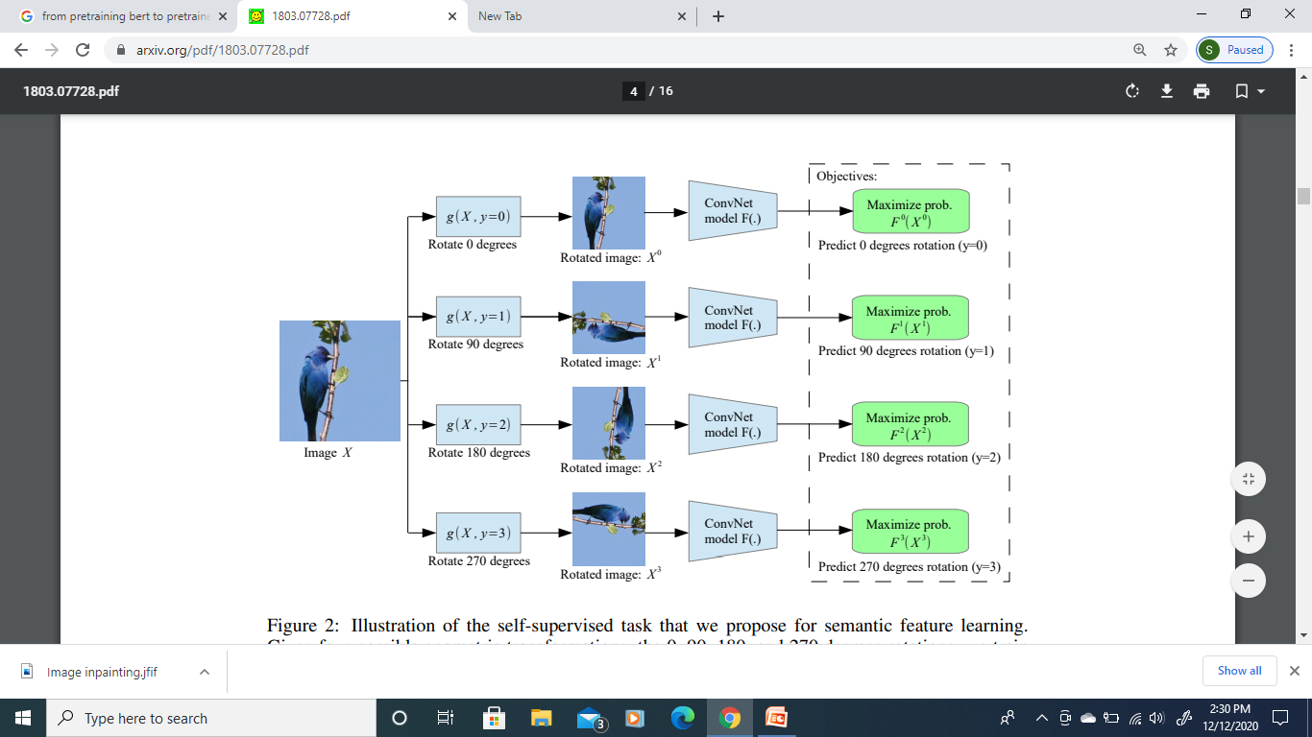
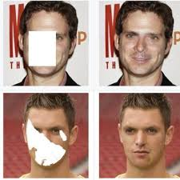
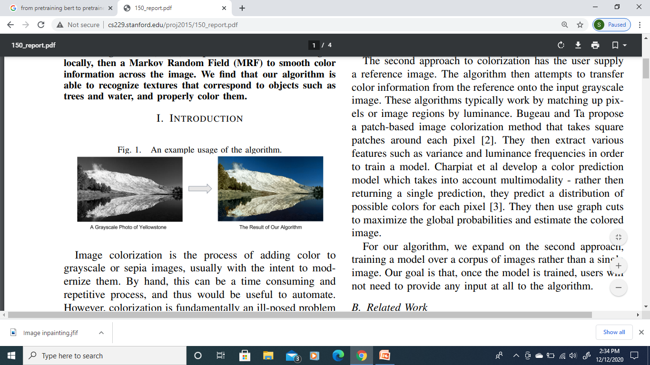
Auxiliary tasks – Image Data Augmentation
Image Inpainting
Geometric Transformation
Automatic Image colorization

Slide 4
Boosting Self-Supervised Learning via Knowledge Transfer
In self-supervised learning, one trains a model to solve a so-called pretext task on a dataset without the need for human annotation.
The main objective, however, is to transfer this model to a target domain and task.
Currently, the most effective transfer strategy is fine-tuning, which restricts one to use the same model or parts thereof for both pretext and target tasks.
First, we compute the features learned through a pretext task which might use a complex model on a dataset of unlabeled images.
Second, we cluster the features (e.g., using k-means) and use the cluster ID as pseudo labels for unlabeled images.
Third, we learn our final representation by training a smaller deep network (e.g., AlexNet) to classify the images based on the pseudo-labels.
Once we have obtained pseudo-labels on some dataset, we can transfer knowledge by simply training a model to predict those pseudo-labels.

Slide 5
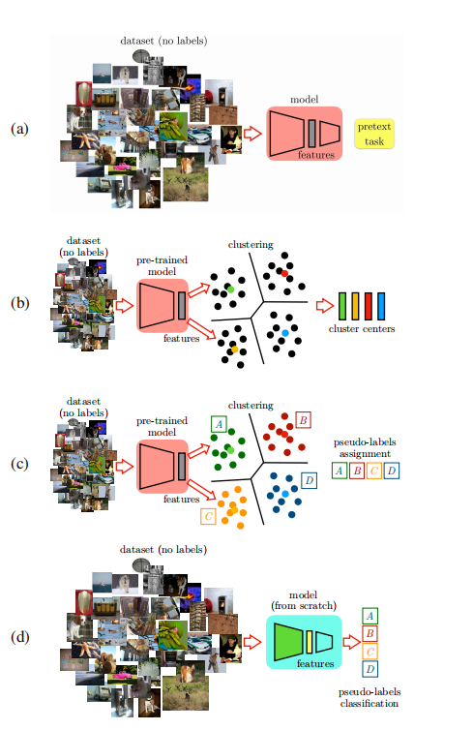
Self-Supervised Learning Pre-Training.
Suppose that we are given a pretext task, a model and a dataset. Our first step in SSL is to train our model on the pretext task with the given dataset.
Clustering.
Our next step is to compute feature vectors for all the unlabeled images in our dataset. Then, we use the k-means algorithm with the Euclidean distance to cluster the features.
Extracting Pseudo-Labels.
The cluster centers computed in the previous section can be considered as virtual categories. Indeed, we can assign feature vectors to the closest cluster center to determine a pseudo-label associated to the chosen cluster.
Notice that the dataset used in this operation might be different from that used in the clustering step or in the SSL pre-training.
Cluster Classification.
Finally, we train a simple classifier using the architecture of the target task so that, given an input image, predicts the corresponding pseudo-label.
https://arxiv.org/pdf/1805.00385.pdf
https://arxiv.org/abs/2007.04234

Slide 6
Thank you

