Slide 1
Problem Statement
To develop a multimodal architecture which classifies the
memes among the 6 labels
Once the meme is given as an input the output will be 3 labels among the 6 labels which are:
0 - NotHate, 1 - Racist, 2 - Sexist, 3 - Homophobe, 4 - Religion, 5 - OtherHate

Slide 2
Pretext Tasks

Slide 3
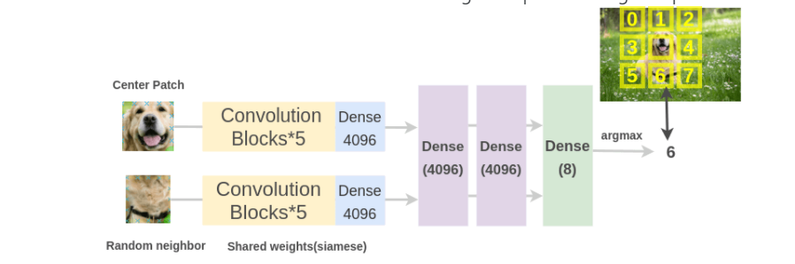
Predicting relative position of image patches.
Input: 2 image patches, one is the anchor image patch while the other is the query image patch.
Given the 2 image patches, the network needs to predict the relative position of the query image patch with respect to the anchor image patch.
Thus, this problem can be modelled as an 8-way classification problem, since there are 8 possible locations for a query image, given an anchor.
And, the label for this task can be automatically generated by feeding the relative position of query patch with respect to the anchor.

Slide 4
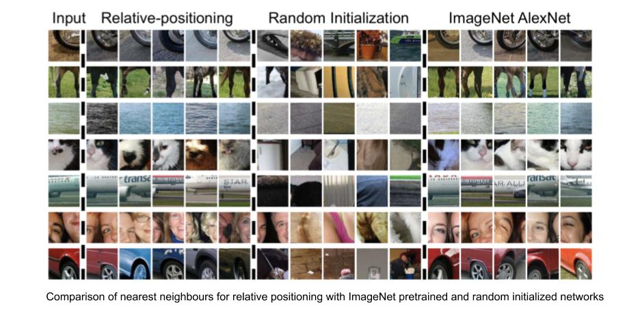
We can evaluate the effectiveness of the learned visual representations by checking nearest neighbours for a given image patch basis feature representations provided by the network. For computing nearest neighbours of a given image patch
Compute the CNN features for all images in the dataset, that will act as the sample pool for retrieval.
Compute CNN features for the required image patch.
Identify nearest neighbours for the feature vector of the required image, from the pool of feature vectors of images available.

Slide 5
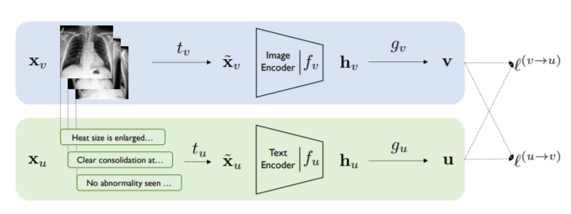
ConVIRT (Contrastive Visual Representation from Text) Framework
Paper : CONTRASTIVE LEARNING OF MEDICAL VISUAL REPRESENTATIONS FROM PAIRED IMAGES AND TEXT

Slide 6
Pretext task for text
Next Sentence Prediction
Masked language modelling
Sentence order prediction
Center word prediction
Neighbour word prediction
Sentence prediction
Document rotation

Slide 7
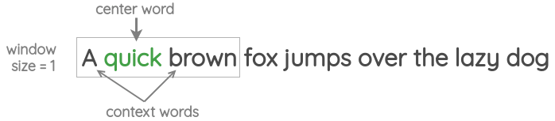
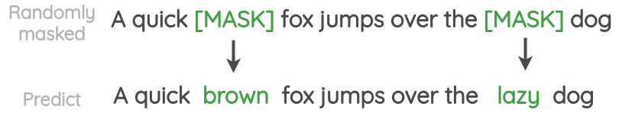
Center word prediction
Masked language modeling

