Slide 1
Enhance Multimodal Transformer With External
Label And In-Domain Pretrain
Transformers
  VL-BERT
  UNITER
  VILLA
  ERNIE-Vil
Web Entity Detection
FairFace classifier.

Slide 2
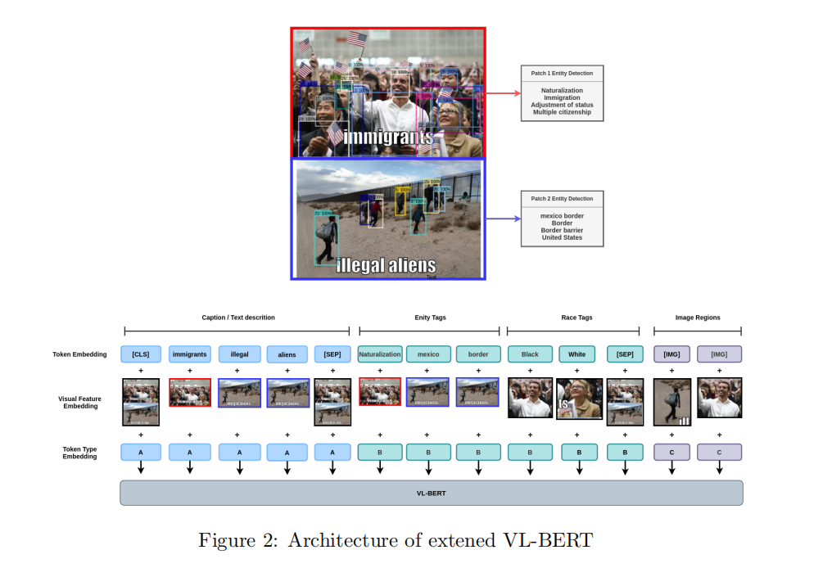

Slide 3
