Slide 1
Literature Survey
1

Slide 2
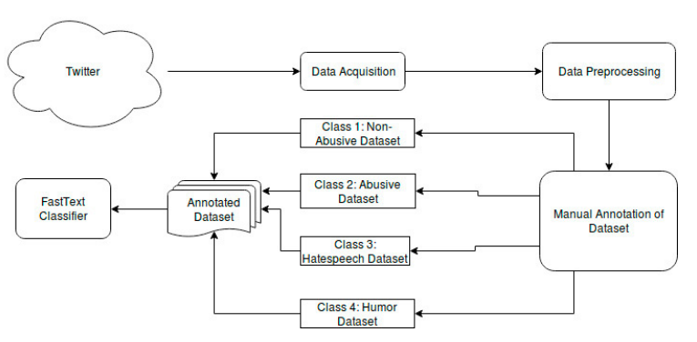
DHOT-Repository and Classification of Offensive Tweets in the Hindi Language[1]

Slide 3
References
[1] Vikas Kumar Jha, Hrudya P, Vinu P N, Vishnu Vijayana, Prabaharan P:DHOT-Repository and Classification of Offensive Tweets in the Hindi Language, Third International Conference on Computing and Network Communications (CoCoNet’19),2020

