Slide 1
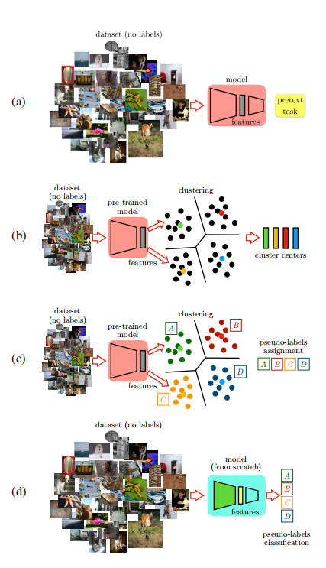
Boosting Self-Supervised Learning via Knowledge Transfer
(a) An arbitrary model is pre-trained on an SSL pretext
task.
(b) The features extracted from this model are clustered
and cluster centers are extracted.
(c) Pseudo-labels are de-fined for each image in the dataset by finding the closest cluster center.
(d) Training of the target model on the classi-
fication of the pseudo-labels.

Slide 2
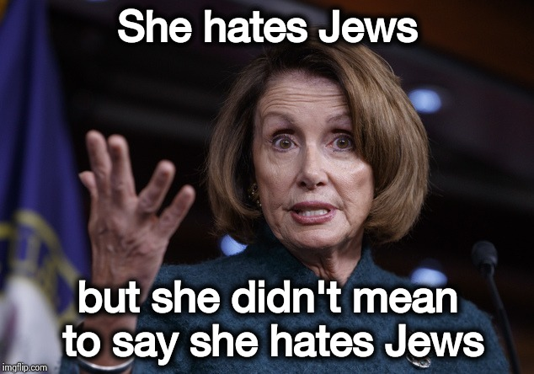
Input
Output
Non Hate
Racist
Sexist
Homophobe
Religion
Other Hate
Final Model
MMHS
Xception
Features
Clustering
Psuedo Labels
6 labels for each Image
FBDataset
Xception
Features
https://arxiv.org/pdf/1805.00385.pdf

Slide 3
MMHS150
MMHS150-Label
(pseudo labels)
MMHS150-Label
(pseudo labels)
Facebook DT-Image Features
Facebook DT-Labelled Image Features

Slide 4
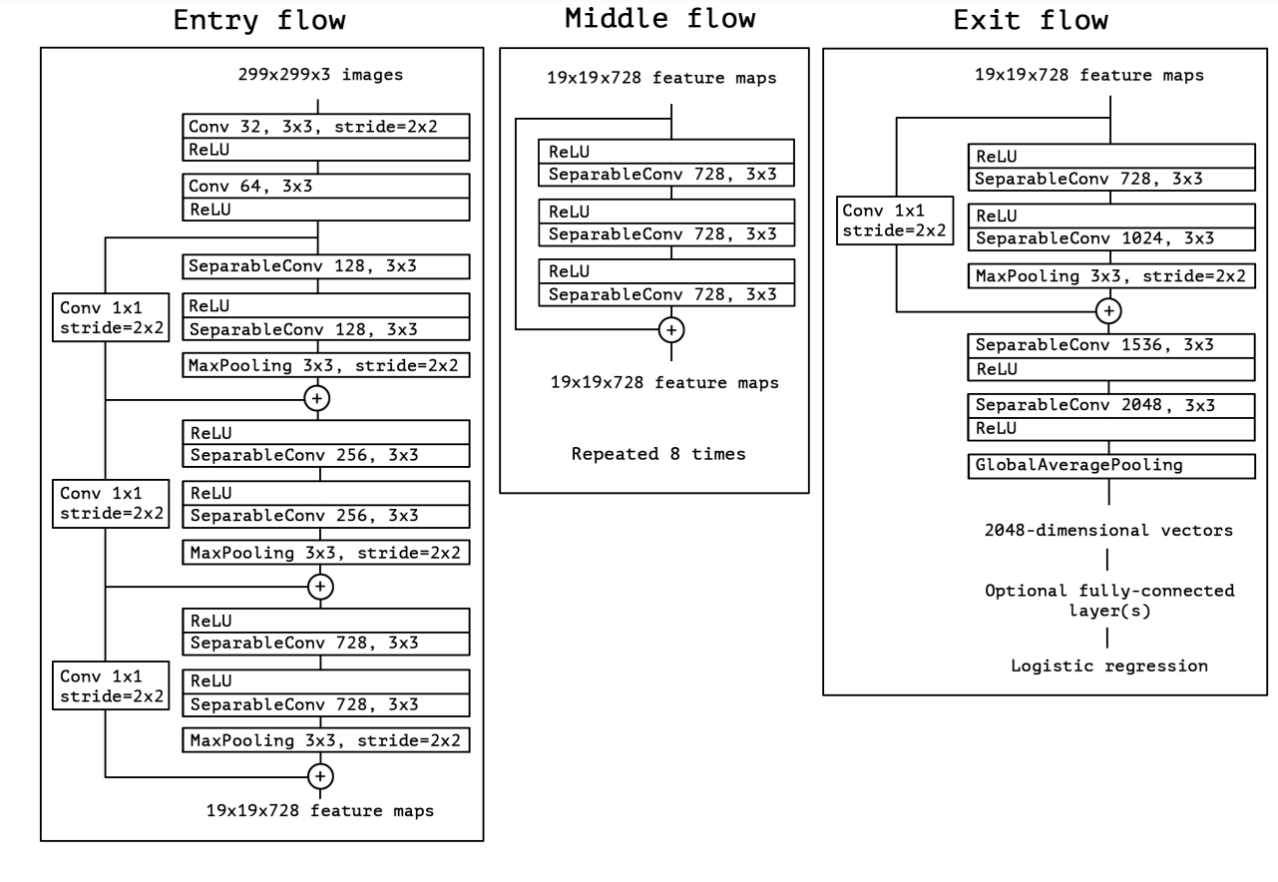
Xception Architecture :

Slide 5
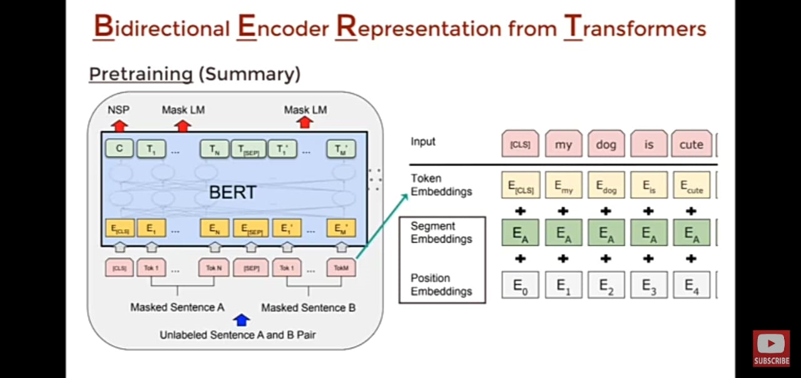
Sbert

Slide 6
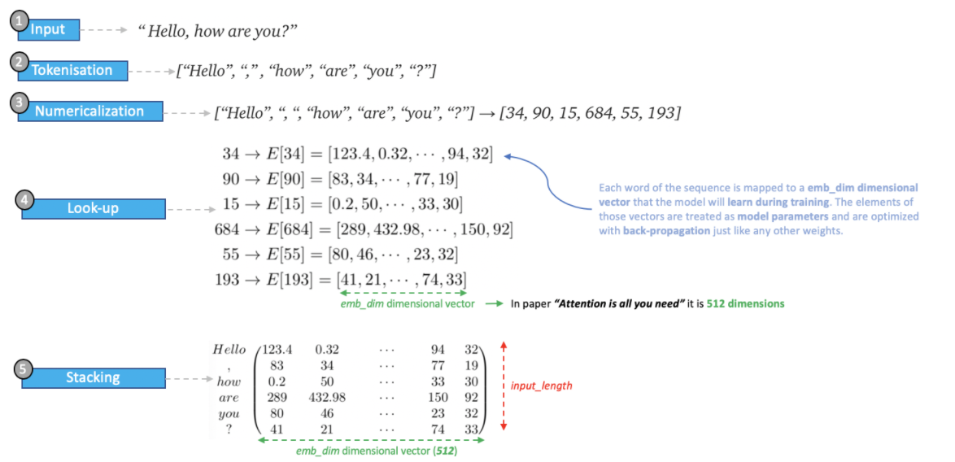

Slide 7
