Slide 1
What are we doing ?
Problem statement
Given the MMHS which is having 6 labels , after performing certain methodology we should be able to predict among the 6 labels to the facebook dataset .
Once the meme is given as an input the output will be 3 labels among those 6 labels which are:
0 - NotHate, 1 - Racist, 2 - Sexist, 3 - Homophobe, 4 - Religion, 5 - OtherHate

Slide 2
Self supervised Learning
Pre-training step:
Neural Network to perform an Auxiliary task
Source Data
Feature of source data A
Prediction on Auxiliary task
Fine-Tuning step:
Neural Network for Target Data
Class Labels of Target Data
Target Data
Features of Target Data
Predictive task on Target data

Slide 3
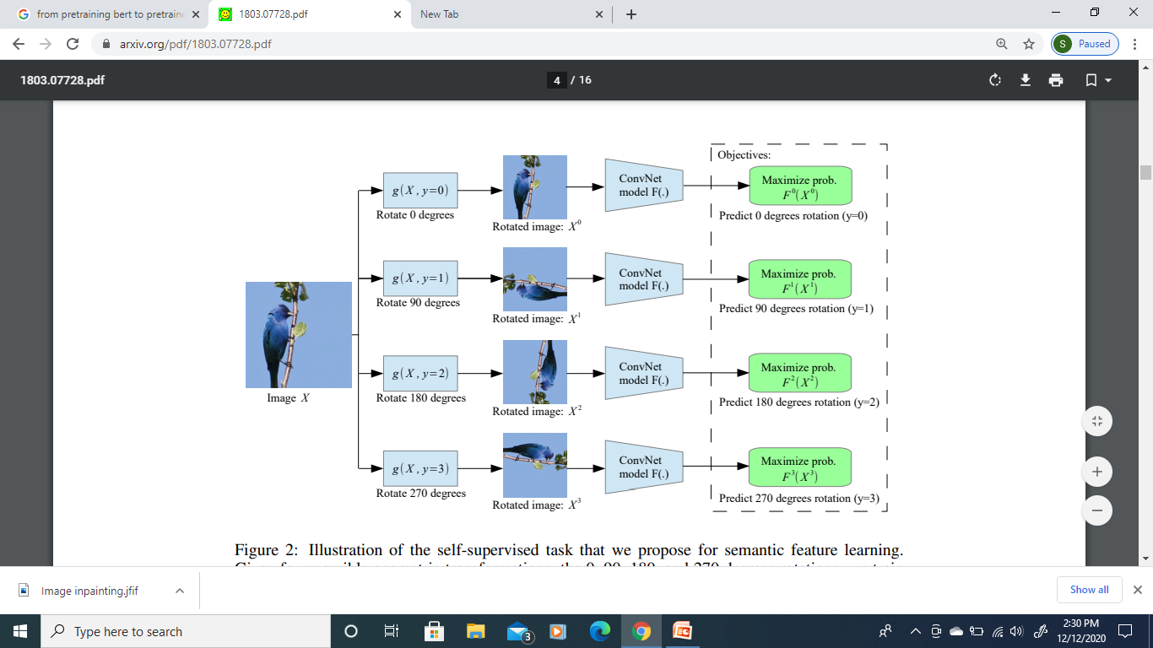
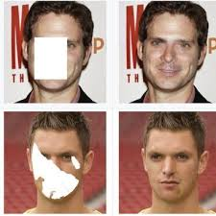
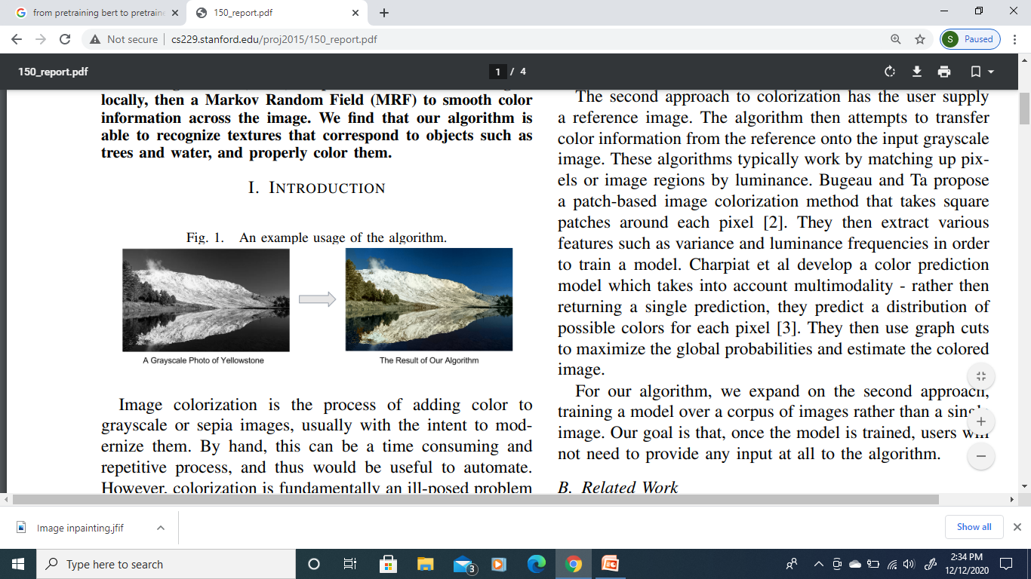
Auxiliary tasks – Image Data Augmentation
Image Inpainting
Geometric Transformation
Automatic Image colorization

Slide 4
Thank you

