Slide 1
Paper: 9 Contextual Crowd Intelligence
By :
Varun Chavakula (Classid:4)
Vikas Kondapalli (Classid:11)

Slide 2
INTRODUCTION:
Most data analytics applications are industry/domain specific and their solutions are based on “best practices”, i.e., the systems’ decisions are knowledge-driven (based on general guidelines) and/or data-driven (based on observations).
Example: consider the task of identifying the risk factors related to heart failure.
The knowledge-driven solution uses risk factors identified from existing clinical knowledge or literature, such as, age, hypertension and diabetes status.
Data driven solutions employs machine learning algorithms based on observational data(Data collected based on the symptoms of the patient).

Slide 3
Are these methods good enough for critical applications like that???

Slide 4

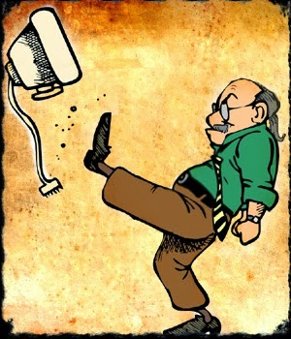


NO
Grrrrr!!!!!
I’m dead coz of your dumb AI.
It was you who made that app!!!

Slide 5
Crowd Intelligence And Crowd Sourcing
To deal with these exceptional case that are hard to formalize we need SMEs.
SME- (Subject Matter experts) having many years of experience and can identify these situation.
They can effectively support the applications and improve the accuracy in the predictions.
This paper proposes in building an intelligent database management systems (DBMSs) that can exploit contextual crowd intelligence(SME in this case).
They use the concept crowd sourcing.
What is crowd sourcing?
https://www.youtube.com/watch?v=-38uPkyH9vI

Slide 6
Implementation and Examples
To use Crowd intelligence into the DBMS, the system needs to keep SMEs as part of the feedback loop.
To infer and enhance system’s processing, thus continuously improving the effectiveness of the system.
If the system has low confidence(weak classifiers) in predicting it asks the doctors(SME) for labels and the rules/hypothesis of the labels. Eg : An elderly person who stays alone having many diseases may visit the hospital more frequently.
The system would verify or adjust these rules/hypotheses and revert back to the doctors with evidence to support or reject their rules/hypotheses.
Such interactions are beneficial to both the system and the doctors. Eventually, the application evolves over time.

Slide 7
Challenges of Big Data
Unstructured data: Eg: Doctor’s notes cannot be simply treated as bag of words documents.
We need contextualize the data. Eg: relate the lab tests to the diseases.
Doctors from different department might use different notation.
Eg: PID in orthopedic department means “Prolapsed Intervertebral Disc” and not “Pelvic Inflammatory Disease”
Lack of training samples with well defined class labels: Eg: predicting suicide cases, Its almost impossible to have a defined class label for it.
Growing Data: Real Time Analysis for such cases becomes highly impossible. Eg: during a Mass casualty disaster( H5N1, SARS) It gets hard as there would be many victims and data about each patient might be huge by itself.

Slide 8
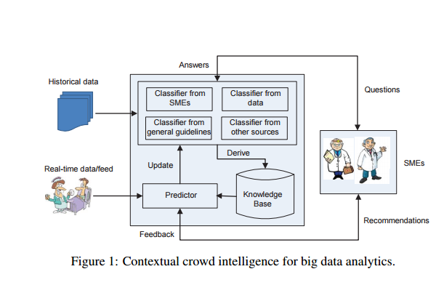
Architecture
The system first builds a knowledge base based on historical data, domain knowledge from SMEs (e.g., doctors), and other sources such as general clinical guidelines.
Each source contributes to build some “weak classifiers”
The system needs to combine these classifiers to derive a final classifier that achieves a high level of accuracy.
The system also needs to go through several iterations of interaction with the experts to refine the final classifier
experts participate in the entire process in fine tuning the system and decide on the “best practices”

Slide 9
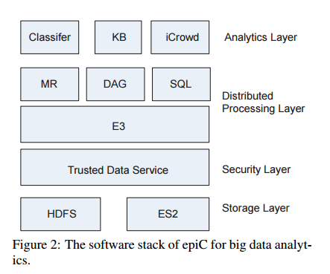
Architecture Contd..
Storage layer consists of HDFS and a key-value storage system called ES2 for both unstructured and structured data.
The security layer enables users to protect data privacy by encryption.
The distributed processing layer provides a distributed processing infrastructure called E3 that supports parallel processing logics such as MapReduce, Directed Acyclic Graph (DAG) and SQL.
The top layer (which is the analytics layer) exploits the contextual crowd intelligence for big data analytics.
Here KB is the knowledge base and iCrowd is the component that interacts with the domain experts.

Slide 10
ASKING EXPERTS THE RIGHT QUESTIONS
The system asks doctors to label tuples that the system has low confidence in performing the prediction task.
The system collects expert rules/hypothesis that the doctors used to do the labeling.
The system can also infer implicit and valuable knowledge based on the answers of the experts.

Slide 11
EXTRACTING DOMAIN ENTITIES FROM UNSTRUCTURED DATA
Feature selection is very important for machine learning task and can greatly affect the algorithms quality.
Doctor’s notes in unstructured format is used to extract important features.
This is done by Natural Language Processing (NLP) engines which use various medical dictionaries.

Slide 12
PROBLEMS DUE TO UNSTRUCTURED DATA AND INCOMPLETE KNOWLEDGE BASE
Ambiguous mentions
A mention in the free text may refer to different entities.
Ex: DM may refer to “Dystrophy Myotonic” or to “Diabetes Mellitus”.
Incomplete Knowledge base
The terms used in doctor’s notes could be specific within a country or to hospital whereas the knowledge base may contain universal ones only.

Slide 13
SOLUTION BY A HUMAN-MACHINE APPROACH
To infer the correct entities from unstructured data a hybrid human-machine approach solution should be employed.
The system will pose questions to healthcare professionals
Based on the answers from experts, the system adjusts its inference results.
As the number of iterations increase, the inference process becomes more accurate and knowledge base becomes more complete.

Slide 14
COMBINING WEAK CLASSIFIERS
The systems contains different classifiers from multiple sources.
Each classifier by itself is a “weak classifier”.
All these classifiers have to be combined to get a final classifier which is of higher accuracy in prediction.
There may be conflicts in between results of various weak classifiers.
It may be necessary to rank results of different classifiers, but how to do this is an open question.

Slide 15
Grouping of Attributes
The attributes representing features which are similar to each other are grouped.
Ex: Hypertension, Hypotension and Ischaemic heart disease are grouped together under the category of Cardiovascular disease.
Inorder to perform such tasks we need to consult domain experts as different hospitals/doctors may have different reasoning this task.

Slide 16
ENGAGING EXPERT USERS
A user friendly interface for the experts to provide their inputs.
The system should provide not only final outcome but also the reasons that drive its decision.
Ex: when a system makes a decision that differs from experts opinions, the system should be able to trace back whether mismatch is mainly due to use of general guidelines or other expert opinions.
Presenting feedback to the experts. For instance the system can reveal the inputs from other experts to see whether an expert would change his decision.

Slide 17
THANK YOU
References: Ooi, Beng Chin, et al. "Contextual crowd intelligence."
ACM SIGKDD Explorations Newsletter 16.1 (2014): 39-46.

