Slide 1

Personalized Music Recommendation System Based on Singer Style
Presenter Names:
D.SAI SRIKANTH-VU21CSEN300097
D.SNEHA – VU21CSEN0300047
N.SHRENIK – VU21CSEN0300106
D.VARUN – VU21CSEN0300102
Guide Name: Dr .MUKKAMALA SNV JITENDRA, Ph.D.
Assistant Professor
CSE, GST, Visakhapatnam

Slide 2

Contents
1. Abstract
2. Introduction
3. Literature Review
4.Problem Statement
5. Requirement Analysis
6. Design Analysis
7. Implementation/Methodology
8. Code Snippets
9. Results
10. Conclusion
11.Future Scope
References
CSE, GST, Visakhapatnam

Slide 3
Abstract
Music recommendation systems enhance user experience by learning preferences and suggesting relevant content. Traditional approaches like collaborative and content-based filtering face challenges such as cold-start, sparsity, and difficulty adapting to changing user behavior. To address these, we propose a reinforcement learning-based system using Deep Q-Networks (DQN).
Treating music recommendation as a Markov Decision Process (MDP), the model selects songs, receives rewards or penalties, and learns iteratively to improve accuracy over time.
Trained on user data, including listening history and genre preferences, the agent optimizes recommendations by maximizing cumulative rewards. Empirical results show 98.33% accuracy, proving reinforcement learning's effectiveness in enhancing adaptive music recommendations.
CSE, GST, Visakhapatnam

Slide 4
Introduction
In today's interconnected world, music is an integral part of daily life, with digital platforms like Spotify, Apple Music, and YouTube Music becoming essential. The ease of streaming and affordable subscriptions have fueled a growing demand for smart recommendation engines to help users navigate vast song catalogs.
Traditional recommendation models include:
Collaborative Filtering: Suggests songs based on similar users' preferences but struggles with the cold-start problem.
Content-Based Filtering: Recommends songs based on attributes like genre and tempo but can result in repetitive suggestions.
Hybrid Models: Combine both methods to improve accuracy but still struggle with evolving user preferences.
CSE, GST, Visakhapatnam

Slide 5
Literature
Author(s) | Year | Indexed | Dataset | Features | Methodology/Model | Results | Remarks (Drawbacks)
Mohammad Rizqul Fatichin et al. | 2024 | IEEE | GTZAN, Free Music Archive | Tempo, Spectral Features, MFCC | SVM (Support Vector Machine) | 80% accuracy, 82% precision | Removing excessive features decreases classification accuracy​
Saman Mesghali, Javad Askari | 2022 | IEEE | Million Songs Dataset | Artist style, searched words | Bi-LSTM (Bidirectional LSTM) | 3% improvement in F1-score over previous models | Cold start problem for new users​
Shenyou Fan, Min Fu | 2022 | IEEE | Questionnaire survey (431 users) | Age, region, hobbies, music preferences | MLP & Random Forest | RF: 95.47% accuracy, MLP: 53.07% | MLP has poor performance compared to RF​
Jagendra Singh, Vijay Kumar Bohat | 2021 | IEEE | Music streaming metadata | Spectral & Temporal features | Convolutional Recurrent Neural Network (CRNN) | Better performance than baseline models | No mention of cold start solution​
Joseph Bamidele Awotunde et al. | 2024 | IEEE | Public datasets (Spotify API) | Spectral audio features (MFCC, Chroma) | Machine Learning & Collaborative Filtering | High similarity scores for recommendations | Limited evaluation metrics​
Mukkamala S.N.V. Jitendra, Y. Radhika | 2020 | IEEE | User listening history (custom dataset) | Listen count, user ID, song-artist | User-based Collaborative Filtering | Precision & recall improvements | Issues with diverse client needs​
J. B. Awotunde, M. K. Abiodun, A. E. Adeniyi | 2024 | IEEE | Multiple datasets | Music genes, user preferences | Hybrid Collaborative Filtering | Improved recommendation scores | High computational complexity​
CSE, GST, Visakhapatnam

Slide 6
Problem Statement
The rise in the number of singers and their diverse styles in online and offline music libraries has introduced two significant challenges: (i) Difficulty in identifying the unique style of each singer, (ii) Difficulty in providing personalized music recommendations based on the listener's preferred singer styles.
The challenge in personalizing music recommendations arises mainly due to the absence of detailed meta-information that categorizes singer-specific styles.
As a result, the task of a personalized music recommendation system based on singer style has gained importance as it analyzes and extracts stylistic features for effective recommendations.
CSE, GST, Visakhapatnam

Slide 7
Requirement Analysis
Functional Requirements:
The system should collect user listening history and song metadata (e.g., genre, artist, album).
It should remove duplicate entries and clean the data for meaningful insights.The system must normalize and encode genre data to ensure model compatibility.
It should implement a recommendation engine using collaborative filtering or content-based filtering.
The system must use genre classification as the primary attribute for recommending songs.
It should apply machine learning models (e.g., KNN, Random Forest, Neural Networks) to enhance song recommendations.
CSE, GST, Visakhapatnam

Slide 8
Requirement Analysis
Non-Functional Requirements:
Performance – The system should provide real-time or near real-time song recommendations with minimal latency.
Scalability – The recommendation engine should support a growing number of users and increasing song data.
Accuracy – The system should ensure high accuracy in genre classification and recommendations.
Data Integrity – The system must maintain clean, duplicate-free, and normalized data.
Usability – The recommendation system should provide an intuitive and user-friendly interface.
Security – User listening history and metadata must be securely stored and accessed.
Maintainability – The system should allow easy updates to improve models and incorporate new data.
CSE, GST, Visakhapatnam

Slide 9
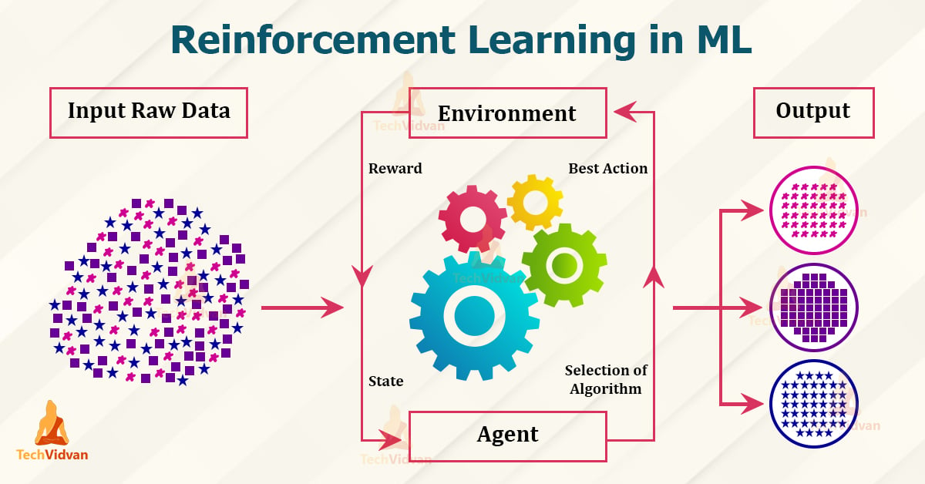
Design Analysis
For this project, we have chosen to implement Reinforcement Learning (RL) as our primary approach for building a music recommendation system. Traditional recommendation models, such as collaborative filtering and content-based filtering, often struggle with dynamic user preferences and the cold start problem. Reinforcement Learning overcomes these limitations by continuously learning from user interactions and refining recommendations in real time.
CSE, GST, Visakhapatnam

Slide 10
Why Reinforcement Learning?
Adaptive Learning: RL allows the model to dynamically adjust recommendations based on real-time user feedback.
Exploration vs. Exploitation: Unlike static models, RL balances new song discovery (exploration) with familiar song recommendations (exploitation).
Sequential Decision-Making: The recommendation system operates as a sequence of decisions, where each recommended song affects future recommendations.
CSE, GST, Visakhapatnam

Slide 11
Markov Decision Process (MDP) Representation
To structure our RL-based recommendation model, we define the problem as a Markov Decision Process (MDP) with the following components:
State (S): Represents the user's current preference, including listening history, liked genres, and interaction patterns.
Action (A): The selection of a song from the recommendation pool.
Reward (R): Feedback from the user, such as:
Positive reward: If the user listens to the entire song, adds it to a playlist, or repeats it.
Negative reward: If the user skips the song or listens for only a few seconds.
Transition (T): Probability of moving from one preference state to another based on the recommended song.
Policy (π): The strategy that determines which song to recommend based on the user’s current state.
CSE, GST, Visakhapatnam

Slide 12
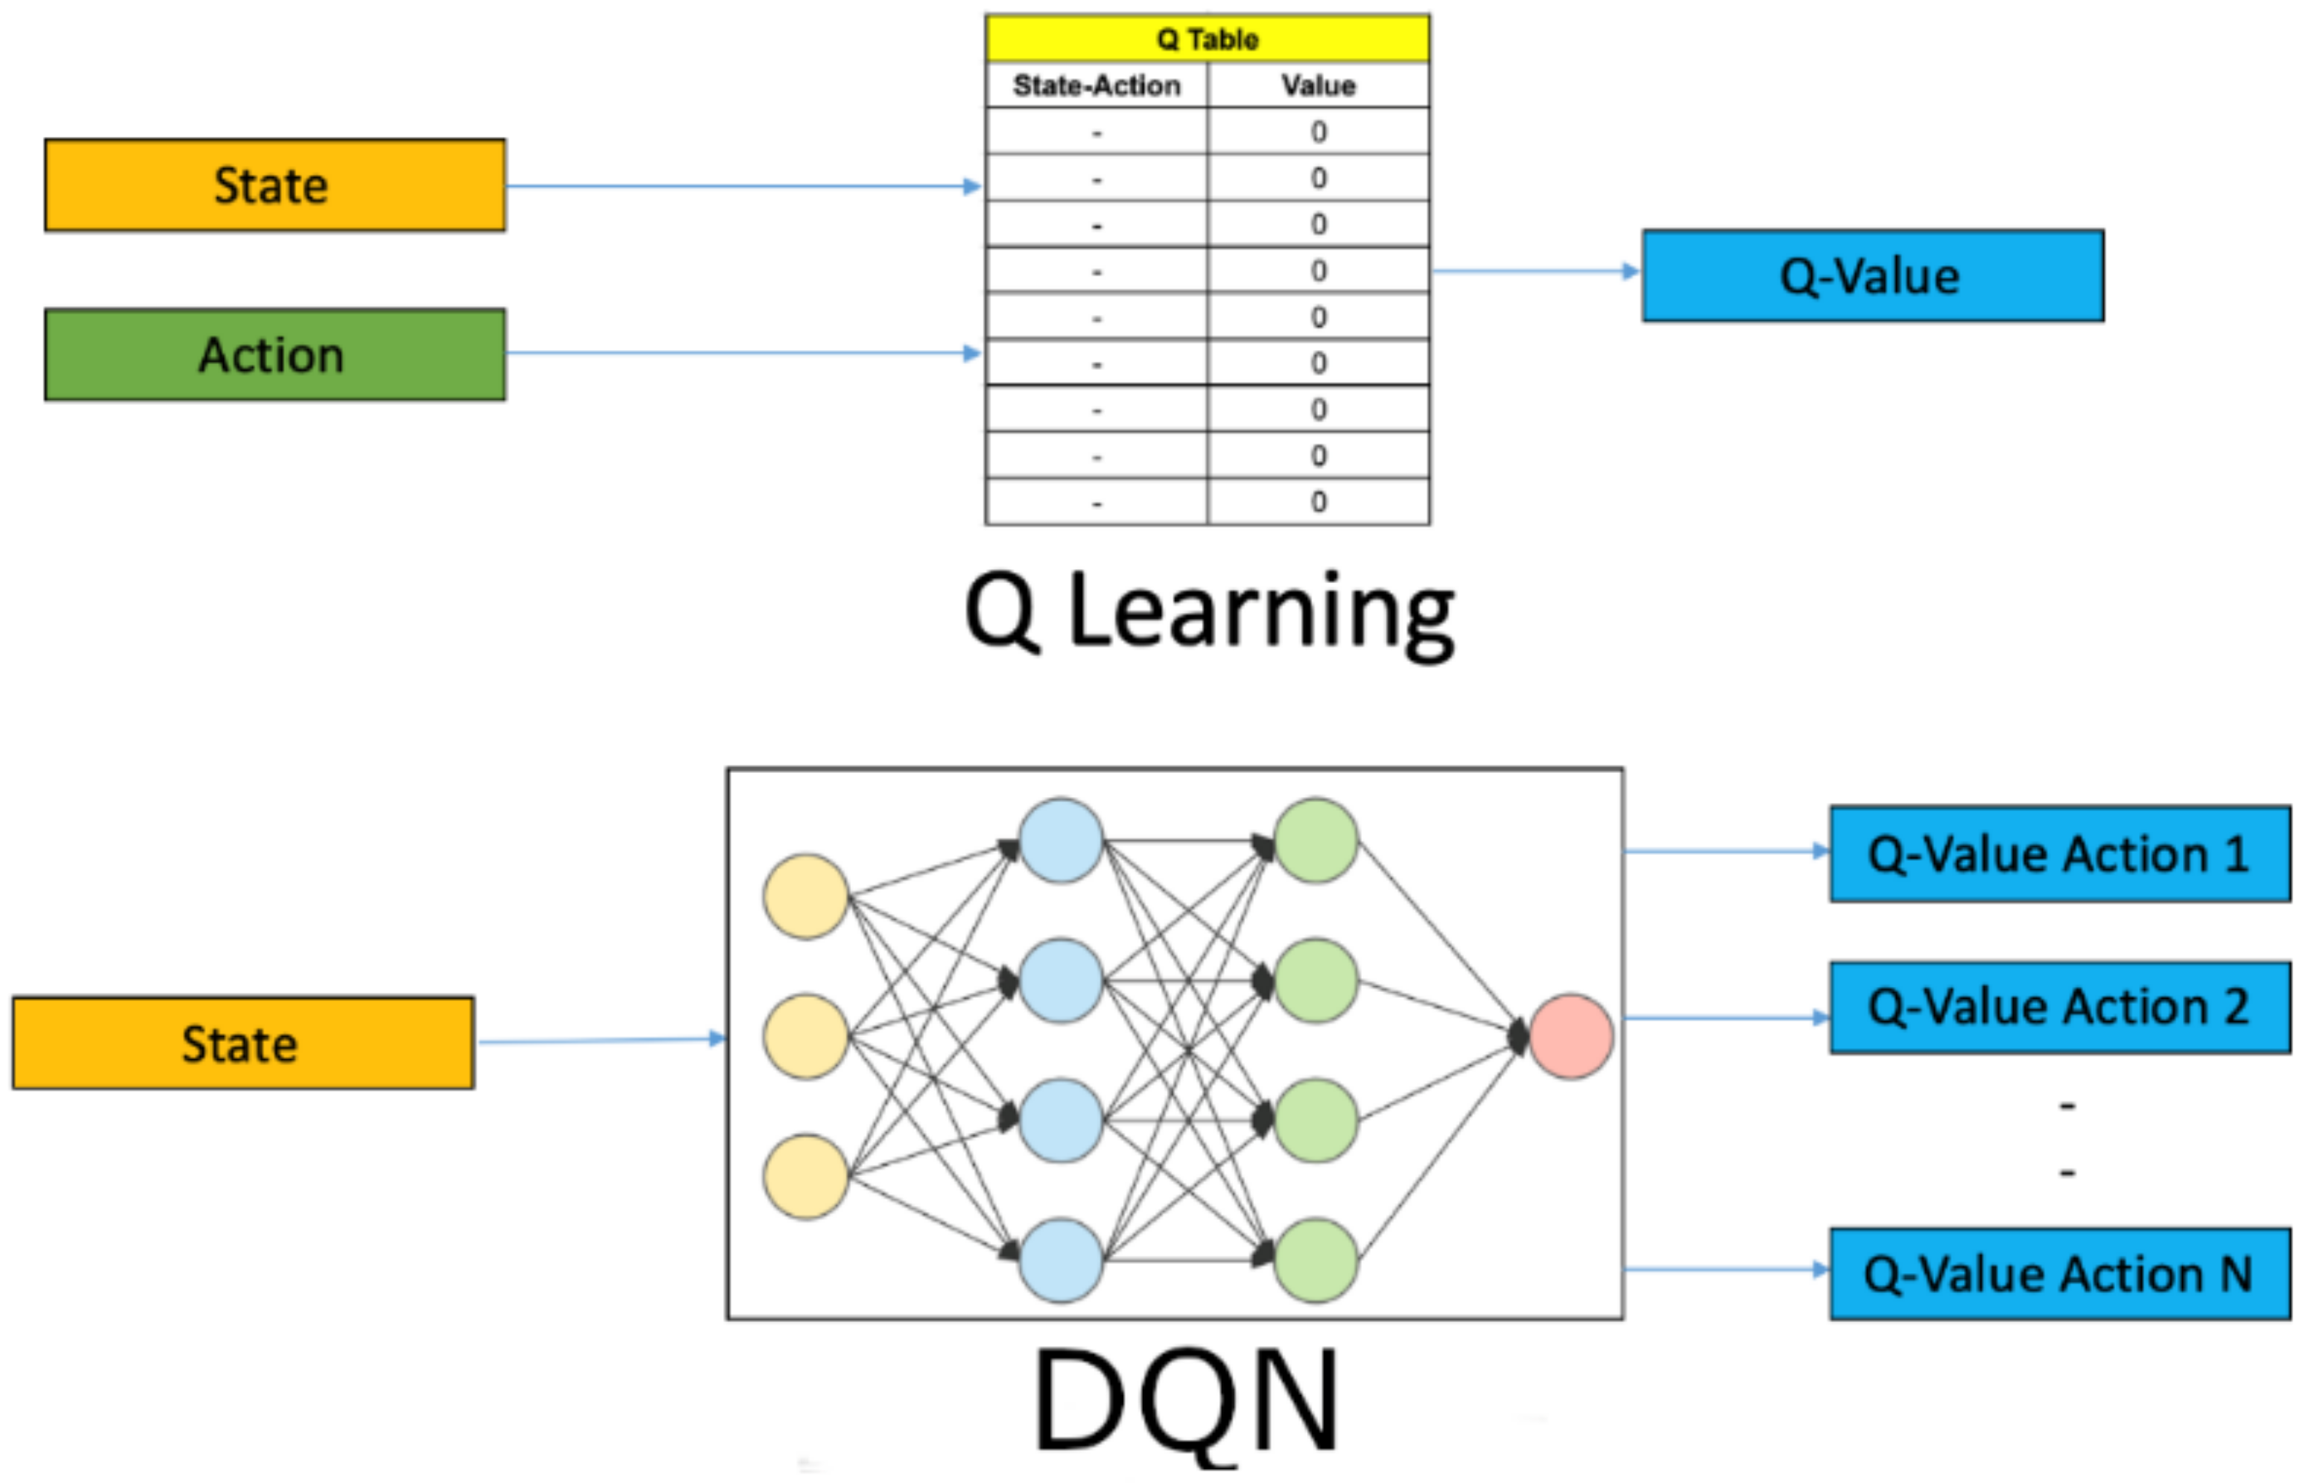
Deep Q-Network (DQN) Model
To solve this MDP-based music recommendation problem, we employ a Deep Q-Network (DQN) approach.
DQN is a reinforcement learning algorithm that uses a neural network to approximate the Q-value function, allowing the system to learn optimal recommendations over time.
CSE, GST, Visakhapatnam

Slide 13
How DQN Works in Our Model:
Input State: The user’s past interactions and song preferences are encoded as input states.
Q-Network Prediction: The DQN model predicts Q-values for different songs, indicating their likelihood of being liked.
Action Selection:
Exploitation: The model recommends the song with the highest predicted Q-value.
Exploration: The model occasionally suggests new songs to improve learning.
Reward Computation: The system updates Q-values based on user feedback (listening behavior).
Model Training: The Q-network is trained iteratively to refine its predictions, improving recommendation accuracy.
CSE, GST, Visakhapatnam

Slide 14
Advantages of Using DQN for Music Recommendation
Personalized Learning: Adapts to individual user preferences over time.
Better Discovery: Encourages users to explore new songs while still recommending familiar favorites.
Continuous Improvement: Unlike traditional models, DQN refines recommendations dynamically through user interactions.
By leveraging MDP-based reinforcement learning with DQN, our system provides a smarter, more adaptive music recommendation experience, improving user engagement and satisfaction
CSE, GST, Visakhapatnam

Slide 15
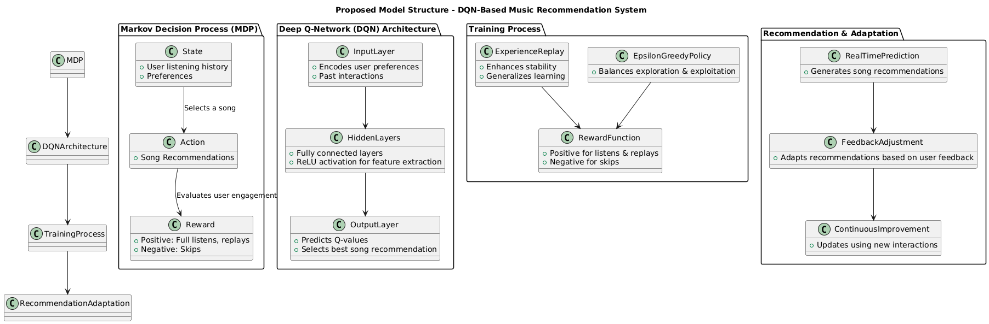
PROPOSED MODEL STRUCTURE

Slide 16
METHODOLOGY & IMPLEMENTATION

Slide 17
DATA PREPROCESSING
Fetching User Listening History:
We implemented an Express.js server to authenticate users with Spotify and fetch their top tracks over different time ranges (short-term, medium-term, long-term).
The fetched data included song metadata such as track name, artist, album, popularity, and genre.
Genres were not directly available for tracks, so we retrieved artist details separately to extract their associated genres.
2. Combining Multiple User Histories:
We collected CSV files for multiple users, each containing their listening history.
These CSV files were merged into a single dataset, ensuring that recommendations were generated based on diverse user preferences rather than a single user’s history.
CSE, GST, Visakhapatnam

Slide 18
DATA PREPROCESSING
3. Data Cleaning & Preprocessing
Duplicate Entries Removed: Since the same song could appear across different users' histories, duplicate track records were eliminated.
Genre Normalization:
Many songs had multiple genres assigned (e.g., "pop, rock").
To improve recommendation accuracy, we split multiple genres into separate records, treating each genre as an independent entry.
Final Dataset Attributes:
Track Name – Name of the song.
Track Artist – Artist(s) performing the track.
Track Album – The album where the track appears.
Genre – Processed genre information for each song.
Popularity – A numerical value (0-100) representing song popularity on Spotify.
CSE, GST, Visakhapatnam

Slide 19
REINFORCEMENT LEARNING FRAMEWORK
Markov Decision Process (MDP): Defines recommendation as a sequence of decisions.
State (S): User’s listening preferences.
Action (A): Selecting a song to recommend
Reward (R): +1 for full listens/replays, -1 for skips.
Policy (π): Optimized using reinforcement learning to maximize user satisfaction.
CSE, GST, Visakhapatnam

Slide 20
Deep Q-Network (DQN) Implementation
Neural Network-Based Q-Learning Model: Predicts the best song recommendations.
Input Layer: Encodes user preferences & song metadata.
Hidden Layers: Fully connected layers with ReLU activation for feature extraction.
Output Layer: Computes Q-values for song selection.
Experience Replay: Improves learning stability.
Epsilon-Greedy Policy: Balances exploration (new songs) & exploitation (familiar songs).
CSE, GST, Visakhapatnam

Slide 21
Model Training & Optimization
Trained with Stable Baselines3’s DQN on a dataset of user interactions.
Bellman Equation updates Q-values iteratively.
Evaluation on 30 songs:
1.Accuracy: 98.33%
2.Recall: 100%
3.F1-Score: 98.89%
CSE, GST, Visakhapatnam

Slide 22
Real-Time Recommendation & Adaptation
Deployed in Stream-lit for real-time song recommendations.
User interactions dynamically update Q-values, refining future suggestions.
Continuously improves personalization & recommendation diversity.
CSE, GST, Visakhapatnam

Slide 23
CODE SNIPPETS

Slide 24
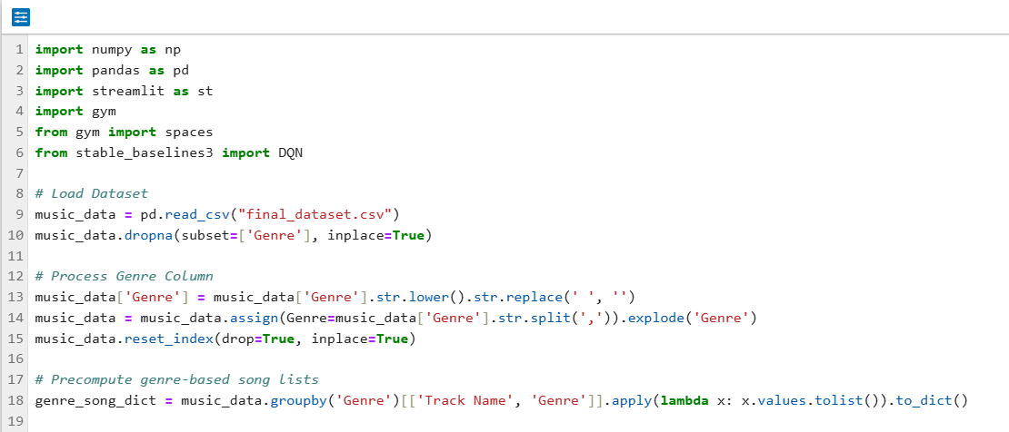
IMPORTING REQUIRED LIBRARIES AND LOADING THE DATASET
CSE, GST, Visakhapatnam

Slide 25
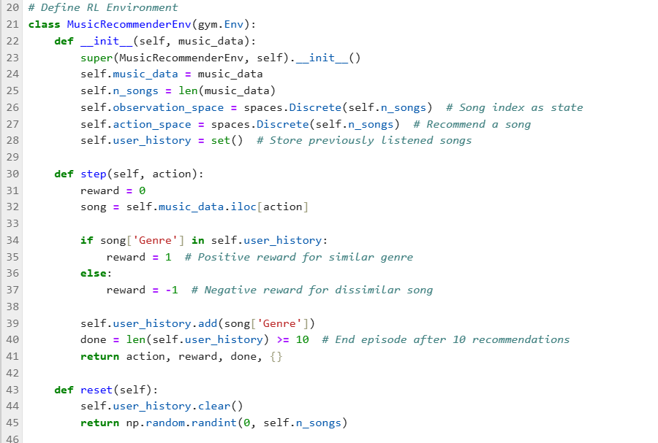
DEFINING THE RL ENVIRONMENT
CSE, GST, Visakhapatnam

Slide 26
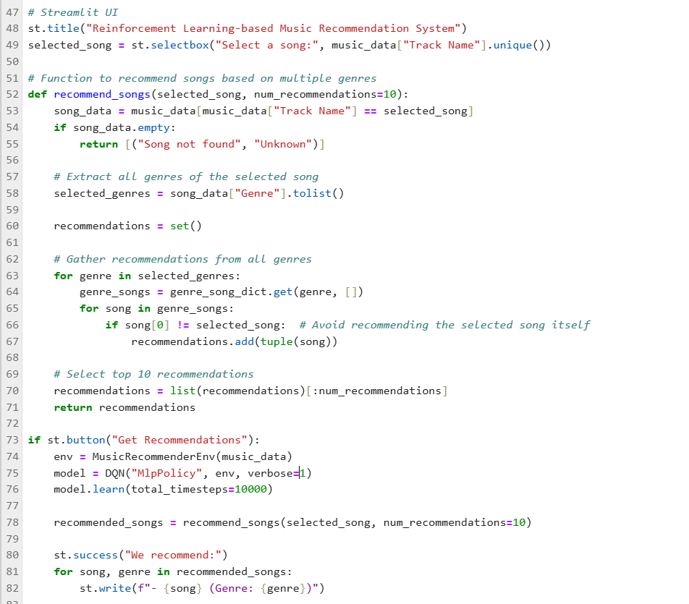
STREAM-LIT UI
CSE, GST, Visakhapatnam

Slide 27
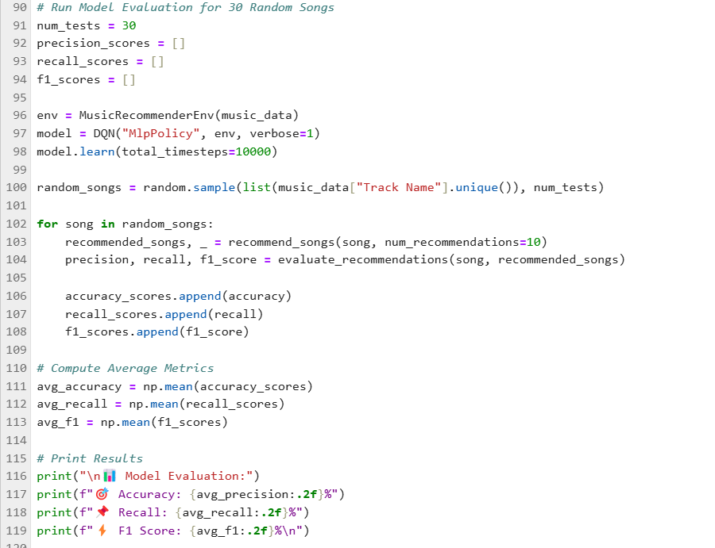
MODEL METRICS
CSE, GST, Visakhapatnam

Slide 28
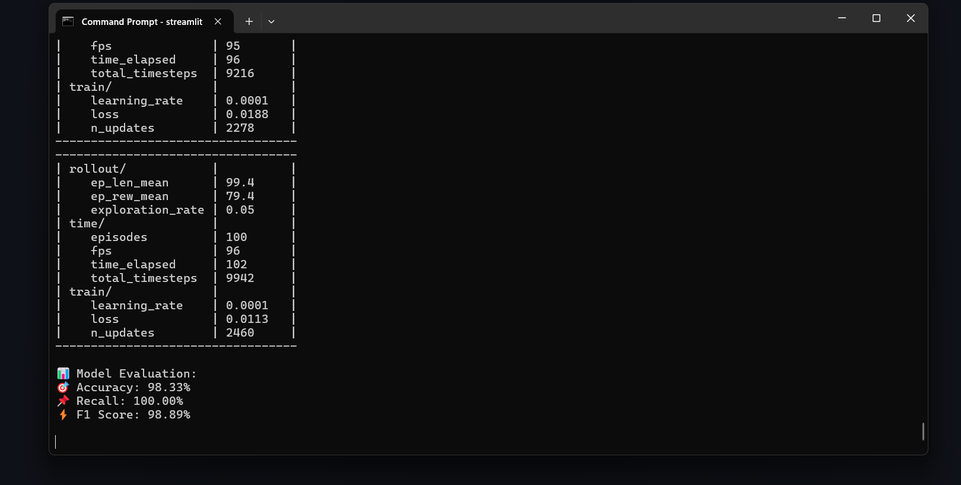
MODEL RESULTS
CSE, GST, Visakhapatnam

Slide 29
RESULTS
ACCURACY | RECALL | F1-SCORE
98.33% | 100% | 98.89%
99.96% | 93.89% | 94.89%
100% | 100% | 94.67%
100% | 100% | 96.11%
99.98% | 96.94% | 95.63%
97.98% | 96.67% | 93.89%
99.37% | 97.86% | 95.68%
CSE, GST, Visakhapatnam

Slide 30
CONCLUSION
The Reinforcement Learning-based Music Recommendation System successfully utilizes Deep Q-Networks (DQN) to provide personalized and adaptive song recommendations.
Unlike traditional models, this approach dynamically learns from user interactions, improving recommendations over time.
Key Achievements: 98.33% Accuracy in song recommendations. 100% Recall, ensuring no relevant song is missed. Real-time Adaptation, adjusting recommendations based on user feedback.

Slide 31
FUTURE SCOPE
Enhancing the reward mechanism for better user preference learning.
Expanding dataset to include more diverse music preferences.
Integrating multi-agent RL for more robust personalization.

Slide 32
References
[1] R. Zhang, S. Tu, and Z. Sun, "A Hybrid Music Recommendation Method Based on Music Genes and Collaborative Filtering," 2022 IEEE International Conference on Dependable, Autonomic and Secure Computing, Pervasive Intelligence and Computing, Cloud and Big Data Computing, and Cyber Science and Technology Congress (DASC/PiCom/CBDCom/CyberSciTech),2022.DOI:10.1109/DASC/PiCom/CBDCom/CyberSciTech55231.2022.9927924.
[2] M. S. N. V. Jitendra and Y. Radhika, "An Automated Music Recommendation System Based on Listener Preferences," Recent Trends in Intensive Computing, IOS Press, 2021. DOI: 10.3233/APC210182.
[3] M. R. Fatichin, E. Riksakomara, R. A. Vinarti, and A. Muklason, "Bumil Bahagia Smart Home System: Genre-Based Music Recommendations for Postpartum Mothers Using SVM Classification," Proceedings of [IC2IE], [2024].
[4] S. Mesghali and J. Askari, "Designing Music Recommendation System Based on Music Genre Using Bi-LSTM," Proceedings of [5th ICEE], [2022].
[5] S. Fan and M. Fu, "Music Genre Recommendation Based on MLP & Random Forest," 2022 IEEE 5th International Conference on Information Systems and Computer Aided Education (ICISCAE), Dalian, China, Sep. 2022.
[6] J. Singh and V. K. Bohat, "Neural Network Model for Recommending Music Based on Music Genres," 2021 International Conference on Computer Communication and Informatics (ICCCI), Coimbatore, India, Jan. 2021.
[7] J. B. Awotunde, M. K. Abiodun, A. E. Adeniyi, B. H. Abiodun, J. K. Adeniyi, D. R. Aremu, A. A. Adebiyi, and O. G. Atanda, "Personalized Music Recommendation System Based on Machine Learning and Collaborative Filtering," 2024 International Conference on Science, Engineering and Business for Driving Sustainable Development Goals (SEB4SDG), [Nigeria], 2024.

Slide 33
Thank You
CSE, GST, Visakhapatnam

