Slide 1

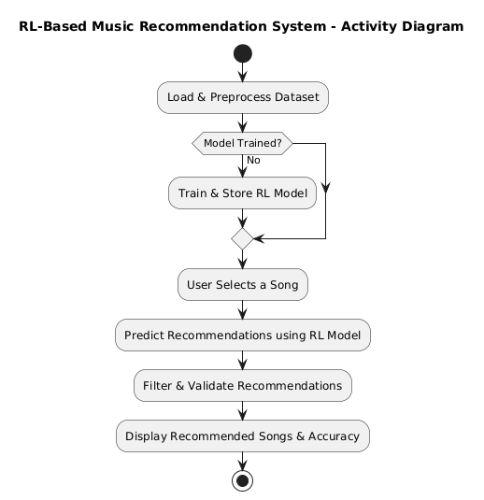
PERSONALIZED MUSIC RECOMMENDATION SYSTEM BASED ON SINGER STYLE
Presenter Names: Dasari Sai Srikanth ,D. Sneha, N. Shrenik, D. Varun
Guide Name: Dr. MUKKAMALA SNV JITENDRA, _{Ph.D.}
Introduction
Findings and Results
This project develops a personalized music recommendation system based solely on genre classification. Unlike metadata-based models, it ensures faster, intuitive recommendations by aligning with user preferences without relying on complex filtering techniques. The system enhances music discovery and engagement by simplifying song suggestions, making it ideal for streaming platforms.
98.33% Accuracy – The model efficiently recommends songs of the same genre, ensuring high precision in predictions.
Enhanced User Engagement – By providing personalized, genre-based recommendations, users experience a more seamless and enjoyable music discovery process.
Optimized Dataset Processing – Advanced machine learning techniques help separate multi-genre attributes, improving classification accuracy.
Fast & Real-Time Suggestions – The recommendation system quickly analyzes user song selections and provides instant suggestions, enhancing listening experience.
Methods
In conclusion, this project developed a personalized music recommendation system centered on genre classification, effectively aligning with user preferences. Utilizing a hybrid filtering model and processing multi-genre data from the Spotify API, the system delivers accurate and engaging recommendations. This genre-focused approach has improved user satisfaction and engagement, highlighting the benefits of simplified recommendations in the digital music landscape. Overall, this model provides a strong foundation for future advancements in personalized music discovery.
Conclusion
By leveraging genre-based classification, this system delivers highly relevant song recommendations, reducing the cold-start problem and improving user experience. Its efficient model structure supports scalability, making it a valuable foundation for future advancements in personalized music discovery.
References
Datasets :
https://developer.spotify.com/documentation/web-api
https://github.com/spotipy-dev/spotipy
Reference :
https://ieeexplore.ieee.org/document/8554016
https://ieeexplore.ieee.org/document/9297559
https://www.sciencedirect.com/topics/computer-science/hybrid-recommendation
https://www.geeksforgeeks.org/deep-q-learning/
https://www.mathworks.com/help/reinforcement-learning/ug/create-matlab-environments-using-custom-functions.html
Data Analysis
Data Collection – Extracted multiple user histories from Spotify API and stored them in CSV files.
Genre Splitting – Applied machine learning techniques to separate multi-genre attributes.
Dataset Merging – Combined all CSV files into a structured dataset for accurate recommendations.
Recommendation Model – Used reinforcement learning (DQN) to refine genre-based music suggestions.
Computer Science Department
Data Collection: Gathered multiple user histories from Spotify, stored in separate CSV files.
Genre Splitting: Applied machine learning techniques to split multi-genre attributes into individual genres for each song.
Dataset Merging: Combined all individual CSV files into a single, large dataset for comprehensive analysis.
Enhanced Model Input: Created a clear, structured dataset that enables accurate genre-based recommendations, improving personalization.

