Slide 1

DataCan: Data Analysis and Prediction for Cancer Dataset
A
Project Progress Report
January-2018 to March-2018
By
Tushar Ranjan Varun Goel Vishal Jangir
159102147 159102156 159103073
Project Guide: Venkatesh G. Shankar
Information Technology
MANIPAL UNIVERSITY JAIPUR
JAIPUR-303007
RAJASTHAN, INDIA
May-2018

Slide 2
Problem Introduction
While tracing the history of the past two decades, it can be seen that high-throughput biology has triggered the active statistical research in high-dimensional data.
Recently, to handle the real dimension of genomic data, which is usually beyond the scale of hundreds of variables, methods to handle ultrahigh-dimensional data are emerging.
The diversity of cancer data types together with the availability of related studies on similar types of cancers adds another two dimensionalities of complexity.
It is of critical clinical and biological interest to understand what subtypes a cancer has, how genomic profiles and survival rates of patients vary among subtypes, whether a patient’s survival can be predicted from his or her genomic profiles, and how one type of genomic profile is correlated with another type of genomic profile.

Slide 3
Once sequenced, a cancer tumor can have thousands of genetic mutations. But the challenge is distinguishing the mutations that contribute to tumor growth (drivers) from the neutral mutations (passengers).
Currently this interpretation of genetic mutations is being done manually. This is a highly time-consuming task where a clinical pathologist has to manually review and classify every single genetic mutation based on evidence from text-based clinical literature.

Slide 4
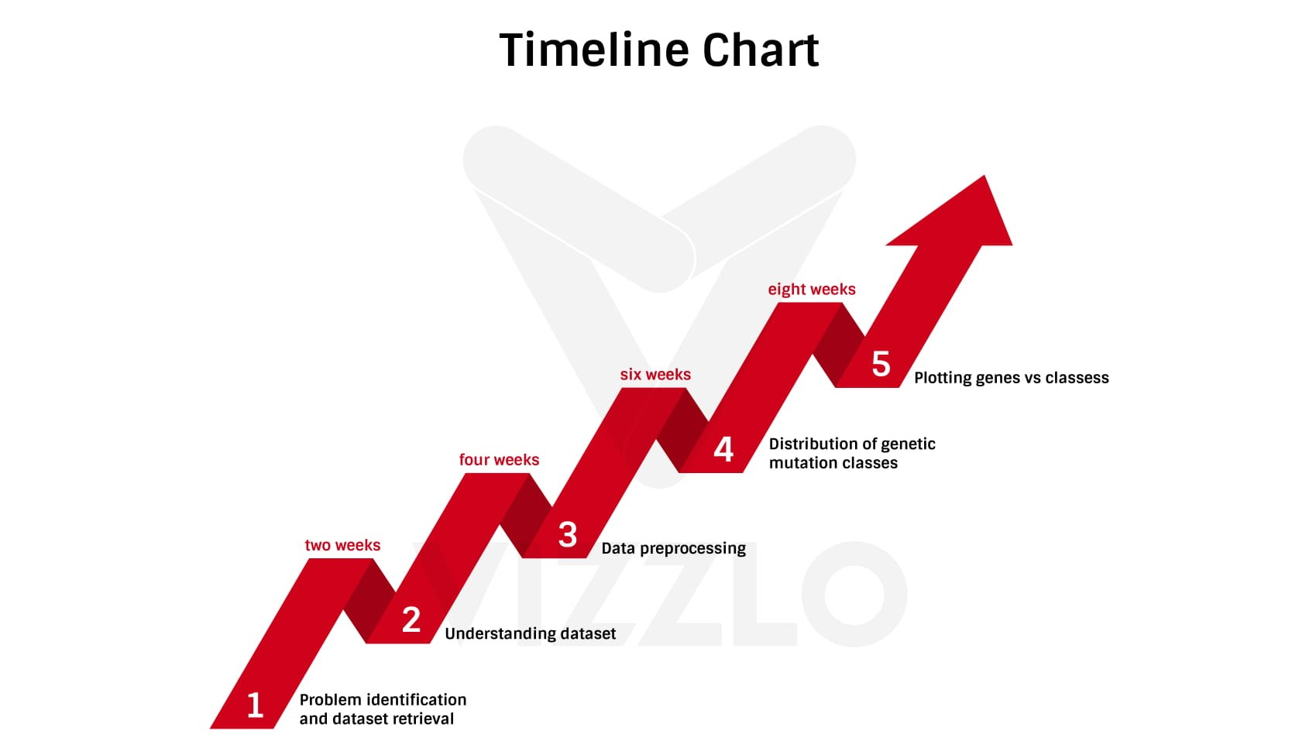

Slide 5
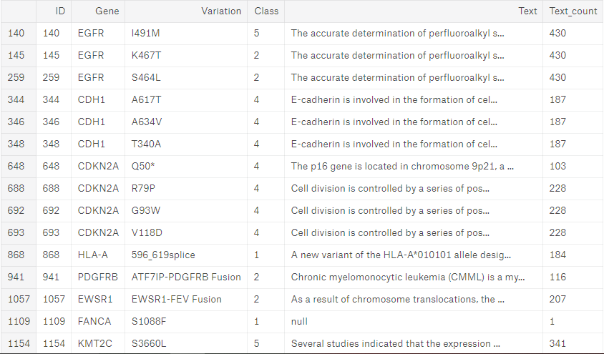
Sample Dataset

Slide 6
Methodology
We will use Machine Learning and Exploratory Data Analysis techniques for this. Our goal is to find out the major cancer causing gene mutations and in which class of genes they lie. This can help the medical researchers in predicting which individual is more likely to have cancer symptoms by finding his/her genome structure and can help doctors in designing procedures to prevent it.
The dataset comes in 4 different files. Two csv files and two text files:
training/test variants: These are csv catalogues of the gene mutations together with the target value Class, which is the (manually) classified assessment of the mutation. The feature variables are Gene, the specific gene where the mutation took place, and Variation, the nature of the mutation. The test data of course doesn’t have the Class values. This is what we have to predict.
These two files each are linked through an ID variable to another file each, namely:
training/test text: Those contain an extensive description of the evidence that was used (by experts) to manually label the mutation classes.

Slide 7
This dataset has been provided by Memorial Sloan Kettering Cancer Center (MSKCC), which has around 8,989 total rows. We have more samples of test data than training data. Training data accounts for about 37.3% of the total data. There are 3321 different IDs in the training set containing 264 different Gene expressions with 2996 different Variations. There are 9 different Classes indicated by integer levels.
The text information holds the key to the classification problem and will have to be understood/modelled well to achieve a useful accuracy.
Data Preprocessing Phase: Here we use train variants dataset using pandas and check it for any null values, which can disrupt our analysis. Then split data in test and train datasets.
Basic data analysis was performed to find out unique genes, variations and classes and the maximal and minimal occurrences of each genetic mutation.
Using Seaborn, we will plot a countplot of the frequency of distribution of genetic classes.
Next, we found out which mutation of gene is dominating for which class of cancer. This is performed by plotting Cancer classes against the genes with maximal occurrences using Seaborn barplot.

Slide 8
We wrote these functions to convert the data in useful format and extract necessary
features from the data:
Tokenizing words
Mutation Word table
Gene-like words
Converting Variants to Mutation Types

Slide 9
Now we created a Mutation table, with mutation types as columns and IDs as rows. This table tells the presence of mutation types in each ID.
this we created a table of Gene-like words. The table contains all the words which are like genes, as columns and IDs as rows
Next using LabelEncoder and OneHotEncoder, we created a Gene table with unique genes as columns and IDs as rows and a Mutation Type table with Mutation Types as columns and IDs as rows.
These tables tell us about the presence of unique gene and mutation type for each ID.

Slide 10
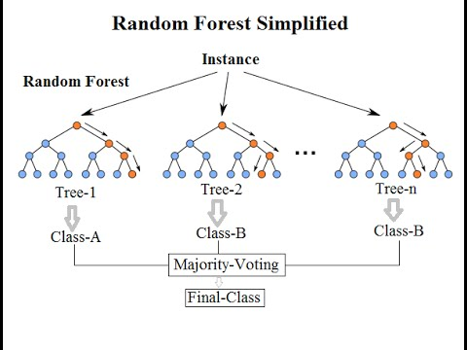
We applied Random forest.
We got an accuracy of 65.86%.
After using 10-Fold Cross Validation,
we got an accuracy of 68%.

Slide 11
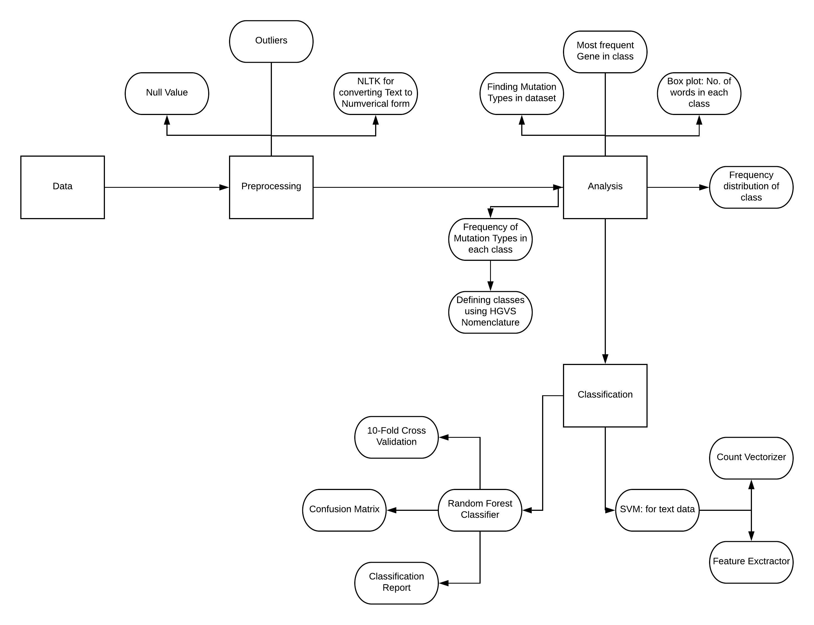
Process Flow Chart

Slide 12
Facilities Required
Programming language:
Python v3.6
Frameworks:
NumPy
Pandas
Matplotlib
Tf-idfVectorizer
ScikitLearn
Seaborn
Regular expression
NLTK
Software:
Anaconda Navigator v1.6.9
Jupyter Notebook
Hardware:
Processor (two quad core processors) with 32 GB RAM

Slide 13
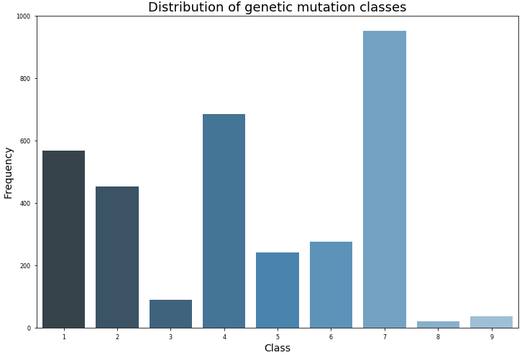
Implementation and Results

Slide 14
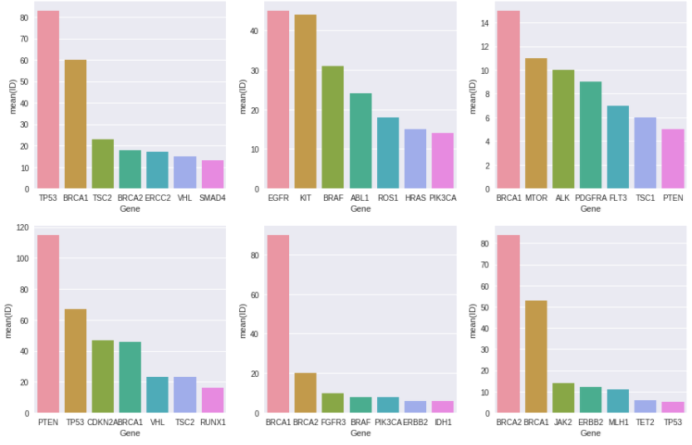

Slide 15
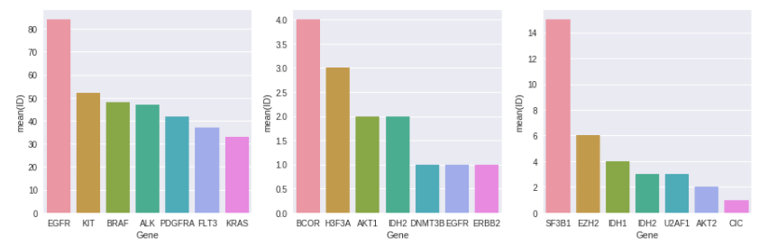

Slide 16
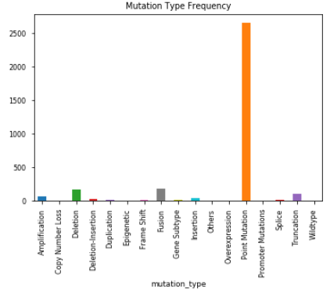
Frequency of Mutation Types

Slide 17
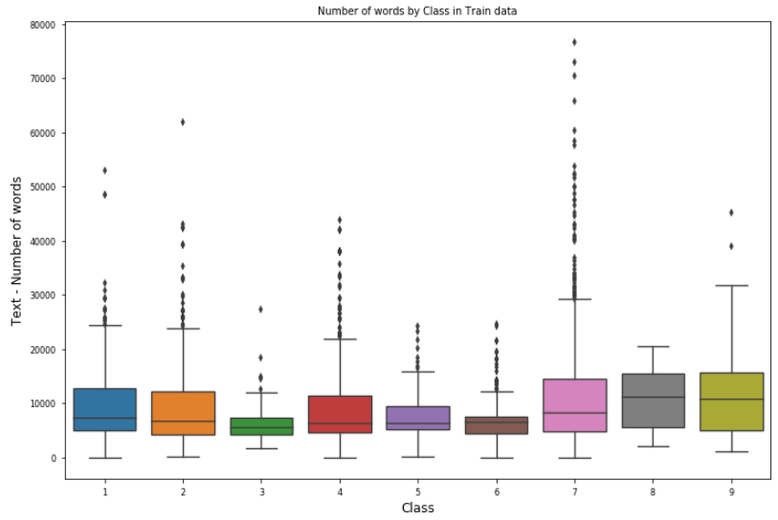
Number of Words by Class

Slide 18
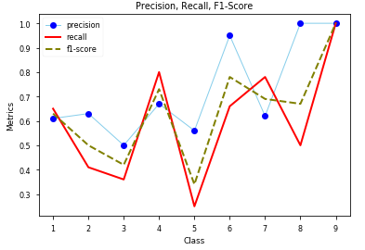
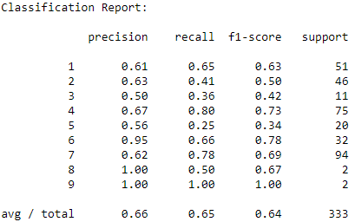
Precision, Recall and F1-Score Classification Report

Slide 19
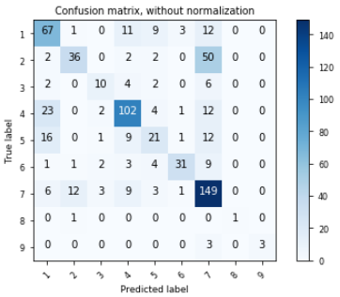
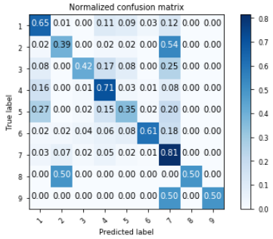
(a) (b)
Confusion Matrix (a)Normalized (b)Without Normalization

Slide 20
Future Work and Conclusion
After the analysis of the dataset and learning about cancer genes and their features, we concluded that the classes appear to be as follows:
Likely Loss-of-function
Likely Gain-of-function
Neutral
Loss-of-function
Likely Neutral
Inconclusive
Gain-of-function
Likely Switch-of-function
Switch-of-function

Slide 21
The best accuracy is achieved from Random Forest model, which is 63.69% and is not very good as our entire dataset is text based and in converting it to numerical form we lost a lot of important features.
After reading about the nomenclature of the genes, the strategy for improving model results was refocused on the information carried in the `Variation` variables themselves.
Amino acid changes are coded according to a set of guidelines and different types of protein mutations are more likely to result in certain types of outcomes.
Different amino acids also carry different properties of phosphorylation and charge which are meaningful to protein function

Slide 22
So, for example, it is probably important if the amino-acid change was to or from a threonine (Thr, T), serine (Ser, S), or tyrosine (Tyr, Y) as these could have more likelihood of loss or gain of function.
But some values in our dataset doesn’t follow the nomenclature properly because of which we couldn’t classify more accurately.

Slide 23
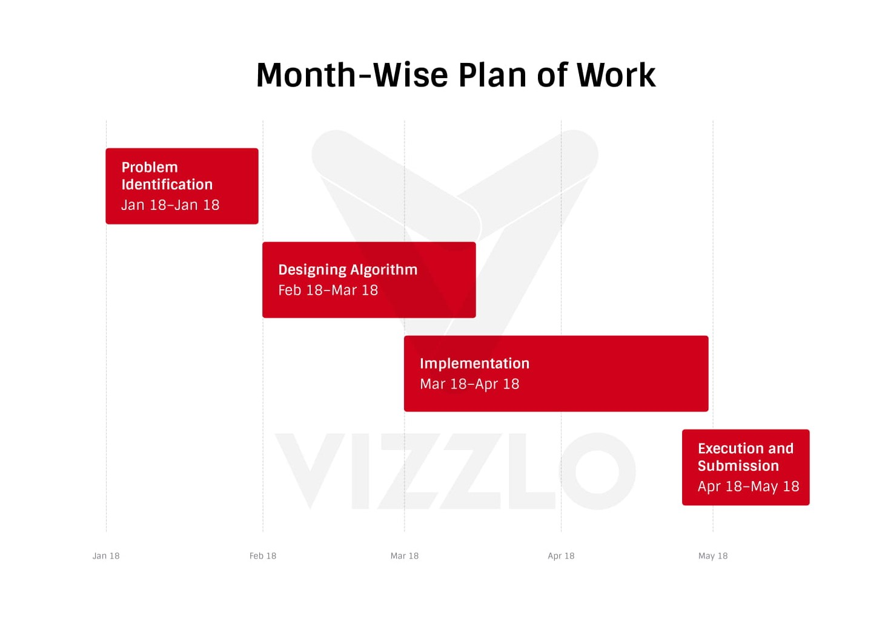

Slide 24
References
[1] Muxuan Liang, Zhizhong Li, Ting Chen, and Jianyang Zeng, ‘INTEGRATIVE DATA ANALYSIS OF MULT-PLATFORM CANCER DATA WITH A MULTIMODAL DEEP LEARNING APPROACH’, IEEE/ACM transactions on computational biology and bioinformatics, Vol. 12, No. 4, July/August 2015
[2] Amit Bhola and Arvind Kumar Tiwari, ‘MACHINE LEARNING BASED APPROACHES FOR CANCER CLASSIFICATION USING GENE EXPRESSION DATA’, Machine Learning and Applications: An International Journal (MLAIJ) Vol.2, No.3/4, December 2015
[3] Shweta Kharya, ‘USING DATA MINING TECHNIQUES FOR DIAGNOSIS AND PROGNOSIS OF CANCER DISEASE’, International Journal of Computer Science, Engineering and Information Technology (IJCSEIT), Vol.2, No.2, April 2012
[4] A. Priyanga and S. Prakasam, ‘Effectiveness of Data Mining - based Cancer Prediction System (DMBCPS)’, International Journal of Computer Applications (0975 – 8887) Volume 83 – No 10, December 2013

