Slide 1
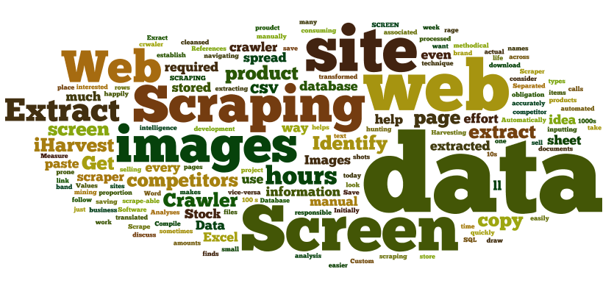
WEB SCRAPING IN PYTHON
PRESENTED BY:
VARUN GOEL
VANSHIKA SAINI
VAIBHAV GARG
SHIVANGI AGARWAL

Slide 2
AGENDA:
WHAT IS WEB SCRAPING?
WHY DO WE SCRAPE?
TOOLS USED
HOW DO WE DO IT?
DESIGN DIAGRAM/FLOWCHART
LIBRARIES USED
PROJECT SNAPSHOTS
GRAPHS
CONCLUSION
FUTURE SCOPE

Slide 3
WHAT IS WEB SCRAPING?
Software technique of extracting
information from websites.
Done with software that simulates human
Web surfing to collect specified bits of
information from different websites.

Slide 4
WHY DO WE SCRAPE?
Useful information
Interfacing with a 3rd party with no API access
Anonymous access
Websites are more important than APIs

Slide 5
TOOLS USED
PREREQUISITES:
Basic knowledge of:
HTML
CSS
JavaScript
IDE USED:
Jupyter

Slide 6
HOW DO WE DO IT?
FETCHING THE DATA
PROCESSING
PARSING (USING BEAUTIFULSOUP)
EXPORTING DATA

Slide 7
SCRAPING IMDB WEBSITE
We will scrape IMDB website to analyze the distributions
of IMDB and Metacritic movie ratings and then store the
scraped data in a CSV file.

Slide 8
DESIGN DIAGRAM

Slide 9
P
Start
Copy IMDB URL
Request Data
Requests Pg>72
Break loop
Data found
Parsing data using BS
Scrape Info
Analyze Data
Plots graphs
End

Slide 10
LIBRARIES USED
Requests:
We have used the get() function from the Requests module to request the server the
content of the web page.
BeautifulSoup:
Used to parse the HTML document and extract the useful data we need for our analysis
Pandas:
Used for the purpose of data munging and preparation. In our project we have used a
function DataFrame(), which is a 2D data structure and is used to reshape the data in the
form of a table. This makes the data readable.
Matplotlib:
Used it to plot the data in form of graphs and conclude our analysis.

Slide 11
PROJECT SNAPSHOTS

Slide 12
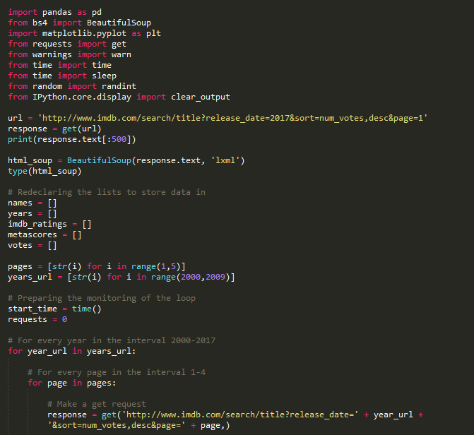
IMAGE 1

Slide 13
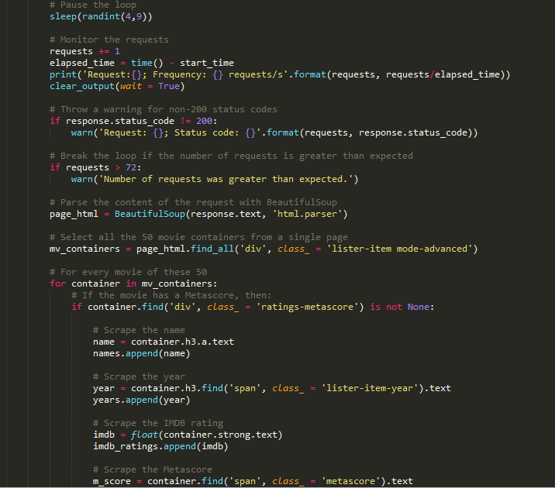
IMAGE 2

Slide 14
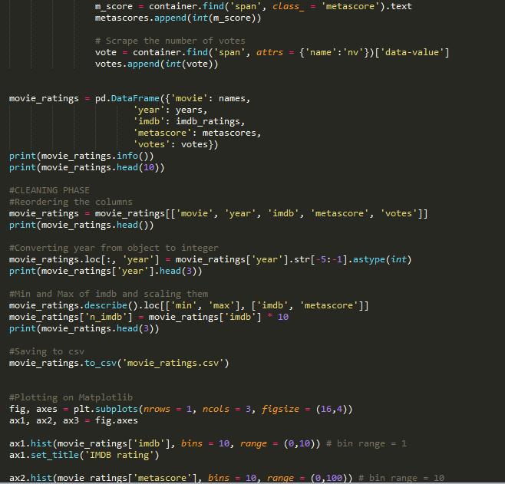
IMAGE 3

Slide 15
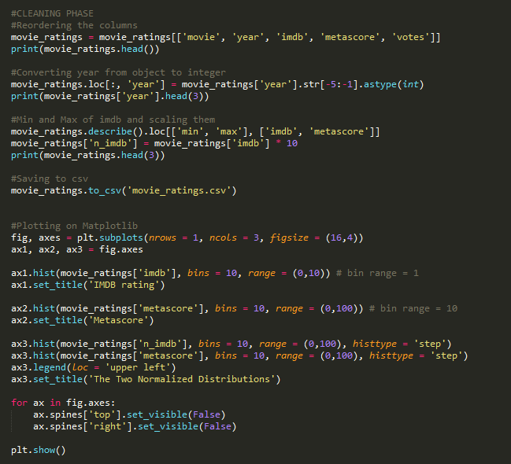
IMAGE 4

Slide 16
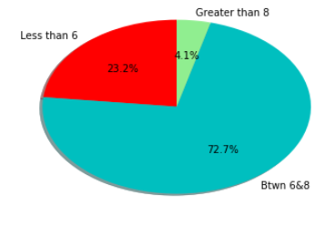

Slide 17
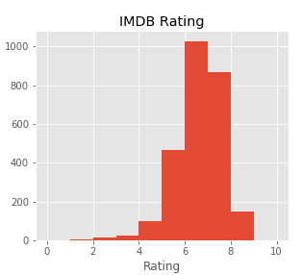
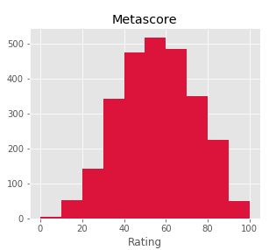
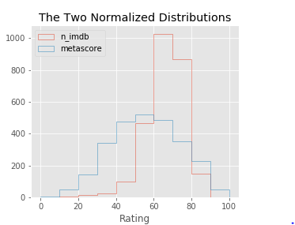

Slide 18
CONCLUSION
From the IMDB histogram, we can see that most ratings are between 6 and 8.
There are few movies with a rating greater than 8, and even fewer with a rating
smaller than 4. This indicates that both very good movies and very bad movies are
rarer.
The distribution of Metascore ratings resembles a normal distribution - most
ratings are average, peaking at the value of approximately 50. According to this
distribution, there are indeed fewer very good and very bad movies, but not that
few as the IMDB ratings indicate.

Slide 19
FUTURE SCOPE
01
Bigger RAM = Bigger Data Extraction
02
Better Aggregation Methods= Flourishment of scraping tools
03
Less complicated processes= Effective and Consistent Scraping

