Slide 1

Maisammaguda, Kompally,
Medchal - Malkajgiri District Hyderabad - 500100, Telangana State
www.mallareddyuniversity.
(Telangana State Private Universities Act No. 13 of 2020 &
G.O.Ms. No. 14, Higher Education (UE) Department)
Department of Computer Science & Engineering
CSE Club Fusion
Batch No. AD - 4
2211CS010539 (Sindhu Ravuri)
2211CS010521 (Sarthak Aitha)
2211CS010500 (Varun Harinath)
2211CS010498 (Reshmi Kumari)
Guide: Mr. G. Raju

Slide 2
Contents of the Presentation
Title Explanation
Abstract of the Application
Introduction to the Application
Existing System
Proposed System
Tech Stack
Conclusion
Future Scope

Slide 3
Title Explanation
CSE ClubFusion : Connect, Collaborate, Create
“ClubFusion” serves as a dynamic space where students can engage, exchange ideas, and actively participate in a variety of clubs and activities that promote personal growth, skill development, and community building within the educational institution.
Connect: Students networking, bonding, and building community. Emphasizes social interaction and support among peers.
Collaborate: Students unite diverse backgrounds, sparking innovation through teamwork..
Create: Emphasizes the aspect of creativity and productivity within the student community. It encourages students to explore their passions, express themselves, and contribute to the development of new ideas, projects, or initiatives.

Slide 4
ABSTRACT:
ClubFusion outlines our university's innovative online platform built on the MERN stack, aimed at facilitating student engagement with the diverse array of clubs available on campus. The platform provides a centralized repository of information about each club, offering insights into their activities, objectives, and leadership structure. Leveraging MongoDB for data storage, Express.js for server-side web application framework, React.js for building interactive user interfaces, and Node.js for server-side scripting, our platform ensures a seamless and dynamic user experience. With features like event postings for past highlights and upcoming gatherings, students can easily stay connected and involved in the vibrant club culture of our university community.

Slide 5
INTRODUCTION:
Welcome to our university's vibrant community of student clubs! Here, you'll find a diverse array of opportunities to connect, collaborate, and pursue your passions. Our website serves as your one-stop destination for information on all the available clubs on campus, providing details on each club's mission, activities, and how to get involved. Meet the dedicated individuals leading each club as we highlight the presidents and vice presidents who are driving these organizations forward. Stay up-to-date with our event calendar, featuring both past highlights and upcoming gatherings, ensuring you never miss out on the excitement happening within our dynamic club community. Join us as we celebrate creativity, leadership, and camaraderie, making the most of your university experience through our vibrant club network.

Slide 6
INTRODUCTION:
Features::
1.Club Information: Access detailed information about all available clubs, including activities, missions, and membership requirements.
2. Leadership Profiles: Get acquainted with the presidents and vice presidents of each club, learning about their roles and contributions.
3. Event Calendar: Stay up-to-date with past highlights and upcoming events within the club community.
4. Chat Room: Join discussions, ask questions, and seek assistance in our interactive chat room dedicated to club-related queries and discussions.
5. User-Friendly Interface: Enjoy a seamless and intuitive browsing experience, designed to enhance user engagement and satisfaction.
6. MERN Stack Integration: Leveraging MongoDB, Express.js, React.js, and Node.js, our website ensures robust functionality and performance.

Slide 7
EXISTING SYSTEM:
1. OrgSync: OrgSync is a platform widely used by universities and colleges for managing student organizations, clubs, and activities. It provides features for event management, membership tracking, communication, and collaboration.
2. CampusGroups: CampusGroups is another popular platform used by educational institutions for managing student clubs, organizations, and events. It offers features such as event registration, group messaging, document sharing, and member directories.
3. Presence: Presence is a comprehensive student engagement platform that helps universities and colleges manage clubs, organizations, and events. It provides tools for event planning, member management, budget tracking, and data analytics.

Slide 8
PROPOSED SYSTEM:
1. Authentication & Authorization Secure user sign-up, login, and role-based access control.
2. Club Management Admins create, edit, and delete club profiles with details.
3. Event Organization: Clubs organize events with RSVP options and details.
4. Announcements & News: Admins post updates for the CSE community.
5. Resource Sharing: Clubs share documents and tutorials.
6. Discussion Forums: Engage members in discussions and collaboration.
7. Search & Filtering: Users find clubs, events, and resources easily.
8. User Profiles: Customizable profiles manage personal info and affiliations.
9. Security & Scalability: Implement robust security and scalable architecture.

Slide 9
Methodology
Tech Stack
Frontend: React.js
Backend: Node.js
Database: MongoDB
Server: Express.js
Deployment: Docker, Vercel , Amazon Web Services (EC 2)
Authentication: Passport Js for client-side validation
Version Control: Git
Hosting: Vercel , Amazon Web Services ( EC 2 )
Continuous Integration/Continuous Deployment (CI/CD): GitHub Actions
Data-Base Server : Amazon Web services ( EC 2 ) , Mongo Atlas

Slide 10
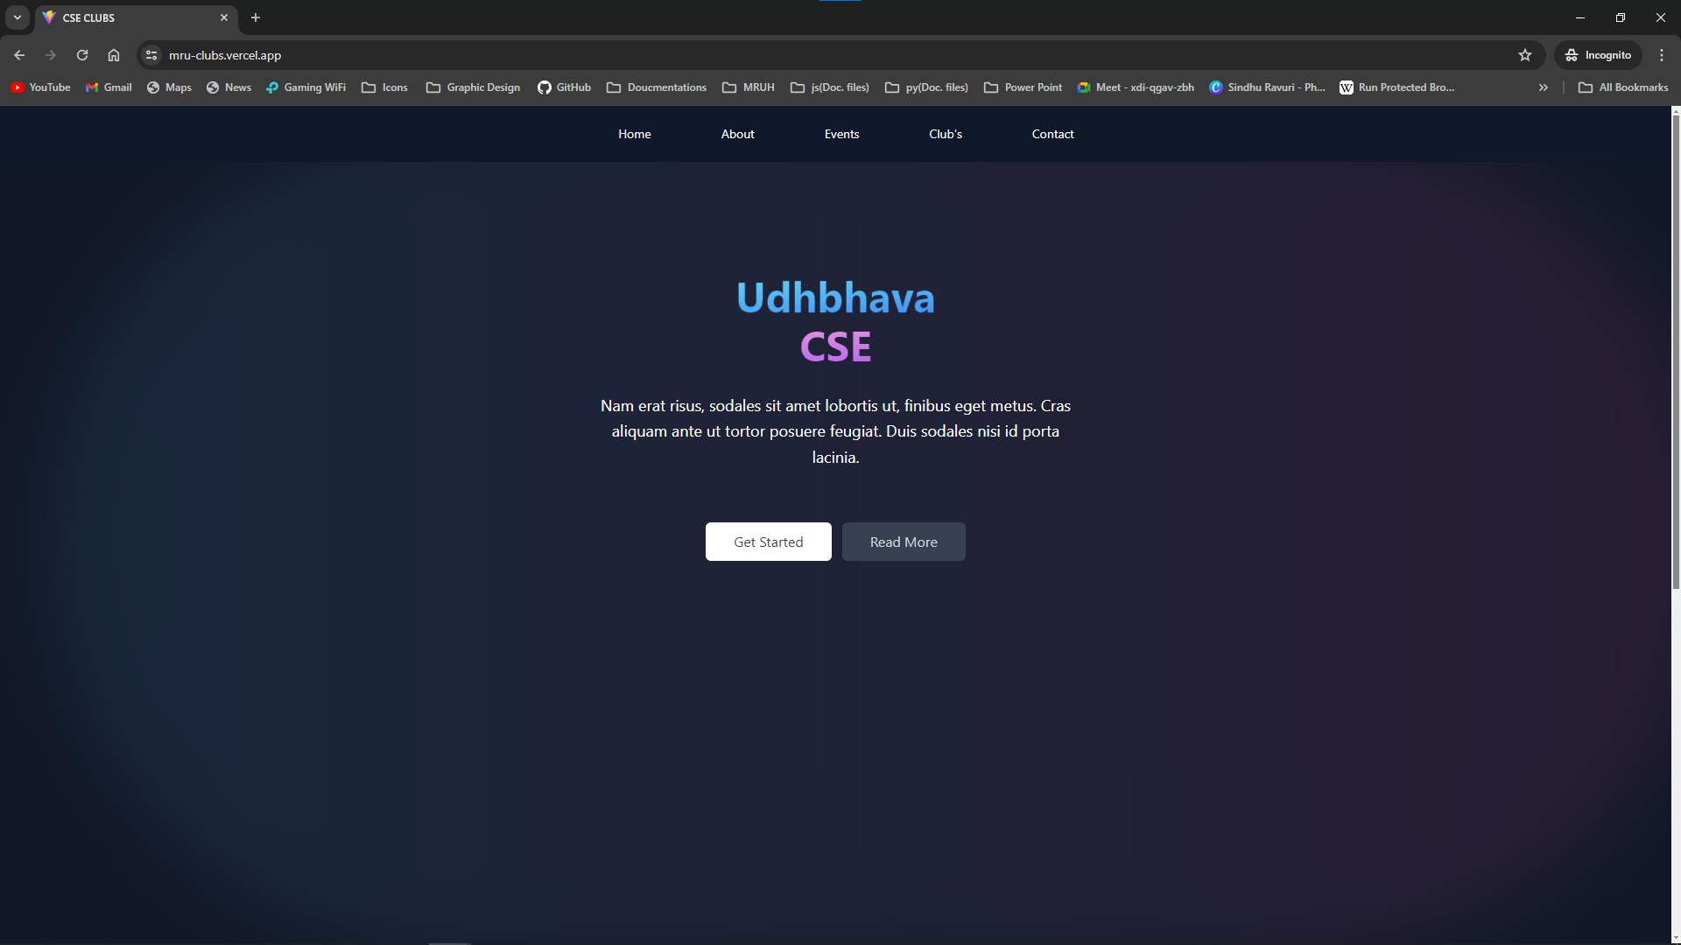
Home Component

Slide 11
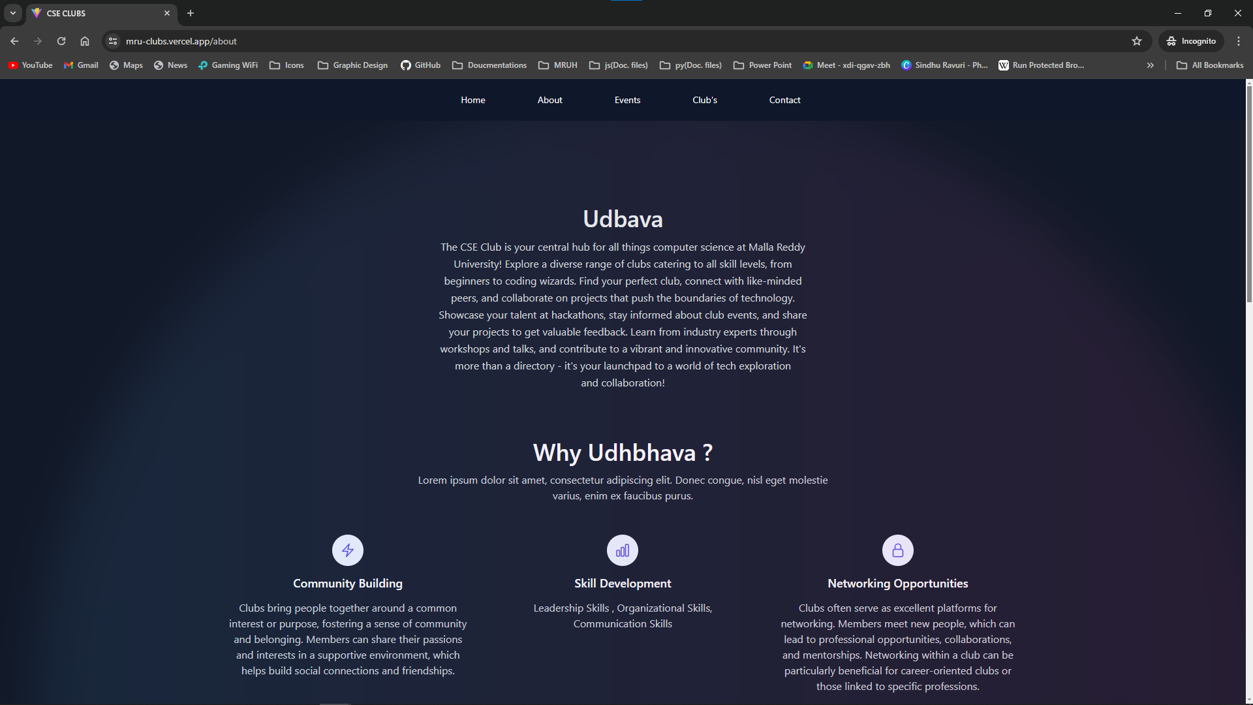
About Component

Slide 12
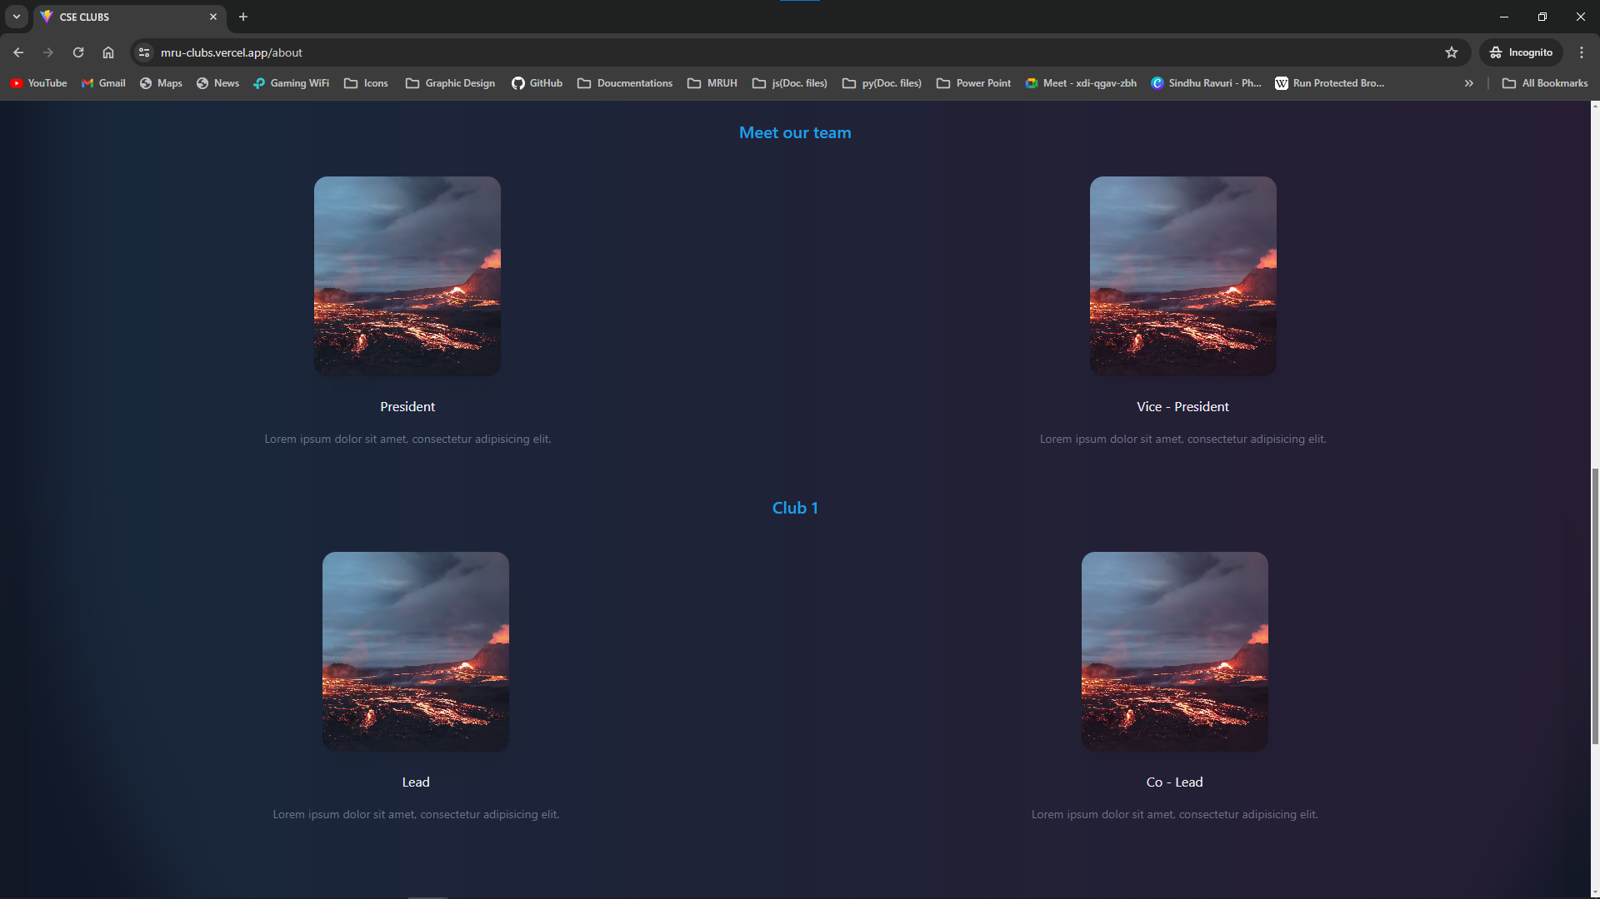
About Component

Slide 13
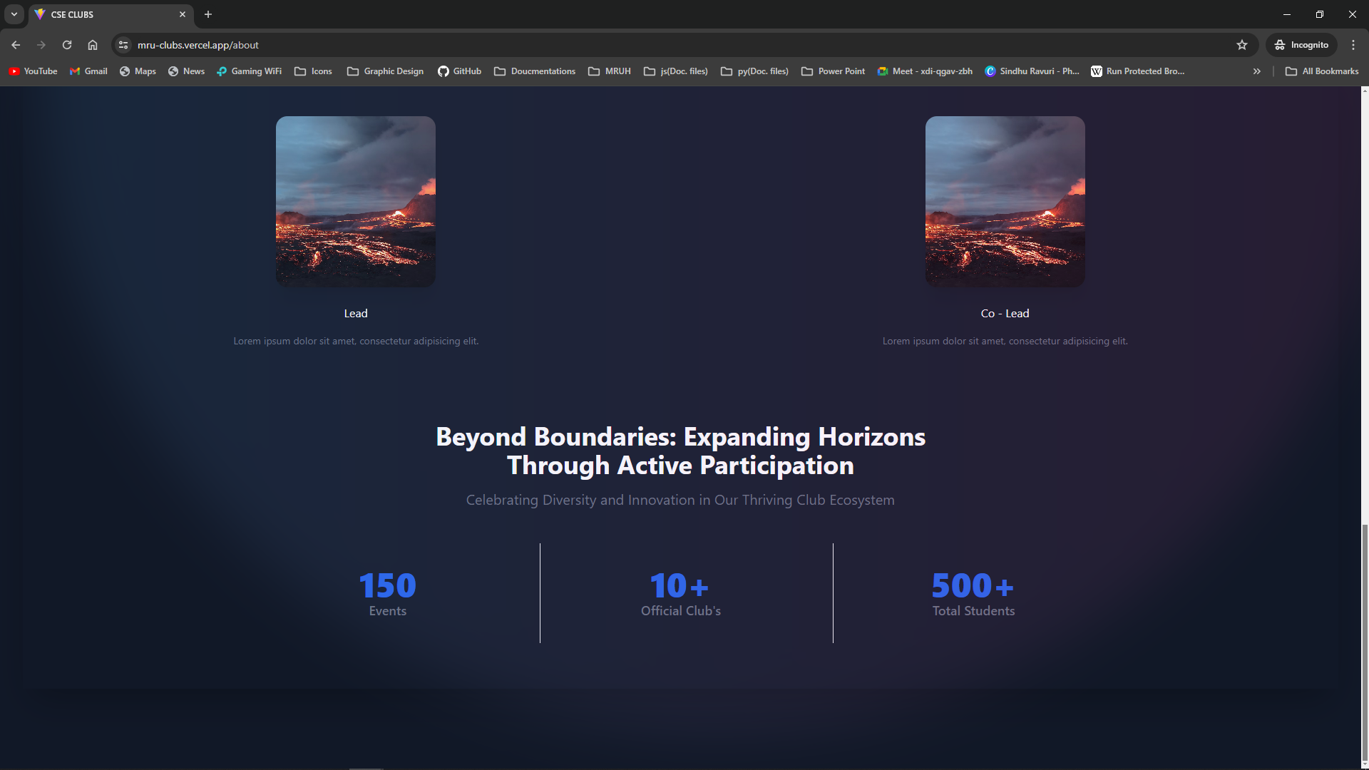
About Component

Slide 14
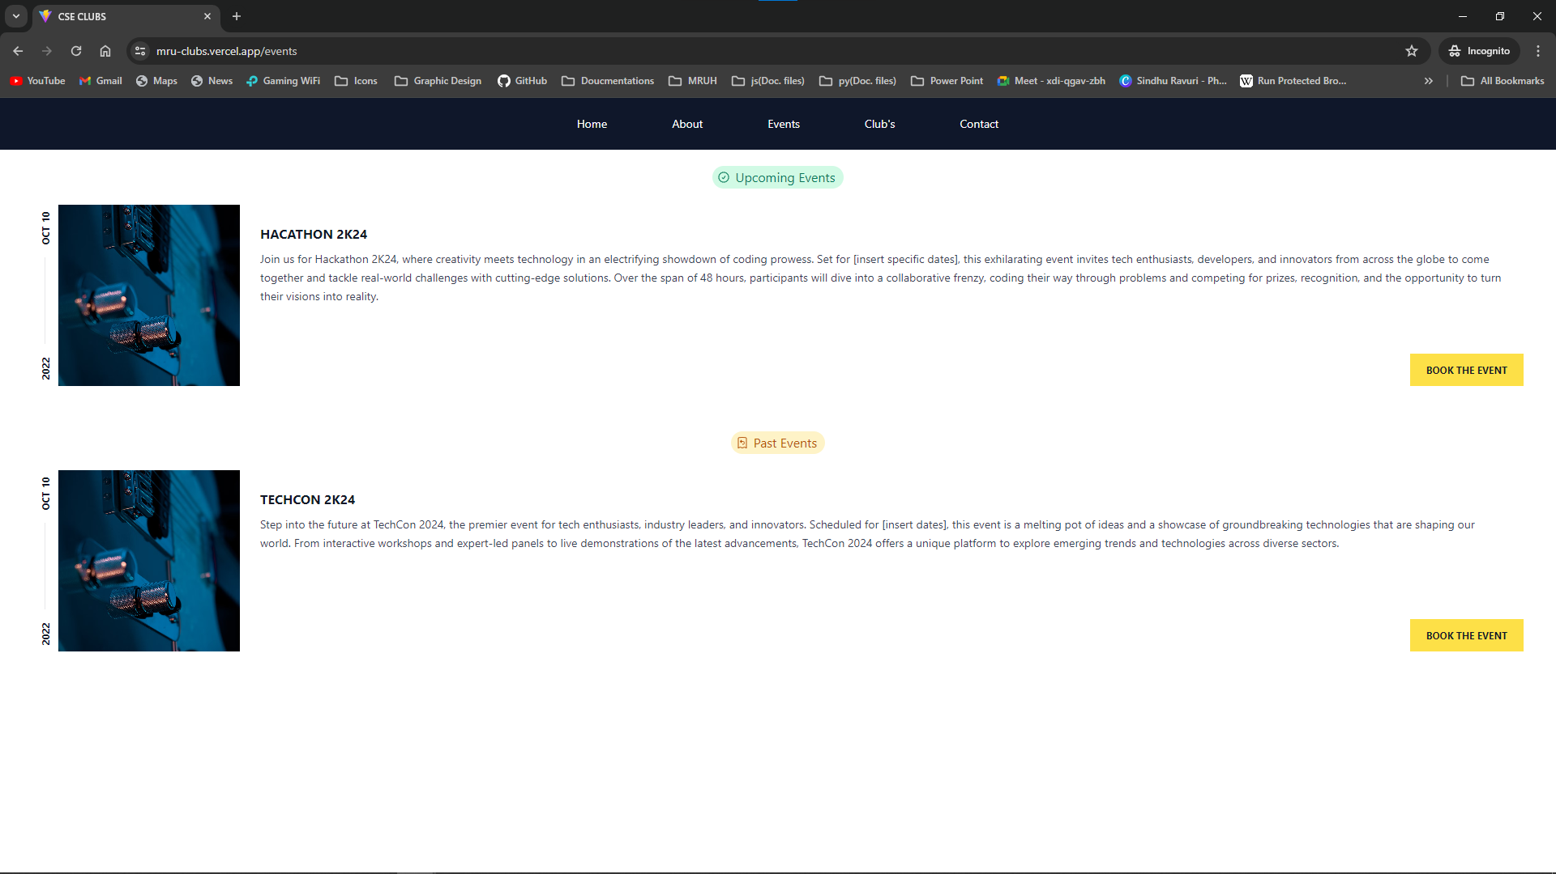
Events Component

Slide 15
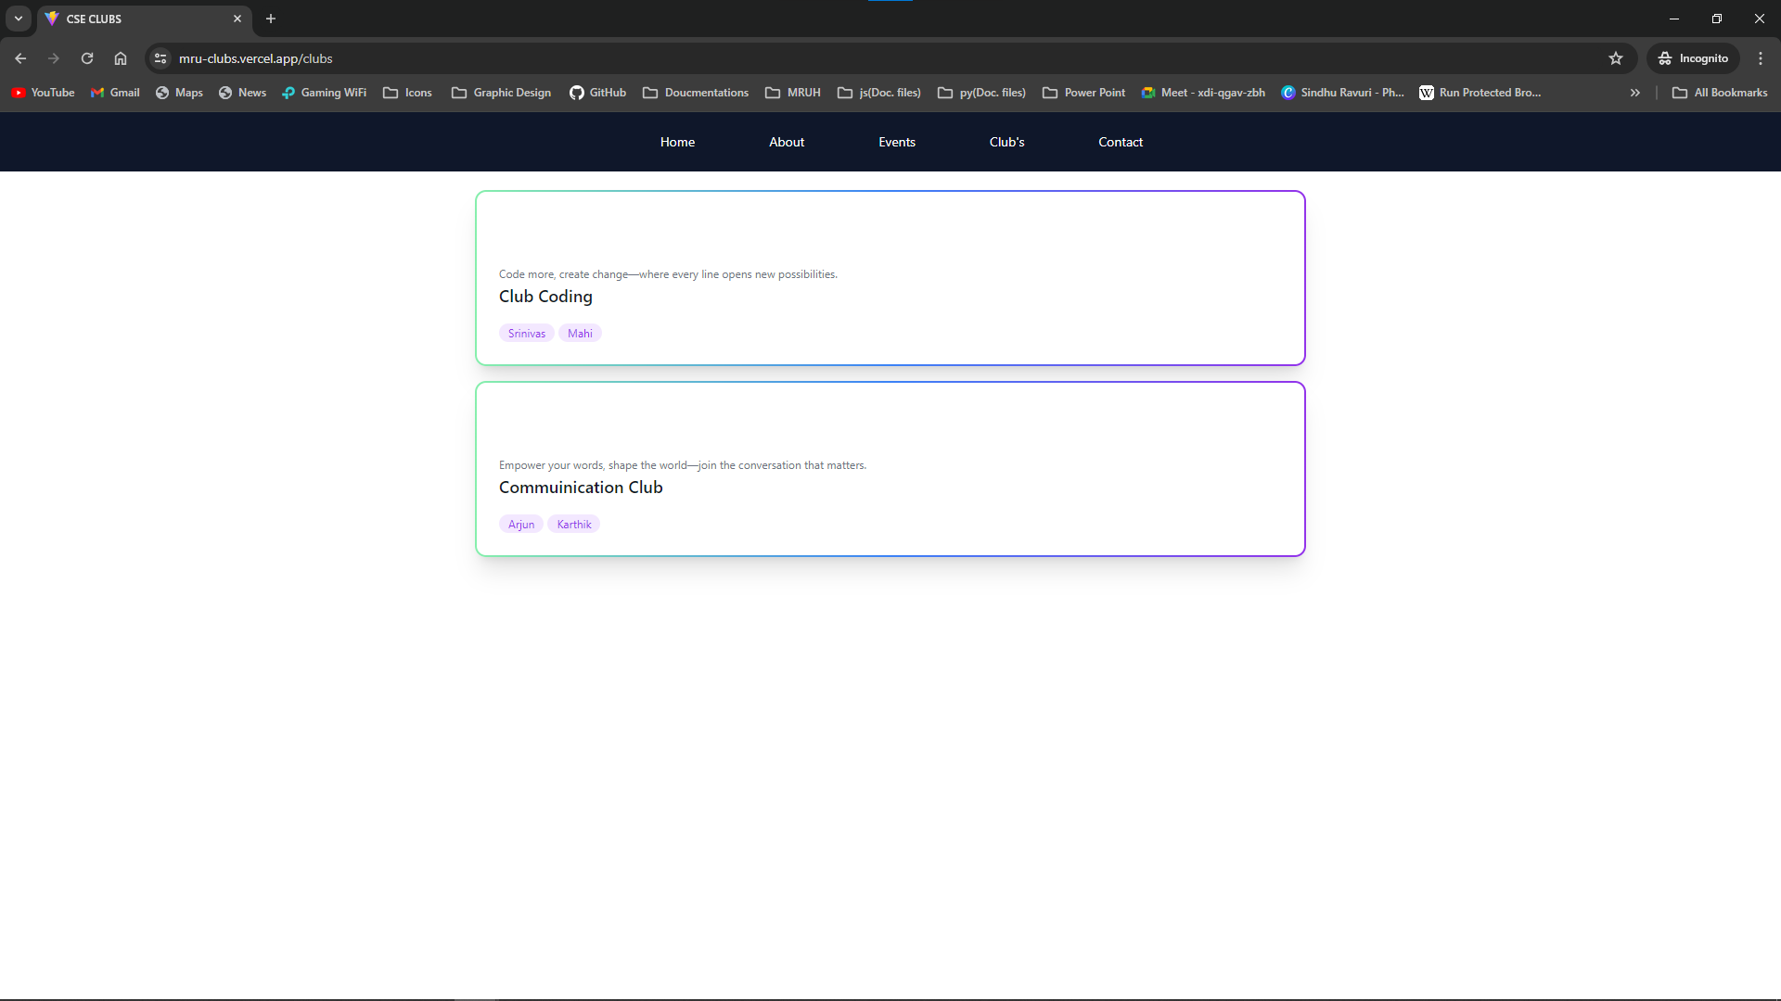
Club’s Component

Slide 16
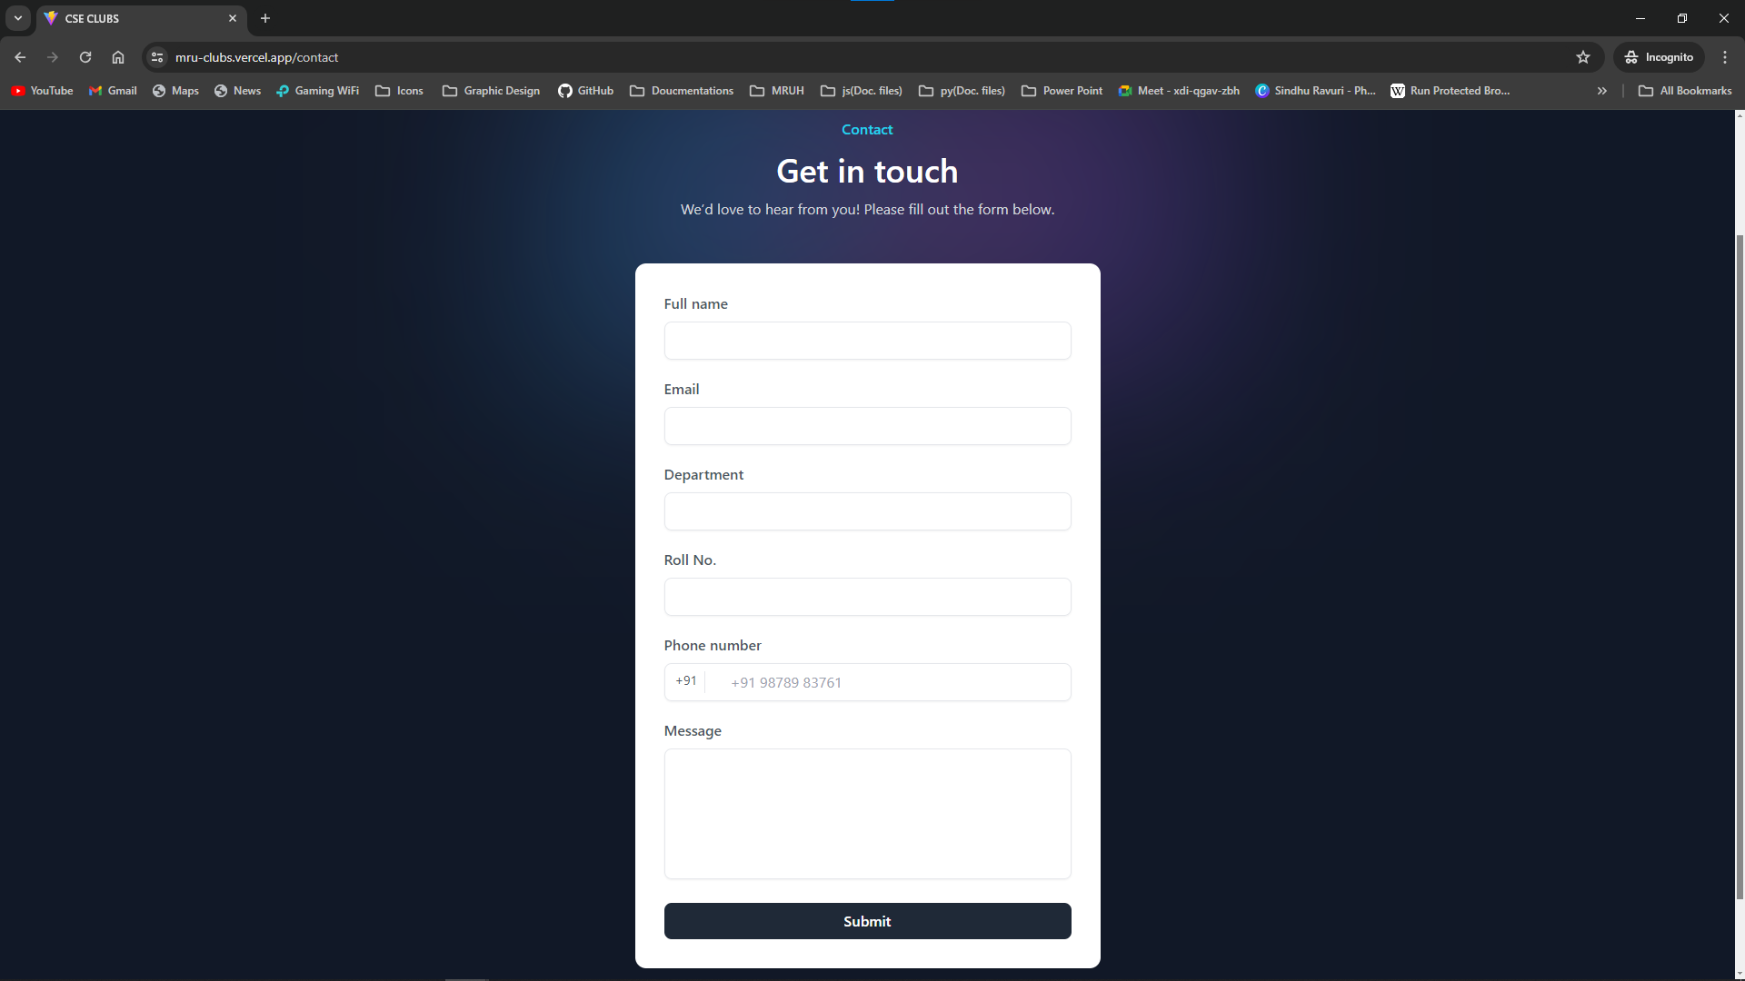
Contact Component

Slide 17
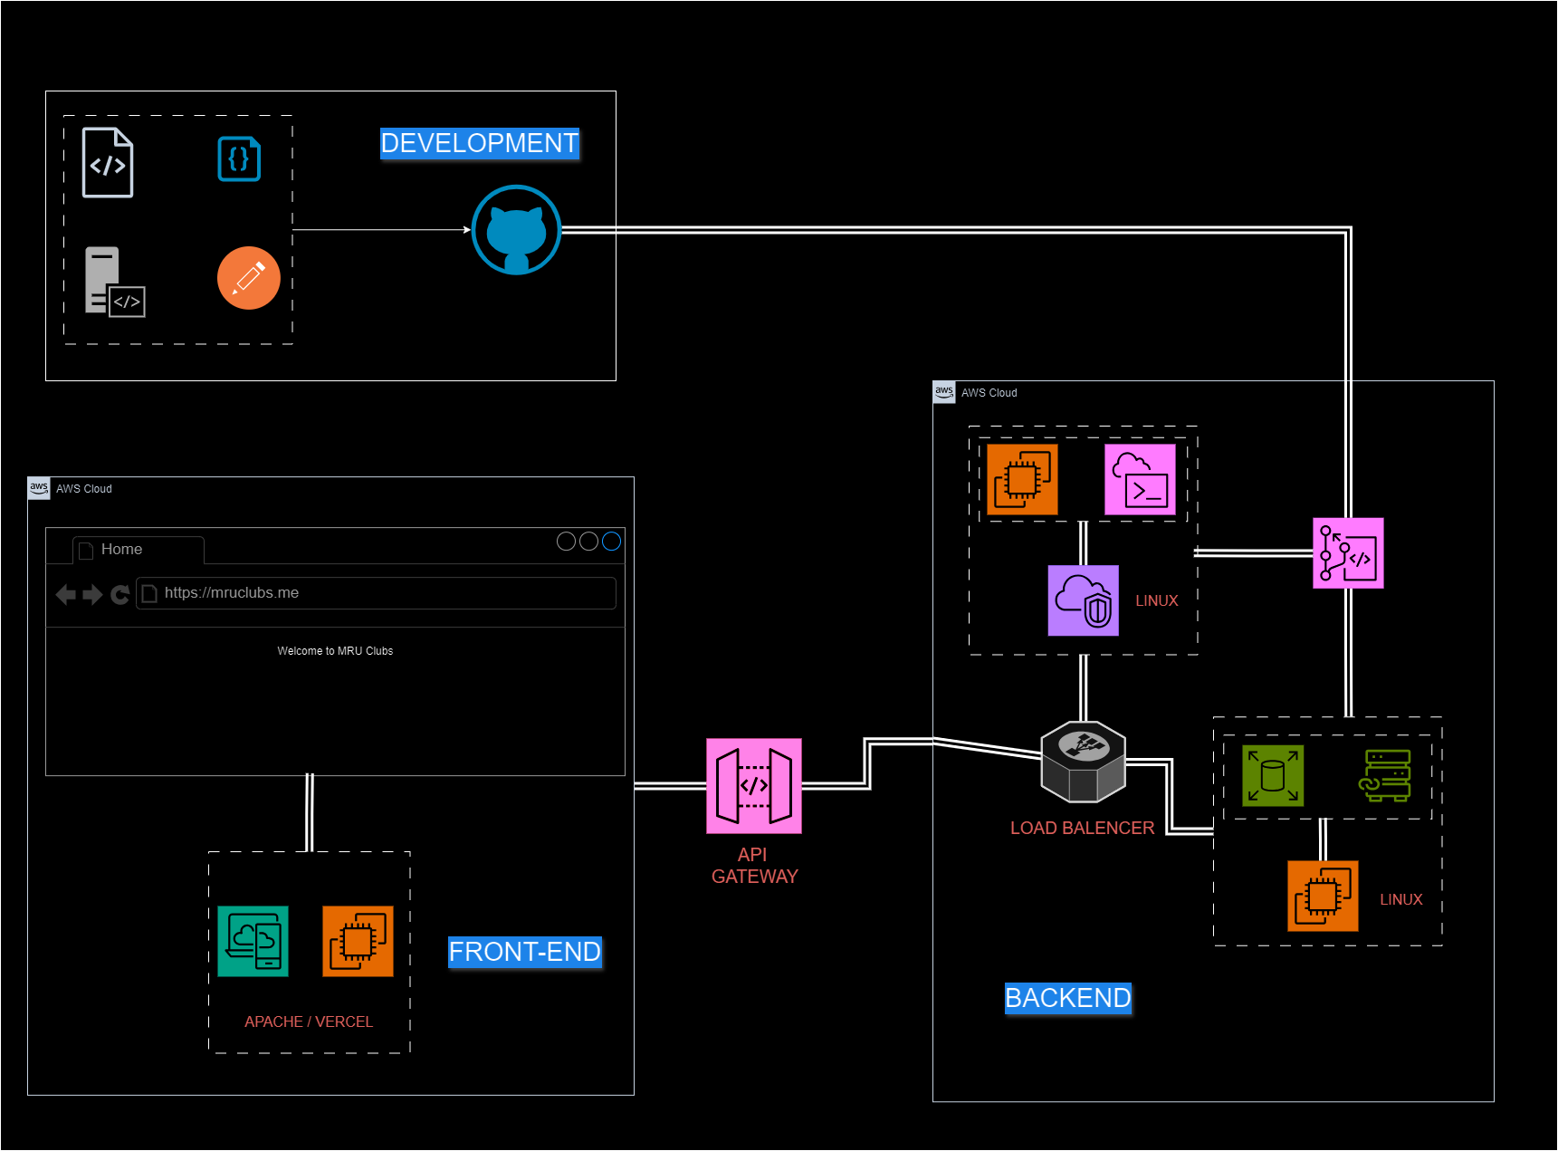
Contact Component

Slide 18
Club Fusion
https://mru-clubs.vercel.app/

Slide 19
Methodology
CONCLUSION
ClubFusion is a MERN-based platform revolutionizes club engagement for students. Seamlessly accessing club details, leadership insights, and upcoming events enhances campus involvement. Powered by MongoDB, Express.js, React.js, and Node.js, our platform ensures a dynamic user experience. Through comprehensive features like event calendars and leadership highlights, we foster a thriving club culture. Thank you for embracing this innovative tool as we strive to unite and empower our university community through vibrant club experiences. Together, let's continue to explore, connect, and enrich our campus journey.

Slide 20
Methodology
Future Advancements
Enhanced User Interactivity: Implementing features such as user profiles, personalized recommendations for clubs/events based on interests, and interactive forums for club discussions.
Mobile App Integration: Developing a mobile application version for easier access and convenience for students on-the-go.
Integration with Campus Resources: Connecting the website with other university resources such as academic calendars, campus maps, and student organizations for a more comprehensive student experience.
Social Media Integration: Allowing users to share club activities and events on social media platforms, fostering greater visibility and engagement.
Virtual Events and Workshops: Expanding the event calendar to include virtual events, workshops, and webinars, catering to the evolving needs of a digitally-connected student bod.

Slide 21
THANK YOU

