Slide 1
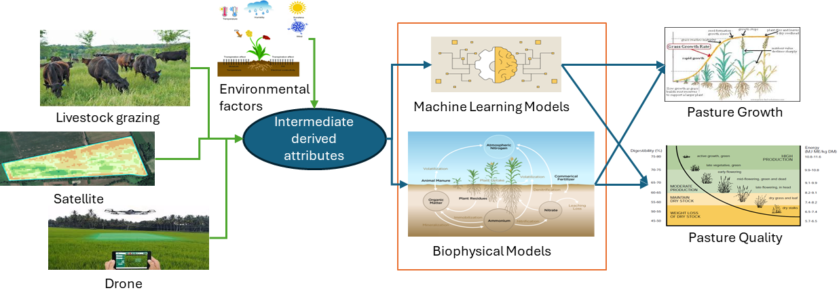
Agriculture Domain Problem Forecasting Pasture growth for optimised farm management and business decision-making
Pastures are important feed sources for livestock and require an optimal management strategy to boost the productivity and sustainability of grassland.
Accurate prediction of pasture availability is critical for effective farm management, livestock growth, and maintaining the supply chain.
Pasture yield depends on various factors such as climate, soil, water, and environment.
You will be given Pasture field data collected using Sentinel-2 satellite imagery over multiple years, paddock metadata and climate data.

Slide 2
Forecasting Pasture growth
Pastures are a primary food source for livestock in Australia, with various pasture species grown in rotations.
NRM1010 TSDM data:
Pasture field data were collected using Sentinel-2 satellite imagery over multiple years (2017 to 2023) across several farms subdivided into many paddocks in the NRM1010 region of Australia.
It provides Pasture yield as total standing dry matter (TSDM), the amount of pasture in a paddock at any given time, measured in kilograms of dry matter per hectare (kg DM/ha).
The data is pre-processed to record TSDM every 15 days. To treat the noise from remote sensing, the data were temporarily smoothed using the median of 30 days. The data has some missing values.
The Sentinel-2 data downloaded from Digital Earth Australia (DEA) for these farms has been pre-processed to remove the cloud coverage, tree coverage (non-pasture), and fence effects.
The other remote sensing data, such as Landsat and MODIS, can be utilised for these beta farms using open data sources such as Digital Earth Australia and Google Earth Engine.
Beta farms (five special farms) are available with paddock boundary information. This includes the geo-location (Long, Lat) of each paddock in these farms.

Slide 3
Forecasting Pasture growth
Paddock metadata:
Each pasture field may crop different pasture species such as clover rye, lucerne, native grasses, etc.
Farm owners used a farm management mobile app to input details such as the crop type (pasture species) and land size of the paddocks.
Pasture field data were collected using Sentinel-2 satellite imagery over multiple years (2017 to 2023) across several farms subdivided into many paddocks in the NRM1010 region of Australia.
SILO Climate data:
The climate data was obtained from SILO, which uses Bureau of Meteorology data and interpolation techniques to create spatial grids.
The climate data includes attributes such as rain (mm), temperature (℃), humidity (%), evaporation (mm), and radiation (MJ/m2) daily from 2017 to 2022.

