Slide 1



CFPB_Consumer_Financial_Complaints_Dashboard
View in Power BI
Last data refresh:
3/11/2026 12:44:02 PM UTC
Downloaded at:
3/11/2026 12:46:07 PM UTC

Slide 2
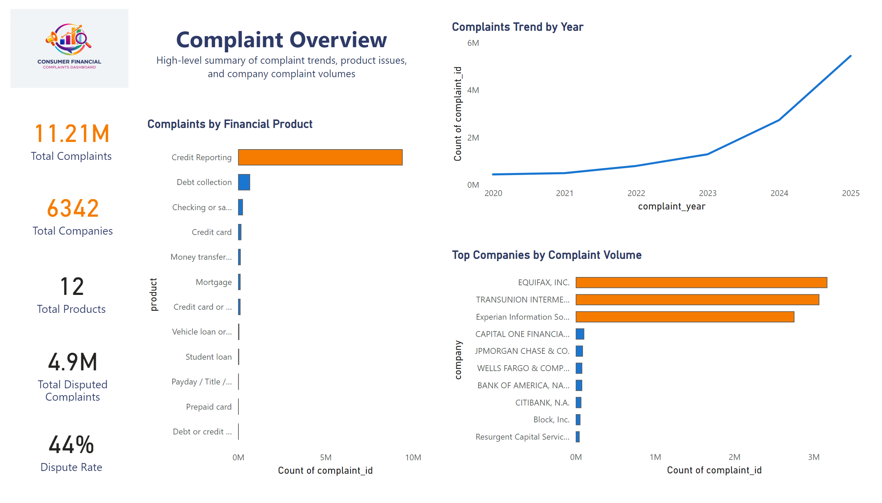
Complaint Overview
Notes:
image
No alt text provided
textbox
No alt text provided
PBI_CV_7B952816_A48F_49B4_9E13_15E3BB2C0337
No alt text provided
PBI_CV_7B952816_A48F_49B4_9E13_15E3BB2C0337
No alt text provided
PBI_CV_7B952816_A48F_49B4_9E13_15E3BB2C0337
No alt text provided
PBI_CV_7B952816_A48F_49B4_9E13_15E3BB2C0337
No alt text provided
Complaints by Financial Product
No alt text provided
Complaints Trend by Year
No alt text provided
Top Companies by Complaint Volume
No alt text provided
PBI_CV_7B952816_A48F_49B4_9E13_15E3BB2C0337
No alt text provided

Slide 3
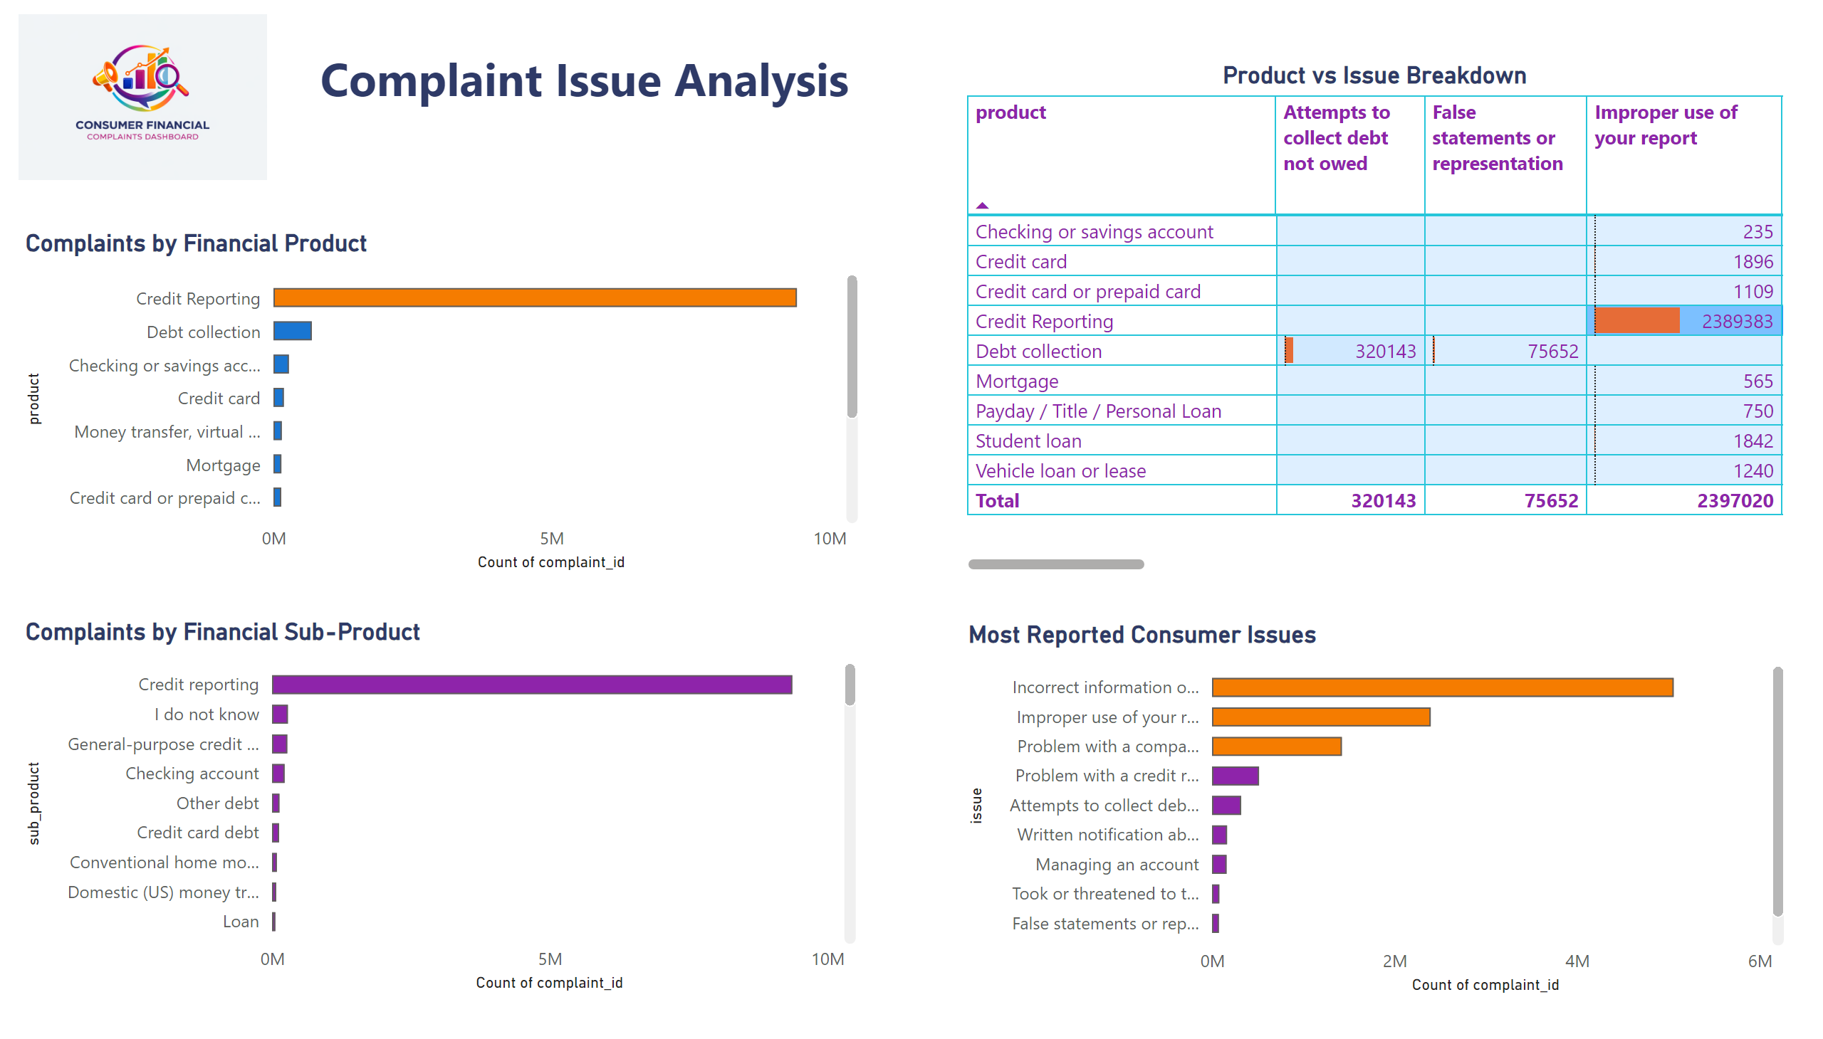
Complaint Issue Analysis
Notes:
image
No alt text provided
textbox
No alt text provided
Complaints by Financial Sub-Product
No alt text provided
Product vs Issue Breakdown
No alt text provided
Most Reported Consumer Issues
No alt text provided
Complaints by Financial Product
No alt text provided

Slide 4
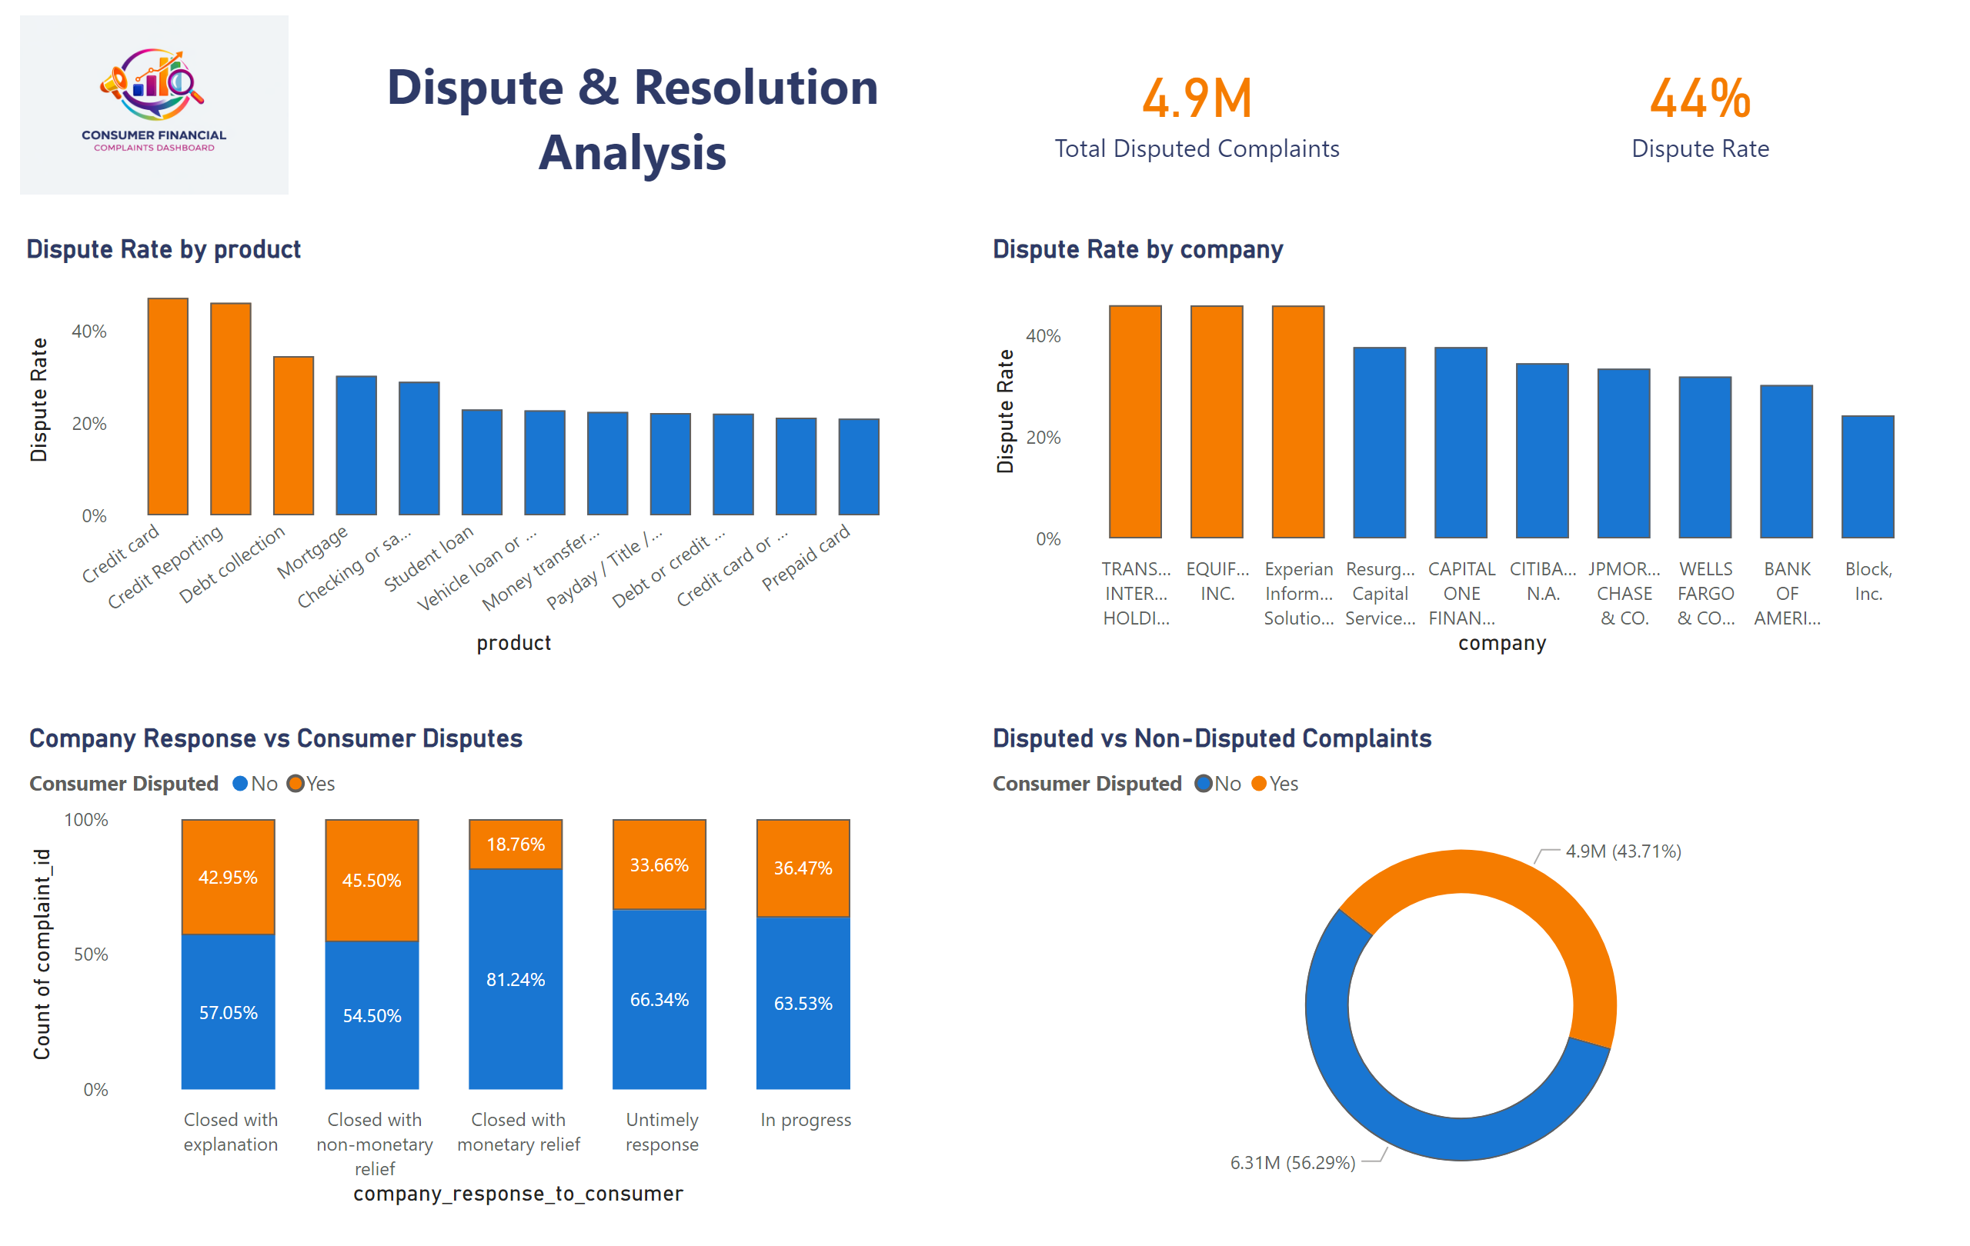
Dispute & Resolution Analysis
Notes:
image
No alt text provided
textbox
No alt text provided
PBI_CV_7B952816_A48F_49B4_9E13_15E3BB2C0337
No alt text provided
PBI_CV_7B952816_A48F_49B4_9E13_15E3BB2C0337
No alt text provided
columnChart
No alt text provided
Disputed vs Non-Disputed Complaints
No alt text provided
Company Response vs Consumer Disputes
No alt text provided
columnChart
No alt text provided

