Slide 1
Search And Recommendation System (SARS) Text Information System (CS410)
Contributors:
Varun Kakkar (vkakkar2@Illinois.edu)
Prem Prakash (premp3@Illinois.edu)

Slide 2
Overview
Goal
Data Acquisition & Analysis
Data Extraction
Topic Modelling
Sentiment Extraction
Indexing
Search
UI
Demo Search Queries

Slide 3
Goal
Build a Search and Recommendation system for user queries related to local businesses.

Slide 4
Data Acquisition & Analysis
Source: https://www.kaggle.com/yelp-dataset/yelp-dataset
Core attributes:
Name
Address
City
State
Categories
Ratings (stars)
ReviewText (reviews > 2)

Slide 5
Topic Modeling
Installation: SpaCy python library
pip install –U spacy
python –m spacy download en
Execution Steps:
Tokenization
Stopword removal
Character length filter
Apply Gensim LDA model
Concatenate topics
Output:
Index file with businessIds and Topics

Slide 6
Sentiment Analysis
Installation: VADER python library
pip install vaderSentiment
Execution Steps:
Apply vader analyser for each review
Aggregate sentiment score for each business
Aggregate rating for each business
Output:
Look up file with all business attributes (including vader sentiment score)
TechReview - https://github.com/VarunKakkarUIUC/SearchAndRecommendationSystem/blob/master/TechnologyReview.pdf

Slide 7
Indexing
Installation: metapy python libraries
pip install metapy pytoml
Execution Steps:
Define dataset, corpus and stopwords
Define analyzers
Make Inverted Index
Output:
Index files with listing and postings in MeTA format.

Slide 8
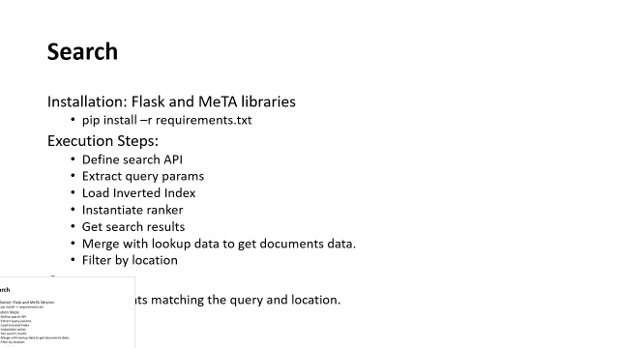
Search
Installation: Flask and MeTA libraries
pip install –r requirements.txt
Execution Steps:
Define search API
Extract query params
Load Inverted Index
Instantiate ranker
Get search results
Merge with lookup data to get documents data.
Filter by location
Output:
Documents matching the query and location.

Slide 9
UI
Installation: Node and React libraries
npm install .
npm start
Execution Steps:
Get user location
Get query from user
Make API call
Render results and recommendations
Output:
Search results and Recommendations in UI.
UI Url - https://sars.azurewebsites.net/index.html

Slide 10
Demo Search Queries
Indian Restaurants
Italian Restaurants
Romantic Restaurants

Slide 11
Potential Improvements
Lemmatization needs to be incorporated.
Current index does not contain address as one of the attributes.
UI should display the individual reviews from the users.
Need to train and tune BM25 using user queries.

Slide 12
THANK YOU !!
Contributors:
Varun Kakkar (vkakkar2@Illinois.edu)
Prem Prakash (premp3@Illinois.edu)

