Slide 1


Slide 2

Simulating FIFA 2018 World Cup Using Monte Carlo
Presented By-
Hiral Rayani
Varun Kasbekar

Slide 3
Introduction
Feedback
Project Scope
Implementation
Random variables & Distribution
Results
AGENDA

Slide 4
Introduction
FIFA-Federation Internationale De Football Association World Cup is held every 4 years.
Different countries host this tournament with the last one seeing Germany beat Argentina in Brazil in 2014.
FIFA World Cup 2018 will be hosted by Russia, will kickoff on June 14th.

Slide 5



Betting on FIFA World Cup
INVESTMENTS
PROFITS
FIFA PROFITS
$ 1.82 Billion
$ 36.4 Billion
$ 2.6 Billion
Our Simulation Model will benefit the Betting population in making accurate and precise Betting decisions.

Slide 6
FIFA World Cup Guidelines
32 nations compete against each other.
The format of this tournament is LEAGUE + KNOCK-OUT
8 Groups contain 4 Teams each
Top 2 teams from every group qualify for the KNOCK-OUT
The prize money for the World Cup Champions is 400 Billion.

Slide 7
































COSTA RICA
AUSTRALIA
ARGENTINA
BELGIUM
COLUMBIA
EGYPT
CROATIA
BRAZIL
ENGLAND
DENMARK
ICELAND
IRAN
GERMANY
POLAND
PERU
SENEGAL
TEAMS QUALIFIED FOR FIFA WORLD CUP 2018
FRANCE
PORTUGAL
PANAMA
NIGERIA
MOROCCO
SOUTH KOREA
SWITZERLAND
URUGUAY
JAPAN
SAUDI ARABIA
TUNISIA
SWEDEN
RUSSIA
SPAIN
SERBIA
ITALY

Slide 8
Random variables & Distribution
Match Draws
Randomly assign the teams to 8 different groups
Toss
Randomize toss before every match to give an advantage to the winner
Attacking Power
Randomly assign a value to the teams based on their FIFA rankings
Defending Power
Goals Scored
Randomly assign a value to the teams based on their FIFA rankings
Using poissons distribution to randomly generate goals scored by both the teams ( Match Score)

Slide 9
GROUP A
GROUP B
GROUP C
GROUP D
GROUP E
GROUP F
GROUP G
GROUP H

Slide 10
Attacking Power & Defending Power Attributes of Teams
TEAMS

Slide 11
Model Equations
avgscoredbyteam1 = AverageAttack(Team1)/ AverageDefense(Team2) * TossFactor
avgscoredbyteam2 = AverageAttack(Team2)/ AverageDefense(Team1) * TossFactor
goal_scored_team1 = np.random.poisson(avgScoredByTeam1)
goal_scored_team2 = np.random.poisson(avgScoredByTeam2)

Slide 13
Improvising Model Accuracy
avgscored = Sum(Attack)/len(Teams)
avgconceeded = Sum(Defense)/len(Teams)
winrate = worldcup_wins / matches_played
avgAttack=Attack/ avgscored
+ winrate
avgDefense=Attack/ avgscored
+ winrate
Notes:
avgAttack=Attack/ avgscored + winrate

Slide 14
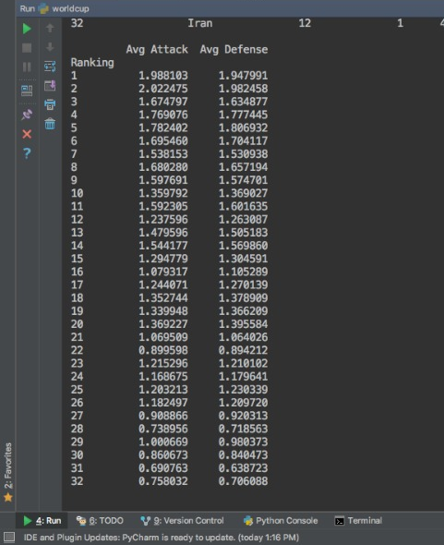
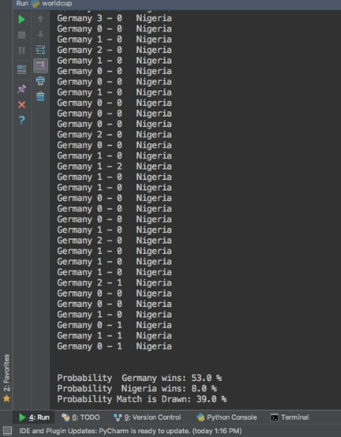
Result Snapshots
Average Attack & Defense
Probability after 1000 Simulations

Slide 15
References
http://www.scielo.br/scielo.php?script=sci_arttext&pid=S0101-74382015000300577#B7
https://medium.com/@adamfreymiller/a-monte-carlo-simulation-of-the-2017-18-premier-league-season-3b7bbe8b8a13
https://www.sciencedirect.com/topics/biochemistry-genetics-and-molecular-biology/poisson-distribution
Github link : https://github.com/hiralrayani/Final_Project.git

Slide 16
THANK YOU
Questions/ Feedback are welcomed.

