Slide 1
Multiple Disease Prediction System

Slide 2
Abstract
Machine learning has various applications and one of them is healthcare.
There should be much more advanced medical facilities so as to provide the best possible treatment for the patients.
Multi Disease Prediction” system based on predictive modeling predicts the disease of the user on the basis of the symptoms that user provides as an input to the system.
In this Paper proposed to analyse Diabetes analysis, Diabetes Retinopathy analysis, Heart disease.
Later other diseases like skin diseases, fever analysis and many more diseases can be included.

Slide 3
INTRODUCTION
The Cardiovascular system is sometimes called the blood-vascular, or simply the circulatory, system.
The vital role of the cardiovascular system in maintaining homeostasis depends on the continuous and controlled movement of blood through the thousands of miles of capillaries that permeate every tissue and reach every cell in the body.
Diabetes is considered as a chronic disease associated with an abnormal state of the human body where the level of blood glucose is inconsistent due to some pancreas dysfunction

Slide 4
Problems Identified
It's a major challenge in the medical or healthcare industries to offer the highest quality services to all patients, and only those who can afford it can benefit from it.
There is a vast amount of healthcare data available that is not being mined in a more efficient and reliable manner to uncover secret knowledge for successful decision-making There are instruments available which can predict heart disease but either it is expensive or are not efficient to calculate chance of heart disease in human.
Early detection of cardiac diseases can decrease the mortality rate and overall complications

Slide 5
Objective
In multiple diseases prediction system a user can analyse more than one disease on a single website.
The user doesn’t need to traverse different places in order to predict whether he/she has a particular disease or not.
In multiple diseases prediction system, the user needs to select the name of the particular disease, enter its parameters and just click on submit.

Slide 6
Literature Survey
No | Title, Author & Year | Objective | Algorithms/Techniques | Dataset | Findings | Doi
1 | Usefulness of Functional MRI Textures in the Evaluation of Renal Function, Israa Alnazer,2021 | This work aims to evaluate the role of textures extracted from functional magnetic resonance imaging in renal dysfunction detection by differentiating healthy and chronic kidney disease patients. | Principal component analysis projection is applied to eliminate irrelevant features and compact the dataset. | CKD MRI Dataset | chronic kidney disease affects texture parameters significantly. | https://ieeexplore.ieee.org/document/9604879
2. | Kidney Segmentation in Renal Magnetic Resonance Imaging - Current Status and Prospects, Frank G. Zöllner,2021. | The aim of the present article is to discuss the recent existing literature on renal image segmentation techniques and show today's limitations of the proposed techniques that might hinder clinical translation. | ROI - regions of interest | In the US, the National Institute of Diabetes and Digestive and Kidney Diseases (NIDDK) has compiled a large database of T1w and T2w MRI images | Improper segmentation. | https://ieeexplore.ieee.org/document/9427136

Slide 7
Literature Survey
No | Title, Author & Year | Objective | Algorithms/Techniques | Dataset | Findings | Doi
3 | Cascaded Regression Neural Nets for Kidney Localization and Segmentation-free Volume Estimation, Mohammad Arafat Hussain,2021 | This paper proposes an integrated deep learning approach for (i) kidney localization in computed tomography scans and (ii) segmentation-free renal volume estimation. | sagittal-axial Mask-RCNN | 100 patients' CT scans from the Vancouver General Hospital records and obtained 210 patients' CT scans from the 2019 Kidney Tumor Segmentation Challenge | proposed kidney localization approach would further contribute to improve the outcomes | https://ieeexplore.ieee.org/document/9358223
4 | Correlation-Guided Network for Fine-Grained Classification of Glomerular lesions in Kidney Histopathology Images, Fengyi Li,2021. | In this paper, the author propose a novel architecture for fine-grained classification of glomerular lesions in renal pathology images sampling from patients with IgA nephropathy. | parallel convolutional neural network | A total of 17551 instances were cropped by pathologists, while 16513 of them were used for training and validation, and 1038 for testing. | Need to a lighter architecture to deal with the finegrained classification in bio-medical image analysis. | https://ieeexplore.ieee.org/document/9176234

Slide 8
Existing System
Naive Bayes
The Naïve Bayes Classifier technique is mainly applicable when the dimensionality of the inputs is high.
Despite its simplicity, Naive Bayes can often outperform more sophisticated classification methods.
Active Contour Model (ACM) filter
Active contour models (ACMs) have been widely applied to image segmentation since their introduction.

Slide 9
Disadvantages
One algorithm may work well on a specific dataset while it cannot show a good performance on some others.
So, selecting a suitable algorithm for a specific dataset is a big challenge in bioinformatics.
Consequently, selecting good feature selection or classification algorithms is also a big challenge in this field.
The classification performance is slightly worst.

Slide 10
Proposed System
In multi disease model prediction, it is possible to predict more than one disease at a time.
It will reduce time and also due to predicting multiple diseases at a time there is a chance of reducing mortality rate.
The proposed framework employs data mining techniques to detect Chronic diseases early.
Training and Testing are the two stages of the machine learningalgorithm.
Deep Convolutional Neural Network (CNN) is a class of DL and commonly used in analyzing visual imagery and designed to require minimal preprocessing.
Deep CNN based feature learning for Multu disease and their severity.

Slide 11
Advantages
This is a novel method that builds on current research to derive quick and precise diagnostics.
The method significantly outperforms other published research in this area due to its superior accuracy.
intention is to accurately classify the presence of diseases.
It may result in early detection that leads to a decrease in mortality rate.

Slide 12
Block List
1. Multi Disease UI Diagnosis Model
2. Training Phase – Multi Disease Classification
2.1. Data set Acquisition
2.2. preprocessing
2.3. Segmentation
2.4. Feature Extraction
2.5. CNN Classification
3. Testing Phase –Multi Disease Prediction
3.1. Multi Disease MRI Image
3.2. Pre-processing
3.3. Segmentation
3.4. Feature Extraction
3.5. Prediction
4. Performance Metrics

Slide 13
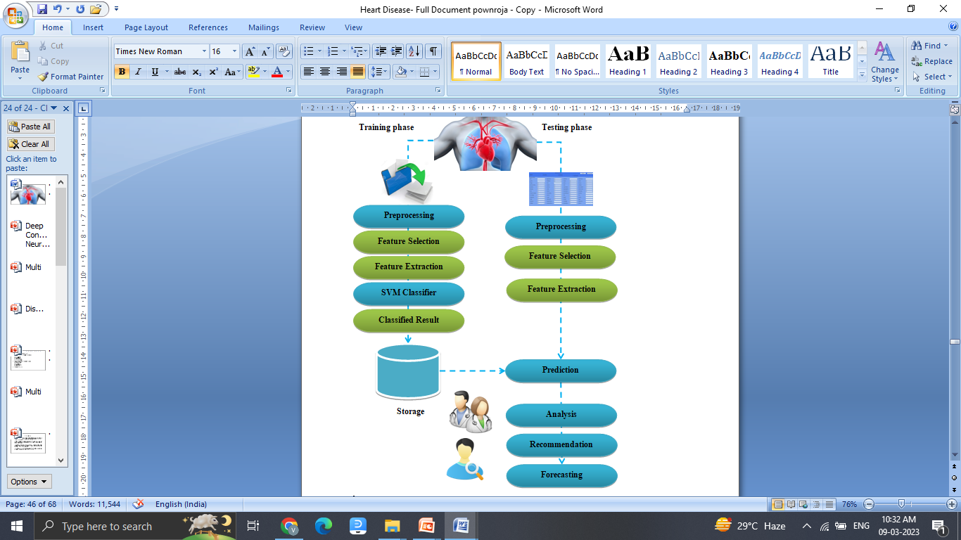
System Architecture

Slide 14
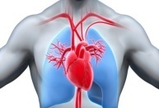
Model Flow – Training Phase
MRI Dataset
Preprocessing
Load
Resize
Noise Filter
Segmentation
Grey Trans.
Binarization
FG Extraction
DCNN
BG Subtraction
Disease Detect
Feature Extraction
Localize
Size
Brach
Shape
Texture
Classification
Disease Class
Labels
Classified File

Slide 15
Model Flow – Testing Phase
MRI Image
Preprocessing
Load
Resize
Noise Filter
Segmentation
Grey Trans.
Binarization
FG Extraction
BG Subtraction
Disease Detect
Feature Extraction
Localize
Size
Branch
Shape
Texture
Load Classified File
Extracted Disease Threshold
Prediction
Match
Disease
Non- Disease
Class
Grade
Localization

Slide 16
Software Specification
Server Side : Python 3.7.4(64-bit) or (32-bit)
Client Side : HTML, CSS, Bootstrap
IDE : Flask 1.1.1
Back end : MySQL 5.
Server : Wampserver 2i
DL DLL : TensorFlow, Pandas, SiKit Learn

Slide 17
References
N. M. Selby et al., ‘‘Magnetic resonance imaging biomarkers for chronic kidney disease: A position paper from the European cooperation in science and technology action PARENCHIMA,’’ Nephrol. Dial. Transplantation, vol. 33, no. 2, pp. 4–14, Sep. 2018.
N. Wake, J. S. Wysock, M. A. Bjurlin, H. Chandarana, and W. C. Huang, ‘‘‘Pin the tumor on the kidney’: An evaluation of how surgeons translate CT and MRI data to 3D models,’’ Urology, vol. 131, pp. 255–261, Sep. 2019.
F. G. Zöllner, A. Šerifović-Trbali, G. Kabelitz, M. Kociäski, A. Materka, and P. Rogelj, ‘‘Image registration in dynamic renal MRI—Current status and prospects,’’ Magn. Reson. Mater. Phys., Biol. Med., vol. 33, no. 1, pp. 33–48, Feb. 2020.
A. E. Kavur et al., ‘‘CHAOS challenge-combined (CT-MR) healthy abdominal organ segmentation,’’ Med. Image Anal., vol. 69, Apr. 2021, Art. no. 101950

