Slide 1



Paavai Engineering College (Autonomous)
Department Of Computer Science And Engineering
An Approach to forecasting multiple maladies utilizing machine learning algorithms
Domain : Machine Learning
Guide: Mrs P. Renukadevi
Team Members:
Varun Krishnan V- 19104117
Nandhakumar M - 19104069
Suriyasankar P - 19104108

Slide 2
Abstract
Machine learning has various applications and one of them is healthcare.
There should be much more advanced medical facilities so as to provide the best possible treatment for the patients.
Multi Disease Prediction” system based on predictive modeling predicts the disease of the user on the basis of the symptoms that user provides as an input to the system.
In this Paper proposed to analyse Diabetes analysis and Heart disease.
Later other diseases like skin diseases, fever analysis and many more diseases can be included.

Slide 3
INTRODUCTION
The Cardiovascular system is sometimes called the blood-vascular, or simply the circulatory, system.
The vital role of the cardiovascular system in maintaining homeostasis depends on the continuous and controlled movement of blood through the thousands of miles of capillaries that permeate every tissue and reach every cell in the body.
Diabetes is considered as a chronic disease associated with an abnormal state of the human body where the level of blood glucose is inconsistent due to some pancreas dysfunction

Slide 4
Problems Identified in other system
Have to traverse between two different sites to forecast multiple disease.
The usage of Naïve Bayes algorithm in other system were slow
Doesn’t have the functionality where admin can able to train their own ML model
The accuracy of the project is low.

Slide 5
Objective
In multiple diseases prediction system a user can analyse more than one disease on a single website.
The user doesn’t need to traverse different places in order to predict whether he/she has a particular disease or not.
In multiple diseases prediction system, the user needs to select the name of the particular disease, enter its parameters and just click on submit.

Slide 6
Existing System
Naive Bayes
The Naïve Bayes Classifier technique is mainly applicable when the dimensionality of the inputs is high.
Despite its simplicity, Naive Bayes can often out perform more sophisticated classification methods.

Slide 7
Disadvantages
One algorithm may work well on a specific dataset while it cannot show a good performance on some others.
So, selecting a suitable algorithm for a specific dataset is a big challenge in bioinformatics.
Consequently, selecting good feature selection or classification algorithms is also a big challenge in this field.
The classification performance is slightly worst.

Slide 8
Proposed System
In multi disease model prediction, it is possible to predict more than one disease at a time.
It will reduce time and also due to predicting multiple diseases at a time there is a chance of reducing mortality rate.
The proposed framework employs data mining techniques to detect Chronic diseases early.
Training and Testing are the two stages of the machine learning algorithm.

Slide 9
Advantages
This is a novel method that builds on current research to derive quick and precise diagnostics.
The method significantly outperforms other published research in this area due to its superior accuracy.
intention is to accurately classify the presence of diseases.
It may result in early detection that leads to a decrease in mortality rate.

Slide 10
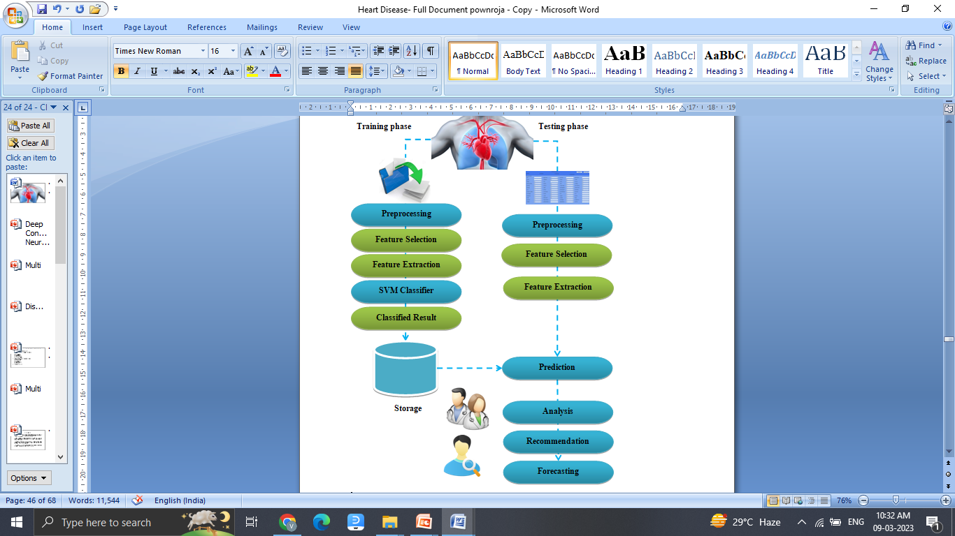
System Architecture

Slide 11
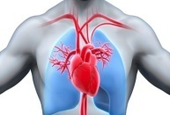
Model Flow – Training Phase
MRI Dataset
Preprocessing
Load
Resize
Noise Filter
Segmentation
Grey Trans.
Binarization
FG Extraction
DCNN
BG Subtraction
Disease Detect
Feature Extraction
Localize
Size
Brach
Shape
Texture
Classification
Disease Class
Labels
Classified File

Slide 12
Model Flow – Testing Phase
MRI Image
Preprocessing
Load
Resize
Noise Filter
Segmentation
Grey Trans.
Binarization
FG Extraction
BG Subtraction
Disease Detect
Feature Extraction
Localize
Size
Branch
Shape
Texture
Load Classified File
Extracted Disease Threshold
Prediction
Match
Disease
Non- Disease
Class
Grade
Localization

Slide 13
Software Specification
Server Side : Python 3.7.4(64-bit) or (32-bit)
Client Side : HTML, CSS, Bootstrap
IDE : Flask 1.1.1
Back end : MySQL 5.
Server : Wampserver 2i
DL DLL : TensorFlow, Pandas, SiKit Learn

Slide 14
References
[1] R. Manne, S.C. Kantheti, Application of artificial intelligence in healthcare: chances and challenges, Curr. J. Appl. Sci. Technol. 40 (6) (2021) 78–89, https:// doi.org/10.9734/cjast/2021/v40i631320.
[2] M. Sivakami, P. Prabhu. Classification of algorithms supported factual knowledge recovery from cardiac data set, Int. J. Curr. Res. Rev. 13(6) 161- 166. ISSN: 2231-2196 (Print) ISSN: 0975-5241 (Online).

Slide 15
References
[1] R. Manne, S.C. Kantheti, Application of artificial intelligence in healthcare: chances and challenges, Curr. J. Appl. Sci. Technol. 40 (6) (2021) 78–89, https:// doi.org/10.9734/cjast/2021/v40i631320.
[2] M. Sivakami, P. Prabhu. Classification of algorithms supported factual knowledge recovery from cardiac data set, Int. J. Curr. Res. Rev. 13(6) 161- 166. ISSN: 2231-2196 (Print) ISSN: 0975-5241 (Online).

