Slide 1


Paavai Engineering College (Autonomous)
Department Of Computer Science And Engineering
An Approach to forecasting multiple diseases utilizing machine learning algorithms
Team Members:
Varun Krishnan V- 19104117
Nandhakumar M - 19104069
Suriyasankar P - 19104108
Guide: Mrs P. Renukadevi

Slide 2
Abstract
Machine learning has various applications and one of them is healthcare.
There should be much more advanced medical facilities so as to provide the best possible treatment for the patients.
“Multi Disease Prediction” system based on predictive modeling predicts the disease of the user on the basis of the symptoms that user provides as an input to the system.
In this Paper proposed to analyse Diabetes analysis and Heart disease.
Later other diseases like skin diseases, fever analysis and many more diseases can be included.

Slide 3
Problems Identified in other system
Have to traverse between two different sites to forecast multiple disease.
The usage of Naïve Bayes algorithm in other system were slow
Doesn’t have the functionality where admin can able to train their own ML model
The accuracy of the project is low.

Slide 4
Objective
In multiple diseases prediction system a user can analyse more than one disease on a single website.
The user doesn’t need to traverse different places in order to predict whether he/she has a particular disease or not.
In multiple diseases prediction system, the user needs to select the name of the particular disease, enter its parameters and just click on submit.

Slide 5
Proposed System
In multi disease model prediction, it is possible to predict more than one disease at a time.
It will reduce time and also due to predicting multiple diseases at a time there is a chance of reducing mortality rate.
We have used
SVM for heart disease prediction
DTB for Diabetes

Slide 6
Advantages
This is a novel method that builds on current research to derive quick and precise diagnostics.
The method significantly outperforms other published research in this area due to its superior accuracy.
intention is to accurately classify the presence of diseases.
It may result in early detection that leads to a decrease in mortality rate.

Slide 7
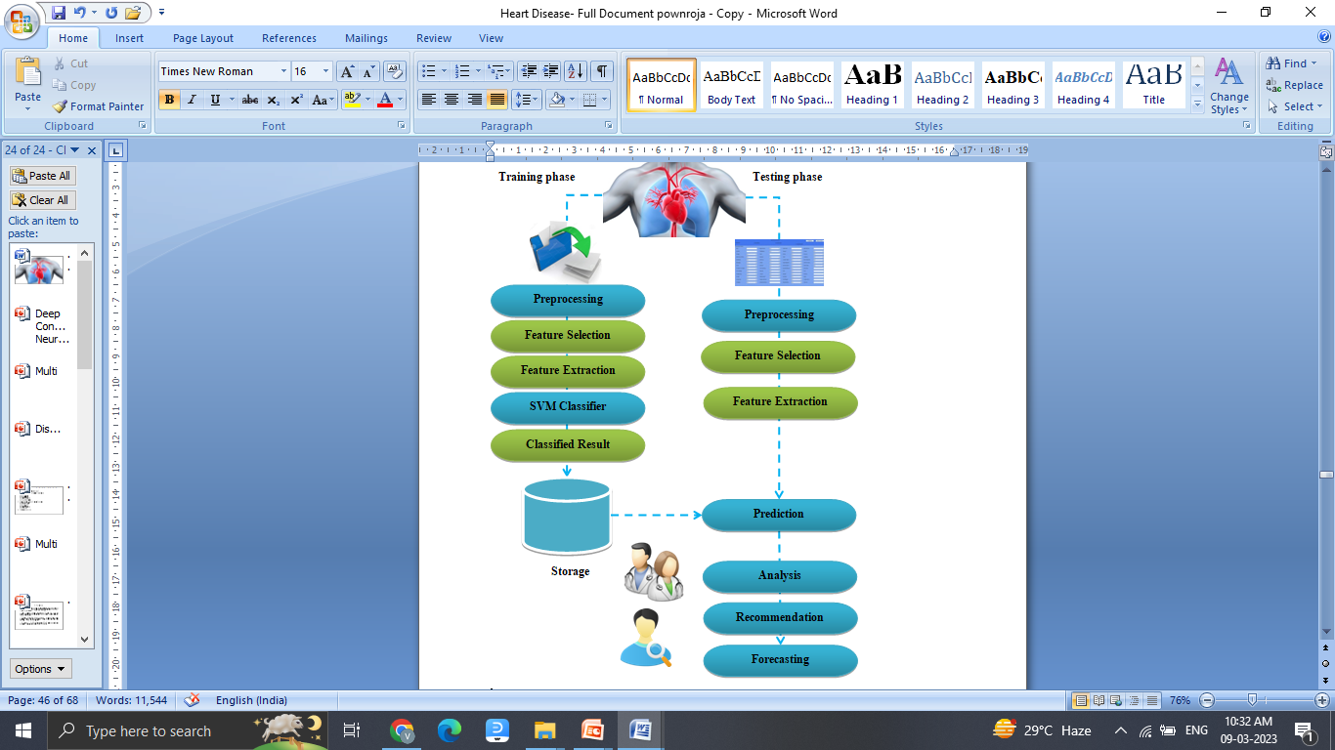
System Architecture

Slide 8
Software Specification
Server Side : Python 3.7.4(64-bit) or (32-bit)
Client Side : HTML, CSS, Bootstrap
IDE : Flask 1.1.1
Back end : MySQL 5.
Server : Wampserver 2i
Libraries : Pandas, SciKit Learn

Slide 9

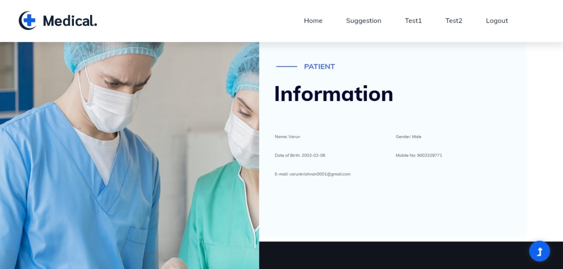

Slide 10
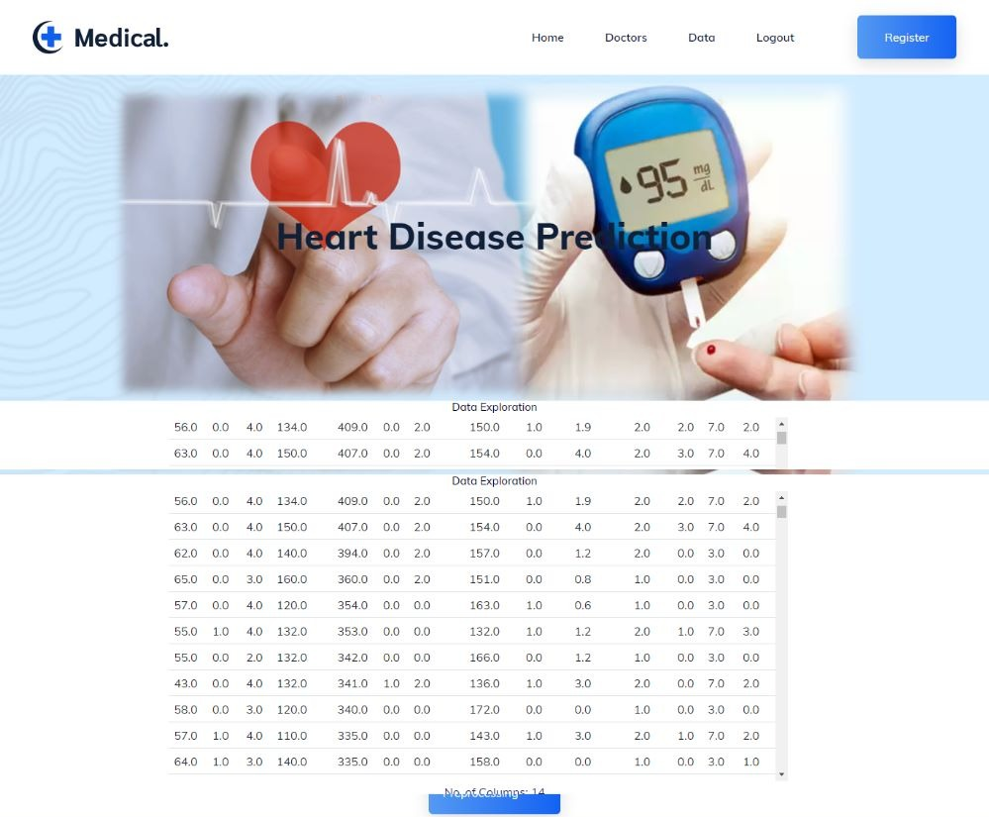

Slide 11
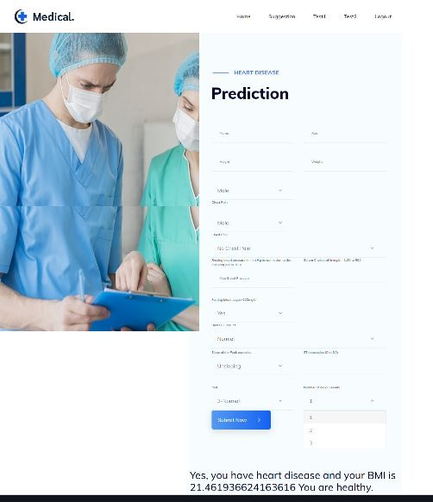



Slide 12
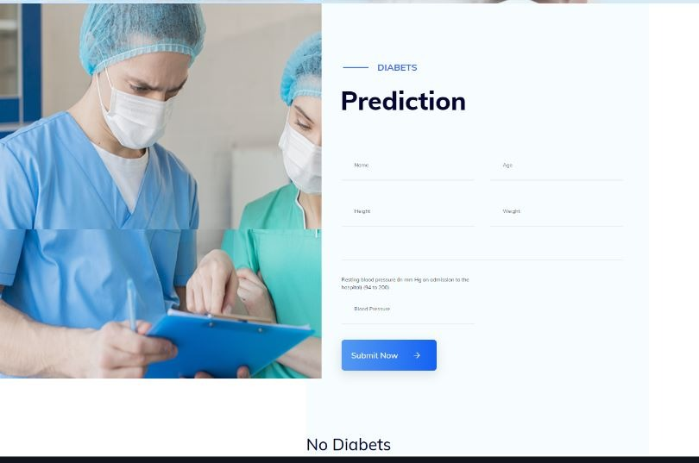



Slide 13
THANK YOU

