Slide 1
CIS634- FINAL PROJECT SECURE CHAT ANDROID APP
DONE BY:-GROUP 11
Abdul Rehman 2836088
Varun Nagalla 2828837
Sravan Kumar 2837055
Tejam Reddy 2835430

Slide 2
CONTENTS:
Introduction- SecureChat
Features of the Application
Features to be Tested
Functionality Testing
Test Cases and Pass/Fail criteria.
Conclusion
References
Questions

Slide 3
Introduction:
Secure chat app Android chat app, which is a chat application used for personal and office purposes. A friend or office colleague can share any kind of private data through this application. It will help to chat with friends and office colleagues. Mainly, it will help people who want to hide their conversation.
This app allows users to chat securely and create groups for chatting to keep privacy in the group.
Privacy is the top priority of this application.
It was developed in JAVA and XML environment.
This app uses real-time database (firebase) developed by the Google.
Recourses used:
Cell Phone supported Android version is 5.1, Jellybean and above version or Laptop with OS Microsoft Windows 7/8/10 (64-bit) with Android studio.
4GB RAM minimum, 8GB RAM recommended

Slide 4
Feature of the Application:
Dashboard
Profile
Chat
Invite
New Chat
Encrypt/Decrypt Messages
Prevent Screenshots
Create Group
Settings

Slide 5
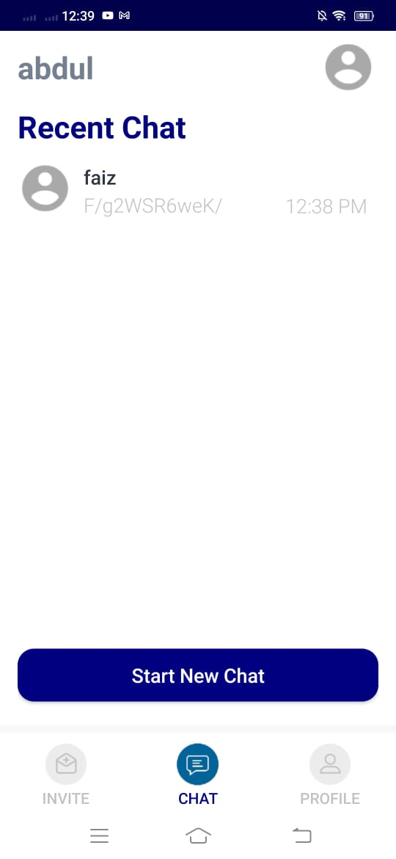
Dashboard
The Dashboard activity provides the list of previous chats available in the database.
User has multiple options:
Start new chat
Create new group
Chat with available contacts
Invite new friends
Profile management

Slide 6
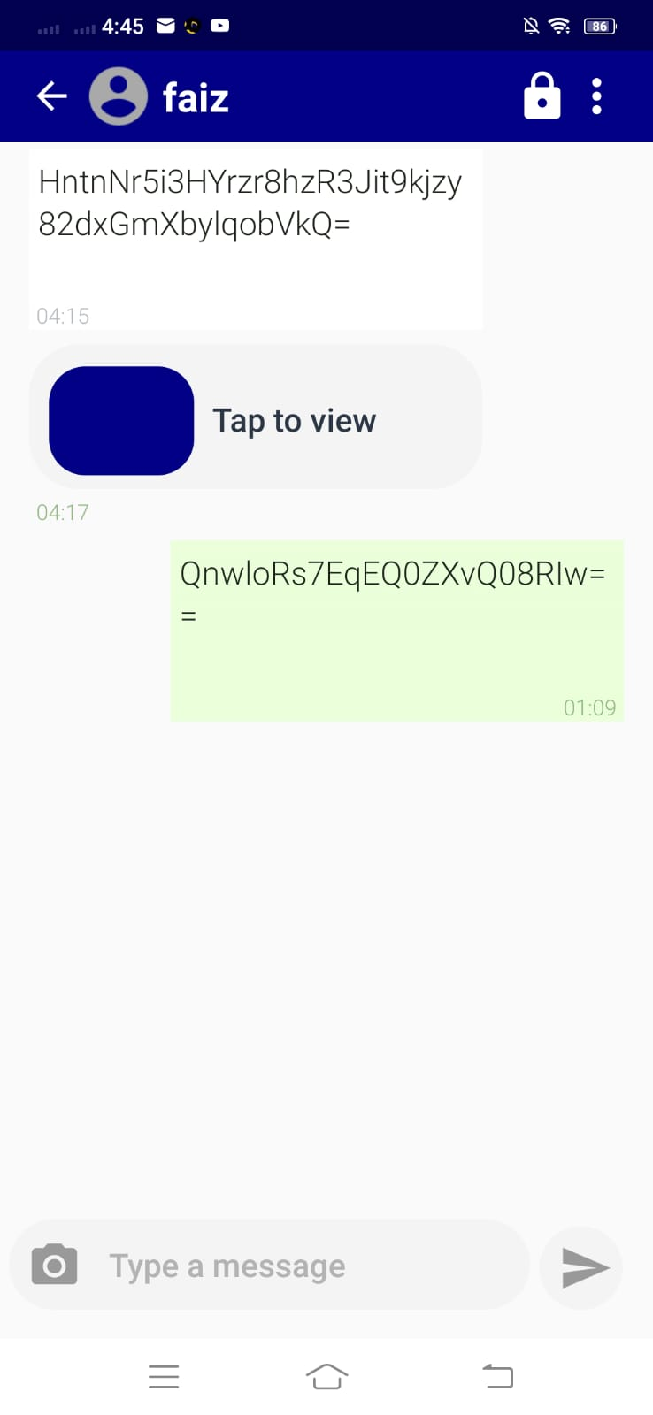
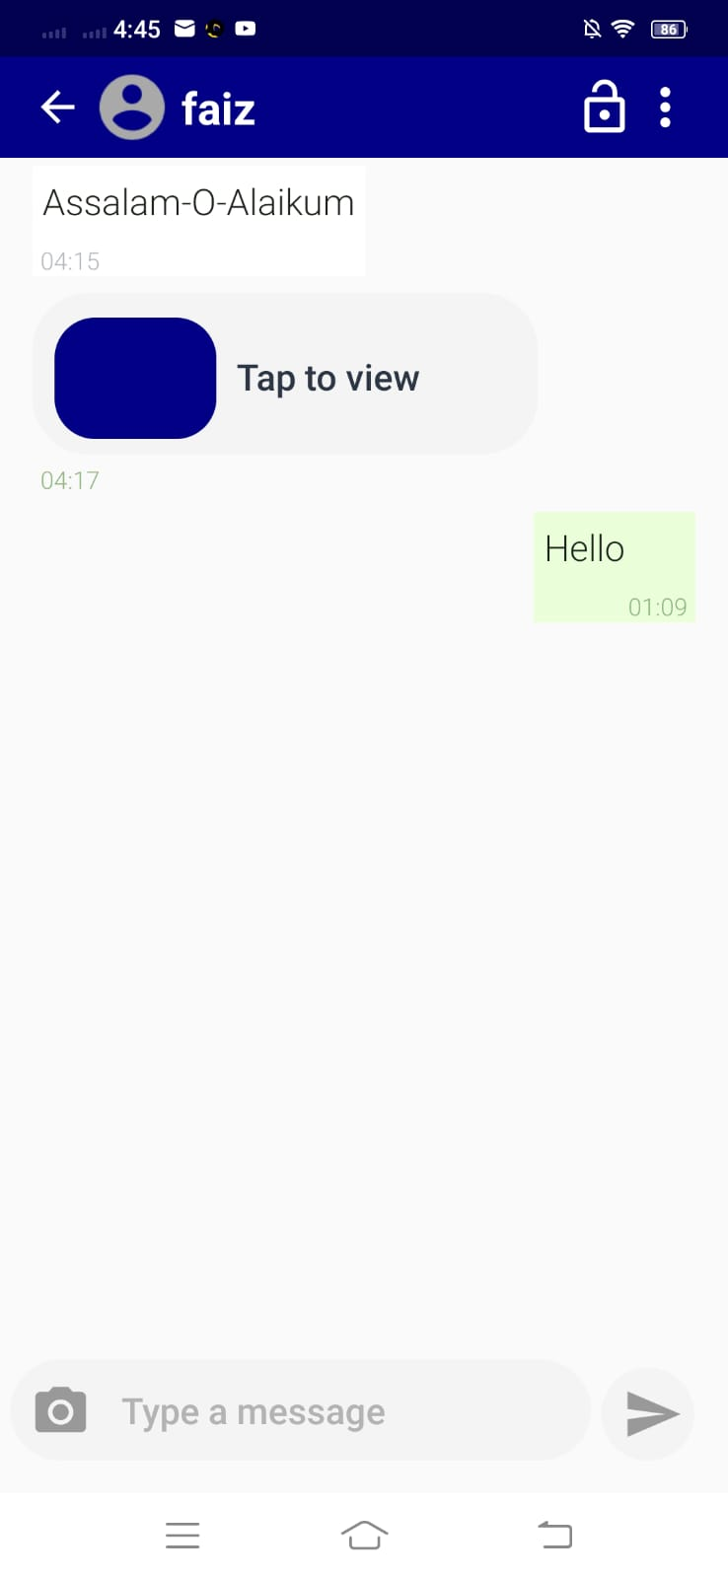
Chat
In this App, we can create profile for ‘n’ number of users.
Reliable, secure and with real-time support.
User can encrypt message with a key to decrypt that message.
Receivers can read encrypted message only when they have decryption key.

Slide 7
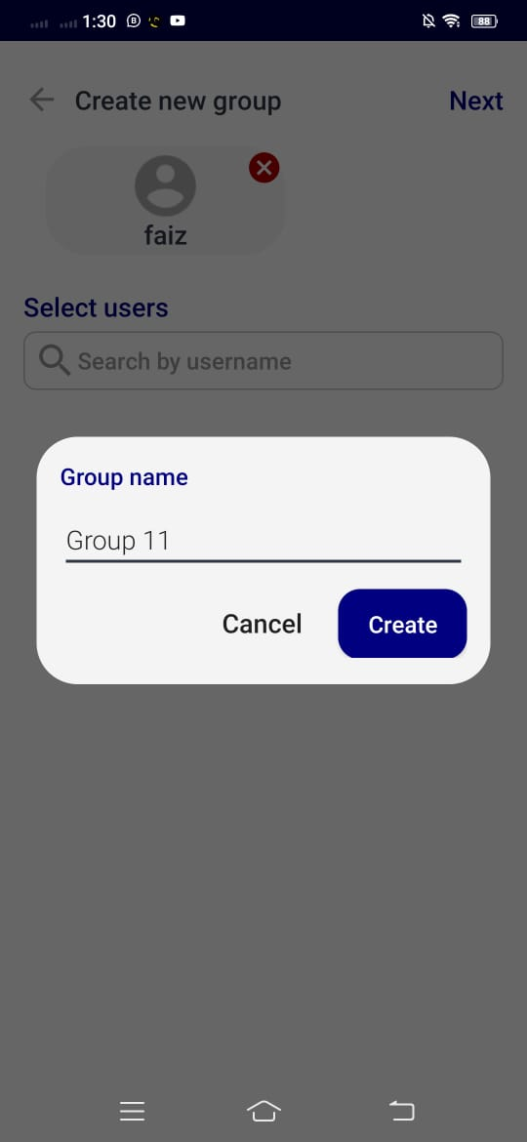
Create Group
In this App, we can create group and add registered users.
Reliable, secure and with real-time support.
User can encrypt message with a key to decrypt that message.
Receivers can read encrypted message only when they have decryption key.

Slide 8
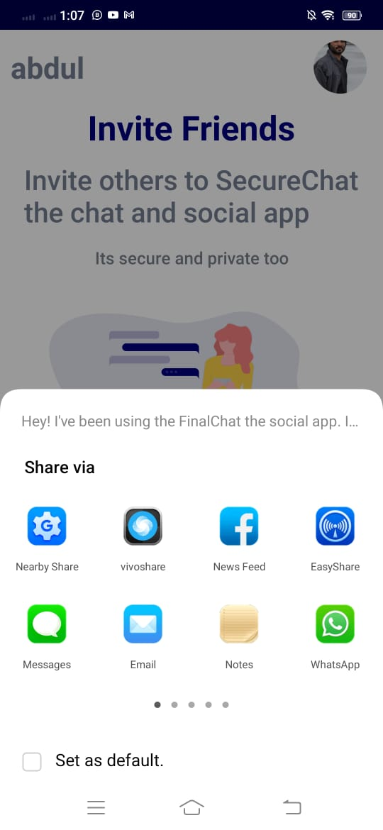
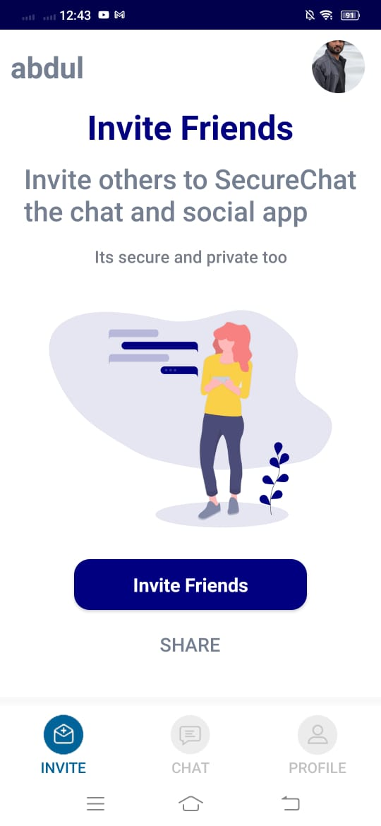
Invite
User can invite new users by sharing application by sharing a link using multiple options
.apk file is also shareable on demand.
Users can search for registered user if they are not available in the database. They can send an invitation to join this application.

Slide 9
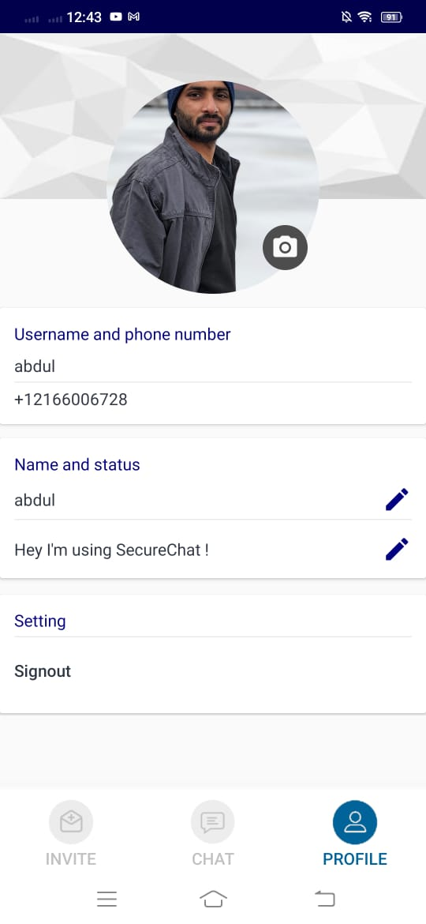
Profile
User can manage his profile
User can update name and status to show.
This app is based on phone number so it is easy to signup or login with any account.

Slide 10
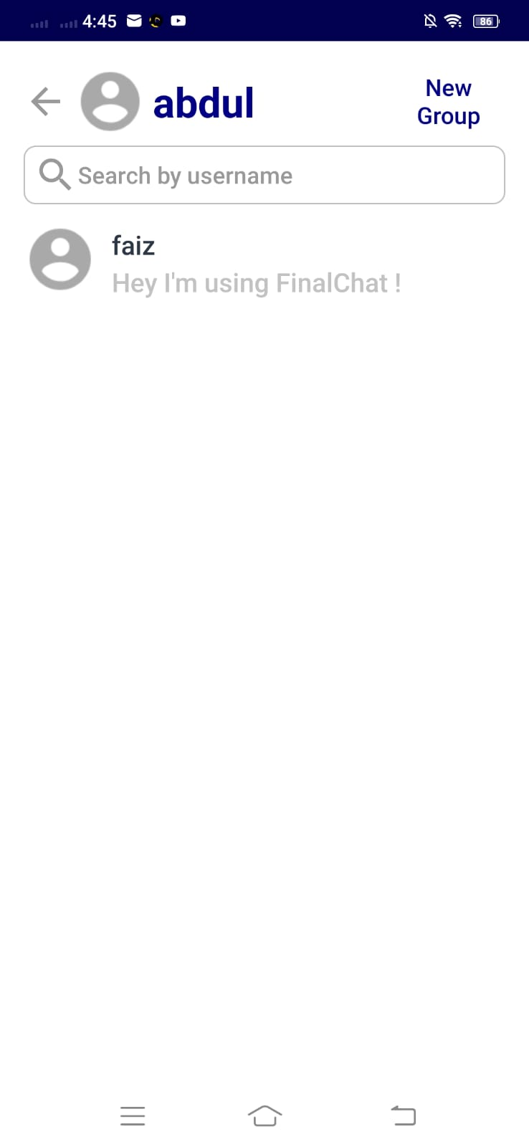
New Chat
On starting new chat, a new activity will start running.
User can send message to his friend/colleague.
User can encrypt message as per need.
Receiver can receive the message but the encrypted message cannot be readable until user enter decryption key.

Slide 11
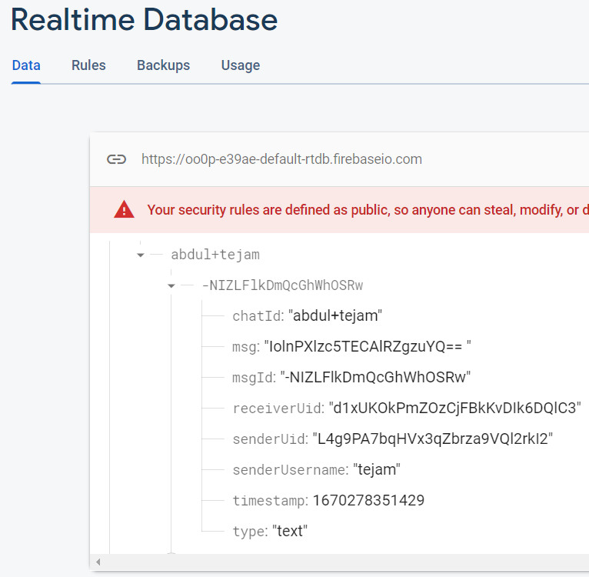
Server Side View
In this app we are using firebase real-time database.
This app also encryption on the server side and saves user data.
Encrypted message on server side

Slide 12
FUNCTIONALITY TESTING
Every possible feature in the application is tested and all the functions are working as expected without any defects.
Functions like Dashboard, Profile, Chat, Invite, New Chat, and Settings are working fine and passed the function test.

Slide 13
TEST RESULTS
Profile
Test Date: 11/20/2022
Test Results: Passed
Tester: Sravan kumar
Additional Comments: User was able to manage his profile.
Chat
Test Date: 11/23/2022
Test Results: Passed
Tester: Varun Nagalla
Additional Comments: User was able to send and encrypt messages.

Slide 14
Invite
Test Date: 11/26/2022
Test Results: Passed
Tester: Sravan Kumar
Additional Comments: User was able to invite his contacts to this application.
New chat
Test Date: 11/28/2022
Test Results: Passed
Tester: Abdul Rehman
Additional Comments: User was able to start new chat.

Slide 15
Create group
Test Date: 11/30/2022
Test Results: Passed
Tester: Tejam Reddy
Additional Comments: User was able to create group and chat with group.
Setting
Test Date: 12/02/2022
Test Results: Pass
Tester: Abdul Rehman
Additional Comments: User was able to set his details in the settings.

Slide 16
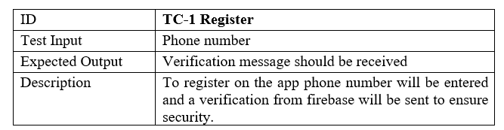
Test Case:
Test Case-1 Register

Slide 17
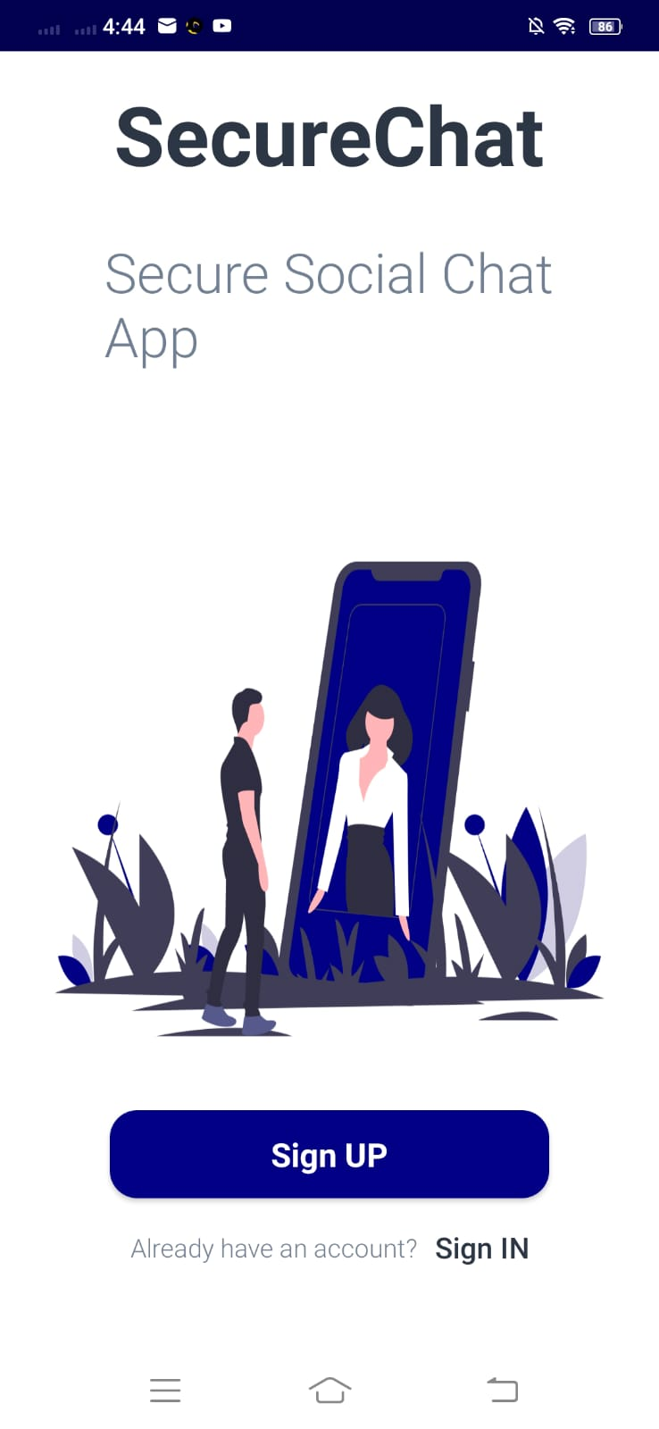
Click and start register your self

Slide 18
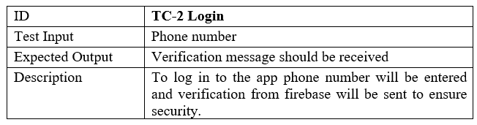
Test Case-2 Login

Slide 19
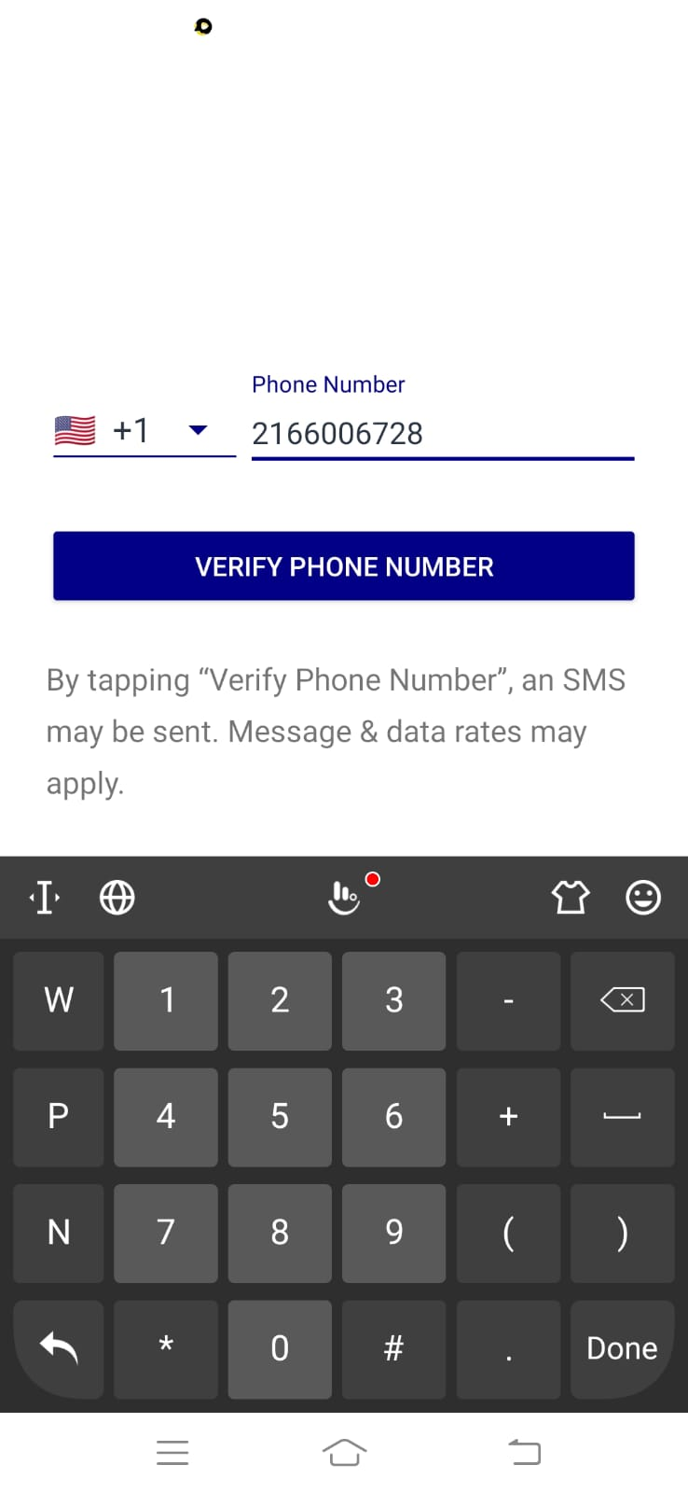
Select Country Code
Entered phone number
Verify Number

Slide 20
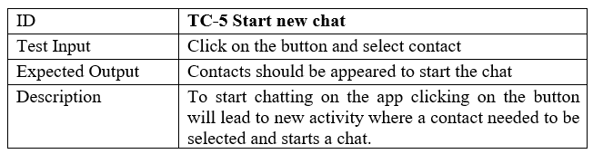
Test Case-3 New Chat

Slide 21
Create New Group
Search Registered User
Select Registered User

Slide 22
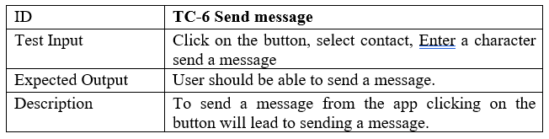
Test Case 4: Send Message

Slide 23
Choose Photo
Type Message
Send Message

Slide 24
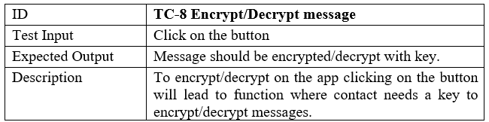
Test Case-5 Encryption and Description

Slide 25
Encrypt Button
Decrypt Button
Decrypted Message
Encrypted Message

Slide 26

Future Work
We found this project very useful and a need for these types of apps is required. We are planning to extend its functions like audio/video calls, status, or story sharing, sharing posts and also integrating payment method. We have the plan to make it a social platform in the future.

Slide 27
Conclusion
In this project, we have developed, designed, and test the complete working of the application and every possible working feature in it.
It is found that the secure window feature which usually when turned off is able to take a screenshot. But it is not.
In order to summarize, the SecureChat android app is one application that completely focuses on the privacy of people who want to hide their conversation.

Slide 28
References
https://en.wikipedia.org/wiki/Android_(operating_system)
https://github.com/citiususc/calendula
https://stackoverflow.com/questions/47457105/class-has-been-compiled-by-a-more-recent-version-of-the-java-environment
https://freeicons.io/search/icons?q=chat&iuc=3424759699

Slide 29
THANK YOU!

