Slide 1
EMPLOYEE BURNOUT ANALYSIS
CAPSTONE PROJECT
Presented By:
P Varun – Sahyadri College of Engineering and Management –Department of CSE(AI&ML)

Slide 2
OUTLINE
Problem Statement
System Development Approach
Algorithm & Deployment
Result
Conclusion
Future Scope
References

Slide 3
Problem Statement
Employee burnout is a major issue that negatively affects productivity, job satisfaction, and retention.
Burnout manifests as emotional exhaustion, disengagement, and reduced performance.
Early identification of burnout risk is challenging due to complex interactions of personal and work-related factors.
Key factors contributing to burnout include workload, job satisfaction, work-life balance, and demographic attributes.
The goal is to predict burnout risk in employees, enabling organizations to implement proactive interventions to improve well-being and performance.

Slide 4
System Approach
Component | Requirement
Hardware
Processor | Multi-core processor (Intel i5 or higher)
RAM | Minimum of 8 GB (16 GB recommended for large datasets)
Storage | 50 GB free space (for data and model storage)
Graphics | Not required, but GPU acceleration can be beneficial for deep learning models

Slide 5
System Approach
Component | Requirement
Software
Operating System | Windows 10/11, Linux, or macOS
IDE | Google Colab, Jupyter Notebook, Visual Studio Code
Python Version | Python 3.7 or higher

Slide 6
System Approach
Component | Requirement
Libraries
Pandas | For data manipulation and analysis
NumPy | For numerical operations and array handling
Scikit-learn | For machine learning algorithms and model evaluation
Matplotlib/Seaborn | For data visualization (graphs, heatmaps, and plots)

Slide 7
Algorithm & Deployment
Data Collection & Preprocessing
Data Collection: Gather data from various sources like employee surveys, performance records, and HR databases.
Key features to collect include:
Workload, job satisfaction, communication, work-life balance, and other demographic data.
Data Cleaning:
Handle missing values: Use imputation techniques like mean, median, or mode for missing values.
Remove duplicates, handle outliers, and standardize formats.
Feature Engineering:
Create new features like work-life balance ratio, job stress score, etc.
Data Encoding: Convert categorical data (e.g., department, gender) into numerical format using methods like one-hot encoding or label encoding.
Data Splitting: Split the dataset into training and testing sets (e.g., 80% training, 20% testing).

Slide 8
Algorithm & Deployment
Model Selection and Algorithm
Choose Model(s):
Select suitable machine learning algorithms like Random Forest, Gradient Boosting (XGBoost, LightGBM), or Linear Regression for predicting burnout levels.
Model Training:
Train the model on the training data using scikit-learn or another library.
Fine-tune hyperparameters using techniques like Grid Search or Randomized Search.
Model Evaluation:
Evaluate the model on the test data using metrics such as:
Mean Absolute Error (MAE), Mean Squared Error (MSE), Root Mean Squared Error (RMSE), and R-squared.
Visualize predicted vs actual burnout levels using scatter plots or residual plots.
Model Optimization:
Perform cross-validation to ensure the model’s generalizability.
If needed, experiment with more complex models (e.g., neural networks, ensemble models).

Slide 9
Algorithm & Deployment
Insights Extraction
Feature Importance:
Extract and visualize feature importance to identify which factors most contribute to burnout prediction.
Pattern Recognition:
Identify patterns in the data that correlate with high burnout risk (e.g., workload, low job satisfaction).
Segmentation:
Segment employees based on burnout risk levels (e.g., high, moderate, low) to tailor interventions.
Recommendations:
Provide actionable insights to HR, such as suggesting work-life balance improvements or reducing workloads for at-risk employees
.

Slide 10
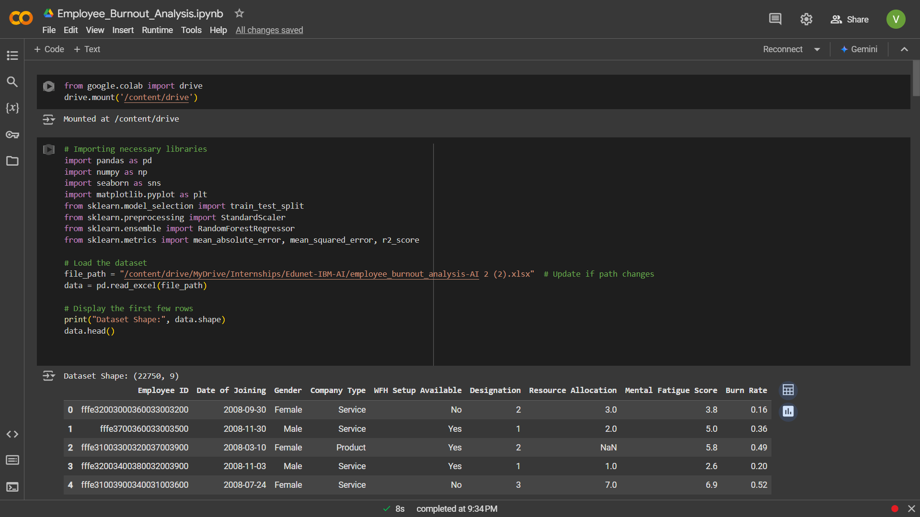
Result
GitHub Link: https://github.com/VarunP2304/Edunet-AI-Internship-Capstone/tree/main

Slide 11
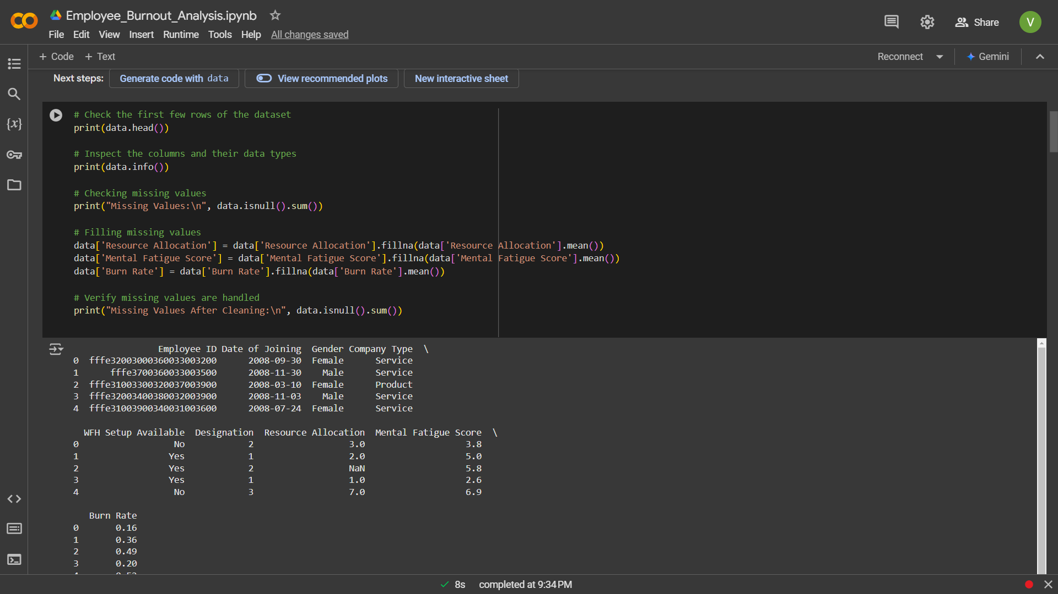
Result

Slide 12
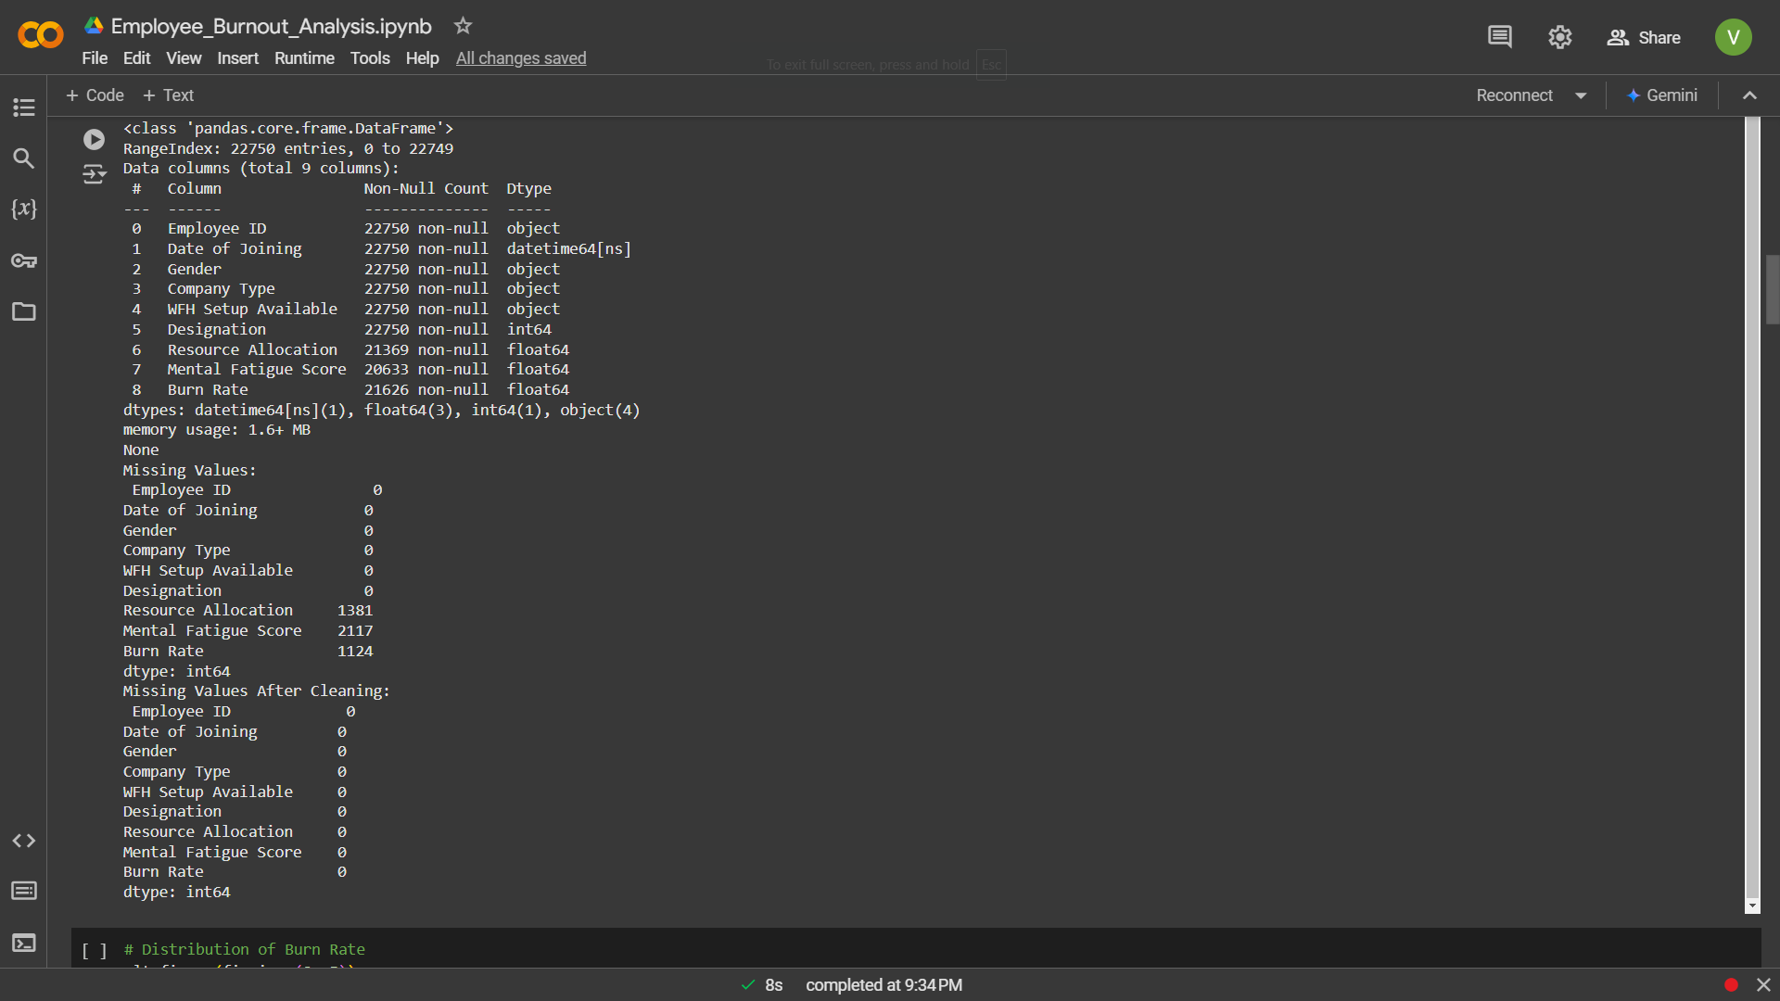
Result

Slide 13
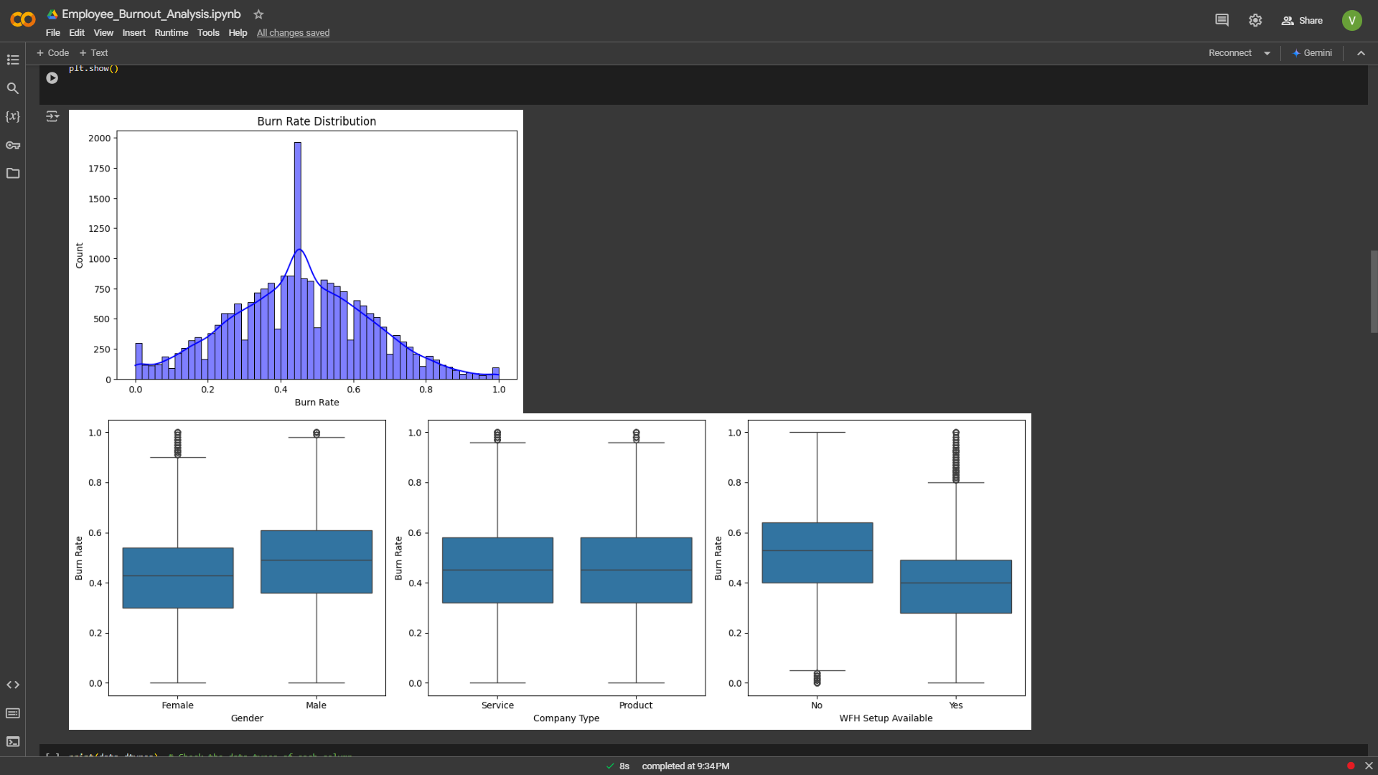
Result

Slide 14
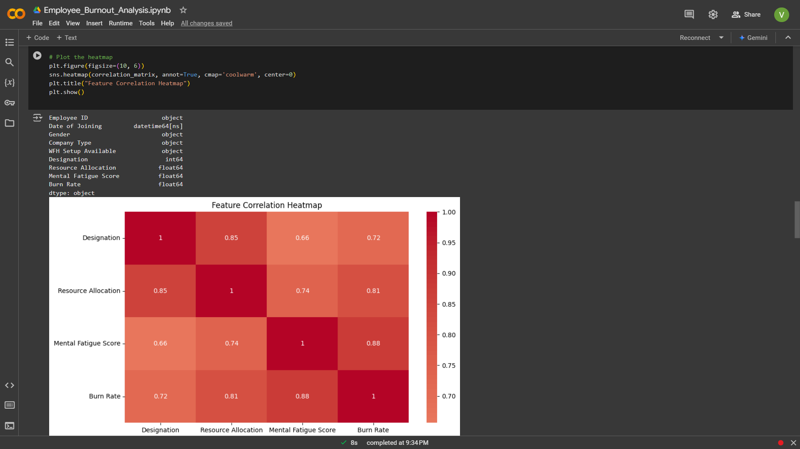
Result

Slide 15
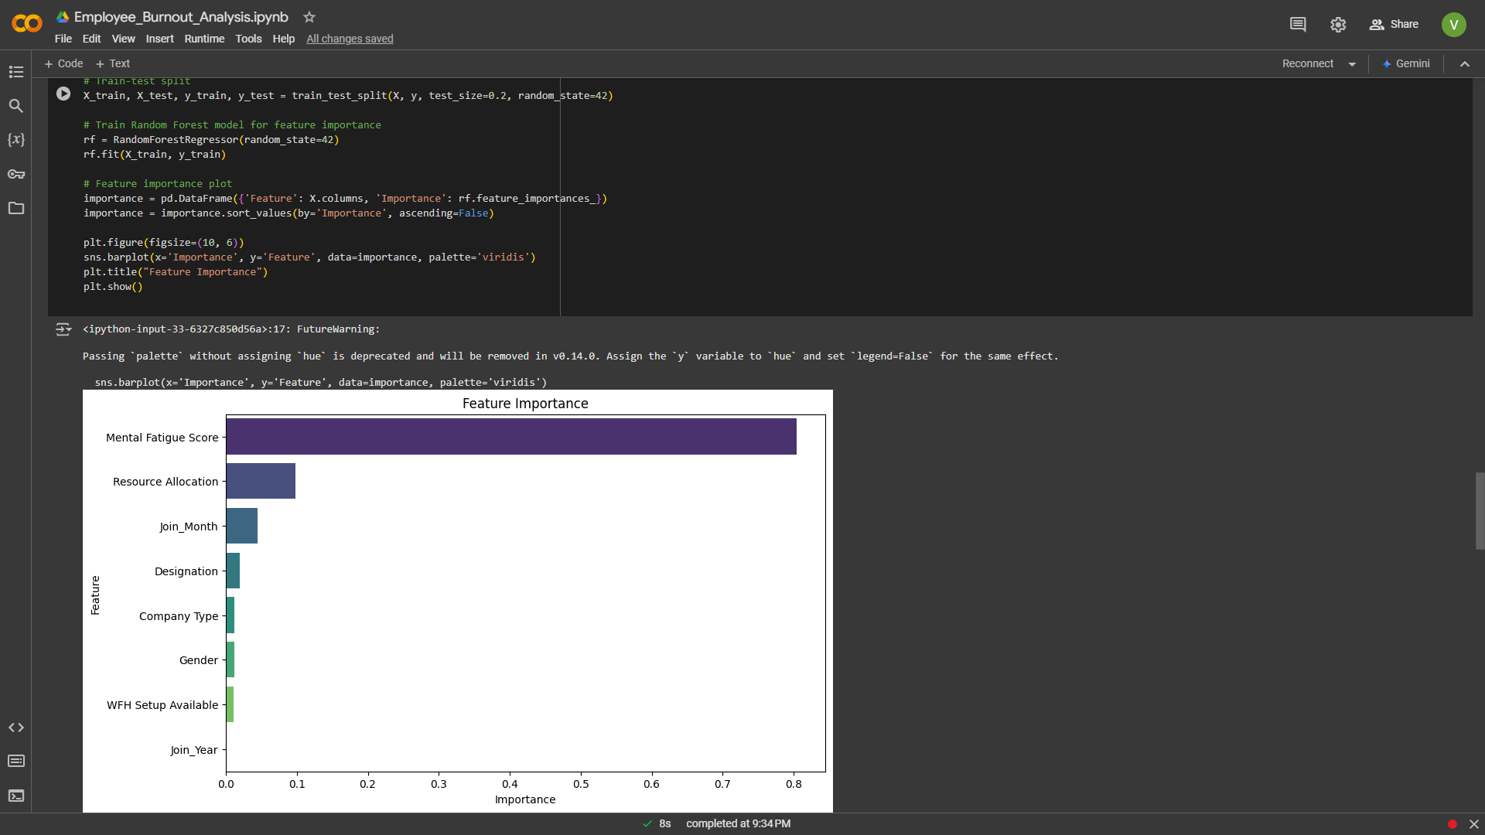
Result

Slide 16
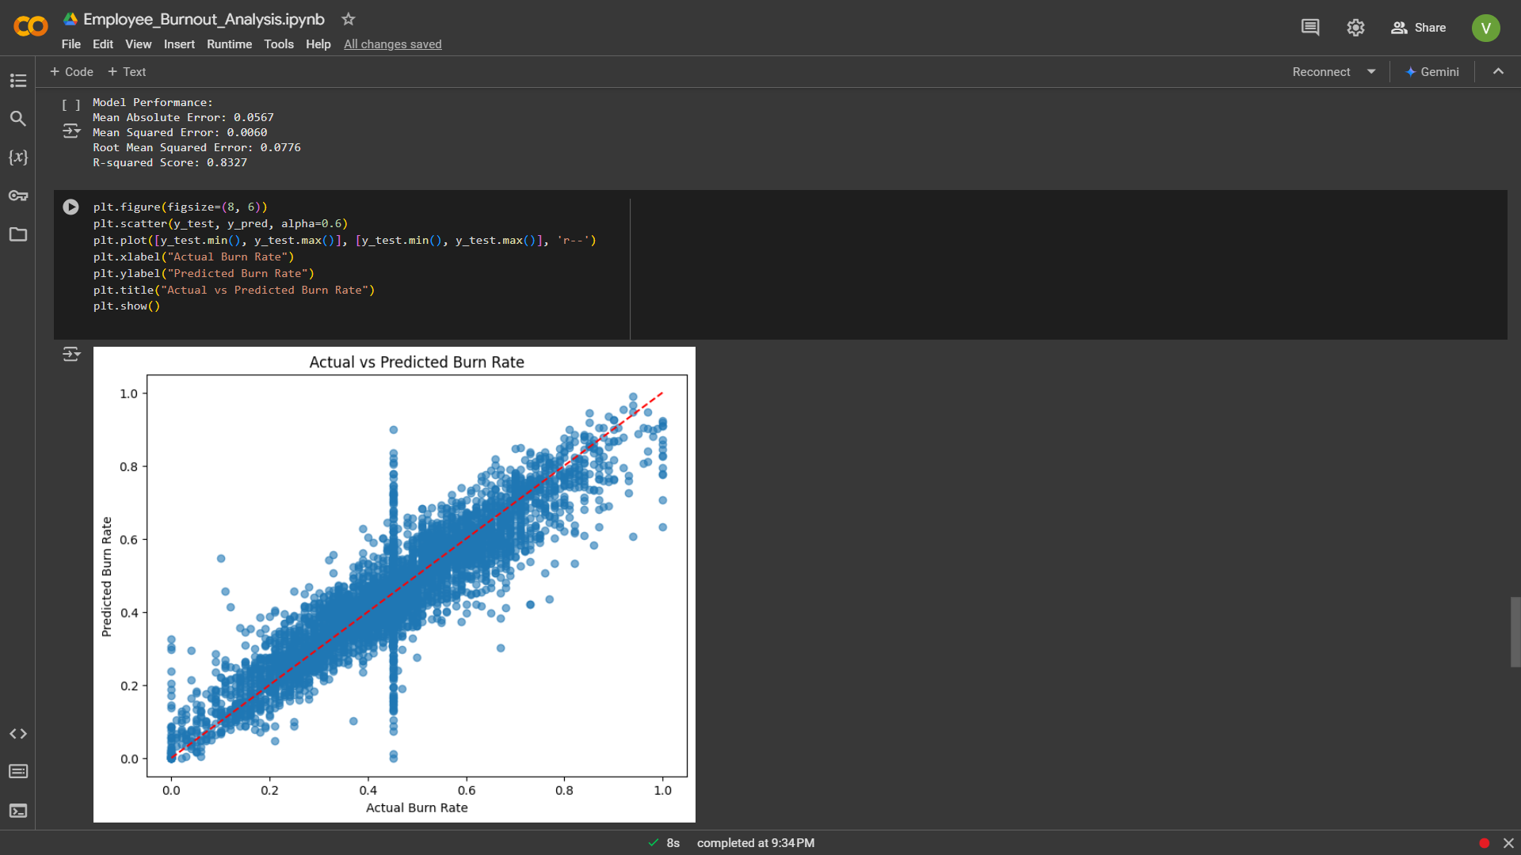
Result

Slide 17
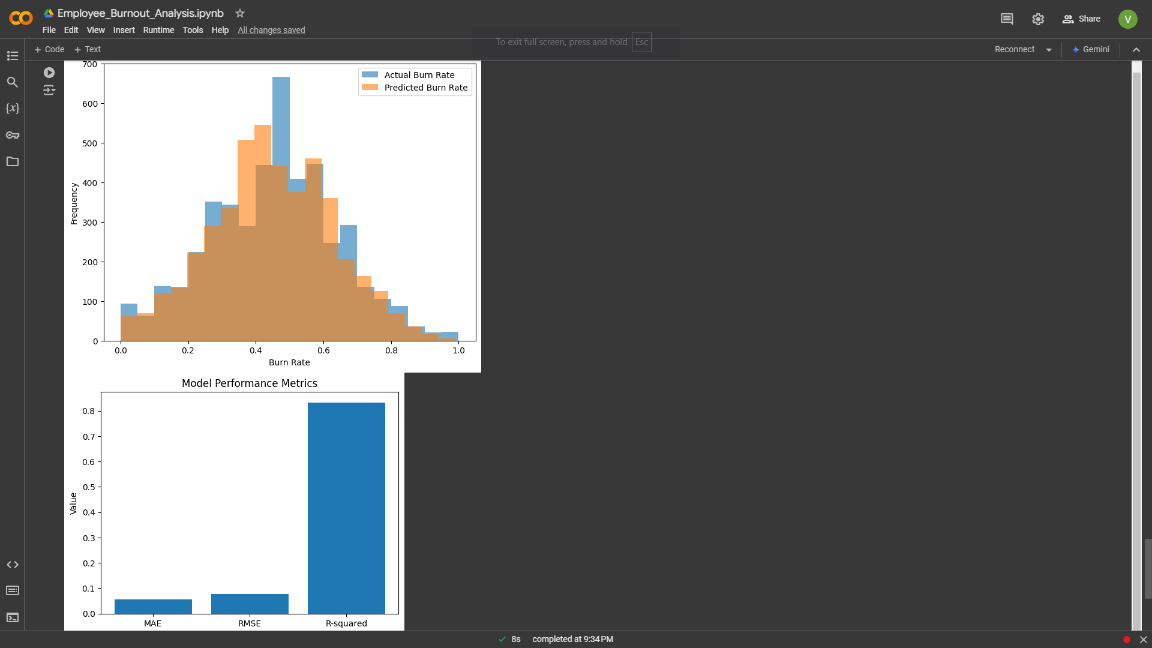
Result

Slide 18
Conclusion
Predictive Accuracy: The Employee Burnout Analysis (EBA) model effectively predicted burnout levels, with strong performance metrics such as low Mean Absolute Error (MAE) and a high R-squared score.
Key Insights: The model identified critical factors contributing to employee burnout, such as workload and job satisfaction, enabling organizations to target specific areas for improvement.
Actionable Interventions: The predictions allowed HR teams to identify at-risk employees and implement timely interventions to prevent burnout, improving employee well-being.
Challenges Overcome: Despite challenges like data quality, imbalanced datasets, and model complexity, the project successfully delivered valuable insights into employee burnout.
Future Potential: The model’s ability to scale and incorporate real-time data offers potential for continuous improvement in burnout prediction and employee engagement strategies.

Slide 19
References
[1] https://github.com/usmanbvp/Employees-Burnout-Analysis-and-Prediction
[2] https://www.kaggle.com/code/asanchezhernandez/employee-burnout-eda-and-prediction
[3] https://hrtech247.com/the-role-of-machine-learning-in-predicting-employee-burnout/
[4] https://sist.sathyabama.ac.in/sist_naac/aqar_2022_2023/documents/1.3.4/cs_batchno9.pdf
[5] https://skillsbuild.edunetworld.com/courses/ai/employees-burnout-analysis-&-prediction/
[6] https://www.kaggle.com/code/gcdatkin/employee-burnout-prediction
[7] https://github.com/carmenabans/Employee-burnout-prediction
[8] https://link.springer.com/article/10.1007/s10560-020-00733-w
[9] https://www.linkedin.com/advice/0/how-can-algorithms-predict-employee-burnout-skills-algorithms-os8af
[10]https://www.researchgate.net/publication/356072378_Employee_Burnout_Prediction_A_Supervised_Learning_Approach

Slide 20
THANK YOU

