Slide 1

Cloud-based Antiquetion using blockchain
NAME OF THE SUPERVISOR |  | PROJECT MEMBERS
INTERNAL GUIDE:
Dr. S Kanimozhi, ME, PH.D. Associate Professor,
Dept. of Computer Science & Engineering
HEAD OF THE DEPARTMENT:
Dr. S. PAVITHRA, M.E., Ph.D.,
Assistant Professor,
Dept. of Computer Science & Engineering
DEPARTMENT OF COMPUTER SCIENCE
& ENGINEERING
1. Varun Raj V R- 210419104177
2. Sakthi Kumar S – 210419104166
CHENNAI INSTITUTE OF TECHNOLOGY, CHENNAI-600069

Slide 2
Agenda
Title
Abstract
Introduction
Literature Survey
Proposed System
Analysis
References

Slide 3
1. ABSTRACT
Selling art and collectibles, have always remained a huge challenge nevertheless the internet and e-commerce.
Also, the artists take a huge toll when they are ripped off and duplicate copies are sold.
We have developed a web application that can solve this very problem by means of auctioning the art. the customers are made happy because better quality assurance standards are met.

Slide 4
2. OBJECTIVE
To develop an application that can solve the problem of middle-men and eliminate unambiguous broker commission in the process of selling artworks and antique works using blockchain technology.

Slide 5
3. INTRODUCTION
We have developed a cloud-based (AWS) application that can perform auctions and store the databases in a decentralized database.
The decentralization was achieved by the means of Blockchain.

Slide 6
4. LITERATURE REVIEW
The blockchain technology can be used as a really useful tool to build selling apps. [8][9].
The security features of blockchain are imminent. [6][7].
Commerce is made easy with blockchain and accessing it at ease with Cloud computiong.[1][6][5].

Slide 7
Drawbacks of existing model:
ARTFARE:
PADDLE8:
Artfare puts a new spin on the art fair model, using a mobile app, in-house curators and local pop-up shows and fairs to create connections between artists and collectors in local art scenes, starting with New York
Paddle 8 is a curated auction platform that enables a global community of buyers to discover and bid for art in real time.
Lack of decentralization.
Less reliable.
Not cloud based.
Less security

Slide 8
5. PROPOSED SYSTEM
We have created an application that is cloud based and we have implemented the backend using blockchain technology(MetaMask wallet and Truffle suite).
This offers additional security with cloud security and blockchain.

Slide 9
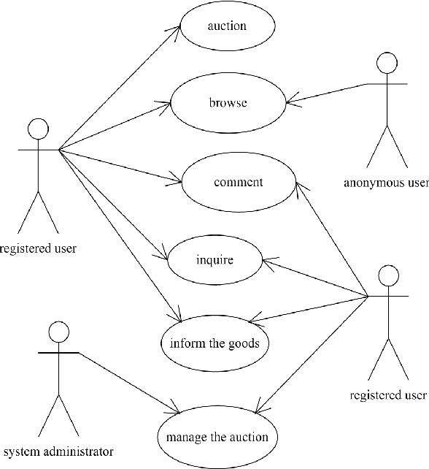
5.1 ADVANTAGES OF PROPOSED SYTEM
5.2 USE CASE DIAGRAM
Enhanced security because of cloud based hosting.
More reliability because of decentralization using Blockchain.
Green and sustainable.

Slide 10
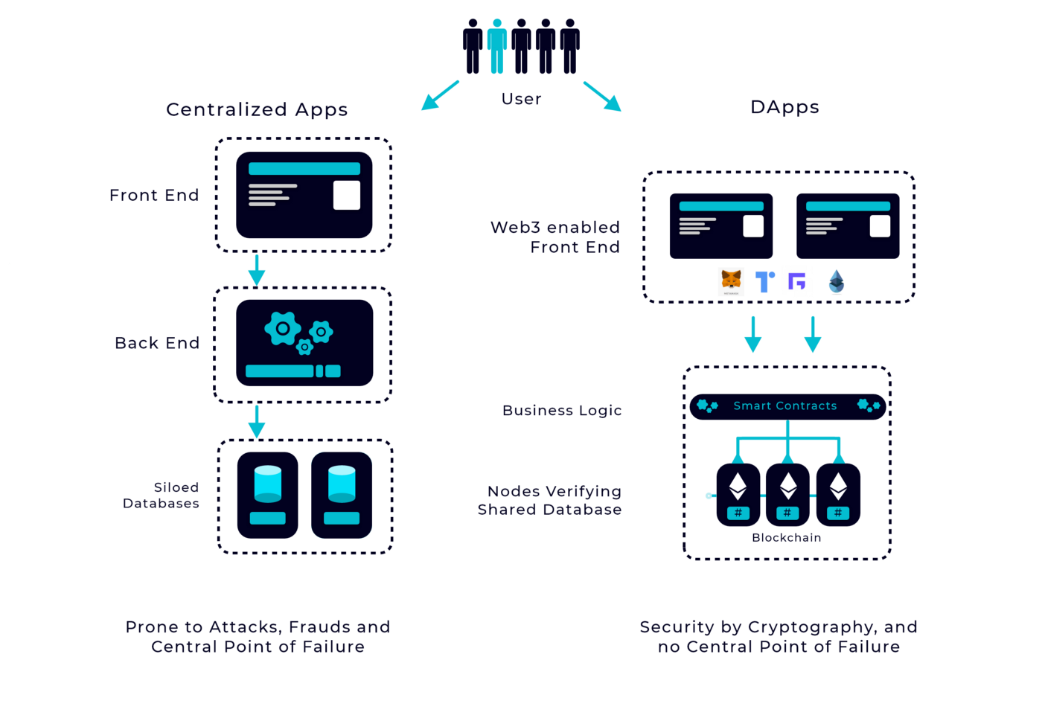
6. System Design
The above diagram shows the typical working of the a decentralized application.
The backend of the Dapps is an integrated unit called “smart contract”.

Slide 11
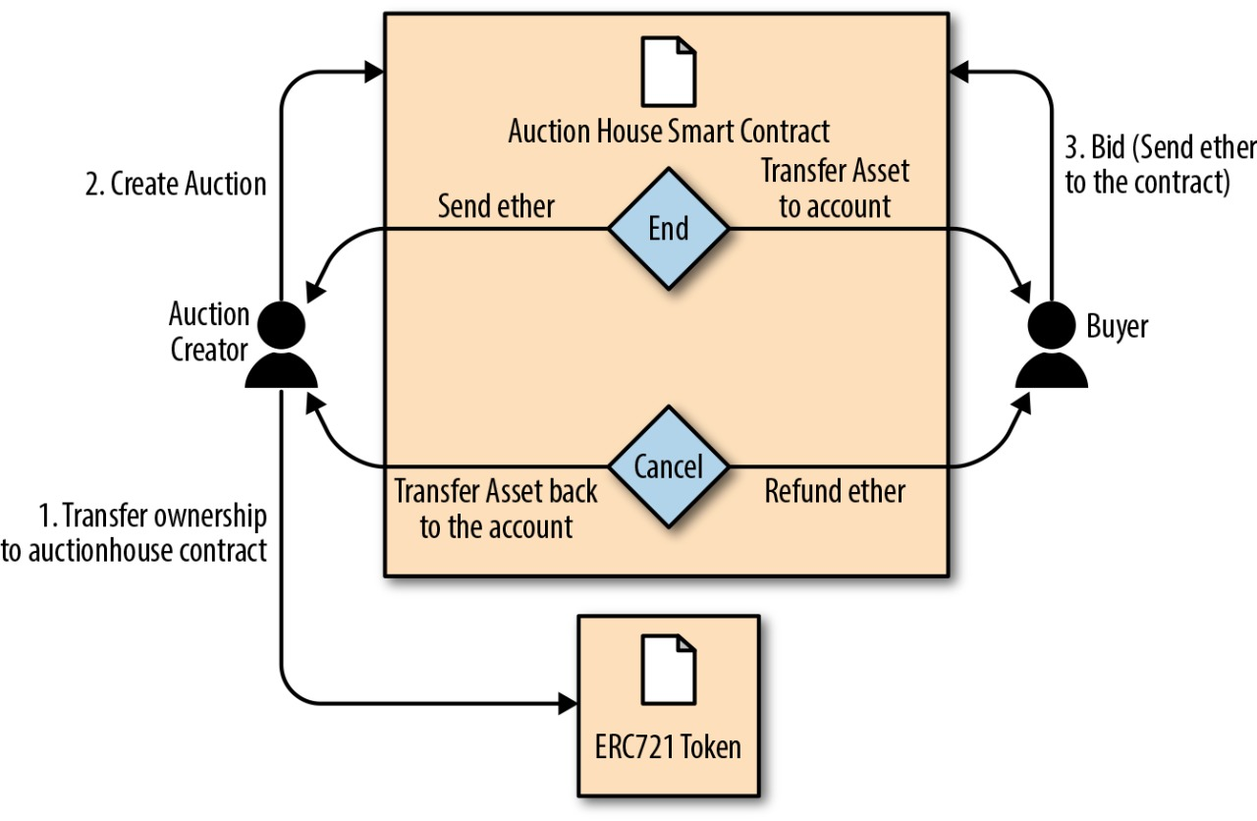
7. Methodology
The Frontend was developed using React.JS
The Smart contract was then developed and integrated with the frontend.
The project was hosted on the cloud successfully.

Slide 12
8. REQUIREMENTS
Table I. Software Specifications
S. No | Software | Version | URL
1 | Avalanche | 6.1 | https://www.avax.network/
2 | Metamask | 10.11.3 | https://metamask.io/
3 | Truffle | 5.5.18 | https://www.npmjs.com/package/truffle
4 | React.js | 18.2.3 | https://reactjs.org/
5 | AWS | 2.4 | https://aws.amazon.com/

Slide 13
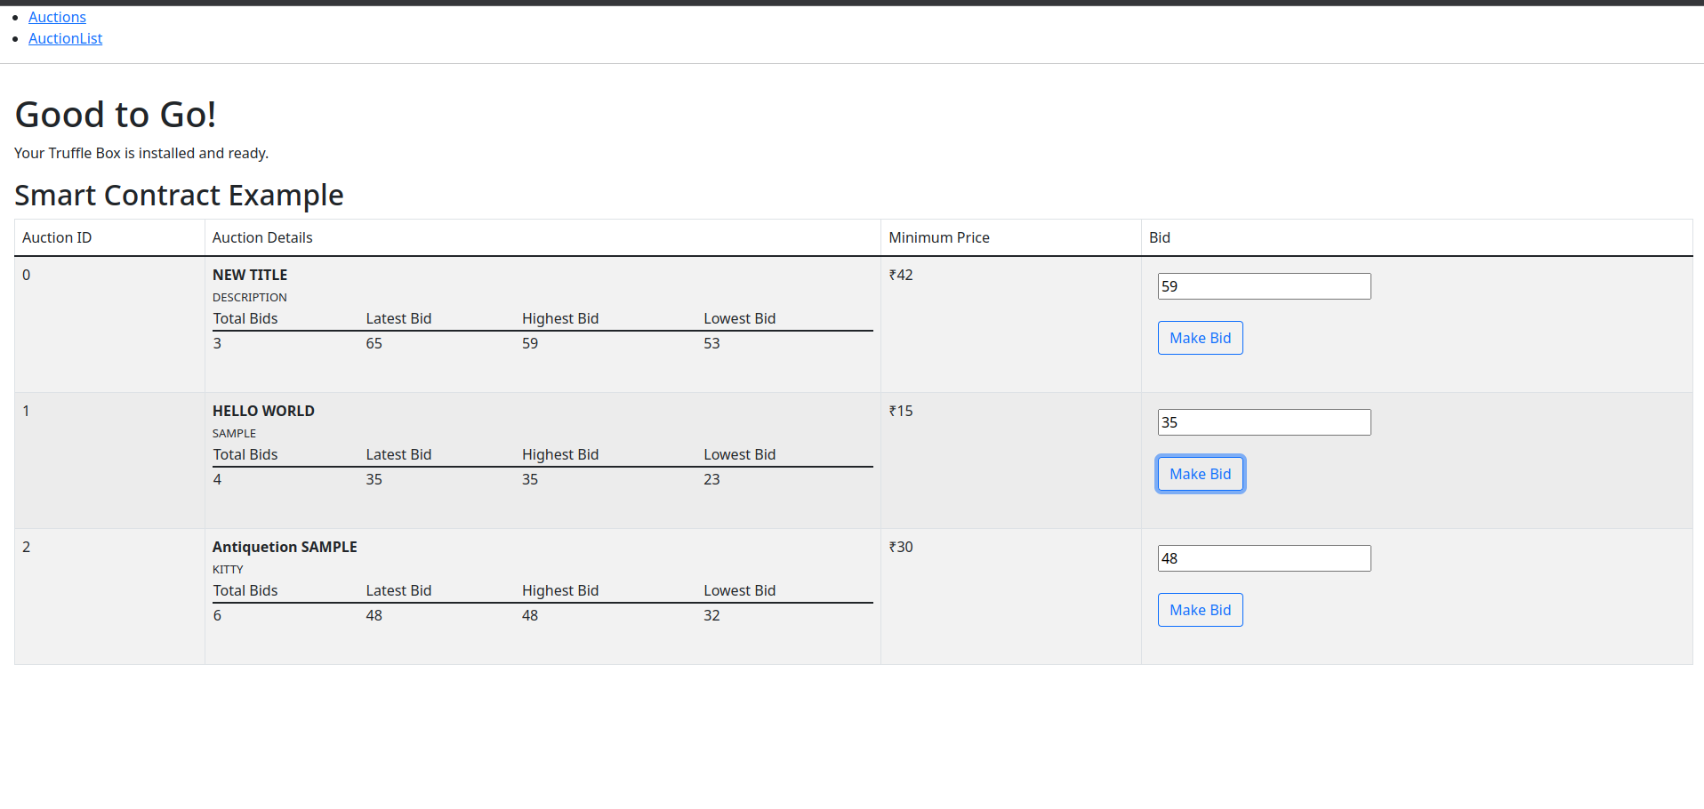
9.IMPLEMENATION
The DApp was executed and run in the local environ
-ent before hosting it in cloud .

Slide 14
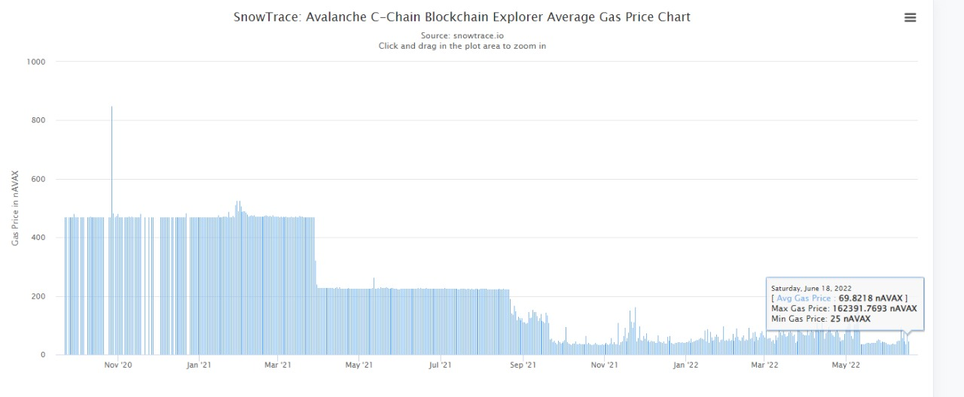
10. ANALYSIS
The Avalanche C-Chain Average Gas Price Chart shows the daily average gas price used of the network.

Slide 15
11. CONCLUSIONS
The decentralized app (DApp) was developed successfully and hosted on the cloud. The devolved model is efficient in removing the middle man brokerage amongst the artists and the buyers.
The app is fully based upon cloud and decentralization and it is efficient.

Slide 16
12. FUTURE SCOPE
We are moving towards the digital arts(NFTs)
and this application can be extended to sell the NFTs as well.
The auction app can also be added with a lot of features using cookies and user data can be collected and the user-experience has scope for improvement.

Slide 17
13. REFERENCES
Vikas Hassija; Gaurang Bansal; Vinay Chamola; Vikas Saxena; Biplab Sikdar- BlockCom: A Blockchain Based Commerce Model for Smart Communities using Auction Mechanism
Steven Goldfeder, Joseph Bonneau, Rosario Gennaro & Arvind Narayanan : “Escrow Protocols for Cryptocurrencies: How to Buy Physical Goods Using Bitcoin”
Jehangir Arshad; Muhammad Abu Bakar Siddique; Zainab Zulfiqar; Amna Khokhar; Saqib Salim; Talha Younas: “A Novel Remote User Authentication Scheme by using Private Blockchain-Based Secure Access Control”
Xianyun Ge : “Smart Payment Contract Mechanism Based on Blockchain Smart Contract Mechanism.

Slide 18
Hybrid Blockchain Architecture for Privacy-Enabled and Accountable Auctions- Harsh Desai; Murat Kantarcioglu; Lalana Kagal
Optimizing Blockchain Based Smart Grid Auctions: A Green Revolution- Muneeb Ul Hassan;Mubashir Husain Rehmani;Jinjun Chen
SECAUCTEE: Securing Auction Smart Contracts using Trusted Execution Environments- Harsh Desai;Murat Kantarcioglu
BEADS: Blockchain-Empowered Auction in Decentralized Storage-Xinxuan Huang;Jigang Wu;Jiaxing Li;Chengpeng Xia

Slide 19
THANK YOU

