Slide 1


FOODZZ INFINITY
GROUP NO 9
__________________________________
MEMBERS
SE3_48 -> VARUN SAMPAT
SE3_10 -> KRISHI DAVE
SE3_46 -> KSHITIJ ROTE
SE3_47 -> SURAJ SAHU
MENTOR
MS. MEGHA MANDAVKAR

Slide 2
Overall Aim Of The Project :
1.It allows customers to order food easily , as it has varying kinds and options.
2.No installation required , Web-Based.
3.Contain Low Storage Compared To Apps.
4.Easy To Order Anytime , Anywhere.

Slide 3
WHY THIS
PROJECT?

Slide 4






Survey :
We had visited the following Websites for getting an idea about this project and gathering the details about their products.

Slide 5
ADVANTAGES :
This project will help to organize data of different apps.
This app would make the ordering process easy and access to a lot of brands.
Buyers don’t have to install all apps rather they can order through a single app,also the food will be delivered at their doorstep.

Slide 6
DISADVANTAGES :
Lack of restaurant experience.
No query resolution.
Time taking.
Slightly more expensive than individual apps.
Wouldn’t work for long distances.

Slide 7
FUNCTIONS :
1.Easy app management.
2.Easy menu management.
3.Easy access to more restaurants.
4.Easy user settings.
5.Payment tracking.

Slide 8
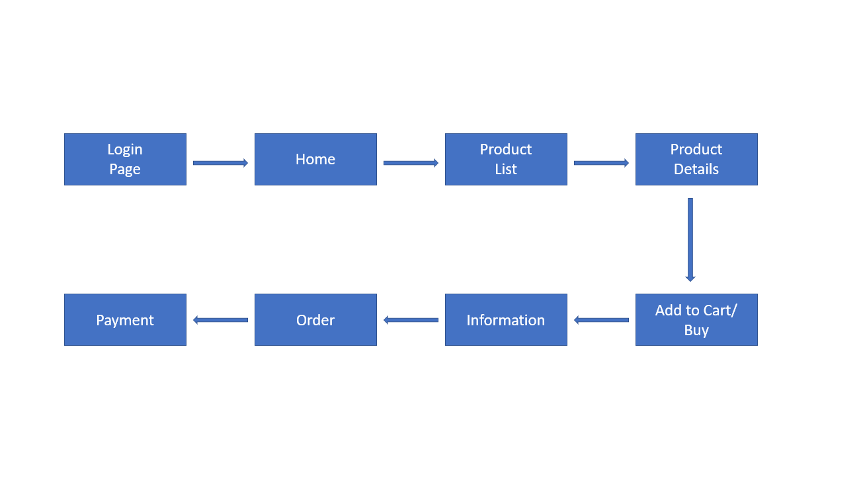
Block Diagram:

Slide 9
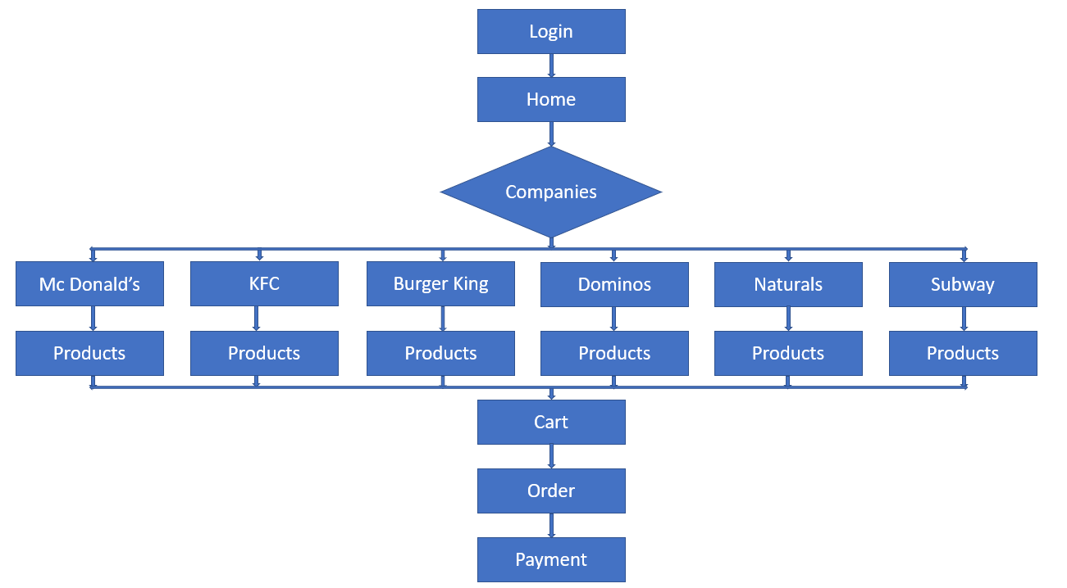
Flow Chart:

Slide 10
SKILLS REQUIRED :
<?php>
HTML - For making the layout of Website.
CSS - For Designing the Website and for adding Animations.
JAVASCRIPT - For making the Website Dynamic.
PHP - For Server-Side Scripting.
MYSQL - For Database Management
<style>
<html>

Slide 11
FEASIBILITY :
No investment/extra fees needed is required.
It is created by using web development skills/tools such as html, css , javascript , php , SQL.
It is a user friendly website.
The project would be feasible in a time span of 4 months.

Slide 12
REFERENCES :
https://www.w3schools.com/html/default.asp
https://www.coursera.org/learn/web-applications-php/home/welcome
https://www.youtube.com/watch?v=7S_tz1z_5bA
https://youtube.com/playlist?list=PLDyQo7g0_nsX8_gZAB8KD1lL4j4halQBJ
https://www.youtube.com/watch?v=yfoY53QXEnI
https://www.w3schools.com/css/

Slide 13
THANK YOU

