Slide 1
FAKE NEWS DETECTION
Submitted in the partial fulfillment for the award of the degree of
BACHELOR OF ENGINEERING
IN
Computer science engineering (hons) Big data analytics
Submitted by:
Gurleen Kaur
20BCS3839
Under the Supervision of:
Mr. Nirmalya Basu
Department of AIT-CSE
DISCOVER . LEARN . EMPOWER

Slide 2
Outline
Introduction to Project
Problem Formulation
Objectives of the work
Methodology used
Results and Outputs
Conclusion
Future Scope
References

Slide 3
Introduction to Project
Data has been increasing at an unprecedented range in an exponential manner and is producing 2.7 quintillion bytes of data everyday.
The definition of fake news is information that pushes people down the wrong road. Fake news is spreading like wildfire these days, people are sharing it without confirming it. This is frequently done to promote or impose specific views and it is frequently accomplished through political agendas.
As a result, it is vital to recognize phoney news.

Slide 4
Problem Formulation
The spreading of fake news becomes especially dangerous during times like elections or pandemic situations. Fake rumors and misinformation that pose harm to human lives are threatening to people and the society. Fake news needs to be detected and prevented early, before it causes panic and spreads to a large number of people.
Fake news have become more prevalent in recent years and with great amount of dynamism in internet and social media, differentiation between facts and opinions, relating to commercial or political upheavals has become more difficult than ever.

Slide 5
Fake information is purposely or unintentionally spread throughout the internet. The massive dissemination of fake news has left an indelible mark on people and culture.
We use various processing methodologies like removal, machine learning classification algorithms – logistic regression, to build a model that differentiates between fake news and real news.

Slide 6
Types of Fake news and patterns that help in detection
Visual based: These false news posts make extensive use of graphics as compared to content, which may include manipulated photographs, doctored video or combination of the two.
User generated news: This sort of falsified news is generated by phoney accounts and is targeted to certain audiences, which might reflect specific age groups, gender, culture or political affiliations.
Knowledge based: These posts provide scientific explanations to some unresolved problems, leading people to feel they are genuine.
Style Based: Pseudo journalists who impersonate and mimic the style of some accredited journalists write style base posts.
Stance bases: It is a portrayal of true statements in such a way that its meaning and purpose are altered.

Slide 7
Objectives of the Work
The main objective is to detect the fake news, which is a classic text classification problem with a straight forward proposition. It is needed to build a model that can differentiate between “Real” news and “Fake” news.

Slide 8
Methodology used
The fake news model detection is bult using steps like
Text collection
Text Processing
Feature Extraction
Finally classification using different classifiers

Slide 9
Text Collection
Text Preprocessing
Feature Extraction
News to be classified
Classified news as fake or real
Classifier

Slide 10
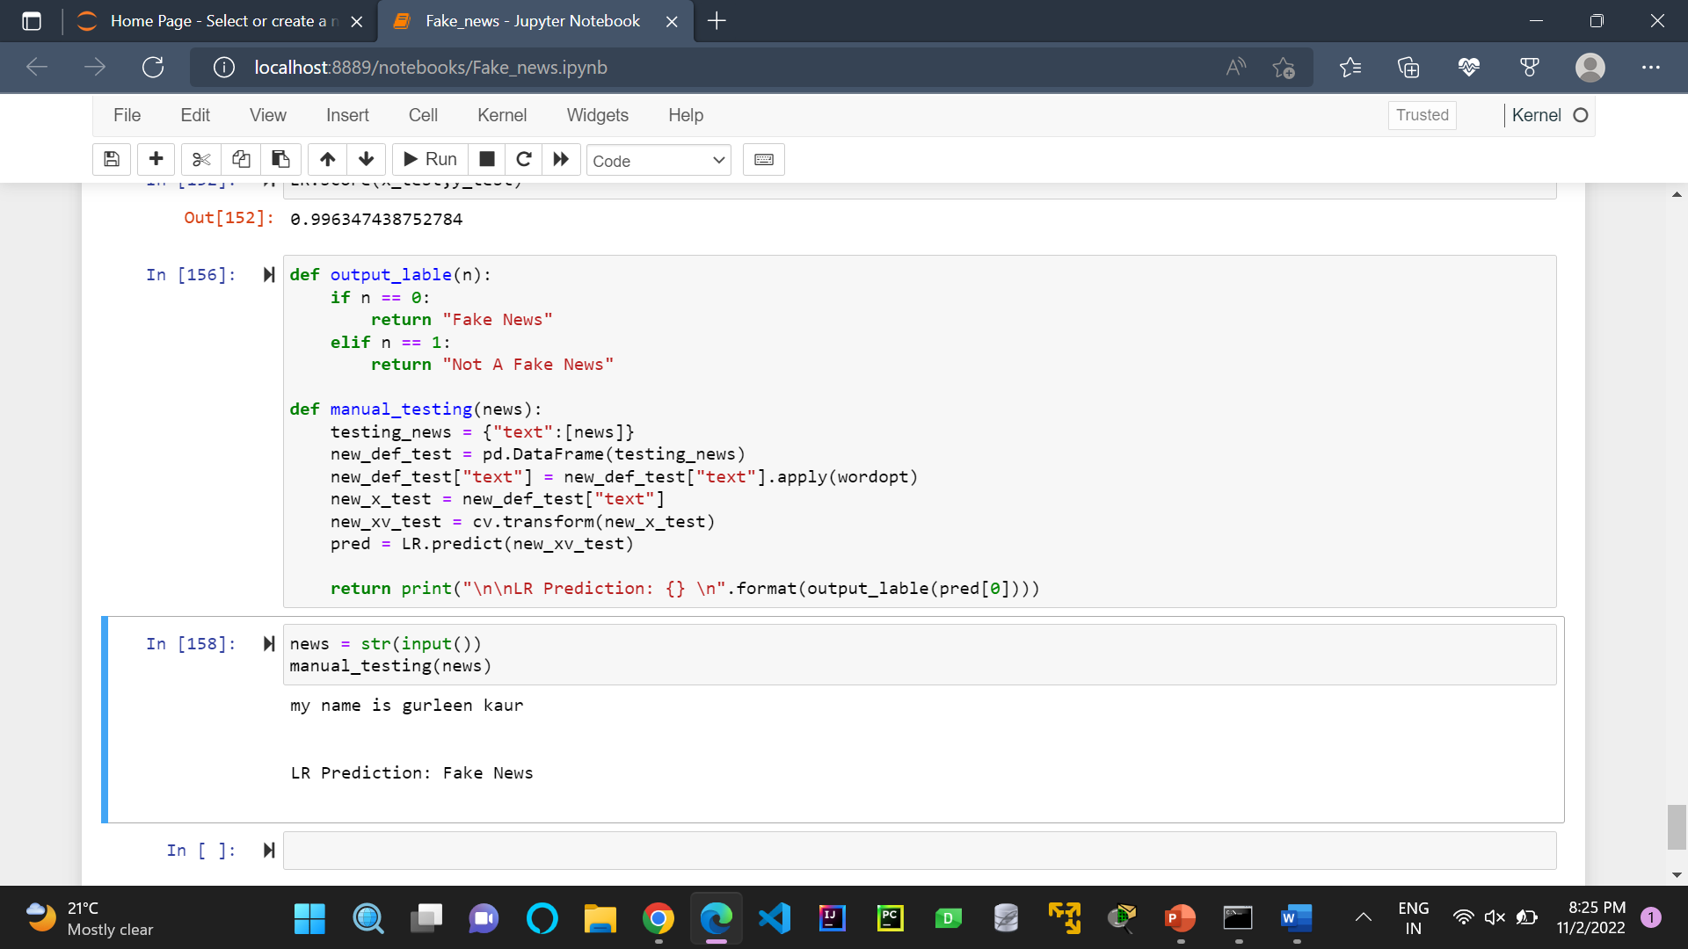
Results and Outputs

Slide 11
Future Scope
We’re living in the age of fake news. Deepfakes relate to technologies that make it possible to create evidence of scenes that never happened through video, photo and audio fakes. These technologies can enable bullying more generally (placing people into compromising scenarios), boost scams (swindling employees into sending money to fraudsters), damage a company’s reputation, or even pose a danger to democracies by putting words in the mouths of politicians.

Slide 12
How can we fight this battle?
We need technology to fight this battle. AI makes it possible to find words and patterns that indicate fake news in huge volumes of data,

Slide 13
THANK YOU

