Slide 1

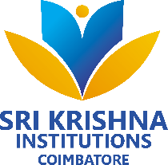

STOCK PRICE PREDICTION AND FORECASTING
USING MACHINE LEARNING
TEAM MEMBERS :
SATHISH KUMAR M – 20EUAI034
THARUN S – 20EUAI048
VARUN S – 20EUAI051
VIKASS ARAVIND C V – 20EUAI054
MENTOR :
Mr. G. S. PUGALENDHI M.E.,
AP, DEPARTMENT OF ARTIFICIAL INTELLIGENCE AND DATA SCIENCE

Slide 2
ABSTRACT
Stock markets can often be one of the highly complex and most volatile places to invest. Statistical analysis of past stock performance and external factors play a major role in the decision to buy or sell stocks. Stock price index forecasting has been a subject of great research for many years, and several algorithms have been proposed to simplify this complex task. People have been using learning tools from diverse fields such as financial mathematics and machine learning to make trustworthy forecasting on such markets. However, the accuracy of such techniques had not been adequate. In order to forecast stocks accurately, it is crucial to understand the context-specific dependence of stock prices on their past values. Our approach offers superior accuracy as the training increases when it proceeds through the testing period through sliding window method.

Slide 3
PROBLEM STATEMENT
Stock forecasting is a challenging task in the financial domain, as accurate predictions of stock prices are crucial for making informed investment decisions.
Traditional methods often fall short in capturing the nonlinear patterns and dynamic nature of stock market data, leading to less reliable predictions.
The objective is to create a robust and scalable forecasting solution that can handle large volumes of data, adapt to changing market conditions, and provide accurate predictions over different forecasting horizons.
By addressing these challenges and developing a robust forecasting solution, this research aims to contribute to the field of financial forecasting and provide valuable tools for the financial industry.

Slide 4
EXISTING SYSTEM
Existing Algorithms :
  Autoregressive Integrated Moving Average (ARIMA)
  Long Short-Term Memory Networks (LSTM)
  Convolutional Neural Networks (CNN)
  Support Vector Machines (SVM)
  Random Forest (RF)
  Gaussian Processes (GPs)
Disadvantages :
  Data Dependency
  Limited Interpretability
  Overfitting and Generalization
  Computational Complexity

Slide 5
PROPOSED SYSTEM
Proposed Algorithms :
  Recurrent Neural Networks (RNN)
  Long Short-Term Memory Networks (LSTM)
  Bi-directional Long Short-Term Memory Networks (Bi-LSTM)
  FBProphet
Advantages :
  Accurate Forecasting
  Automation and Speed
  Adapting to Changing Market Conditions
  Diverse Model Choices
  Reduced Human Bias

Slide 6
LITERATURE REVIEW
S.No | TITLE | ALGORITHM USED | ADVANTAGES | DISADVANTAGES
1 | Novel optimization approach for stock price forecasting using multi-layered sequential LSTM | Multi-layered LSTM | Mean Error Percentage -2.18% | No use of dynamic data.
2 | Multi-scale local cues and hierarchical attention-based LSTM for stock price trend prediction | Multi-scale local cues LSTM | Attention – Based model. | MLCA-LSTM degenerates more slowly than LSTM.
3 | Real-time forecasting of time series in financial markets using sequentially trained dual-LSTMs | Autoregressive integrated moving average model | Dual – LSTM model. | Over-fitting issues

Slide 7
MODULE DESCRIPTION
DATA COLLECTION
DATA PREPROCESSING
MODEL CREATION AND TRAINING
EVALUATION
DEPLOYMENT

Slide 8
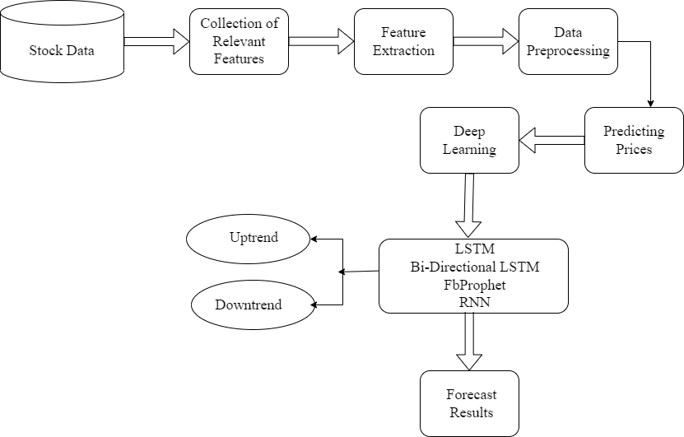
PROPOSED SYSTEM

Slide 9
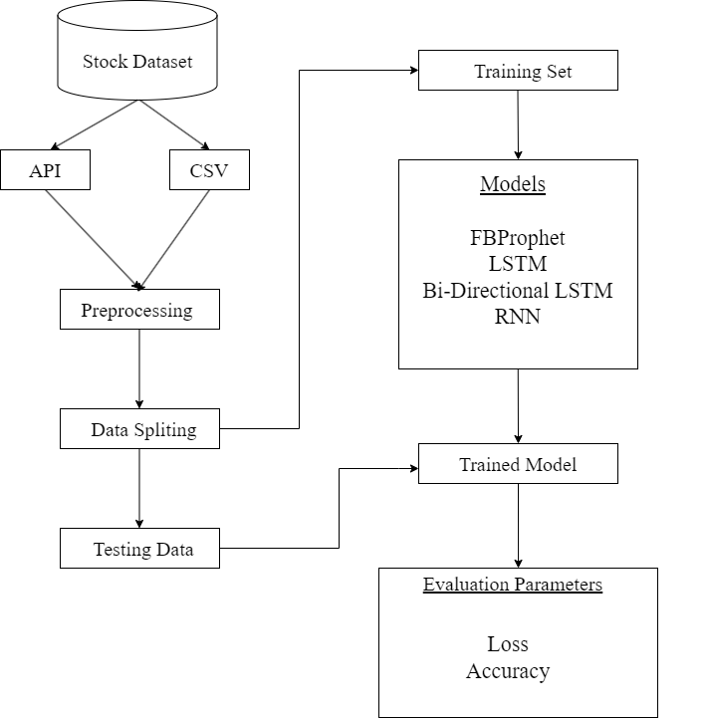
PROPOSED WORFLOW

Slide 10
LONG SHORT-TERM MEMORY (LSTM)
Long Short-Term Memory Networks (LSTM), is a variety of recurrent neural networks (RNNs) that are capable of capturing long-term dependencies and process sequential information.
Forget Gate(f) : The forget gate determines which information from the previous time step is irrelevant and should be discarded. This gate decides which values in the cell state to forget by assigning weights between 0 and 1 to each element.
Input Gate(i) : The input gate determines which new information should be stored in the cell state. It takes the previous hidden state and the current input, passes them through a sigmoid activation function, and produces an input gate output.
Output Gate(o) : The output gate determines the output of the LSTM cell based on the updated cell state. The output gate regulates the information flow from the cell state to the hidden state and generate the output.

Slide 11
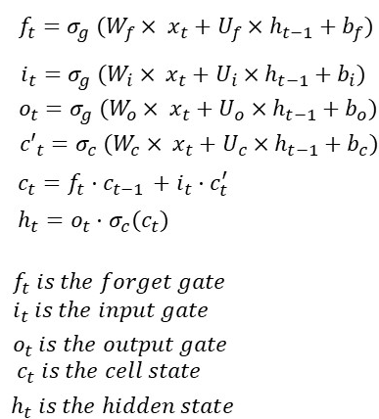
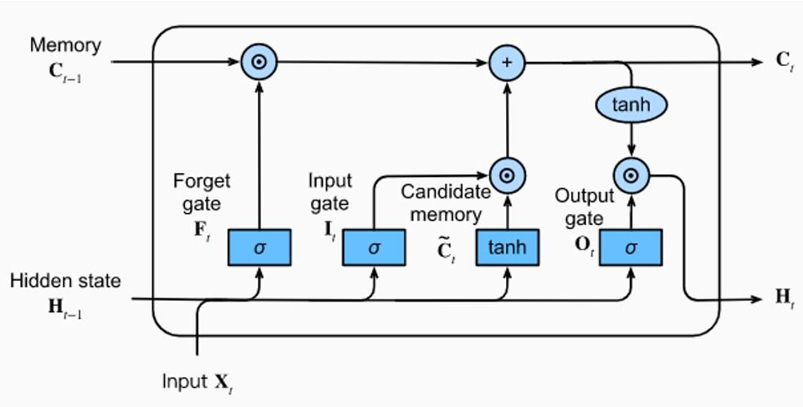
LSTM ARCHITECTURE

Slide 12
BI-DIRECTIONAL LONG SHORT-TERM MEMORY (BI-LSTM)
In bidirectional LSTMs, each training sequence is presented forward and backward so as to separate recurrent nets. Both sequences are connected to the same output layer. Bidirectional LSTMs have complete information about every point in a given sequence, everything before and after it. Using bidirectional will run your inputs in two ways, one from past to future and one from future to past.
FEATURES :
  Bidirectional Processing
  Robust
  Attention Mechanisms
  Ensemble and Stacking

Slide 13
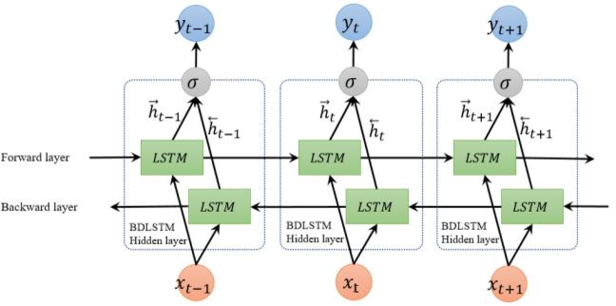
BI-LSTM ARCHITECTURE

Slide 14
RECURRENT NEURAL NETWORK (RNN)
Recurrent Neural Network(RNN) is a type of Neural Network where the output from the previous step are fed as input to the current step. Recurrent Neural Networks (RNNs) are a class of neural networks designed for processing sequential data, where the order of elements in the sequence is significant. RNNs have a recurrent connection that allows them to maintain internal memory and capture temporal dependencies. RNN have a “memory” which remembers all information about what has been calculated.
FEATURES :
  Backpropagation
  Maintaining Memory
  Language Modeling
  Bi-directional Processing

Slide 15
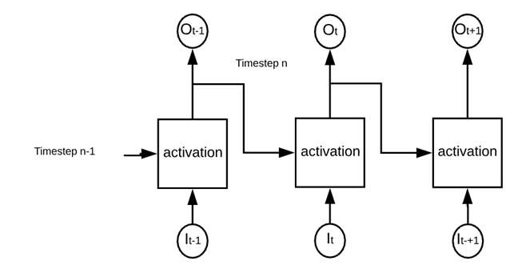
RNN ARCHITECTURE

Slide 16
FBPROPHET
FBProphet is a forecasting library open-sourced by Facebook's Core Data Science team. It is based on an additive model where non-linear trends are fit with yearly, weekly, and daily seasonality, plus holiday effects. It allows for modeling of multiple seasonality, changing growth rates, and can automatically detect changes in trends by implementing a piecewise linear regression model.
FEATURES :
User-friendly interface
Highly Customizable
Minimal Code
Tunable Forecasts.
Fully Automatic.

Slide 17
EFFICIENCY OF THE PROPOSED SYSTEM
EXISTING SOLUTION
DATASET - Static
ALGORITHM USED :
  Multi-layered Sequential
  LSTM – 2% Loss
PROPOSED SOLUTION
DATASET - Dynamic
ALGORITHM USED :
  LSTM - 0.063 % Loss
  BI-LSTM - 0.088 % Loss
  RNN - 0.285 % Loss

Slide 18
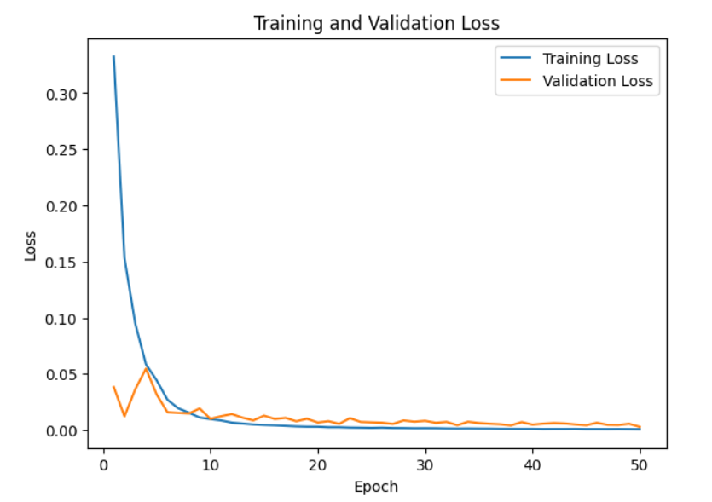
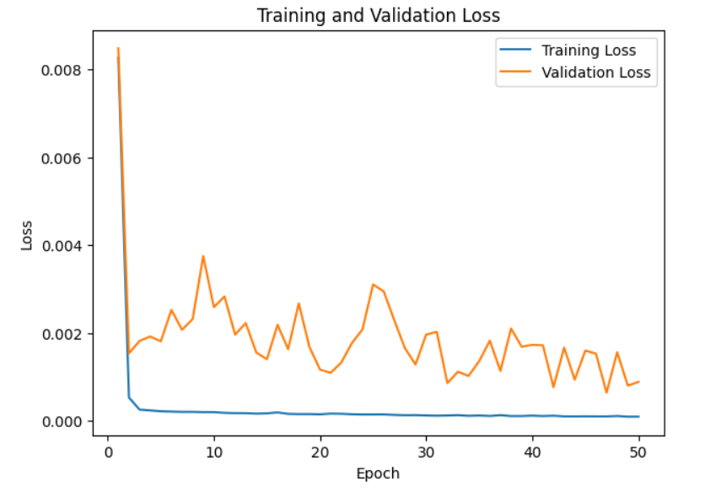
LOSS RESULTS
RNN MODEL
LSTM MODEL

Slide 19
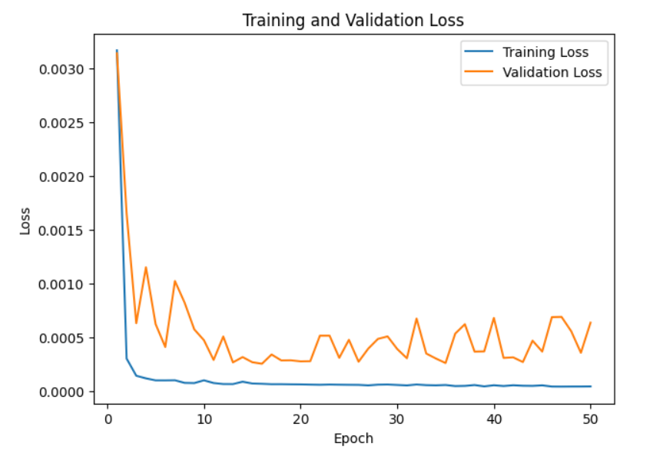
LOSS RESULTS
BI-LSTM MODEL

Slide 20
MODEL METRICS
MODEL | EPOCHS | LOSS %
RNN | 50 | 0.285
LSTM | 50 | 0.063
BI-LSTM | 50 | 0.088

Slide 21
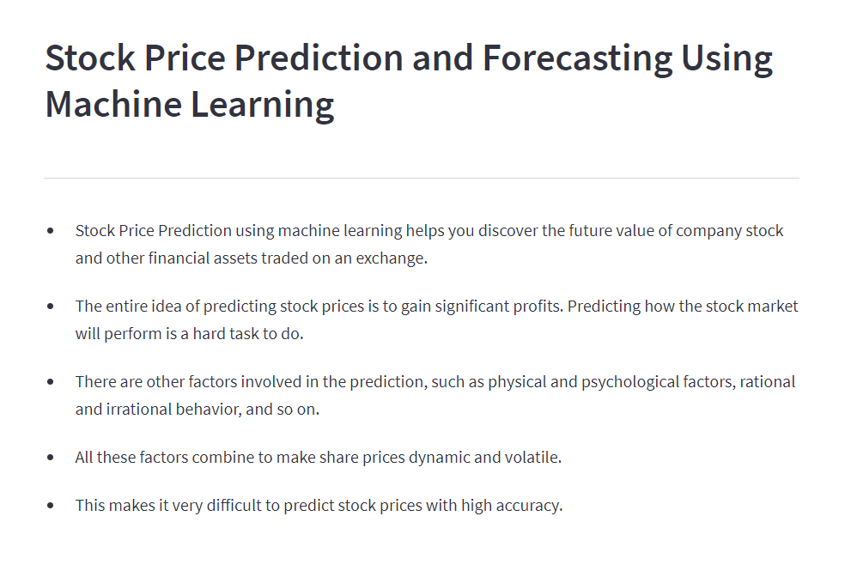
HOME PAGE

Slide 22
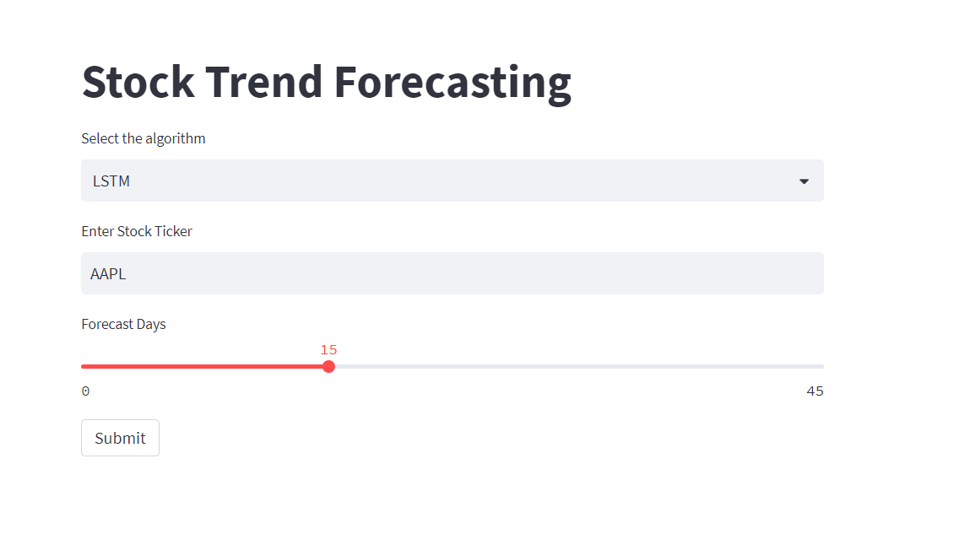
PREDICTION PAGE

Slide 23
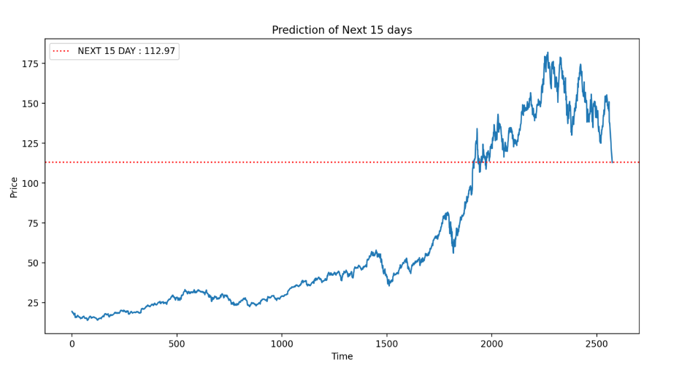
TEST CASE - 1
AAPL Stock Price Forecasting for next 15 days.

Slide 24
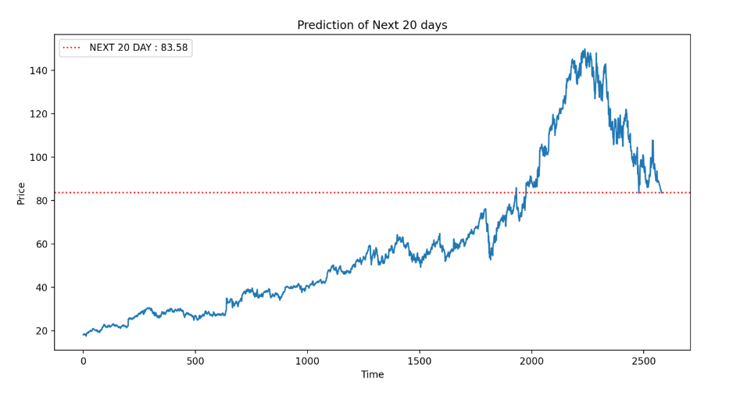
TEST CASE - 2
GOOGL Stock Price Forecasting for next 20 days.

Slide 25
REFERENCES
[1] Novel Optimization Approach For Stock Price Forecasting Using Multi-Layered Sequential LSTM. Applied Soft Computing 134 (2023) 109830
[2] Multi-scale local cues and hierarchical attention-based LSTM for stock price trend prediction. Neurocomputing 505 (2022) 92–100
[3] Real-time forecasting of time series in financial markets using sequentially trained dual-LSTMs. Expert Systems With Applications 223 (2023) 119879
[4] Forecasting Turning Points In Stock Price By Applying A Novel Hybrid CNN-LSTM-RESNET Model Fed By 2d Segmented Images. Engineering Applications of Artificial Intelligence 116 (2022) 105464
[5] P. Mondal, L. Shit, S. Goswami, Study of effectiveness of time series modeling (ARIMA) in forecasting stock prices, Int. J. Comput. Sci. Eng. Appl. 4 (2) (2014) 13.
[6] J. Bergstra, Y. Bengio, Random search for hyper-parameter optimization, J. Mach. Learn. Res. 13 (2) (2012).

Slide 26
REFERENCES
[7] G.J. Deboeck, Trading on the edge: neural, genetic, and fuzzy systems for chaotic financial markets 39 (1994).
[8] F. Feng, H. Chen, X. He, J. Ding, M. Sun, T.S. Chua, Enhancing stock movement prediction with adversarial training, IJCAI (2019)
[9] K. Chen, Y. Zhou, F. Dai, A LSTM-based method for stock returns prediction: A case study of China stock market, in: 2015 IEEE International Conference on Big Data, big data, IEEE, 2015, pp. 2823–2824.
[10] F. Jiang, G. Tang, G. Zhou, Firm characteristics and Chinese stocks, J. Manage. Sci. Eng. 3 (4) (2018) 259–283.
[11] A. Yadav, C.K. Jha, A. Sharan, Optimizing LSTM for time series prediction in Indian stock market, Procedia Comput. Sci. 167 (2020) 2091–2100.
[12] Y. Zhao, Y. Shen, Y. Zhu, J. Yao, Forecasting wavelet transformed time series

Slide 27
QUERIES ?

Slide 28
THANK YOU

