Slide 1
CS799 Project: Autonomous Car System
Shenghong Dai, Varun Sreenivasan, Andrew Castelino

Slide 2
Object Detection

Slide 3
Objectives
Train a model for our custom dataset.
Deploy the model on the Jetson Xavier board to do live detection.

Slide 4
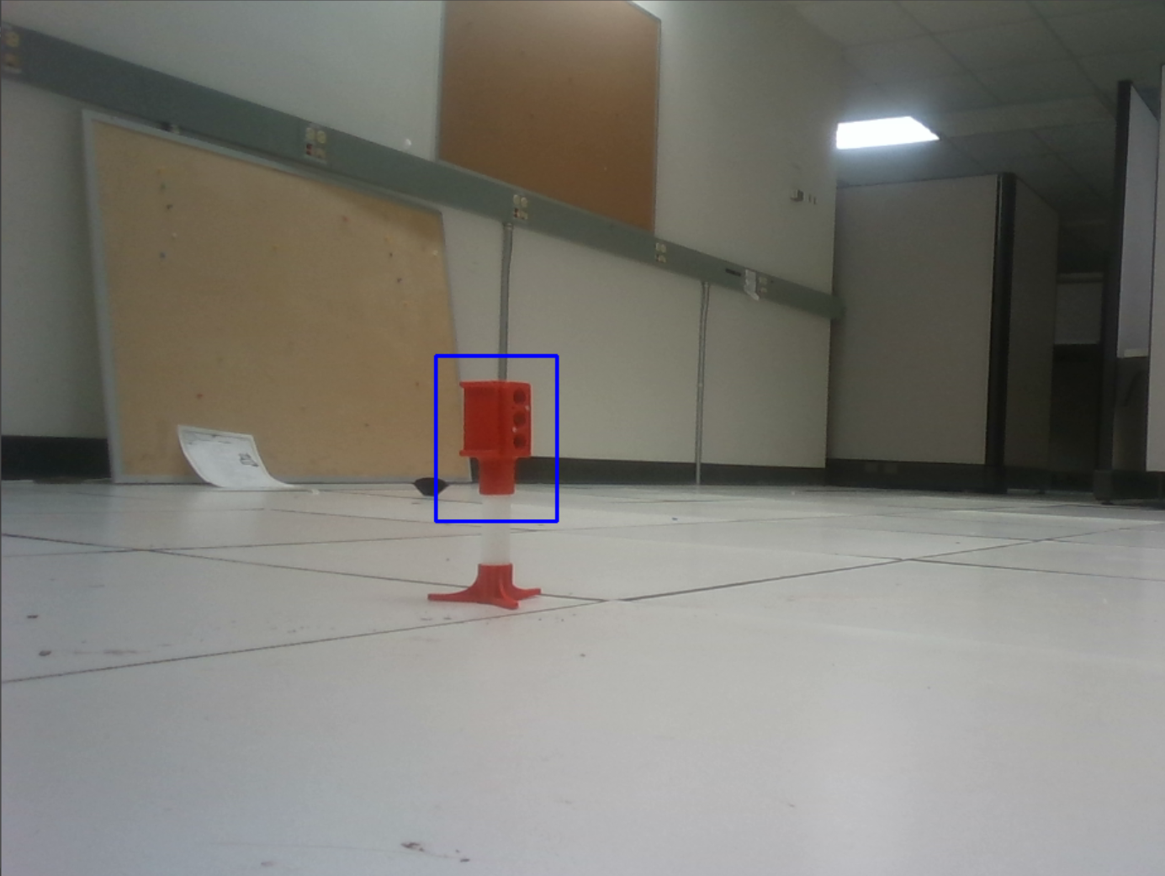
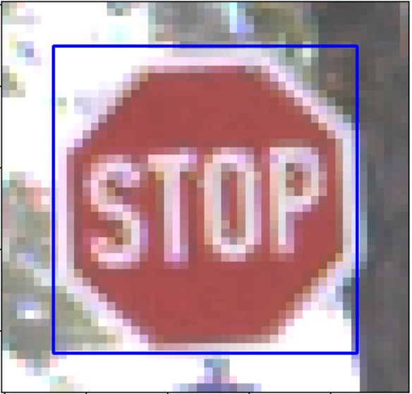
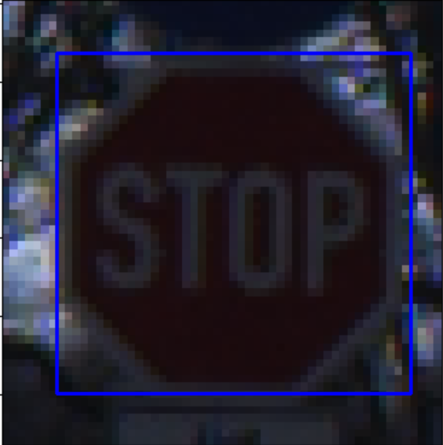
Datasets
Custom Dataset (generated by us)
888 images for 1 class (traffic light)
Same method can be used for more general cases
Road signs

Slide 5
Model
SSD Mobilenet
Popular network architecture for real time object detection on mobile and embedded devices.
Provided by NVIDIA Jetson
Link: https://github.com/dusty-nv/jetson-inference/blob/master/docs/pytorch-ssd.md

Slide 6
Training
Created inference model using the dataset after training for multiple epochs on CSL machines.

Slide 7
Challenges
Creating annotations compliant with Pascal VOC format.
Deploying the Intel RealSense Depth Camera to do real time detection.

Slide 8
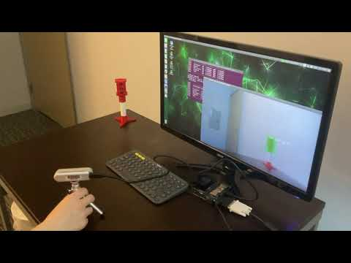
Demo

