Slide 1
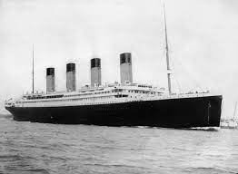
Project #2: Titanic - Who will survive?
By Dylan Gold, Varun Vaidhyanathan

Slide 2
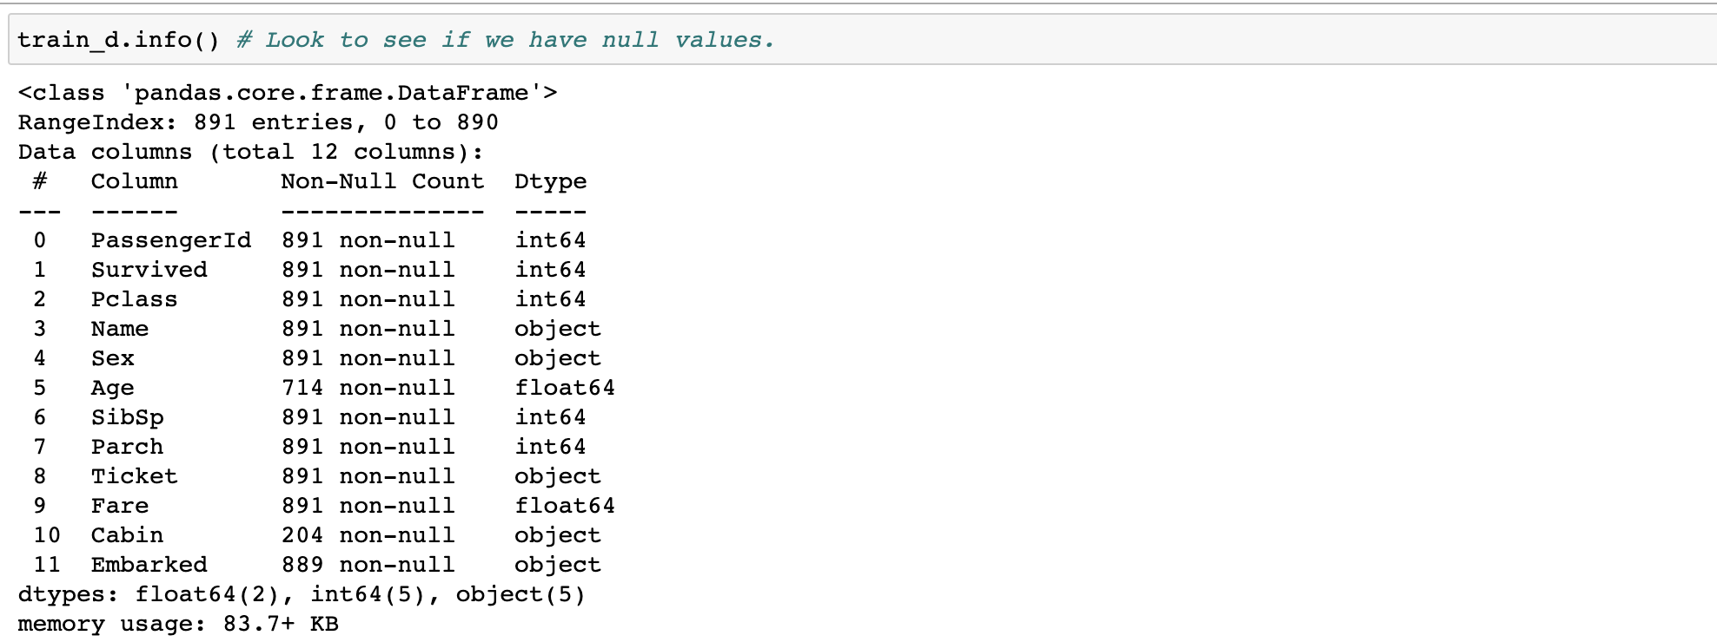
Initial look at the data
An initial look at the data revealed that some columns had a few null values.
These columns were namely: “Age”, “Cabin”, and “Embarked”

Slide 3
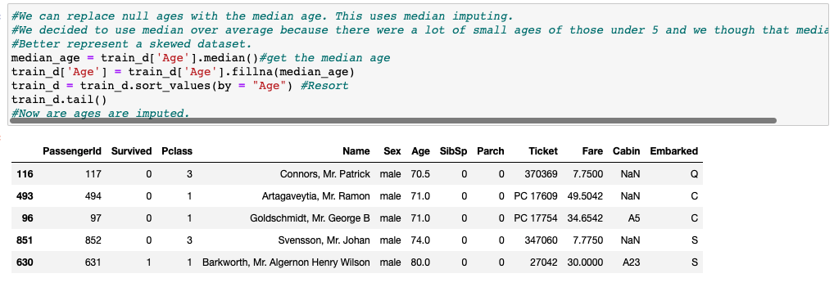
Dealing with the “Age” column
The null ages in the “Age” column are replaced by the median age of the column.

Slide 4
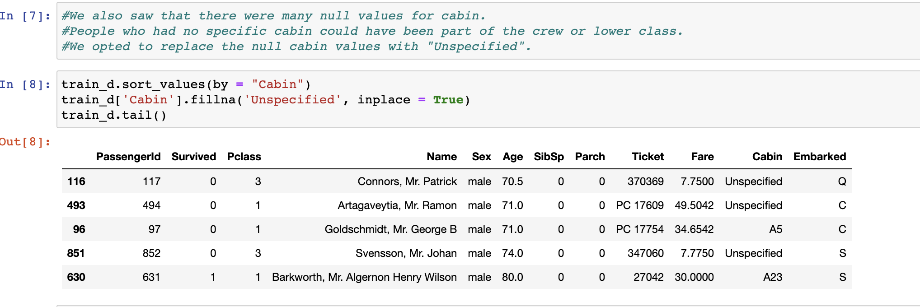
Dealing with the “Cabin” column
The null values in the “Cabin” column are replaced by “Unspecified”.

Slide 5
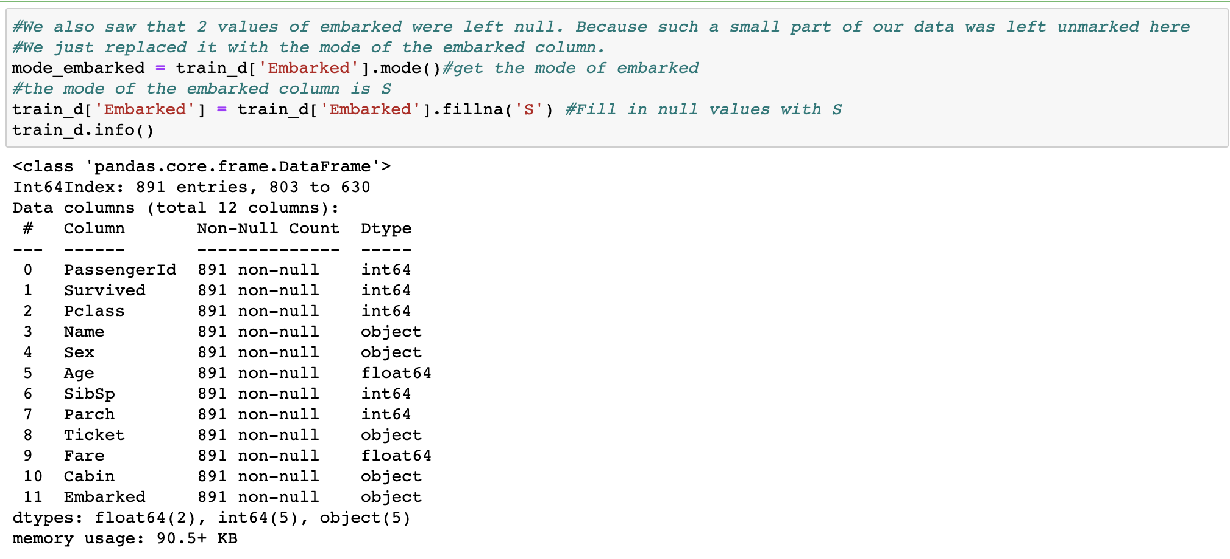
Dealing with the “Embarked” column
The 2 null values in the “Embarked” column are replaced by the mode of the column.

Slide 6
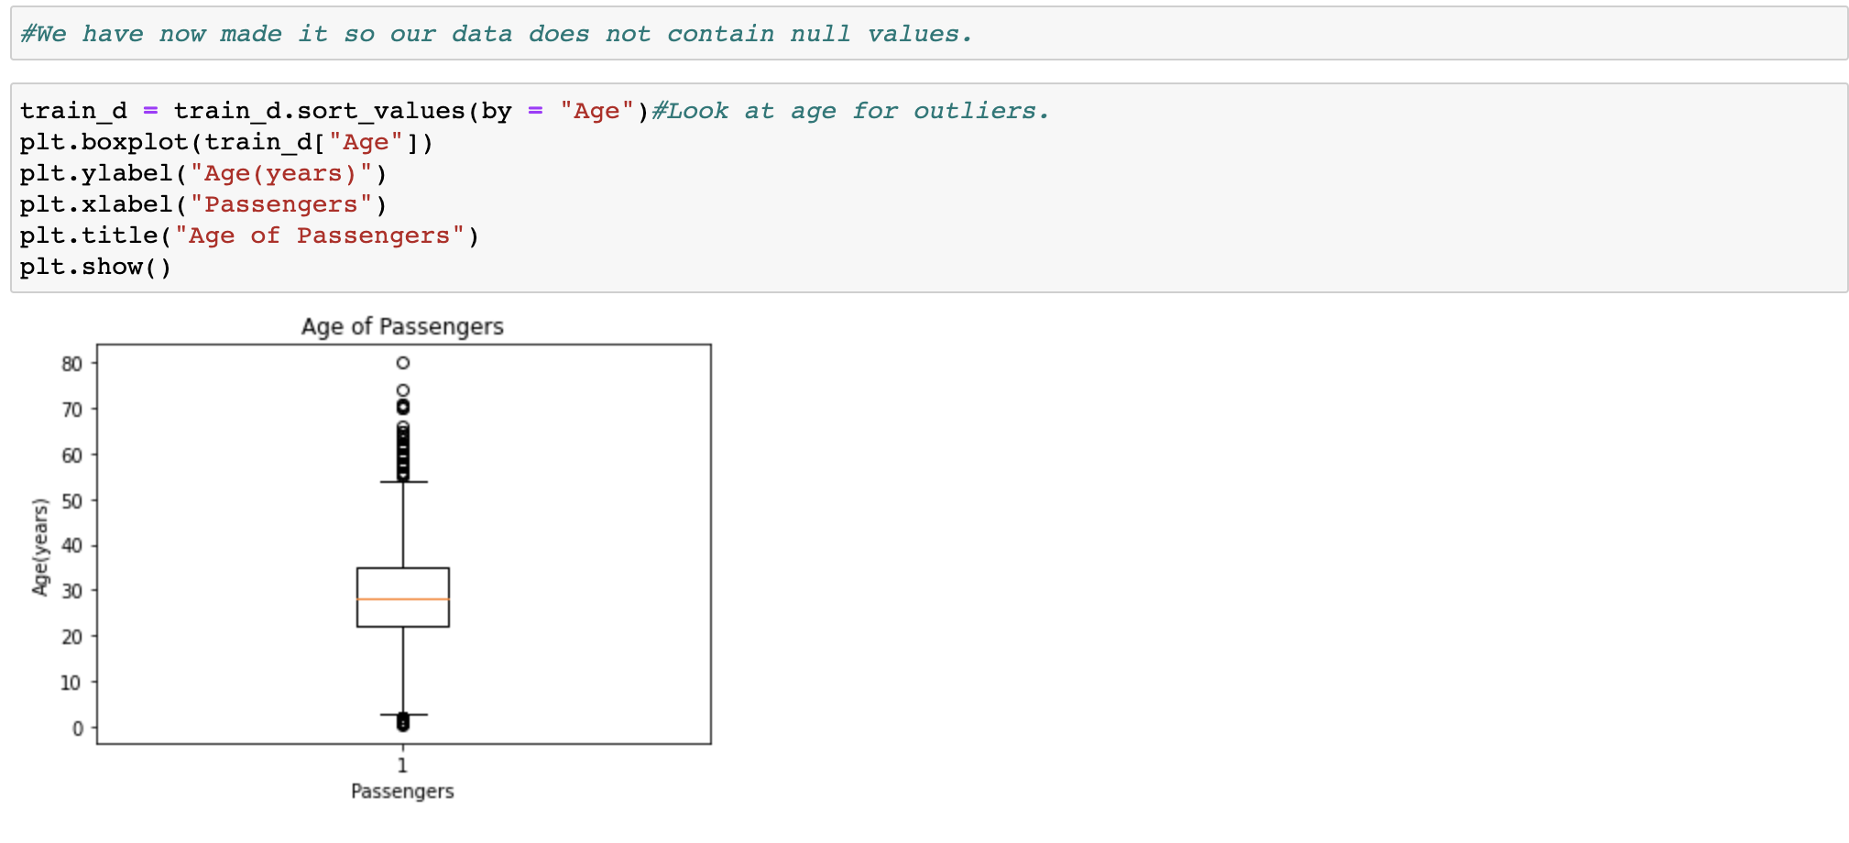
Checking for Outliers
“Age”: There were many data points outside the IQR but we didn’t feel the need to remove any of the points. (Max value of age was 80)

Slide 7
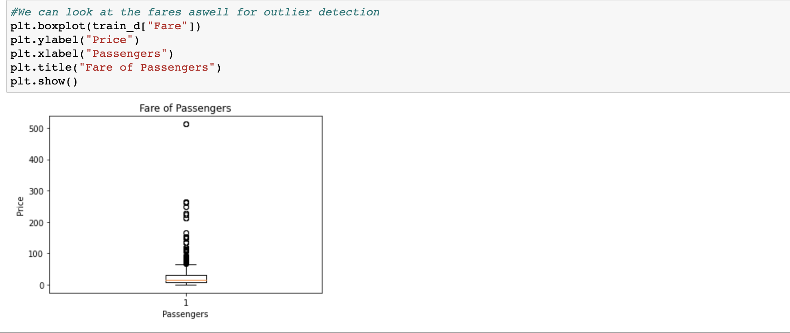
Checking for Outliers
“Fare”: We can see that there are some outliers. We decided to keep them except for the data point over 500

Slide 8
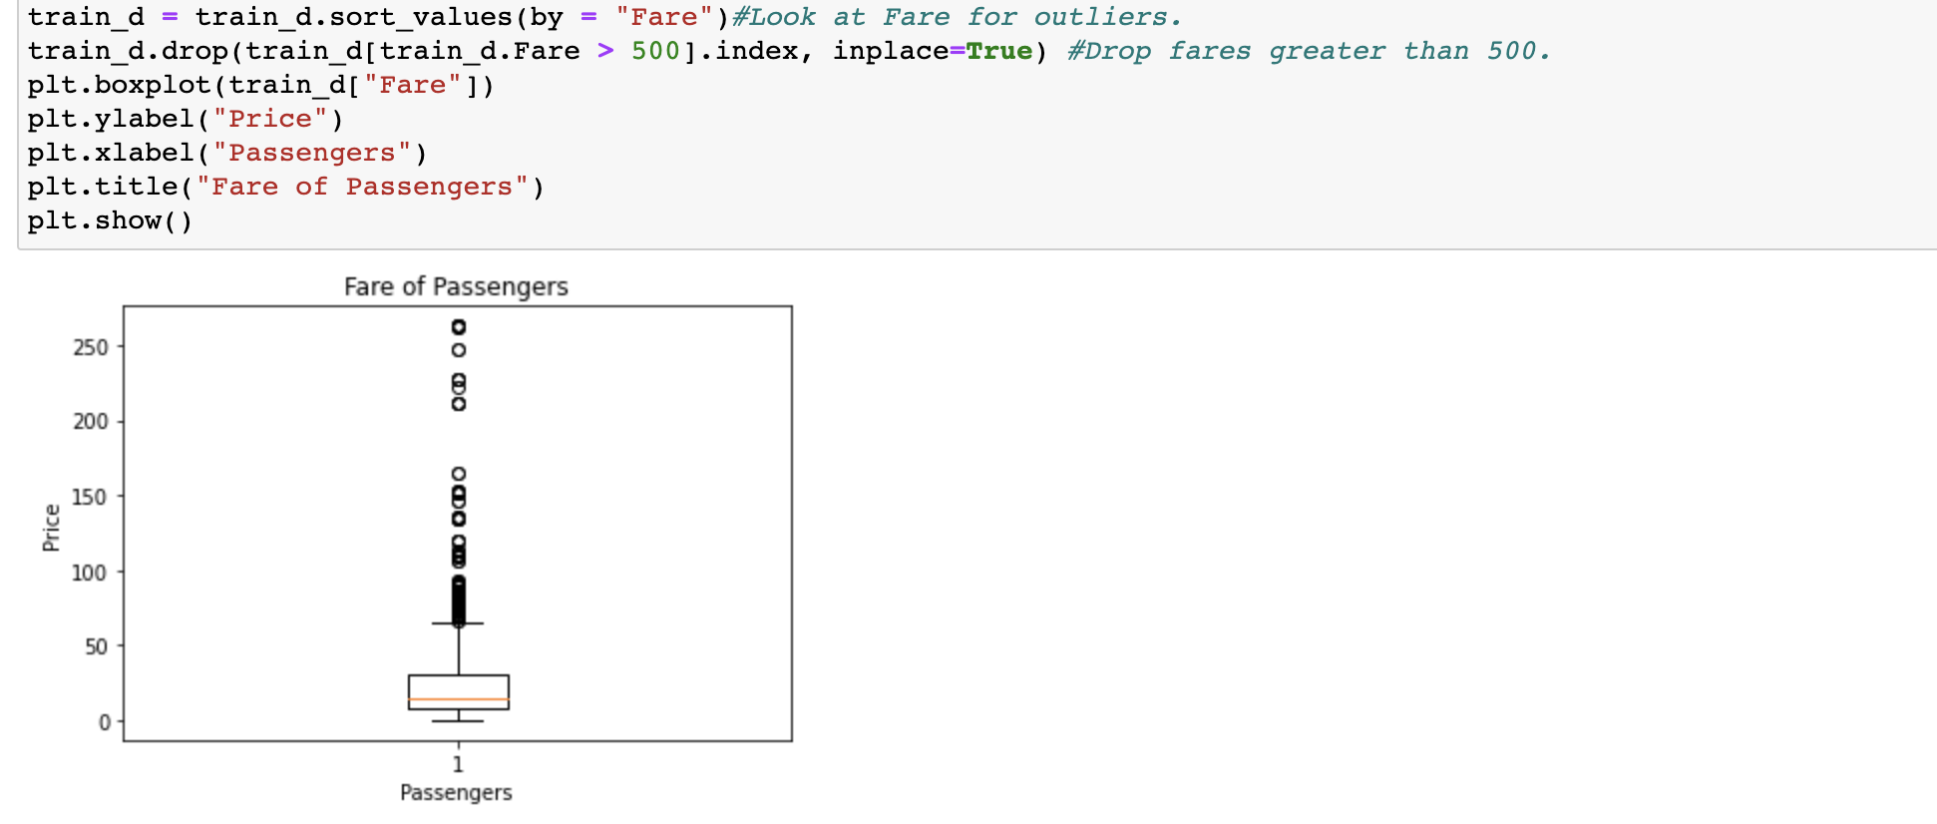
Checking for Outliers
“Fare”: Here we drop the fares greater than 500

Slide 9
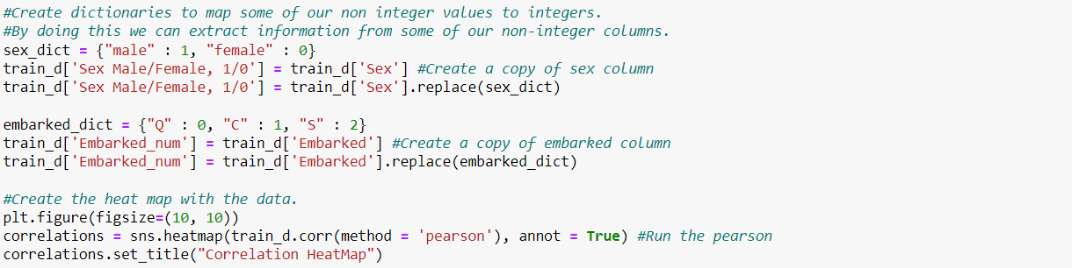
Exploring correlations between variables
In preparation for making a HeatMap, we decided to map some of our non integer values to integers using dictionaries.

Slide 10
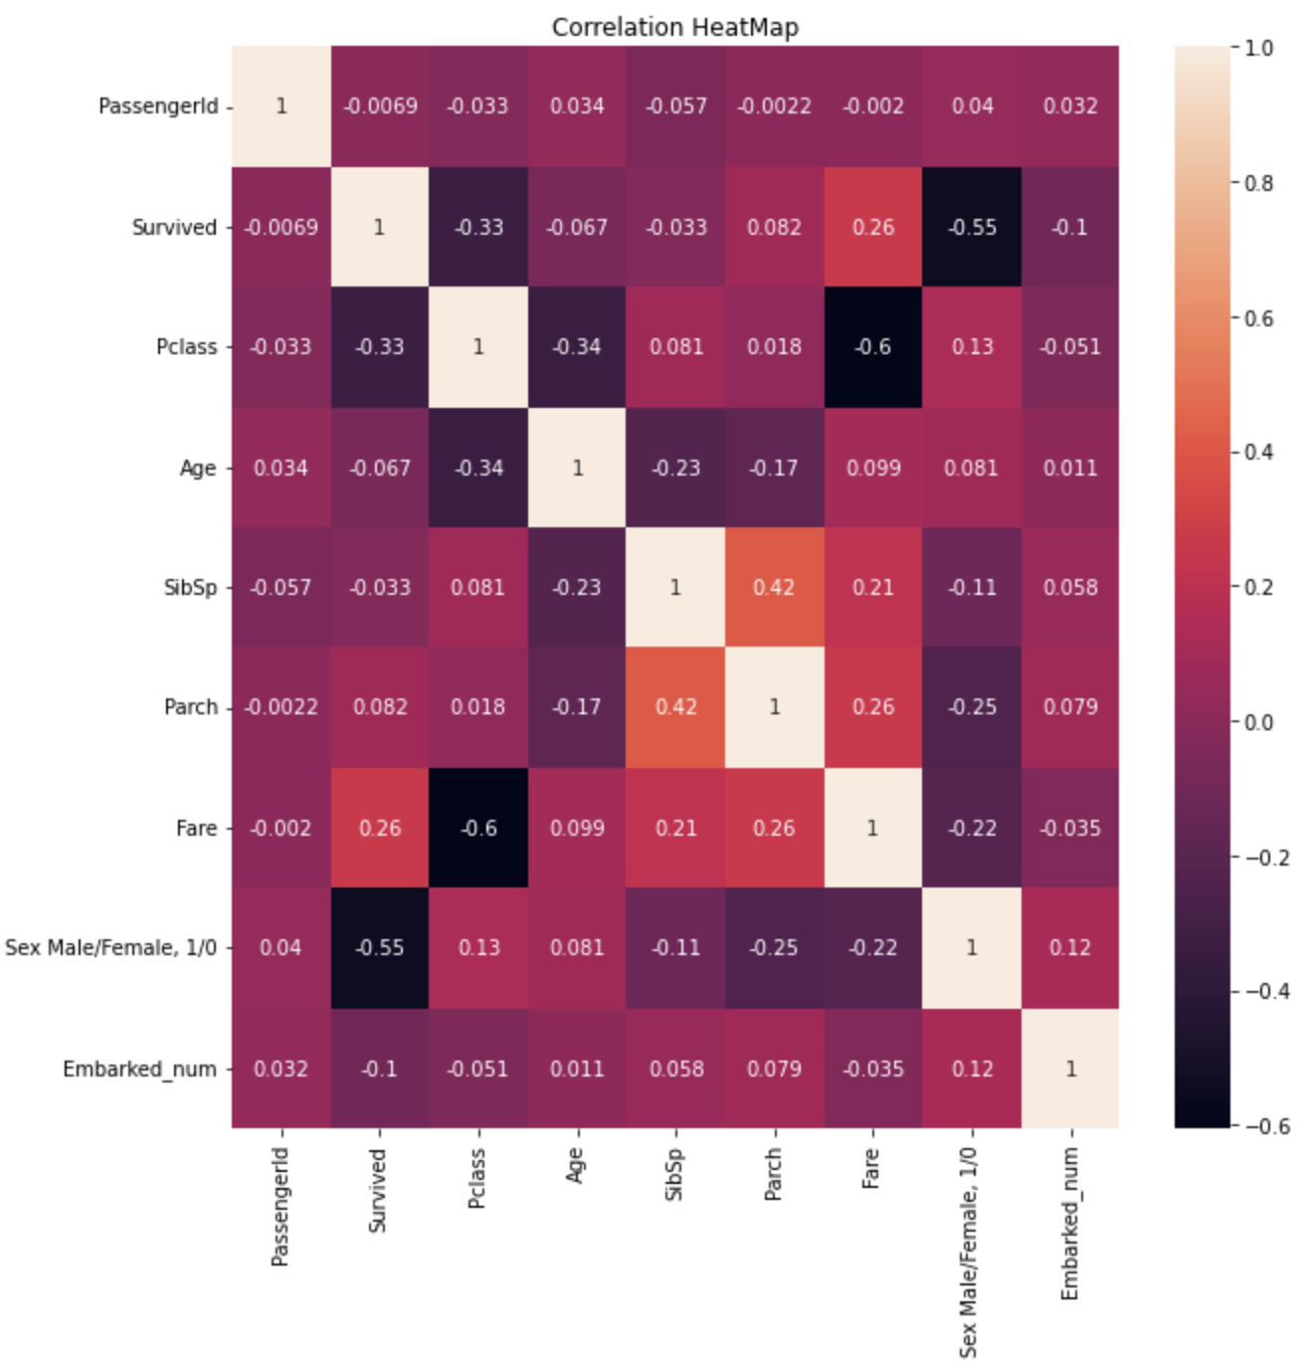
Exploring correlations between variables
To understand the correlations between variables, we decided to make a HeatMap.
For the most part we do not see much correlation between “Pclass” and most other variables like “Sex” or where they embarked from.
or number of family members on board

Slide 11
Exploring correlations between variables
The highest correlation we see is a negative correlation between the fare and the Pclass variables of -0.6
This leads us to believe that those with higher fares, got a “Pclass” with a lower number.
Pclasses with a lower number indicates a higher class, for example “Pclass” 1 is first class.
This correlation makes sense, we would expect those with better socio-economic statuses(ie better classes) to be able to afford better seats..

Slide 12
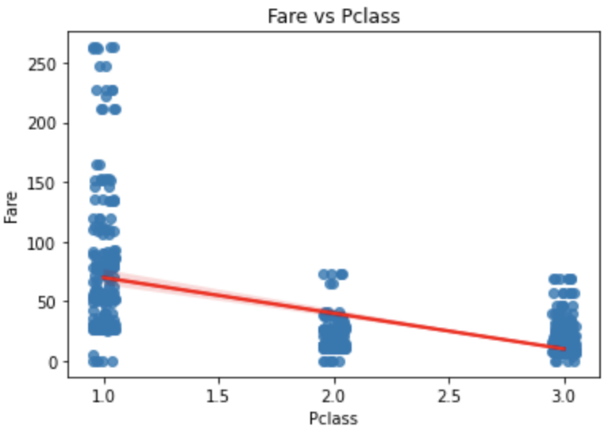
Fare vs Pclass
The red line indicates : lower fare is related to higher Pclass number

Slide 13
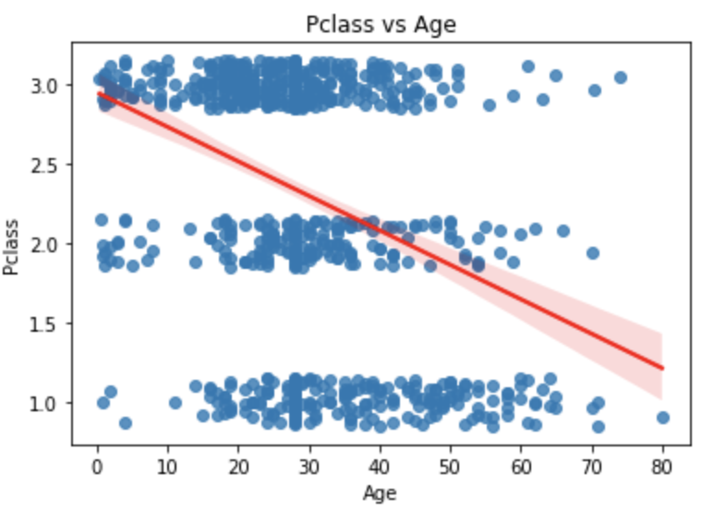
Pclass vs Age
The red line indicates : higher age is related to lower Pclass number

Slide 14
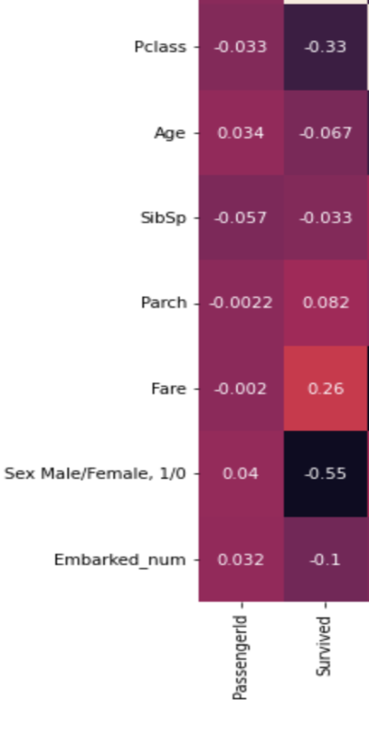
How different variables correlate with Survival
We can see that many things did not have a strong correlation with survival rate in our heatmap.
For example the correlation between the survived and age is very low. We found this to be surprising that age was not an important factor
The highest correlations with survival were our Pclass and Sex variables.

Slide 15
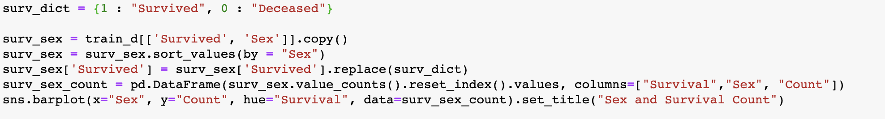
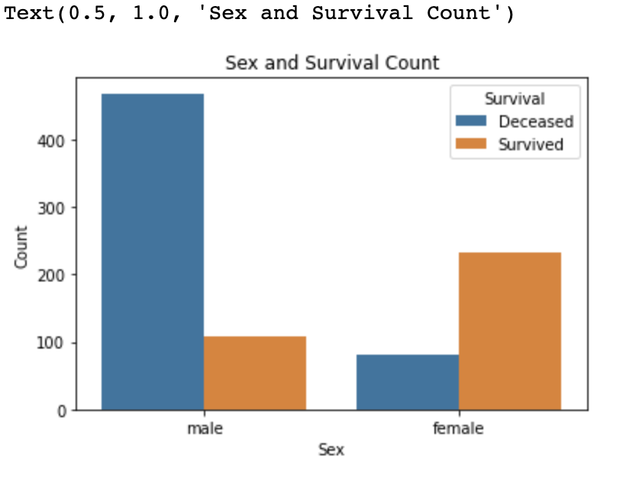
Sex and Survival count
We can see in the graph that Sex had a correlation with survival.
We can see that most men died on the titanic while a large proportion of women survived the titanic.

Slide 16
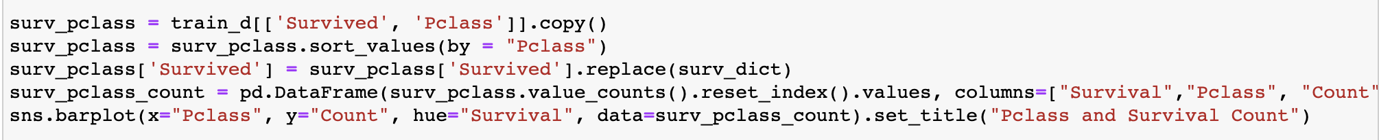
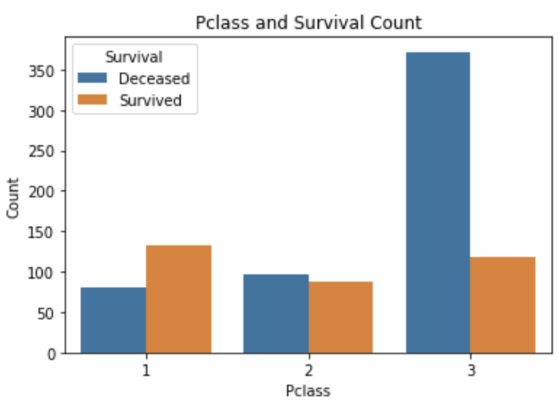
Pclass and Survival count
From the graph we can see that the people in the 1st Pclass had a greater than 50% survival rate. Whereas the people in class 3 had a less than 33% survival rate.

Slide 17
Modelling and Question Answering
First we split our data into both testing and training sets. We will train our models with the training set.
We will also evaluate how well these models do by using the training set.
Makes a training set with a random sample(80%) with a random state that is a key
Create a testing set by dropping the training set from the original
We now have a randomly sampled training and testing set from the original data.

Slide 18
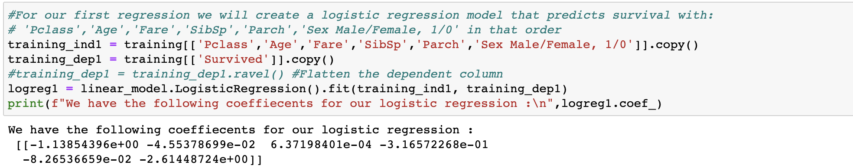
First model: Predicting Survival
This model predicts survival with : 'Pclass', 'Age', 'Fare', 'SibSp', 'Parch', 'Sex Male/Female, 1/0' in that order.
This model works by taking in many parameters (listed above) and predicting whether or not someone survived with this.
We opted to use a logistic regression over a linear regression because our output was binary, 0/1.

Slide 19
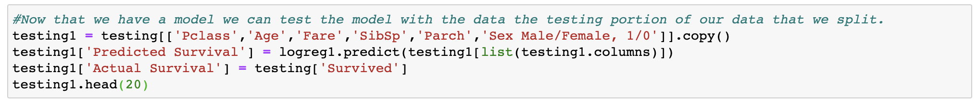
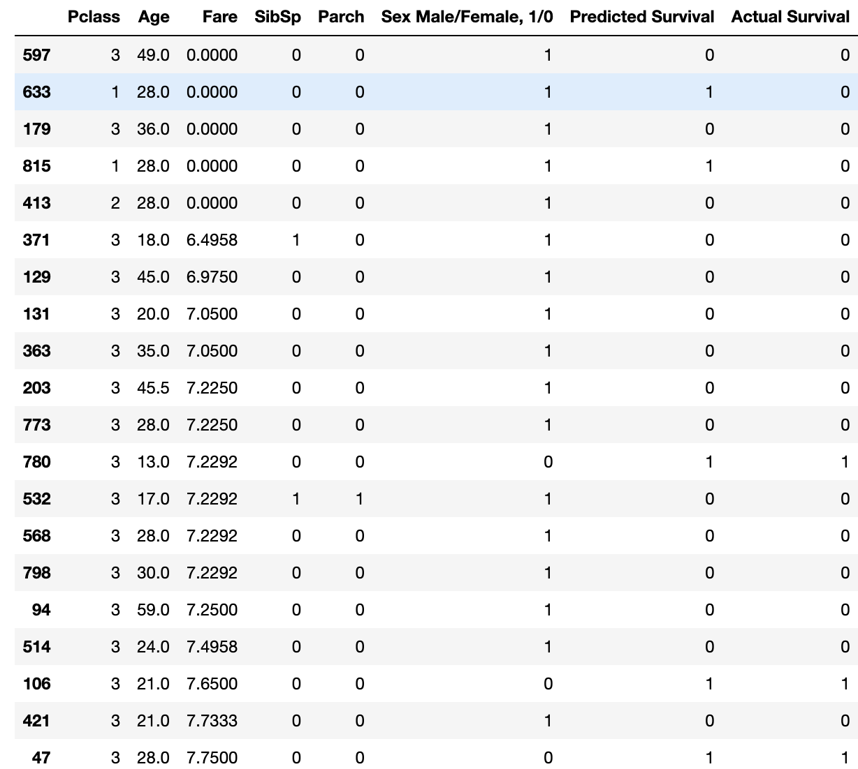
Testing the First Model
By comparing the Predicted Survival and Actual Survival columns, We can see that the model seems to have performed alright

Slide 20
Better Evaluation methods
We can use Precision, Recall, and Fscore to better evaluate our model
Precision : exactness, % of points labeled positive that are actually positive
= True Positives / (True Positives + False Positives)
Recall : completeness, % of positive points labeled as positive
= True Positives / (True Positives + False Negatives)
F measure/score : harmonic mean of precision and recall
= (2 * precision * recall) / (precision + recall)

Slide 21
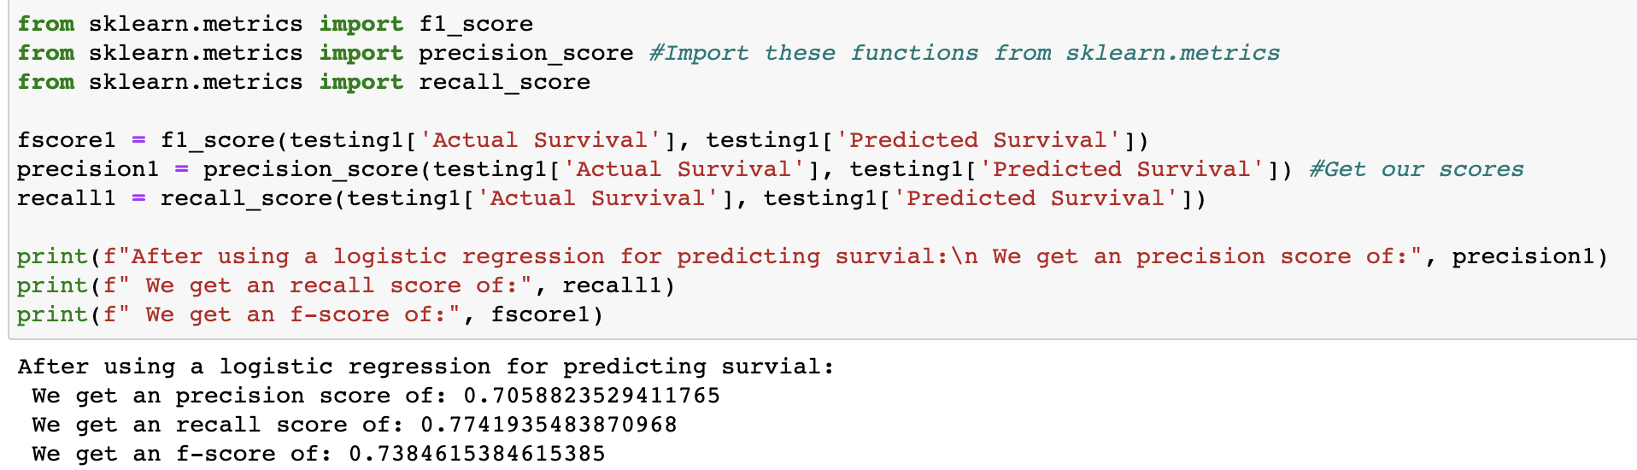
Evaluating The Model Using These Scores
From the scores, we can conclude that this is overall a pretty decent model for predicting survival.
The best indication on whether or not this model did well is the f-score. We got a decent f-score for our model.
This makes sense because we saw correlations between some factors and survival, for example the individual's sex.

Slide 22
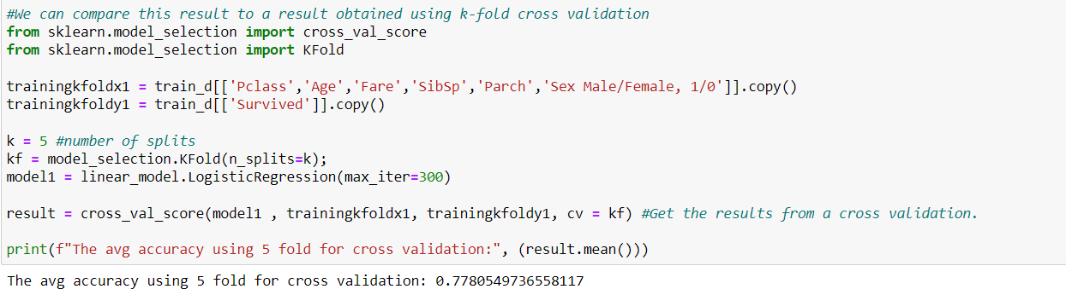
K-fold Cross Validation
By using 5 folds, we see that the average accuracy has slightly risen.

Slide 23
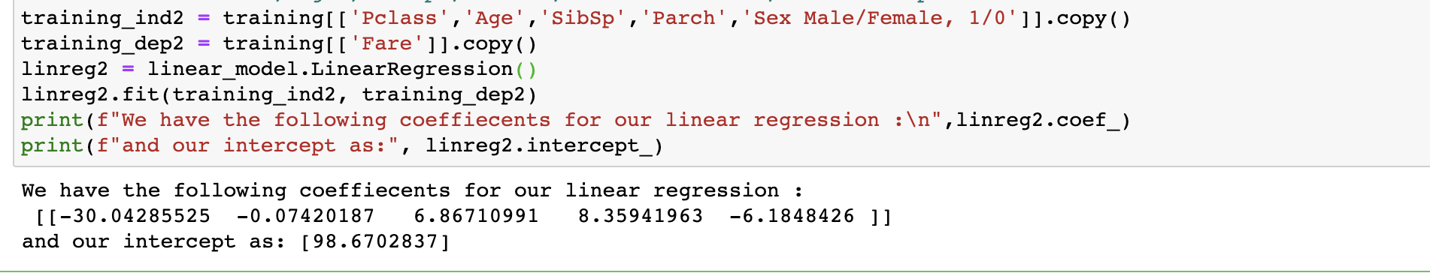
Second model: Predicting Fare
This model predicts the value of Fare with : 'Pclass', ’Age', 'SibSp', 'Parch', 'Sex Male/Female, 1/0' as input for our model.
This model is a Linear Regression Model.

Slide 24
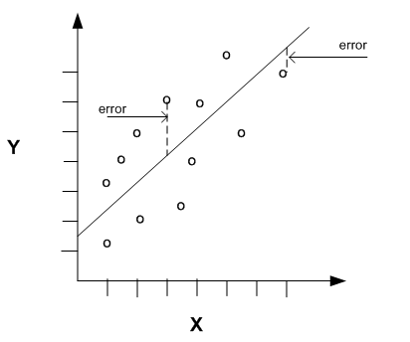
Linear Regression Explanation:
Linear Regression works by minimizing the error between the predicted values and the actual values.
Where the error can be quantified as:
Errori = 𝑦𝑖 − 𝑓(𝑥𝑖)
Our linear regression model finds an f(x) that minimizes this error.
Picture source:
https://docs.oracle.com/cd/E18283_01/datamine.112/e16808/regress.htm

Slide 25
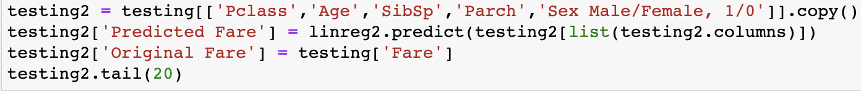
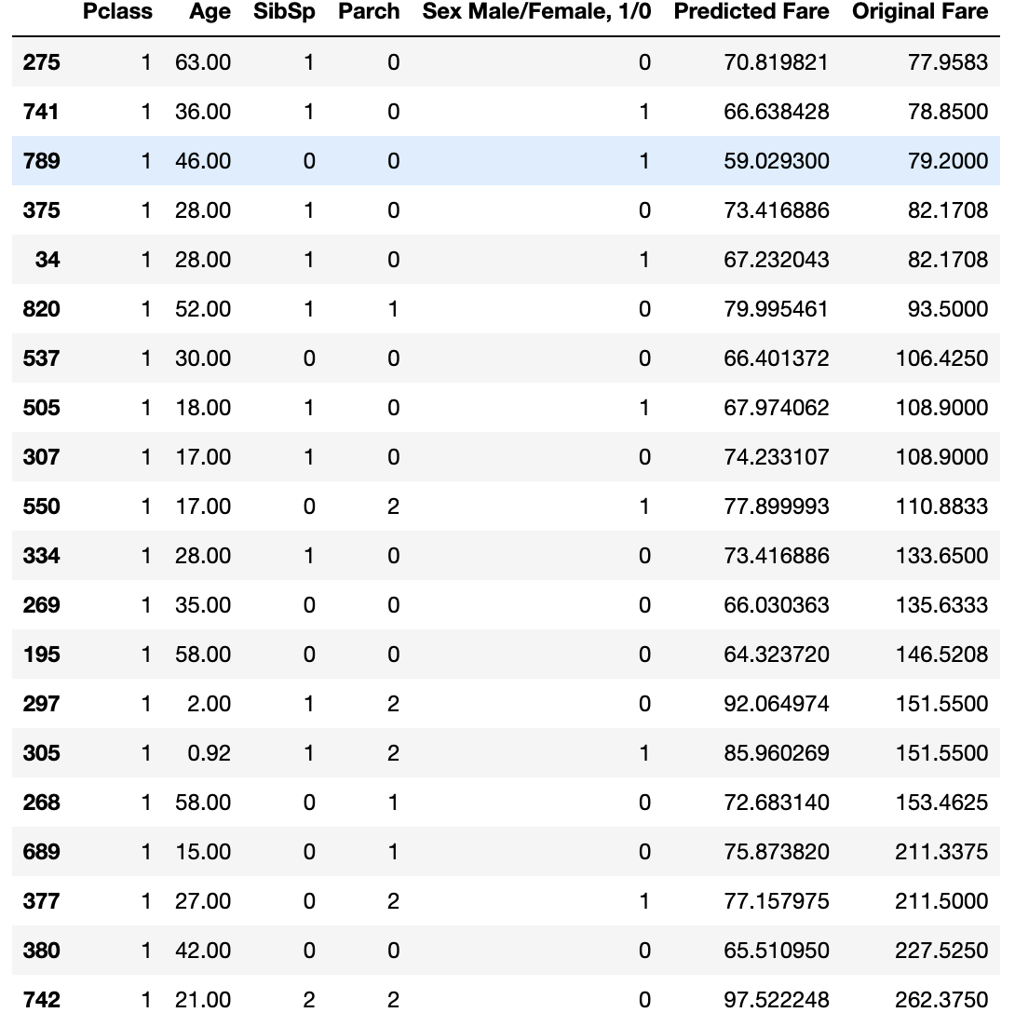
Testing the Second Model
It is hard to tell how well the model performed just by looking at the Predicted Fare and Original Fare columns. Hence we must find the root mean squared error of our prediction.

Slide 26
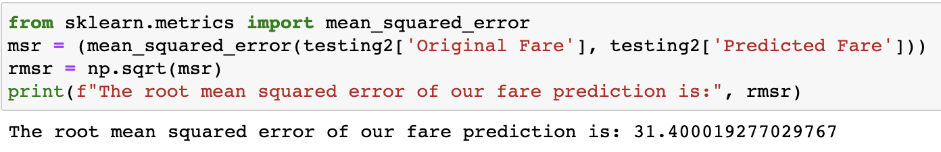
Root mean squared error
We can see that this model did not do the best job predicting the fare.
Our root mean squared error gave us an error that high considering the data.
For our fare to be off by this much could mean that there was not a very strong correlation between the other data points and the fare.

Slide 27
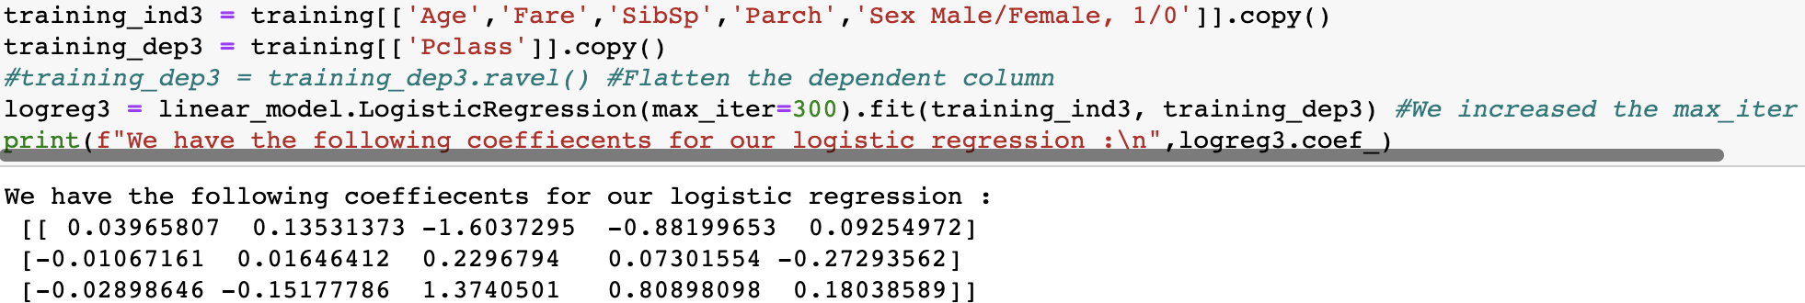
Third model: Predicting Pclass value
This model predicts Pclass value with : the following columns as input: 'Age', 'Fare', 'SibSp', 'Parch', 'Sex Male/Female, 1/0'.
This is a logistic model.

Slide 28
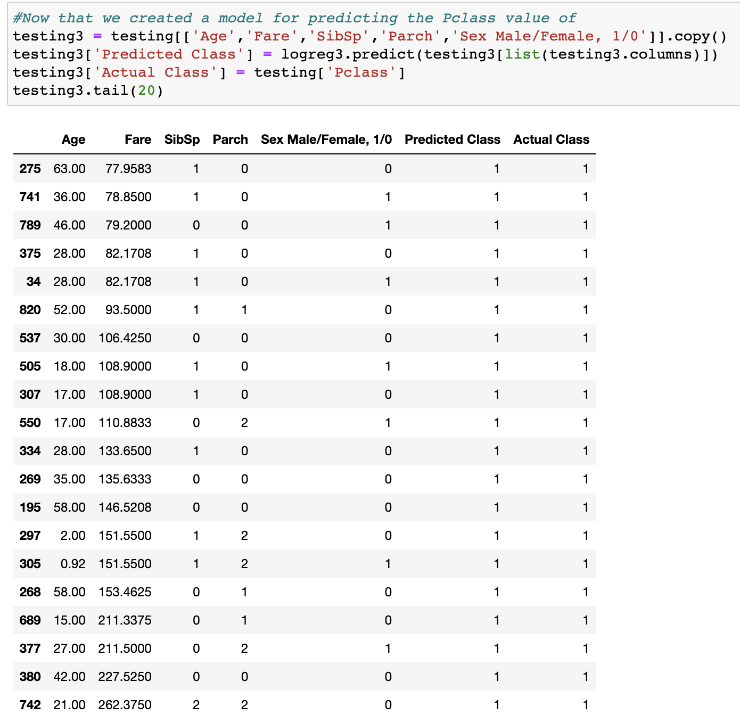
Testing the Third Model
It is hard to tell how well the model performed just by looking at the Predicted Class and Actual Class columns. Hence we must use better evaluation methods again.

Slide 29
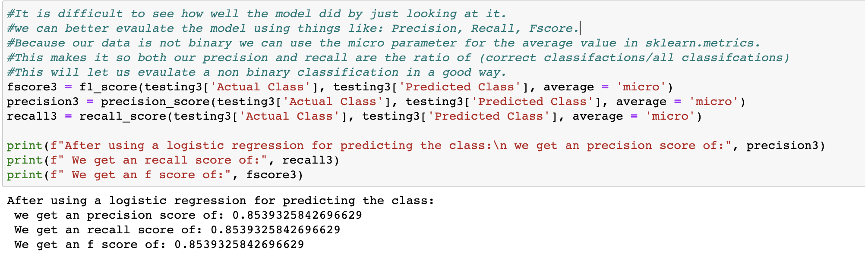
Evaluating The Model Using Scores
From the scores, we can conclude that our model was able to pretty accurately determine the Pclass value based on other features.

