Slide 1
American Express Campus Analyze This 2018
Final Submission

Slide 2
Team Details
Team Name : KaushalArmy
Name | Campus | Roll No. | Mobile No. | Email Id
Varun Vankineni | IIT Madras | AE14B050 | 9176492457 | varunvankineni@gmail.com
Sateesh Sivakoti | IIT Madras | AE14B047 | 8639560574 | sivakoti.sateesh@gmail.com

Slide 3
Estimation Techniques Used
An Ensemble of Gradient boosting tree and a Neural Net was used for the final prediction
Gradient boosting tree was used as it could internally handle the large number of missing values prevalent in our data
A Neural was trained to maximize the prediction accuracy of non-defaulters, which intuitively should optimize our application checking procedure
We use other techniques to
Linearize our feature set for transformation of our data
Fill missing using a robust kNN imputation technique
Create binary sparse features for missing values to retain the unavailability

Slide 4
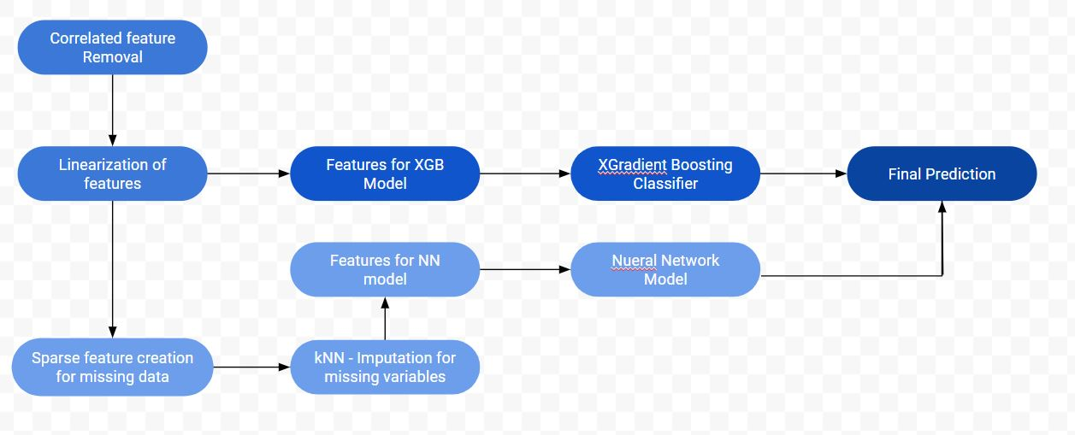
Estimation Techniques Flow Chart

Slide 5
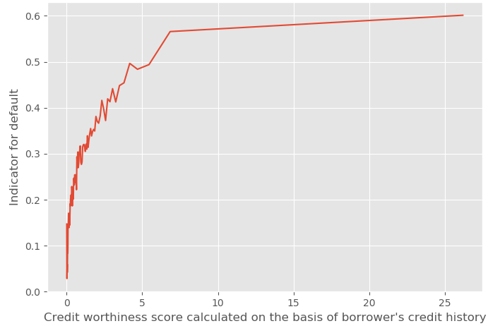
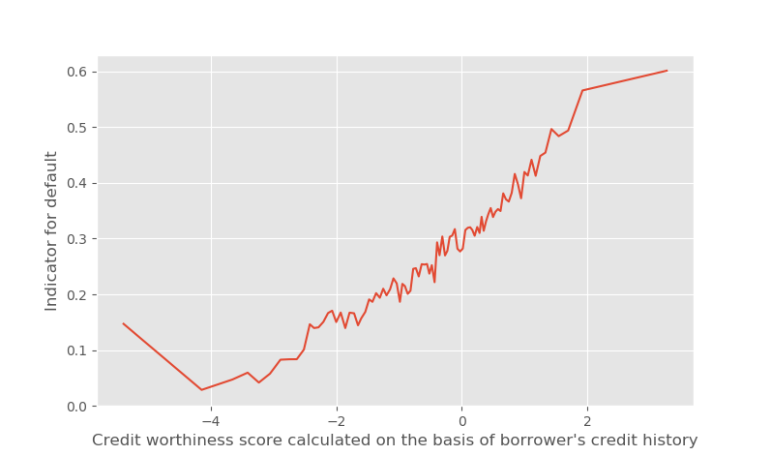
Feature Linearization
We transform the data in each column of our given dataset such that the probability of defaulting is either increasing or decreasing linearly. Given are two general transformations of the 20 we have used:
X-axis data transformed by applying log()
→
Variable 2 : Credit worthiness score calculated on the basis of borrower's credit history

Slide 6
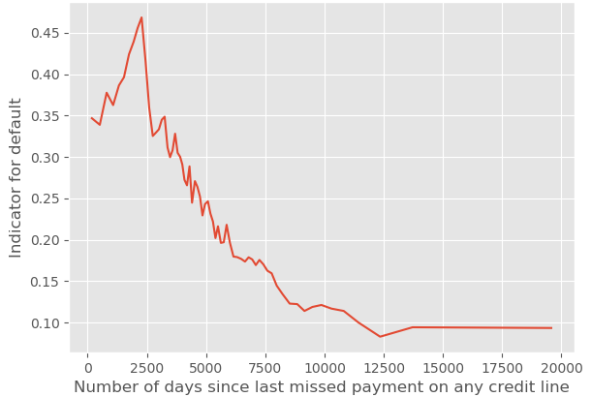
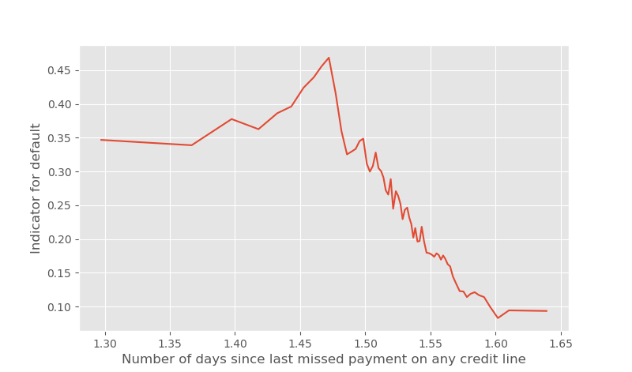
Feature Linearization
X-axis data transformed by applying sqrt()
→
Variable 28 : Number of days since last missed payment on any credit line

Slide 7
Strategy to decide final list
Please provide the strategy employed to decide the final list for submission

Slide 8
Correlated Features
We plot the correlation heatmap for the given variables and try to remove variables with high correlation.
If two different variables have a high correlation (>0.8), we remove the one with more missing values.
The following are some of the highly correlated features which we remove,
Variable | Correlation | NaN Count
Maximum of credit available on all active credit lines (in $) | 0.892 | 7394
Number of auto loans on which the borrower has missed 2 payments | 0.892 | 22789
Tenure of oldest revolving credit card among all active revolving credit cards (in days) | 0.916 | 13209

Slide 9
Sparse Features and kNN Imputation
After removing 9 highly correlated columns we pass the data into an XGBClassifier.
For the use of data in the Neural Net, we cannot use the NaN values. To correct this we use a sequential approach as follows,
We create new columns with the sparse feature to indicate if the value is missing or not i.e., if a values is missing in the original columns we take it as 1 else 0 in the new column
We then pass the NaN columns into a kNN Imputer and replace all the NaN values accordingly
We then use this new dataset as input to our Neural Net model

Slide 10
Final Submission File
Please embed your final submission file (.csv) here.

Slide 11
THANK YOU

