Slide 1
JPM Quant Challenge 2018

Slide 2
Hello!
Sateesh Sivakoti , AE14B047
Varun Vankineni , AE14B050
Team : KaushalArmy, IIT Madras

Slide 3
Problem 1: Dynamic Pricing Model

Slide 4
Problem 1: Presentation Structure
Problem Statement
First Model
Final Model
Covers the approach in building the model submitted during the competition along with minor improvements made.
CV Score: 0.8735
Covers how the First model was improved by adding new features.
CV Score: 0.98

Slide 5
Problem Description
We are given the flight booking records of passengers which contains various booking details along with the price of the ticket
Using this data, we are expected to determine the price of a ticket for an unseen data record
This effectively is building a Dynamic Pricing Model for air tickets taking into consideration the data generated when a person is booking a ticket
The objective of the model built is to maximize the R2 score of the predicted fares

Slide 6
Data Description
Name | Date of Birth | From | To | Flight Date | Flight Time | Booking Date | Class | Fare
Dr. FG61 FS88 | 10/23/1963 | Mumbai | Kolkata | 11/4/2016 | 13:50 | 10/19/2016 | Business | 14737.67
Dr. FG35 FS74 | 10/9/1981 | Lucknow | Hyderabad | 9/19/2016 | 18:30 | 7/31/2016 | Economy | 7621.71
No missing values
Training Data has 7500 samples. 9 features with ‘Fare’ being the target variable
Test data has 2500 samples
Few features which we know would definitely affect fares are not directly present in the data.
For example – Distance, Airlines, days in advance booking was done etc. Some of these can be extracted from the data provided

Slide 7




R2 Score
It is the squared correlation between the predicted values and the observed values
It can be expressed as the ratio of variance explained by the predictor variables to the variance in observed values
$$R^{2}=1−\frac{{Var}_{residual}}{{Var}_{actual}}$$
$$R^{2}=1−\frac{{MSE}_{pred}}{{MSE}_{base}}$$
${Var}_{y}=\frac{1}{N−1}\sum_{i=1}^{N}{{(y−\overline{y})}^{2}}$
${MSE}_{y}=\frac{1}{N}\sum_{i=1}^{N}{{(y−y_{true})}^{2}}$

Slide 8
Solution Approach
The effect of each variable on the Fare is analysed and is modified to get the most information
New features are extracted from the data and their effect is analysed
Gradient Boosting Regressor and Random Forest Regressor have been used due to the high number of categorical variables in the data
A cross validation is set up to obtain the R2 scores of various models considering different features to find the optimal model along with the features to be retained

Slide 9
Gradient Boosting Regressor
It is a boosting algorithm which works by fitting simple decision trees to the data and then sequentially uses more trees to fit the residuals
The trees are not independent of each other. Each tree depends on the residuals left by the tree before it
The model tends to over fit the data if a large number of estimators are used unlike the Random Forest Regressor
This tendency calls for searching for the optimal number of estimators

Slide 10
Name
Miss FG28 FS14
Mr. MG93 MS13
Title
Gender
Mrs. FG53 FS26
Dr. FG61 FS88
Surname?
First Name?
Names with Titles ‘Miss’ and ‘Mrs.’ always begin with F
Names with Title ‘Mr.’ always begin with M. So the first letter is indicative of gender and can be used to obtain gender of any passenger
Features Gender and Title extracted from Name
The Name feature was dropped

Slide 11
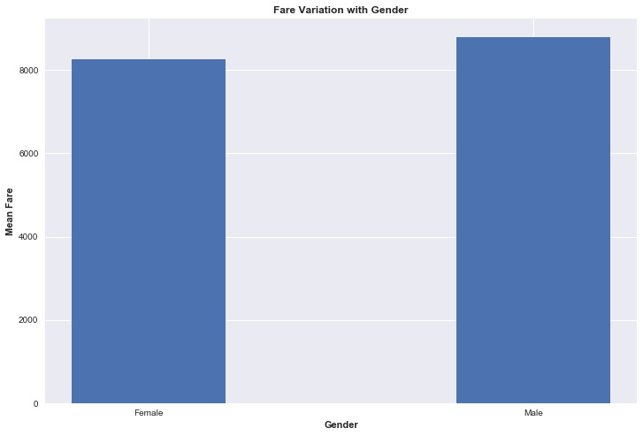
Gender
No significant difference in the average fare across genders
With number of estimators being on the lower side, including this feature decreased the R2 CV score by a small amount
As we went with a higher number of estimators, including this feature improved the R2 score slightly
This feature was retained in the dataset
This column was made binary

Slide 12
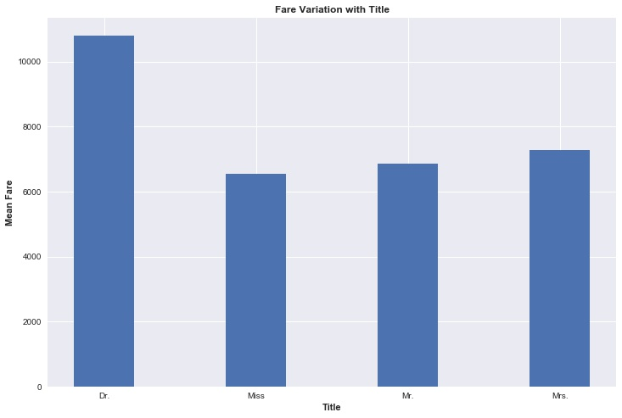
Title
There is a significant variation of average fare with Title
This is retained as a categorical feature

Slide 13
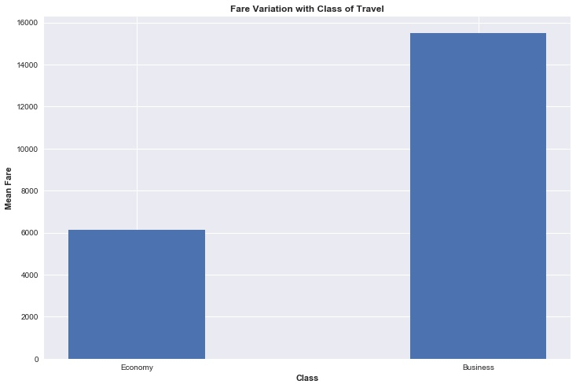
Class
As expected, the business class fares are much higher
This column is made binary

Slide 14
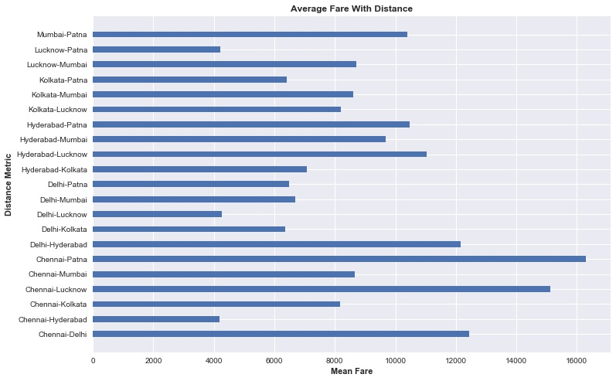
From-To (Distance Metric)
Feature created by merging the cities the journey is between.
City order subtlety was missed in the actual submission.
Improvement in CV score:
0.828 to 0.859

Slide 15
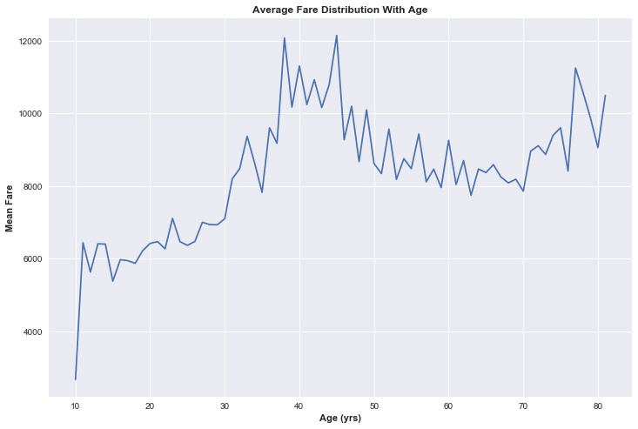
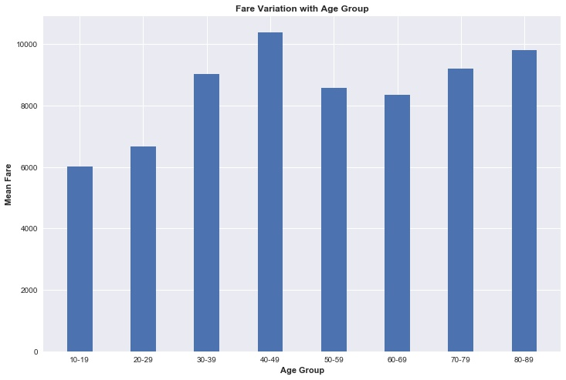
Age
The age is found by subtracting the year of DOB from the year of Booking.
Age as a discrete variable
Age as a binned variable

Slide 16
Age
Age was used as a binned variable and categorical type in the first model
CV score with Age Bins : 0.828
However the performance was found to be better by leaving it as a discrete variable
CV score with Age as a discrete variable : 0.839

Slide 17
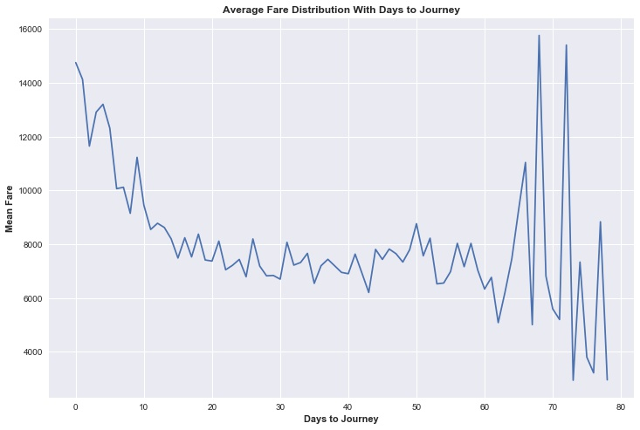
Days to Journey
Feature created by calculating the number of days between date of booking and date of journey.
We see high fluctuation at the higher end of the number of days.
This is because the number of samples/ records with these values is less.

Slide 18
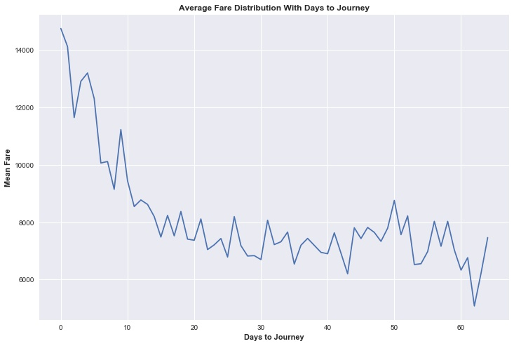
Days to Journey
The mean fare increases as the booking date approaches the flight date.

Slide 19
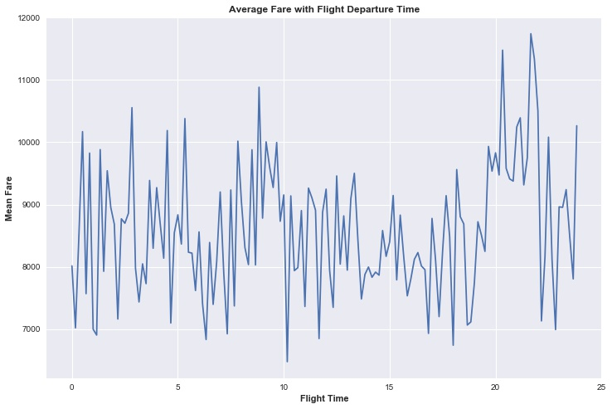
Time
The Fare seems randomly distributed in time except for the higher fares at night.

Slide 20
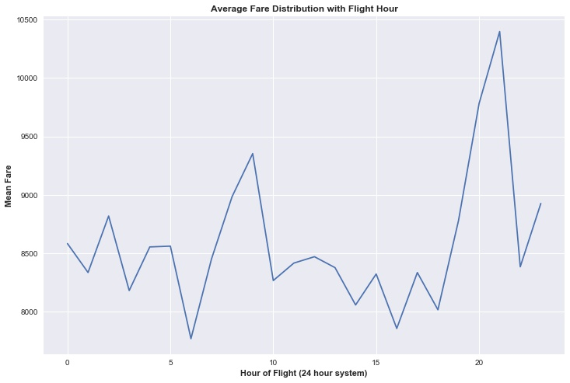
Hour
The time was discretised as Hour of Flight to understand price variations with flight time.
We see certain intervals having high fares.

Slide 21
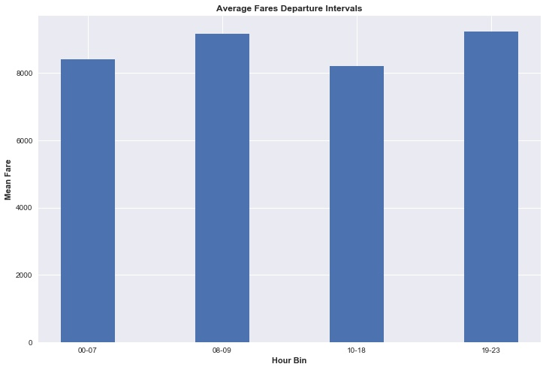
Hour Bins
Bins were created to capture the high fare intervals. This was used in the first model
However the model performs best with the time of flight being left as a continuous variable
Difference in CV score with binned time to continuous time: 0.828 to 0.862

Slide 22

Features Used
Binary Features
Discrete Valued Features
Continuous Feature
Categorical Features with 7 values each
Categorical Feature with 4 categories.
Categorical Feature with 21 categories.

Slide 23
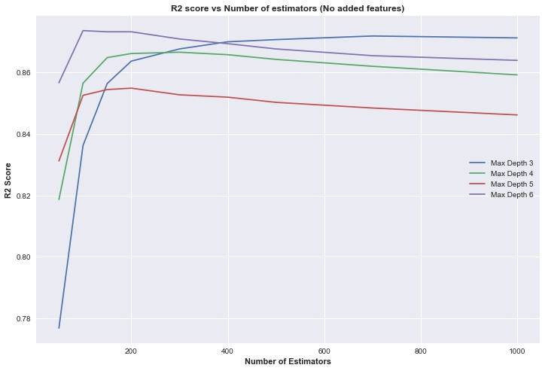
Cross Validation
Till this point we have not added any new features to the dataset used during the submission.
The existing features have been modified and the R2 CV score improved from:
0.828 to 0.8735
GBT with 100 estimators, max depth 6.

Slide 24
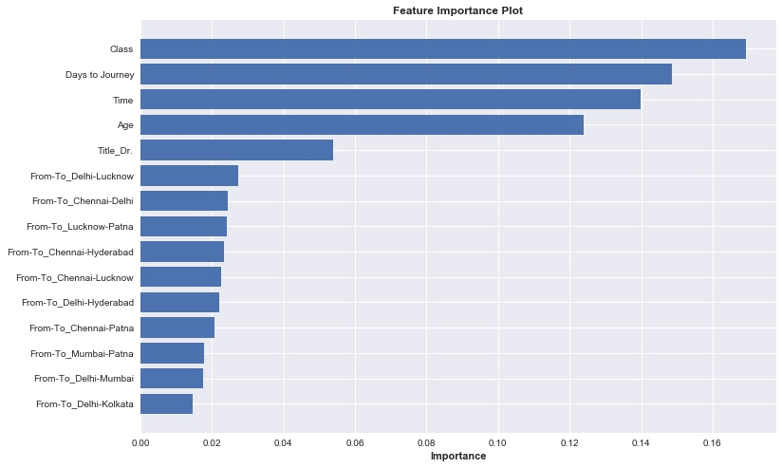
Feature Importance
The 5 most important features are :
Class
Days to Journey
Age
Time of Flight
Title

Slide 25
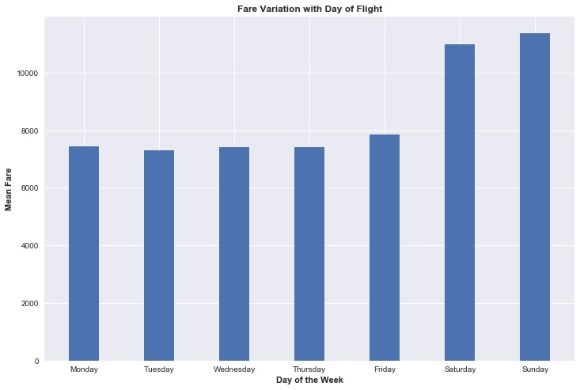
Day of Flight
The fares are almost uniform on the week days
There is a significant increase on the weekends
These were assigned numbers from 0-6
R2 CV score improvement:
0.8735 – 0.98
From this point onwards, this feature is included in the dataset.

Slide 26
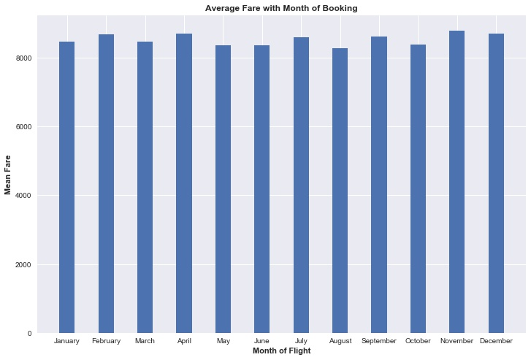
Month of Booking
Expected variation in fares owing to seasonal causes like festive months
No significant variation seen with month of booking
There is almost no change in the R2 CV score on adding this feature

Slide 27
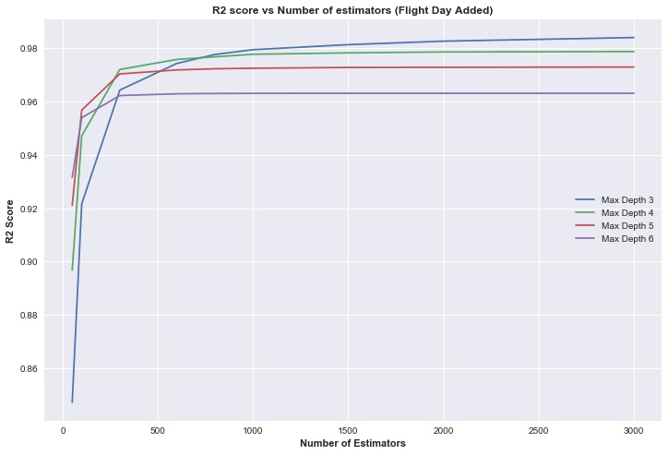
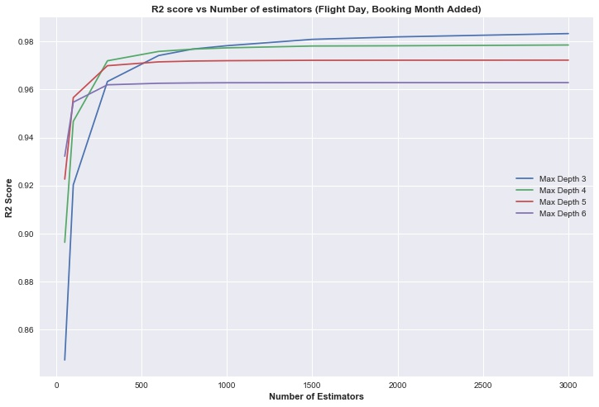
Month of Booking – R2 Comparison

Slide 28
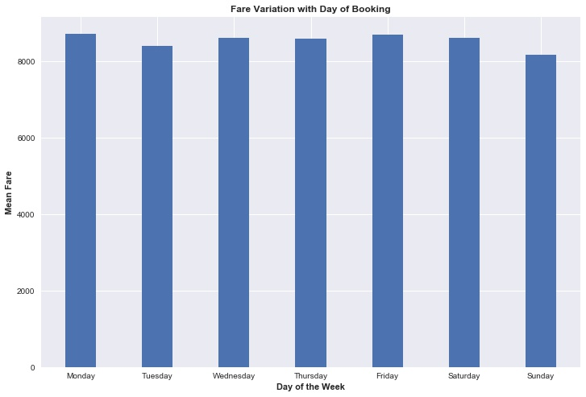
Day of Booking
No significant variation seen with day of booking
No considerable change in R2 CV score obtained

Slide 29
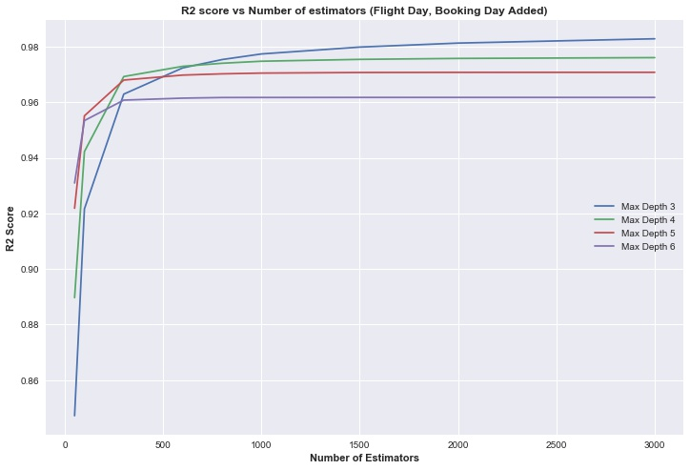
Day of Booking – R2 Comparison

Slide 30
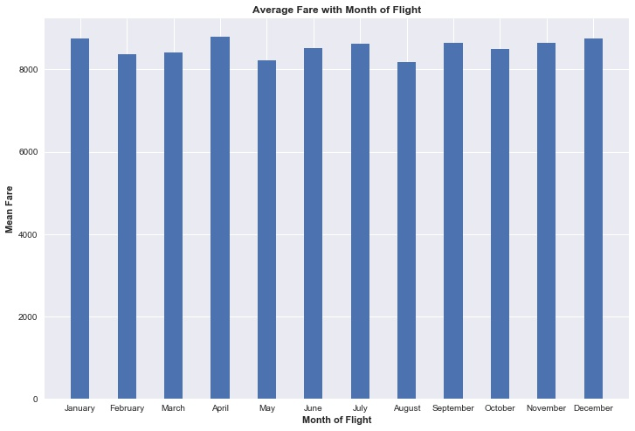
Month of Flight
No significant variation seen with month of flight
No considerable change in R2 CV score obtained

Slide 31
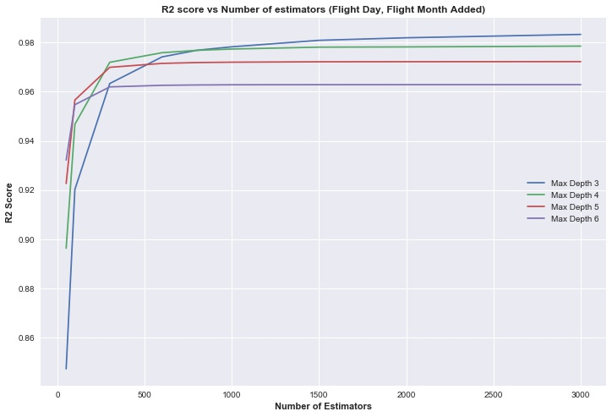
Month of Flight – R2 Comparison

Slide 32
Cross Validation
Split the training data into a training set of 6000 samples and validation set of 1500 samples
Each model was trained on the 6000 samples and tested on the 1500 samples
The model which achieved the highest R2 score on the validation set was chosen
The best model was a Gradient Boosting Regressor with 1000 estimators and a maximum depth of 3

Slide 33
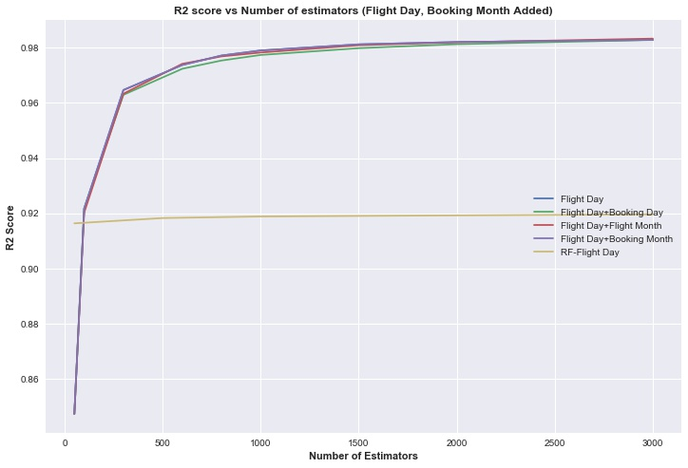
Model Performance Comparison
All the GBT models perform identically
It is clear that there is no value in adding Booking Month, Booking Day and Flight Month to the data after Flight Day
Hence these features are dropped
The GBT outperforms the best performing Random Forest by close to 6%

Slide 34
Final Set of Features
Binary Features
Discrete Valued Features
Continuous Feature
Categorical Features with 7 values each
Categorical Feature with 4 categories.
Categorical Feature with 21 categories.
Discrete Valued Feature

Slide 35
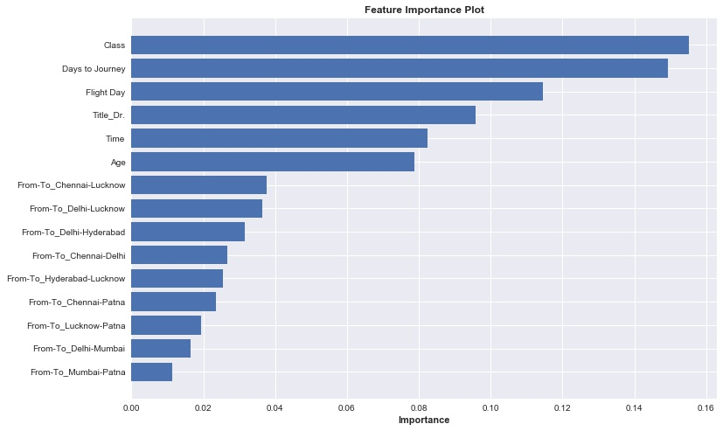
Feature Importance
Flight Day which turns out to be a very important feature was missed out earlier.

Slide 36
Final Model Implementation
Read Data and Pre-process
Create
Features
Drop Features
Feed to Model
Output
Convert ‘class’ to a binary variable
Convert ‘Flight Time’ to a continuous variable
Gender
Title
Age
From-To
Days to Journey
Flight Day
Name
DOB
Booking Date
Flight Date
Gradient Boosting Regressor with 1000 estimators and maximum depth 3
Predicted Fares

Slide 37
Problem 2: Stock Price Simulation

Slide 38


Problem Statement
Governing equation:$dX_{t}=a\left(θ−X_{t}\right)dt+σ\sqrt{X_{t}}dW_{t}$
Random variable :$dW_{t}=N\left(0,1\right)\sqrt{dt}$
Process similar to GBM
Tendency of $X_{t}$ to reach $θ$
Simulation from t=0 to T=2
Function inputs are $a,θ,X_{0},σ$

Slide 39

Solution Approach
Sub-problem 1 : $E[X_{T=2}]$
Divide time into 100 intervals of resolution $dt=0.02$
Sample $dW_{t}$ in each of these intervals
Propagate $X_{t}$ with time using the governing eq.
Total simulation runs = 10000

Slide 40

Variance Reduction
Final solution is a mean of all runs
The lesser the variance in the output, the better the accuracy of our solution
Testing case f($a=0.1,θ=100,X_{0}=100,σ$=0.1)
=>

Slide 41

Control Variables
Reusing variables in each simulation run
$$E\left[X_{T=2}\right]=E\left[X_{T=2}−\sum_{i=1}^{100}{c_{i}{dW}_{i}}\right]$$
$$c_{i}=\frac{cov(E\left[X_{T=2}\right],{dW}_{i}\text{) }}{var({dW}_{i})}$$

Slide 42

Antihectic Variables
Reusing variables from the previous run
For every odd k,
$$dW\left(k+1\right)=−dW(k)$$

Slide 43
Variance reduction analysis – SP1

Slide 44
Variance reduction analysis – SP1

Slide 45
Variance reduction analysis – SP1
The variance with control variables is very close to the normal case
Addition of antihectic variables reduces the variance to ~e-8

Slide 46
Why control variables are
Ineffective?
Inject variance through the addition of the random variable
Reduce variance through its correlation with the final estimate
As number of intervals increase this correlation falls drastically
Influence of drift term further reduces the correlation

Slide 47

Why control variables are
Ineffective?
$$var\left(Y−cX\right)=σ_{Y}^{2}+c^{2}σ_{X}^{2}−2cρ_{XY}σ_{X}σ_{Y}$$
$$c=\frac{σ_{Y}}{σ_{X}}ρ_{XY}$$
$$var(Y−cX)=(1−ρ_{XY}^{2})σ_{Y}^{2}$$
For $ρ_{XY}\sim 0$ the improvement is negligible

Slide 48

Solution Approach
Sub-problem 2 : $E[{max⁡(X}_{t}−100,0)]$
Payoff condition applied at the end

Slide 49
Variance reduction analysis – SP2

Slide 50

Solution Approach
Sub-problem 3 : $\frac{∂E[max⁡(X_{t}−100,0)]}{∂σ}$
$$f(σ) = E[max⁡(X_{t} − 100, 0)]$$
$$f^{′}\left(σ\right)= \frac{df\left(σ\right)}{dσ}=\frac{∂E[max⁡(X_{t}−100,0)]}{∂σ}$$

Slide 51

Forward difference
Differential in +h direction:
$$f^{′}\left(σ\right)= \frac{f\left(σ + h\right)− f\left(σ\right)}{h}−\frac{h}{2!}f^{′′}\left(σ\right)$$
$$− H(O^{3}) − H(E^{4})$$
Not accurate enough

Slide 52

Backward difference
Differential in -h direction:
$$f^{′}\left(σ\right)= \frac{f\left(σ \right)− f\left(σ−h\right)}{h}+\frac{h}{2!}f^{′′}\left(σ\right)$$
$$− H\left(O^{3}\right)+ H(E^{4})$$

Slide 53

Central difference
Combining both differentials:
$$f^{′}\left(σ\right)= \frac{f\left(σ+h\right)− f\left(σ−h\right)}{2h}$$
$$− H\left(O^{3}\right)$$
Reduction in residual terms by half
Reduced most significant order from 2 to 3

Slide 54
Variance reduction analysis – SP3

Slide 55
Conclusion
Control variables were not used due to their insignificance in reducing outcome variance
Antihectic variables reduce variance by ~40% in sub problems 2,3
Central differencing was employed for an accurate measure of the payoff change w.r.t volatility

Slide 56
Problem 3: Payoff from correlated stock prices

Slide 57



Problem Statement
Governing equations:$dX_{t}=rX_{t}dt+σ_{X}dW_{X}$
$dY_{t}=rY_{t}dt+σ_{Y}dW_{Y}$
Random variables :$dW_{X}=ε_{1}\sqrt{dt}$
$dW_{Y}=ε_{2}\sqrt{dt}$
$ε_{1}$, $ε_{2}$ are correlated $N\left(0,1\right)$ variables
Similar to previous case with changes in drift term
Correlation given from past data
r is an input parameter

Slide 58

Problem Statement
Payoff =$max(\frac{X_{T}}{2X_{0}}+\frac{Y_{T}}{2Y_{0}}−1, 0)$
Precondition: $X_{Ti}∈[0.75X_{0},1.25X_{0}]$
$Y_{Ti}∈[0.75Y_{0},1.25Y_{0}]$
$$Ti=t_{0}+0.25i, i=0,1,…N$$
N is the number of quarters given as an input
Final Price = $E[payoff]e^{−rT}$

Slide 59

Solution Approach
Divide the time into number of days
Per quarter we have 63 days (252 per year)
Total simulation runs = 10000
From the given past stock prices compute the correlation between $ε_{1}$, $ε_{2}$
Sample $dW_{X}$, $dW_{Y}$ using multivariate correlated sampling for all the days

Slide 60


Correlation ($ε_{1}$, $ε_{2}$) : Formulation
$$cor(ε_{1}\text{, }ε_{2}) = ρ = cor(∆log⁡(X), ∆log⁡(Y))$$
$$sd(ε_{1})=σ_{X}= std(∆log⁡(X))$$
$$sd(ε_{2})=σ_{Y}= std(∆log⁡(Y))$$
Here, $∆$ = forward difference

Slide 61
Stock X : Past prices

Slide 62
Stock Y : Past prices

Slide 63

Stock X : $∆log⁡(X)$

Slide 64

Stock Y : $∆log⁡(Y)$

Slide 65



Correlation ($ε_{1}$, $ε_{2}$) : Results
$$cor(ε_{1}\text{, }ε_{2}) = ρ =0.4948813$$
$$sd\left(ε_{1}\right)=σ_{X} =0.007757425$$
$$sd(ε_{2})=σ_{Y}=0.01652896$$
We use $ρ$ in multivariate sampling of $dW_{X},dW_{Y}$
The volatilities are used in the governing eq.

Slide 66

Variance Reduction Techniques
Antihectic sampling is used again,
$$dW\left(k+1\right)=−dW(k)$$
The correlation between $ε_{1}$, $ε_{2}$ is retained
Control variables are again omitted following previous conclusions

Slide 67
Solution Approach
In each run propagate the stock price over each day using the governing equation
Check the precondition at the end of each quarter
If the precondition is not satisfied, break with payoff = 0
Compute payoff at EOT if there was no violation
Correspondingly compute final price over all runs

Slide 68
Variance reduction analysis

Slide 69
Variance reduction analysis

Slide 70
Conclusion
Stock X has considerable drift
Both stocks do not exhibit stationarity
Correlation was calculated from past prices after visual stationarity check of forward differences
Antihectic variables reduce variance by ~30%

Slide 71
Thanks!
Any questions?
You can find us at
varunvankineni@gmail.com
sivakoti.sateesh@gmail.com

