Slide 1
JPM Quant Challenge 2018

Slide 2
Problem 1: Dynamic Pricing Model

Slide 3
Problem 1: Presentation Structure
Problem Statement
First Model
Final Model
Approach in building the model submitted during the competition along with minor improvements made.
CV Score: 0.8735
Improving the First Model by adding new features.
CV Score: 0.98

Slide 4
Problem Description
We are given the flight booking records of passengers which contains the booking details along with the price of the ticket.
Using this data, we are expected to determine the price of a ticket for an unseen data record.
This effectively is building a Dynamic Pricing Model for air tickets taking into consideration the data generated when a person is booking a ticket.
The objective of the model built is to maximize the R2 score of the predicted fares.

Slide 5
Data Description
Name | Date of Birth | From | To | Flight Date | Flight Time | Booking Date | Class | Fare
Dr. FG61 FS88 | 10/23/1963 | Mumbai | Kolkata | 11/4/2016 | 13:50 | 10/19/2016 | Business | 14737.67
Dr. FG35 FS74 | 10/9/1981 | Lucknow | Hyderabad | 9/19/2016 | 18:30 | 7/31/2016 | Economy | 7621.71
No missing values
Training Data has 7500 samples. 9 features with ‘Fare’ being the target variable
Test data has 2500 samples
Few features which we know would definitely affect fares are not directly present in the data.
For example – Distance, Airlines, days in advance booking was done etc. Some of these can be extracted from the data provided

Slide 6




R2 Score
“It is the ratio of the variance explained by the independent variables to the variance in the dependent variable.”
“It is the improvement in prediction of the target variable over the baseline (mean prediction) model in terms of the mean squared error.”
If the variance in the target variable is completely explained by the independent variables/ features, the R2 score would be 1. If simply the mean is predicted for the fare for all instances, the R2 score would be zero.
So the objective is to minimise the Mean Squared Error of the predictions.
$$R^{2}=1−\frac{{Var}_{residual}}{{Var}_{actual}}$$
$$R^{2}=1−\frac{{MSE}_{pred}}{{MSE}_{base}}$$
${Var}_{y}=\frac{1}{N−1}\sum_{i=1}^{N}{{(y−\overline{y})}^{2}}$
${MSE}_{y}=\frac{1}{N}\sum_{i=1}^{N}{{(y−y_{t})}^{2}}$

Slide 7
Gradient Boosting Regressor
It is a boosting algorithm which works by fitting simple decision trees to the data and then sequentially uses more trees to fit the residuals.
The trees are not independent of each other. Each tree depends on the residuals left by the tree before it.
The model tends to over fit the data if a large number of estimators are used unlike the Random Forest Regressor.
This tendency calls for searching for the optimal number of estimators.
The estimators are simple individually and hence we do not have to go with deep trees.

Slide 8
Name
Miss FG28 FS14
Mr. MG93 MS13
Title
Gender
Mrs. FG53 FS26
Dr. FG61 FS88
Surname?
First Name?
Names with Titles ‘Miss’ and ‘Mrs.’ always begin with F.
Names with Title ‘Mr.’ always begin with M. So the first letter is indicative of gender and can be used to obtain gender of any passenger.
Features Gender and Title extracted from Name. The Name feature was dropped.

Slide 9
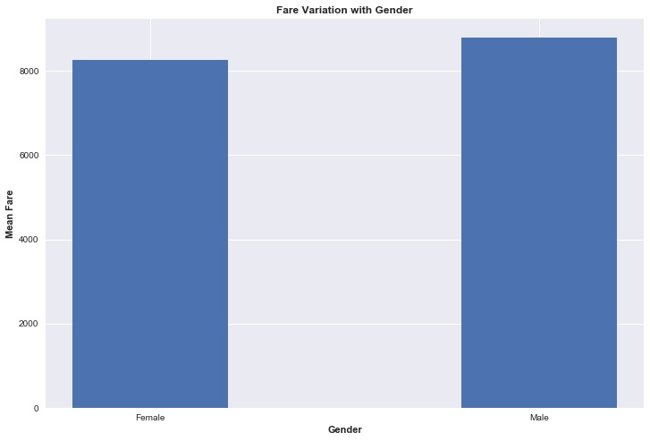
Gender
There is not a huge difference in the average fare across genders.
With number of estimators being on the lower side, including this feature decreased the R2 CV score by a small amount.
As we went with a higher number of estimators, including this feature improved the R2 score slightly.
This feature was retained in the dataset.
The genders were replaced by {0,1}.

Slide 10
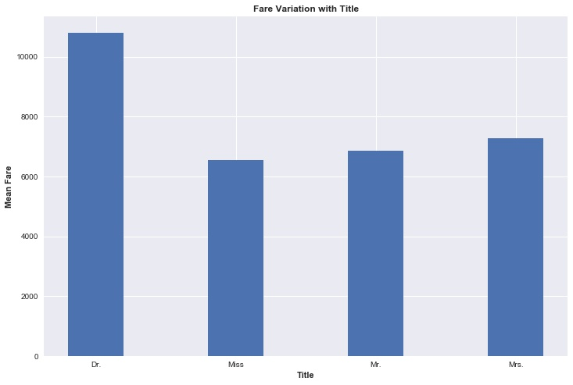
Title
There is a significant variation of average fare with the title of passengers.
This is retained as a categorical feature.

Slide 11
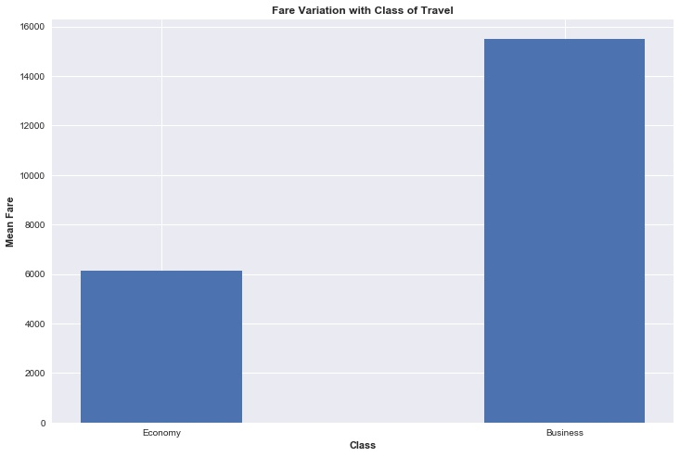
Class
As expected, the business class fares are much higher.
As it is a binary feature the classes were replaced by 1’s and 0’s.

Slide 12
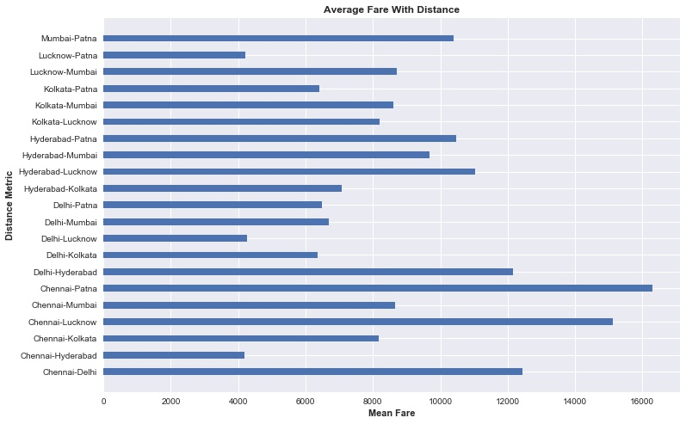
From-To (Distance Metric)
Feature created by merging the cities the journey is between.
City order subtlety was missed in the actual submission.
Improvement in CV score:
0.828 to 0.859

Slide 13
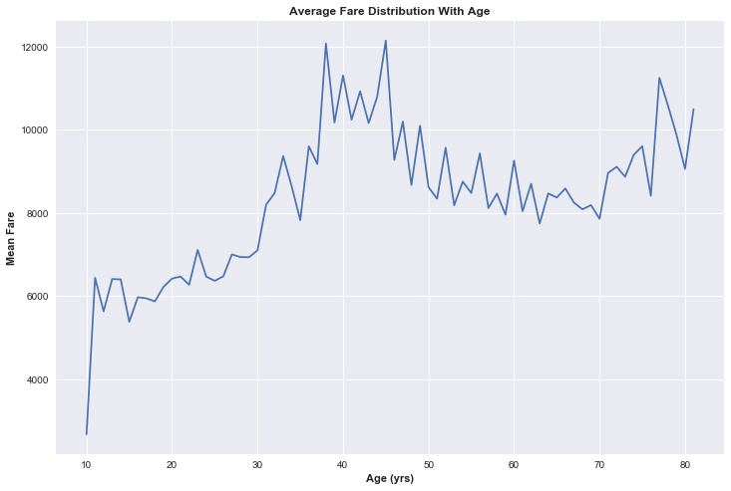
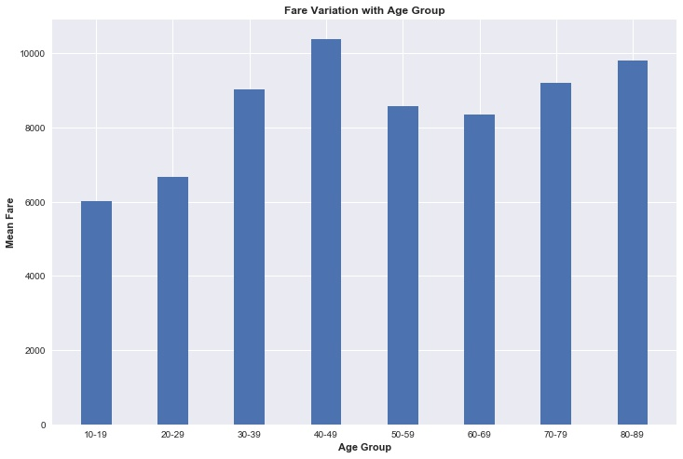
Age
The age is found by subtracting the year of DOB from the year of Booking.
Age as a discrete variable
Age as a binned variable

Slide 14
Age
Age was used as a binned variable and was used as a categorical type in the first model
CV score with Age Bins : 0.828
However the performance was found to be better by leaving it as a discrete variable
CV score with Age as a discrete variable : 0.839

Slide 15
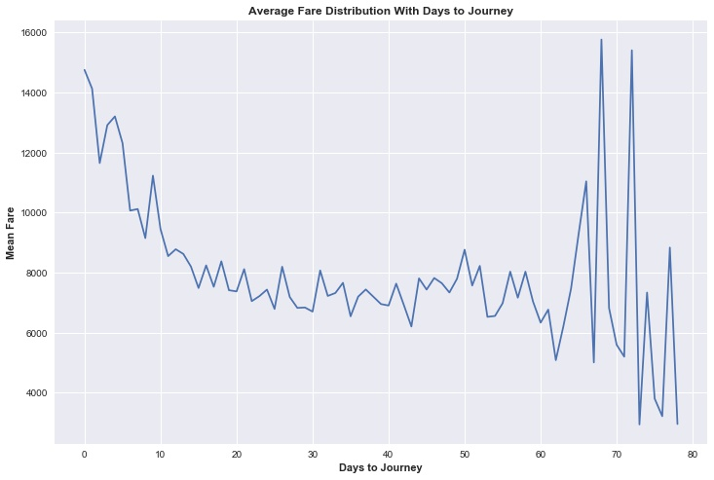
Days to Journey
Feature created by calculating the number of days between date of booking and date of journey.
We see high fluctuation at the higher end of the number of days.
This is because the number of samples/ records with these values is less.

Slide 16
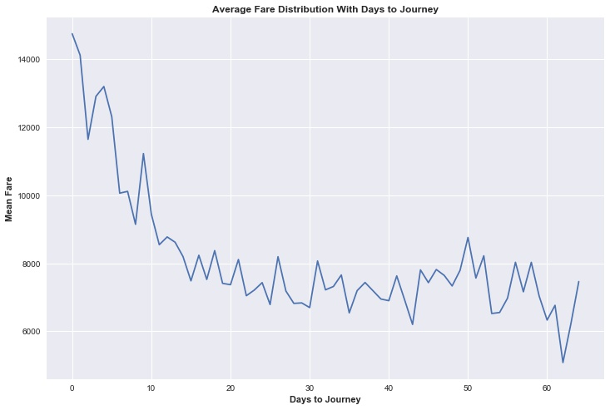
Days to Journey
The mean fare increases as the booking date approaches the flight date.

Slide 17
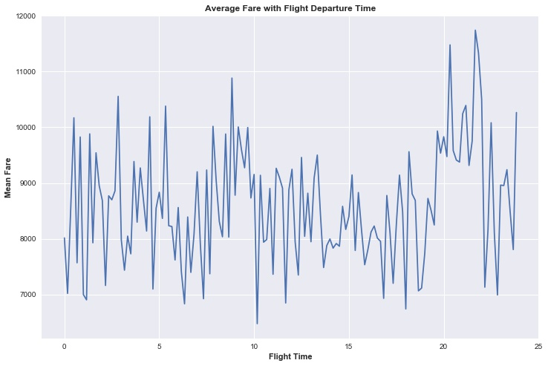
Time
The Fare seems randomly distributed in Time except for the higher fares at night.

Slide 18
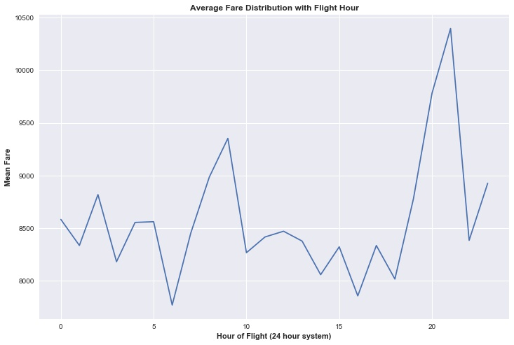
Hour
The time was discretised as Hour of flight to understand price variations with flight time.
We see certain intervals having high fares.

Slide 19
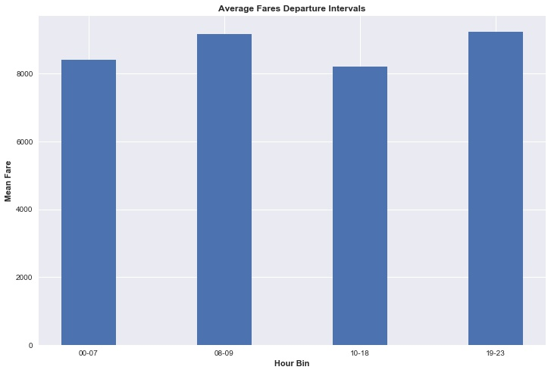
Hour Bins
Bins were created to capture the high fare intervals. This was used in the first model.
However the model performs best with the time of flight being left as a continuous variable.
Difference in CV score with binned time to continuous time: 0.828 to 0.862

Slide 20

Features Used
Binary Features
Discrete Valued Features
Continuous Feature
Categorical Features with 7 values each
Categorical Feature with 4 categories.
Categorical Feature with 21 categories.

Slide 21
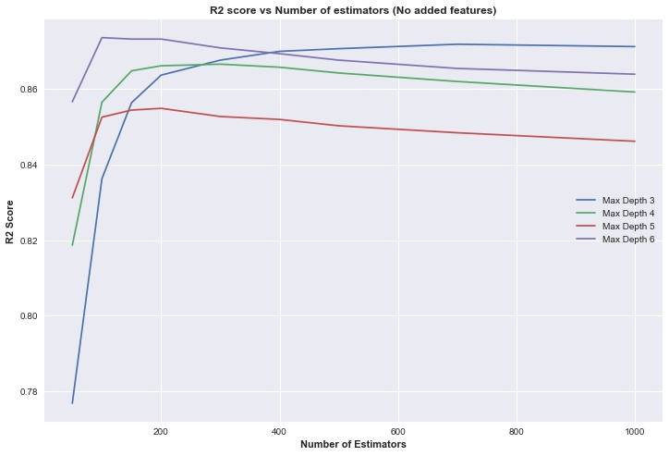
Cross Validation
Till this point we have not added any new features to the dataset used during the submission.
The existing features have been modified and the R2 CV score improved from:
0.828 to 0.8735
GBT with 100 estimators, max depth 6.

Slide 22
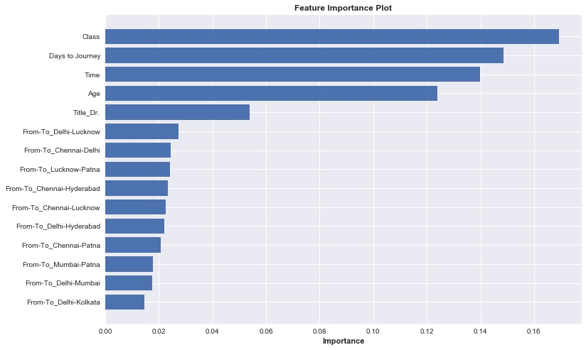
Feature Importance
The 5 most important features are Class, Days To Journey, Age, Time of Flight and title followed by the distance between cities.

Slide 23
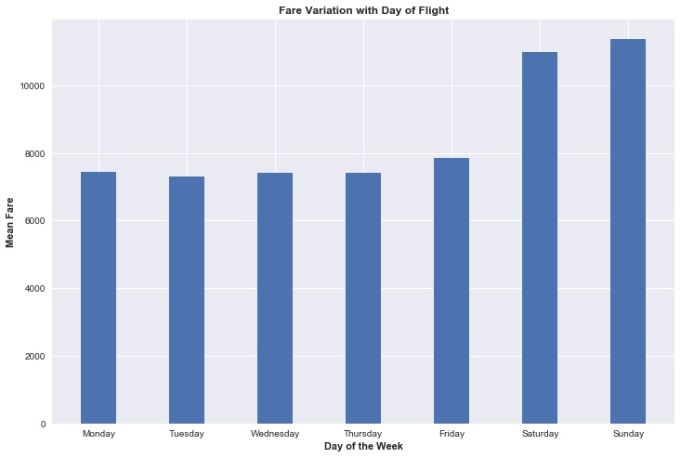
Day of Flight
The fares are almost uniform on the week days.
There is a significant increase on the weekends.
These were assigned numbers from 0-6.
R2 CV score improvement:
0.8735 – 0.98
From this point onwards, this feature is included in the dataset.

Slide 24
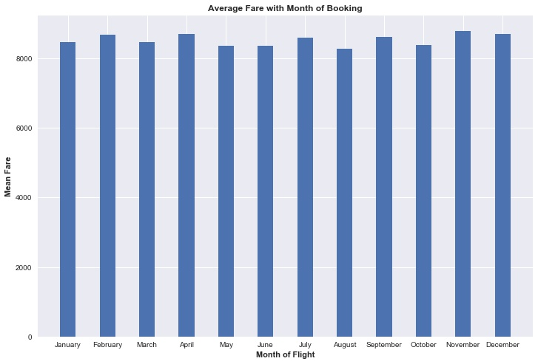
Month of Booking
Expected variation in fares owing to seasonal causes like festive months.
No significant variation seen with month of booking.
There is almost no change in the R2 CV score on adding this feature.

Slide 25
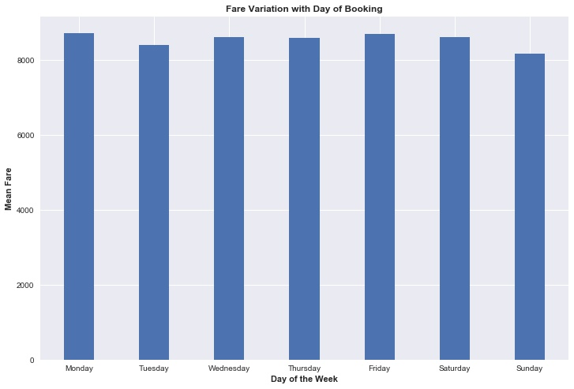
Day of Booking
No significant variation seen with day of booking
No considerable change in R2 CV score obtained

Slide 26
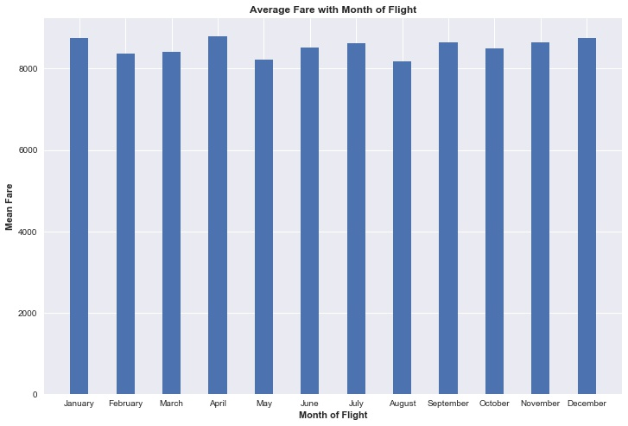
Month of Flight
No significant variation seen with month of flight
No considerable change in R2 CV score obtained

Slide 27
Cross Validation
Split the training data into a training set of 6000 samples and validation set of 1500 samples
Each model was trained on the 6000 samples and tested on the 1500 samples
The model which achieved the highest R2 score on the validation set was chosen
The best model was a Gradient Boosting Regressor with 1000 estimators and a maximum depth of 3

Slide 28
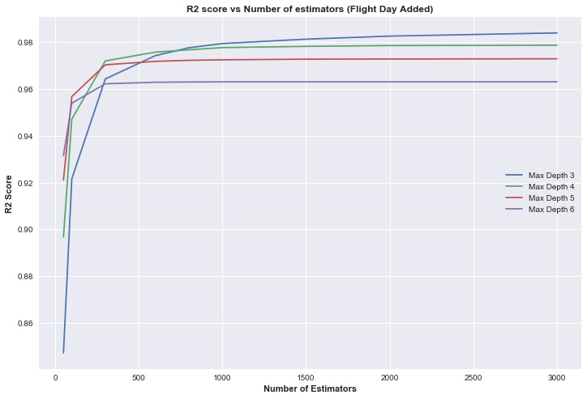
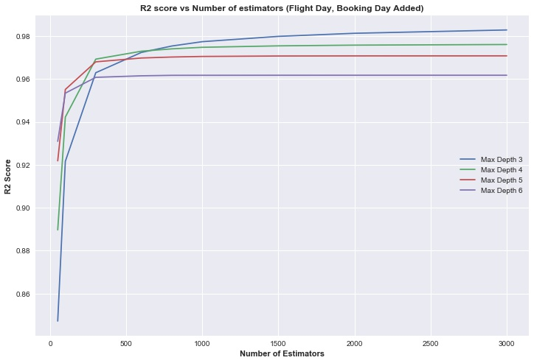
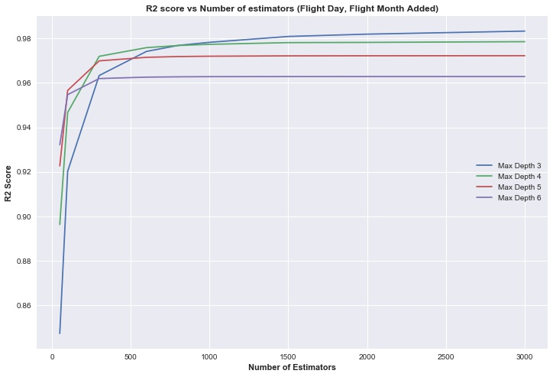
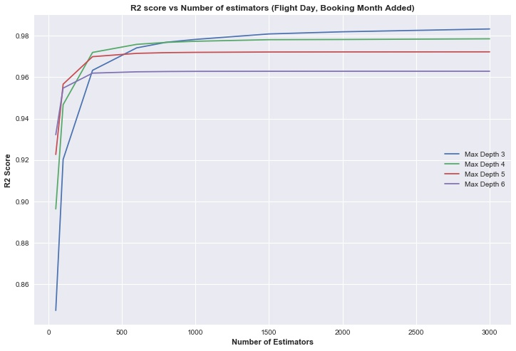

Slide 29
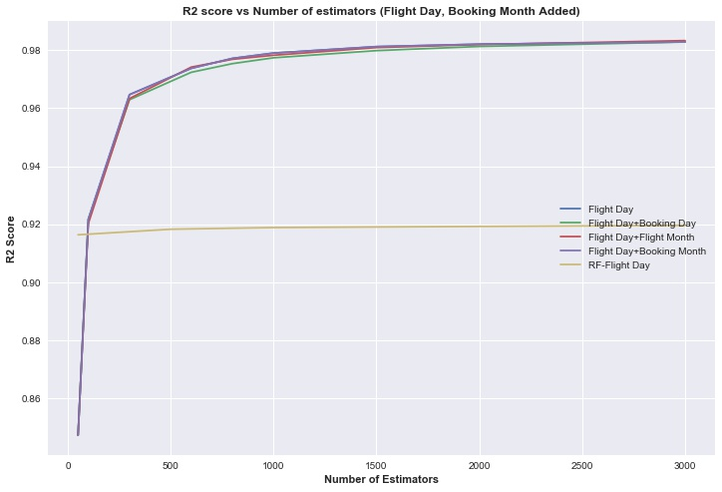
Model Performance Comparison
All the models perform identically.
It is clear that there is no value in adding Booking Month, Booking Day and Flight Month to the dataset after Flight Day.
Hence these features are dropped.
The GBT outperforms the best performing Random Forest by close to 6%.

Slide 30
Final Set of Features
Binary Features
Discrete Valued Features
Continuous Feature
Categorical Features with 7 values each
Categorical Feature with 4 categories.
Categorical Feature with 21 categories.
Discrete Valued Feature

Slide 31
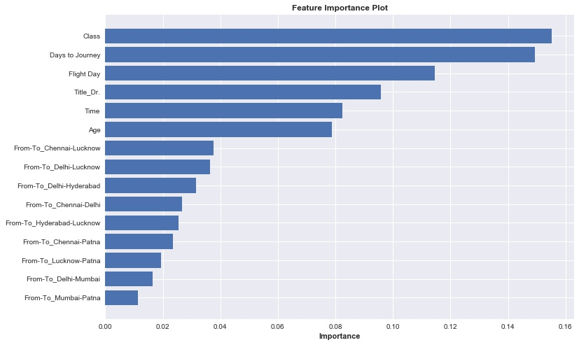
Feature Importance
Flight day which turns out to be a very important feature was missed out earlier.

Slide 32
Final Model Implementation
Read Data and Pre-process
Create
Features
Drop Features
Feed to Model
Output
Convert ‘class’ to a binary variable
Convert ‘Flight Time’ to a continuous variable
Gender
Title
Age
From-To
Days to Journey
Flight Day
Name
DOB
Booking Date
Flight Date
Gradient Boosting Regressor with 1000 estimators and maximum depth 3
Predicted Fares

Slide 33
Problem 2: Stock Price Simulation

Slide 34


Problem Statement
Governing equation:$dX_{t}=a\left(θ−X_{t}\right)dt+σ\sqrt{X_{t}}dW_{t}$
Random variable :$dW_{t}=N\left(0,1\right)\sqrt{dt}$
Process similar to GBM
Tendency of $X_{t}$ to reach $θ$
Simulation from t=0 to T=2
Function inputs are $a,θ,X_{0},σ$

Slide 35

Solution Approach
Sub-problem 1 : $E[X_{T=2}]$
Divide time into 100 intervals of resolution $dt=0.02$
Sample $dW_{t}$ in each of these intervals
Propagate $X_{t}$ with time using the governing eq.
Total simulation runs = 10000

Slide 36
Variance Reduction
Output from each run is not same
Final solution is a mean of all the outputs
The lesser the variance in the output, the better the accuracy of our solution
=>

Slide 37

Control Variables
Reusing variables in each simulation run
$$E\left[X_{T=2}\right]=E\left[X_{T=2}−\sum_{i=1}^{100}{c_{i}{dW}_{i}}\right]$$
$$c_{i}=\frac{cov(E\left[X_{T=2}\right],{dW}_{i}\text{) }}{var({dW}_{i})}$$

Slide 38

Antihectic Variables
Reusing variables from the previous run
For every odd k,
$$dW\left(k+1\right)=−dW(k)$$

Slide 39
Variance reduction analysis – SP1

Slide 40
Variance reduction analysis – SP1

Slide 41
Variance reduction analysis – SP1
The variance with control variables is very close to the normal case
Addition of antihectic variables reduces the variance to ~e-8

Slide 42
Why control variables are
Ineffective?
Inject variance through the addition of the random variable
Reduce variance through its covariance with the final estimate

Slide 43

Why control variables are
Ineffective?
$$var\left(Y−cX\right)=σ_{Y}^{2}+c^{2}σ_{X}^{2}−2cρ_{XY}σ_{X}σ_{Y}$$
$$c=\frac{σ_{Y}}{σ_{X}}ρ_{XY}$$
$$var(Y−cX)=(1−ρ_{XY}^{2})σ_{Y}^{2}$$
For $ρ_{XY}\sim 0$ the improvement is negligible

Slide 44

Solution Approach
Sub-problem 2 : $E[{max⁡(X}_{t}−100,0)]$
Payoff condition applied at the end

Slide 45
Variance reduction analysis – SP2

Slide 46

Solution Approach
Sub-problem 3 : $\frac{∂E[max⁡(X_{t}−100,0)]}{∂σ}$
$$f(σ) = E[max⁡(X_{t} − 100, 0)]$$
$$f^{′}\left(σ\right)= \frac{df\left(σ\right)}{dσ}=\frac{∂E[max⁡(X_{t}−100,0)]}{∂σ}$$

Slide 47

Forward difference
Differential in +h direction:
$$f^{′}\left(σ\right)= \frac{f\left(σ + h\right)− f\left(σ\right)}{h}−\frac{h}{2!}f^{′′}\left(σ\right)$$
$$− H(O^{3}) − H(E^{4})$$
Not accurate enough

Slide 48

Backward difference
Differential in -h direction:
$$f^{′}\left(σ\right)= \frac{f\left(σ \right)− f\left(σ−h\right)}{h}+\frac{h}{2!}f^{′′}\left(σ\right)$$
$$− H\left(O^{3}\right)+ H(E^{4})$$

Slide 49

Central difference
Combining both differentials:
$$f^{′}\left(σ\right)= \frac{f\left(σ+h\right)− f\left(σ−h\right)}{2h}$$
$$− H\left(O^{3}\right)$$
Reduction in residual terms by half
Reduced most significant order from 2 to 3

Slide 50
Variance reduction analysis – SP3

Slide 51
Conclusion
Control variables were not used due to their insignificance in reducing outcome variance
Antihectic variables reduce variance by ~40% in sub problems 2,3
Central differencing was employed for an accurate measure of the payoff change w.r.t volatility

Slide 52
Problem 3: Payoff from correlated stock prices

Slide 53



Problem Statement
Governing equations:$dX_{t}=rX_{t}dt+σ_{X}dW_{X}$
$dY_{t}=rY_{t}dt+σ_{Y}dW_{Y}$
Random variables :$dW_{X}=ε_{1}dt$
$dW_{Y}=ε_{2}dt$
$ε_{1}$, $ε_{2}$ are correlated $N\left(0,1\right)$ variables
Correlation given from past data
r is an input parameter defined over 1 day

Slide 54

Problem Statement
Payoff =$max(\frac{X_{T}}{2X_{0}}+\frac{Y_{T}}{2Y_{0}}−1, 0)$
Precondition: $X_{Ti}∈[0.75X_{0},1.25X_{0}]$
$Y_{Ti}∈[0.75Y_{0},1.25Y_{0}]$
$$Ti=t_{0}+0.25i, i=0,1,…N$$
N is the number of quarters given as an input
Final Price = $E[payoff]e^{−rT}$

Slide 55

Solution Approach
Divide the time into number of days
Per quarter we have 63 days (252 per year)
Total simulation runs = 10000
From the given past stock prices compute the correlation between $ε_{1}$, $ε_{2}$
Sample $dW_{X}$, $dW_{Y}$ using multivariate correlated sampling for all the days

Slide 56


Correlation ($ε_{1}$, $ε_{2}$) : Formulation
$$cor(ε_{1}\text{, }ε_{2}) = ρ = cor(∆log⁡(X), ∆log⁡(Y))$$
$$sd(ε_{1})=σ_{X}= std(∆log⁡(X))$$
$$sd(ε_{2})=σ_{Y}= std(∆log⁡(Y))$$
Here, $∆$ = forward difference

Slide 57
Stock X : Past prices

Slide 58
Stock Y : Past prices

Slide 59

Stock X : $∆log⁡(X)$

Slide 60

Stock Y : $∆log⁡(Y)$

Slide 61



Correlation ($ε_{1}$, $ε_{2}$) : Results
$$cor(ε_{1}\text{, }ε_{2}) = ρ =0.4948813$$
$$sd\left(ε_{1}\right)=σ_{X} =0.007757425$$
$$sd(ε_{2})=σ_{Y}=0.01652896$$
We use $ρ$ in multivariate sampling of $dW_{X},dW_{Y}$
The volatilities are used in the governing eq.

Slide 62

Antihectic Variables
Reusing variables from the previous run
For every odd k,
$$dW\left(k+1\right)=−dW(k)$$
The correlation between $ε_{1}$, $ε_{2}$ is retained

Slide 63
Solution Approach
In each run propagate the stock price over each day using the governing equation
Check the precondition at the end of each quarter
If the precondition is not satisfied, break with payoff = 0
Compute payoff at EOT if there was no violation
Correspondingly compute final price over all runs

Slide 64
Thanks!
Any questions?
You can find me at @username & user@mail.me

