Slide 1
Mental Health in the Workplace Analysis

Slide 2
Team Members
Akhil Bhimarasetty
Phani Venkata Krishna Varun Vegi Sai Raghavendra
Pranavi Rao Lingala
Sathvika Bandlamudi
Anjani Chippa

Slide 3
Introduction
Mental health is crucial for employee well-being and organizational success.
Stigma often prevents employees from seeking treatment, impacting productivity.
Mental health is crucial for employee well-being and organizational success.
Stigma often prevents employees from seeking treatment, impacting productivity.
Analyzing mental health treatment-seeking behavior using survey data.
Identifying demographic and workplace factors that influence this behavior.
Develop predictive models to understand and classify treatment-seeking tendencies.
Provide insights for creating supportive workplace policies.

Slide 4
Problem Statement and Motivation
Importance of Mental Health
Impact on Workplace Productivity
Data-Driven Insights
Personal Interest
Relevance of Machine Learning

Slide 5
Literature Review
The reviewed literature highlights three key studies that underscore the importance of mental health in workplace settings:
WHO Study (Harnois & Gabriel)
Analyzed mental health disorders in workplaces
Explored how work environments impact mental health
Developed best practices for organizational support

Slide 6
Literature Review
2. Employee Well-Being Research (Bryson, Forth, & Stokes)
Demonstrated a direct link between employee mental health and organizational performance
Found that investing in mental health support improves productivity
Showed mental health programs provide significant business returns
3. Workplace Stress Analysis (Ganster & Rosen)
Identified various workplace stressors contributing to mental health issues
Recommended targeted interventions to mitigate stress-related challenges
Emphasized the connection between mental health and work performance

Slide 7
Research Approach

Slide 8
Dataset and Preprocessing
Dataset
Source: 2014 Workplace Mental Health Survey (Kaggle).
Attributes: Age, gender, employment type, family history, workplace mental health resources, and treatment-seeking behavior.
Data Preparation:
Cleaned up missing and inconsistent data to make it usable.
Grouped age into ranges and standardized gender categories.
Added features like company size and employee support options for better analysis.

Slide 9
Machine Learning Models Used:
Naive Bayes: Simple and good for categorical data.
Logistic Regression: Great for seeing how individual factors impact outcomes.
K-Nearest Neighbors (KNN): Looks at similar data points to make predictions.
Random Forest: A collection of decision trees working together, and it performed the best.

Slide 10
Research Questions
Who is more likely to seek treatment? (e.g., based on their age, gender, family history, or workplace conditions).
What factors matter the most? (e.g., Does having workplace benefits or family history make a big difference?).
How accurate can we be at predicting this? (e.g., How well do the models work?).

Slide 11
Exploratory Data Analysis

Slide 12
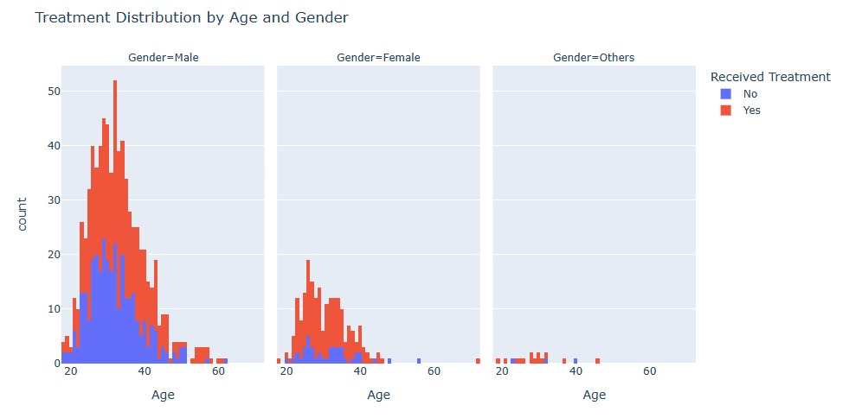
Exploratory Data Analysis - 1
This chart highlights the relationship between age, gender, and treatment-seeking behavior. It underscores that:
Females and non-binary individuals are more likely to seek treatment.
The 20–40 age group is the most affected and the most likely to seek treatment.
Targeted mental health initiatives should focus on younger individuals and address barriers preventing males from seeking treatment.

Slide 13
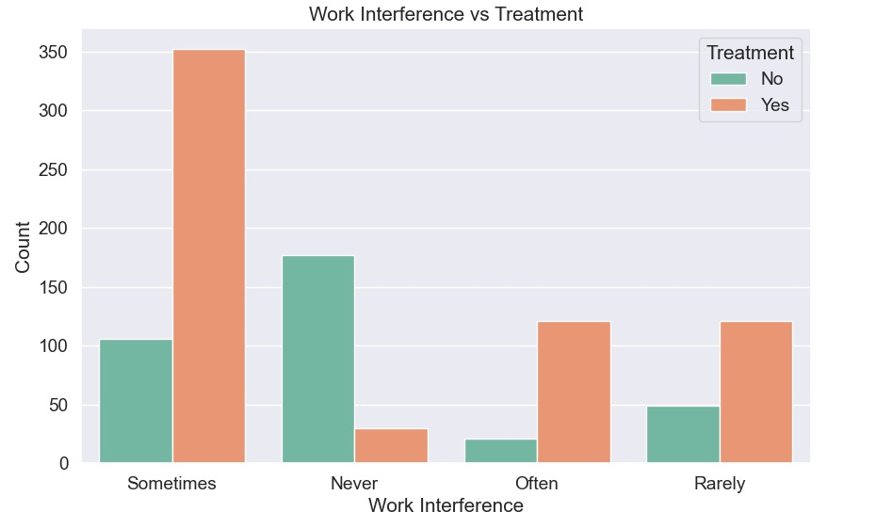
Exploratory Data Analysis - 2
This graph highlights the strong relationship between mental health-related work interference and treatment-seeking behavior.
This graph suggests that work interference can be a key motivator for individuals to seek mental health support.

Slide 14
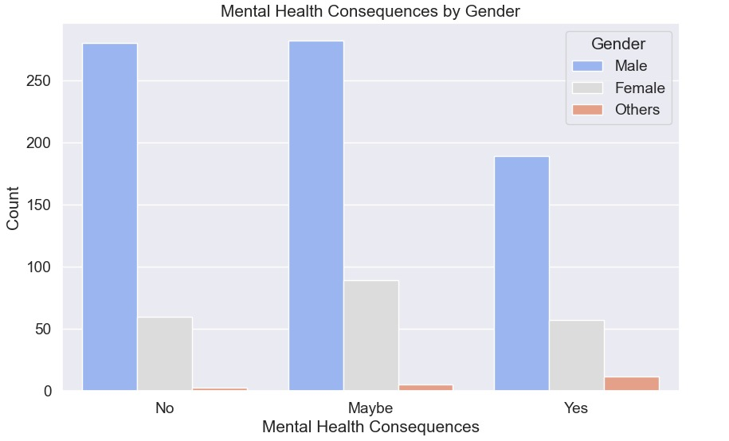
Exploratory Data Analysis - 3
The chart highlights how perceptions of workplace mental health consequences vary by gender. It may indicate differences in workplace experiences, with males being less likely to perceive consequences.
Males are the majority in all three categories, suggesting that more men participated in the survey or felt more strongly about the consequences.
Female respondents, while fewer, seem to distribute more evenly across the three categories, indicating greater variance in their perceptions.

Slide 15

Results

Slide 16
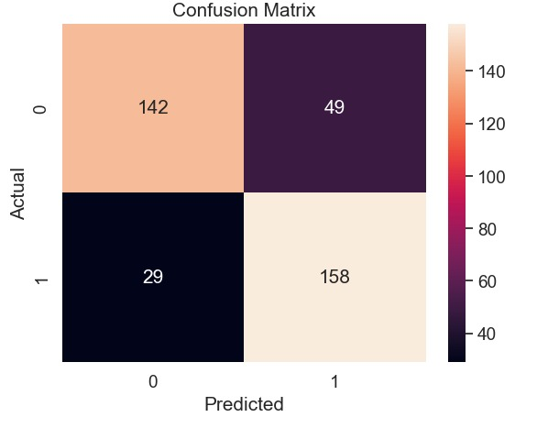
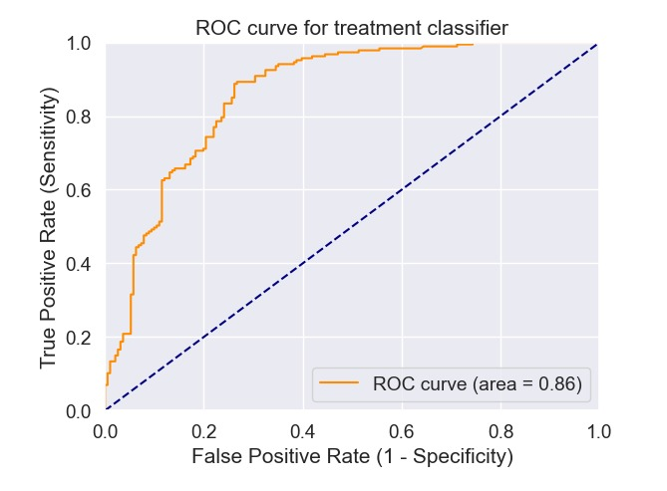
Logistic Regression Results

Slide 17
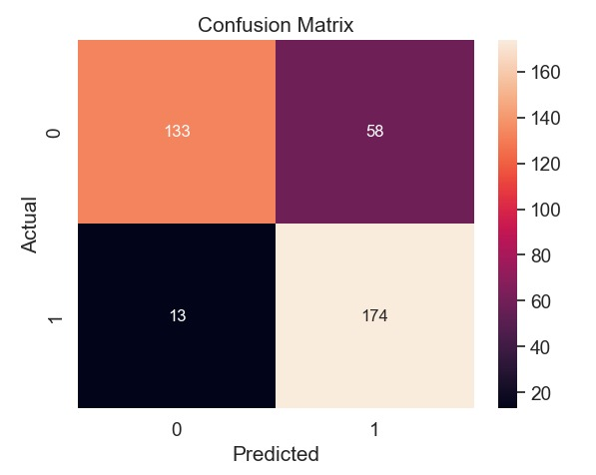
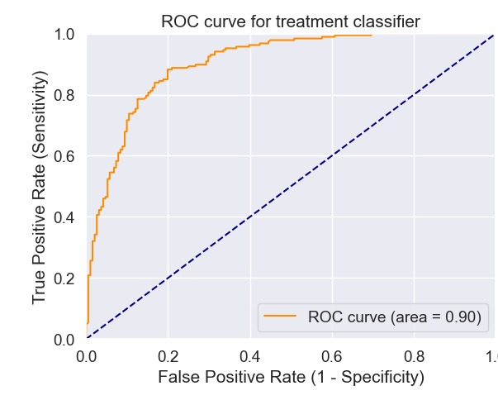
Random Forest Results

Slide 18
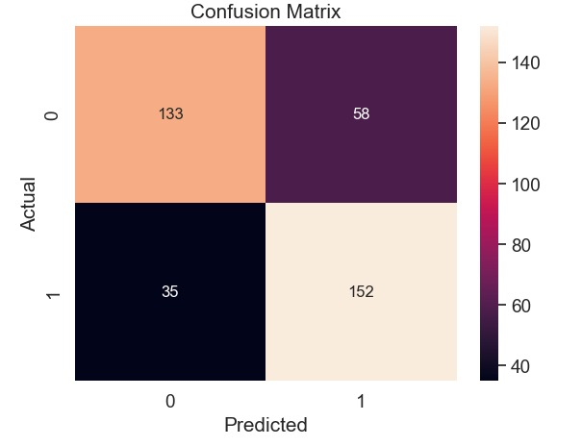
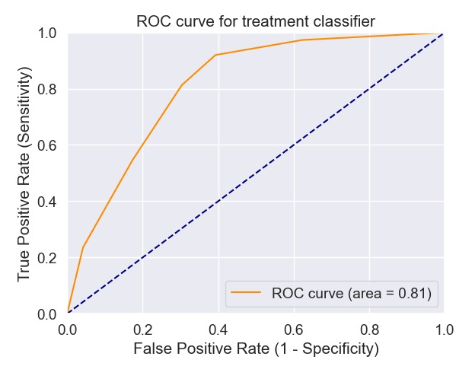
KNN Results

Slide 19
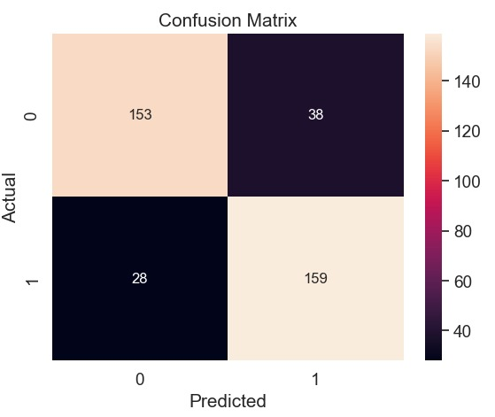
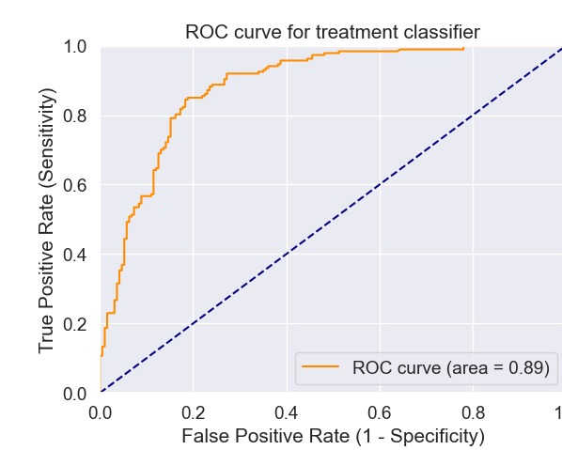
Naïve Bayes Results

Slide 20
Conclusion
Naïve Bayes emerged as the best-performing model with the highest accuracy and AUC-ROC scores.
Key factors influencing treatment-seeking behavior included:
Gender
Family history of mental health issues
Availability of workplace support programs
Machine learning proved effective in identifying patterns and trends in mental health treatment-seeking behavior.
The project highlights the importance of data-driven approaches for addressing workplace mental health challenges.

Slide 21
Future Work
Expand the Dataset:
Incorporate recent survey data to reflect current workplace mental health trends.
Include diverse industries and regions for broader applicability.
Advanced Modeling Techniques:
Explore deep learning models to capture more complex patterns.
Test ensemble methods to further enhance predictive performance.
Incorporate Additional Features:
Analyze industry-specific factors or organizational policies.
Study the impact of remote work and hybrid environments.
Practical Implementation:
Collaborate with organizations to apply insights in real-world workplace policies.
Develop an interactive tool for HR departments to predict employee needs.

Slide 22
Thank you

