Slide 1
OurVedic
India’s First worship Item ordering app

Slide 2
Project OUTLINE
Overview
Current Features
Upcoming Features
Our team
Our products and services
Pricing/packages
Competitive comparison
Current App development status
App Development Roadmap
Our proposal
Next steps

Slide 3
Overview
OurVedic is the India’s 1st online worship item ordering app.
We ship products all over India.
You can even book Dharamshalas near you for your special events.
Now book Pandit, Molvi and Father from your home.
With Festival special packages, you can plan whole festival puja in one click.

Slide 4

Current features
Puja essential items ordering
Pandit, Molvi and father bookings
Advance and secure log in and Sign up
WishList your favorite items
Order History
Admin Panel for admins

Slide 5
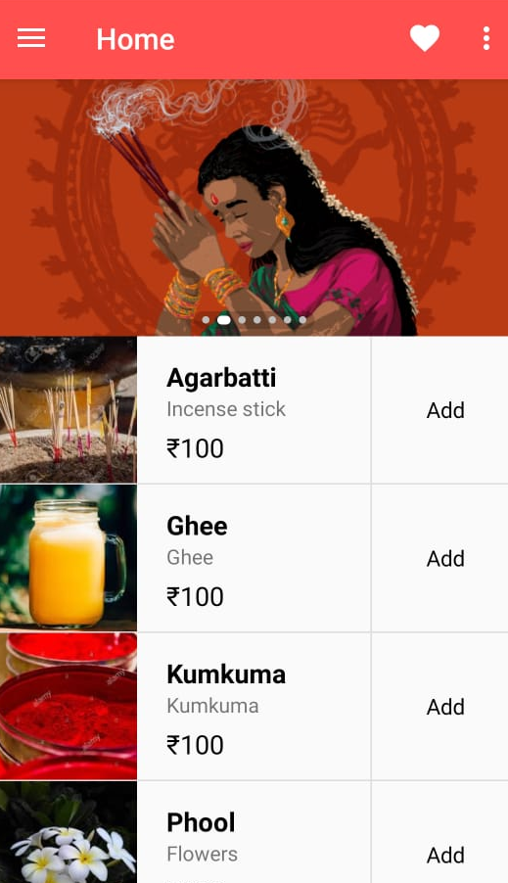
Item order
Home Screen of the app
Order hundreds of puja item from your home

Slide 6
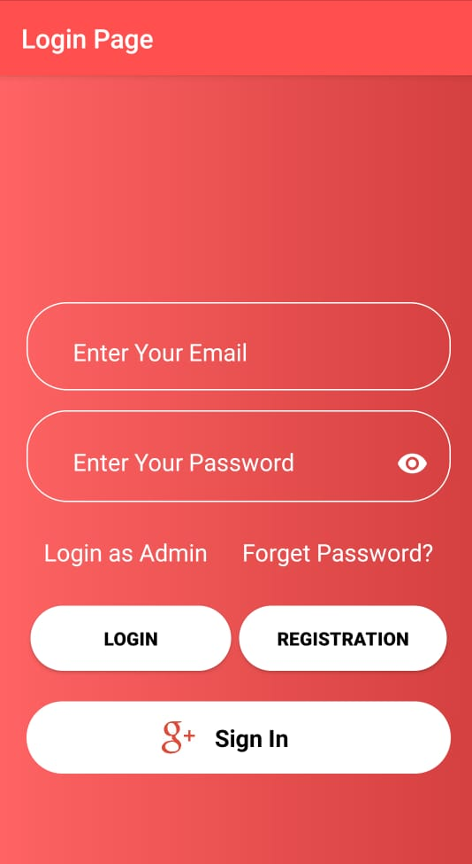
Advance and secure login page
Register for new account
Login if you already registered
Login with Gmail
Forget password then reset it
Login as admin for admin panel

Slide 7
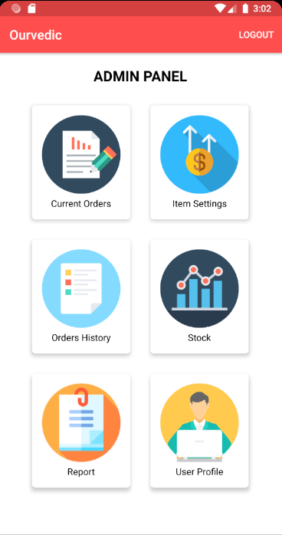
Admin panel
For admins
Get the current orders
Look into the order History
Set the Item price and add new Items through item settings

Slide 8
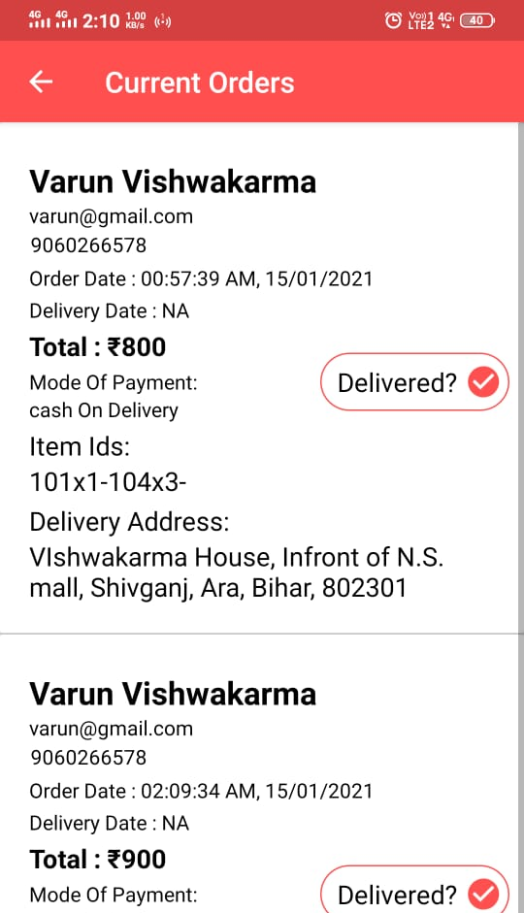
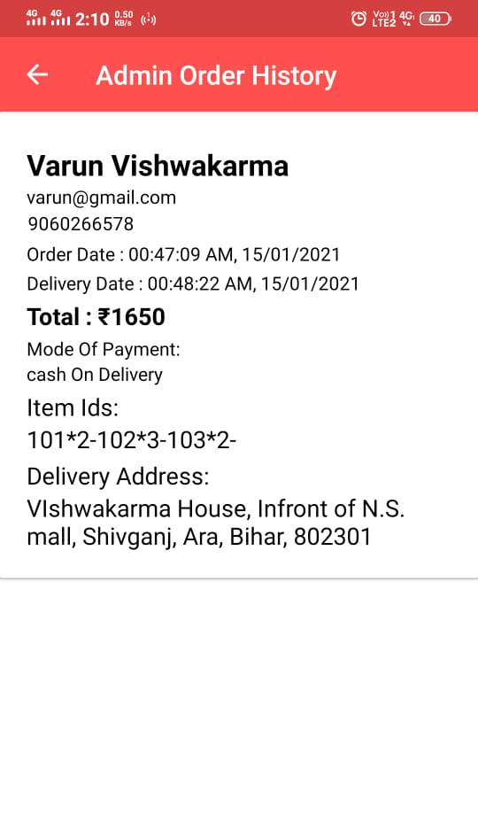
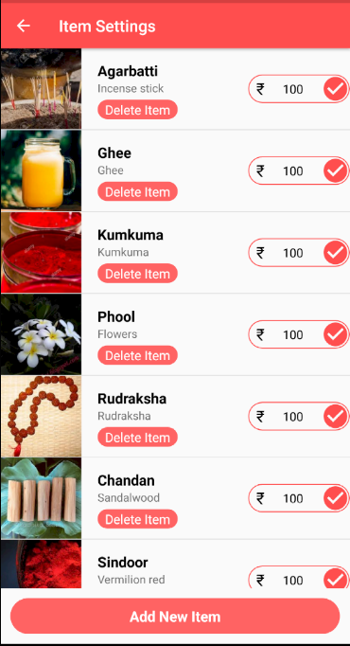
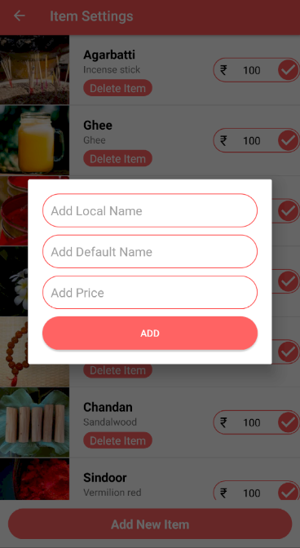
Admin panel features

Slide 9
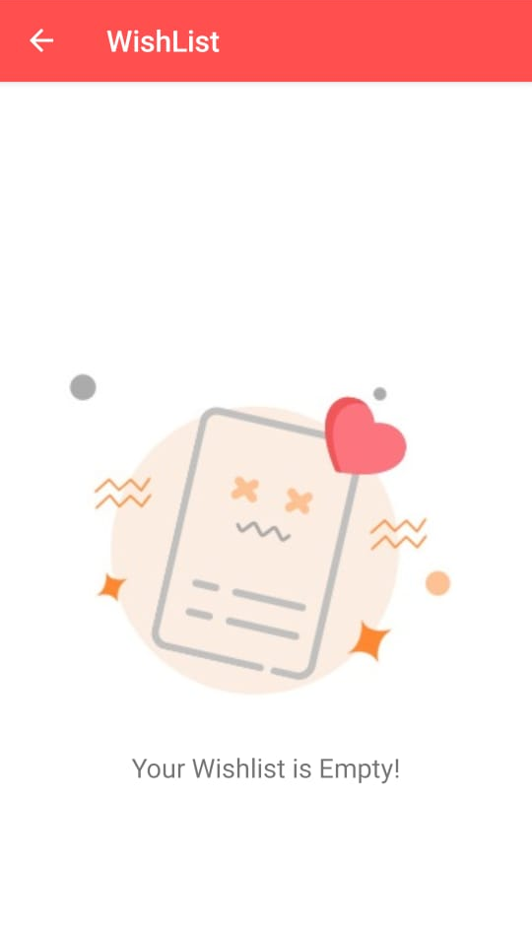
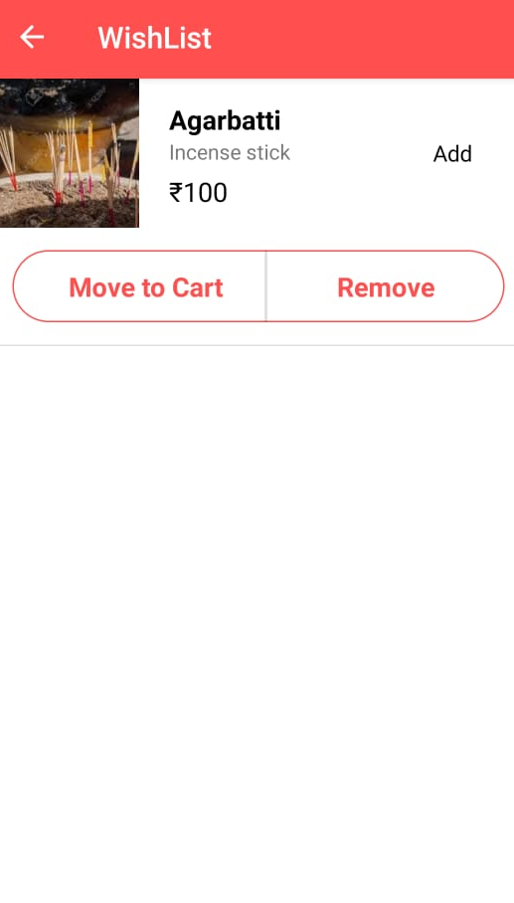
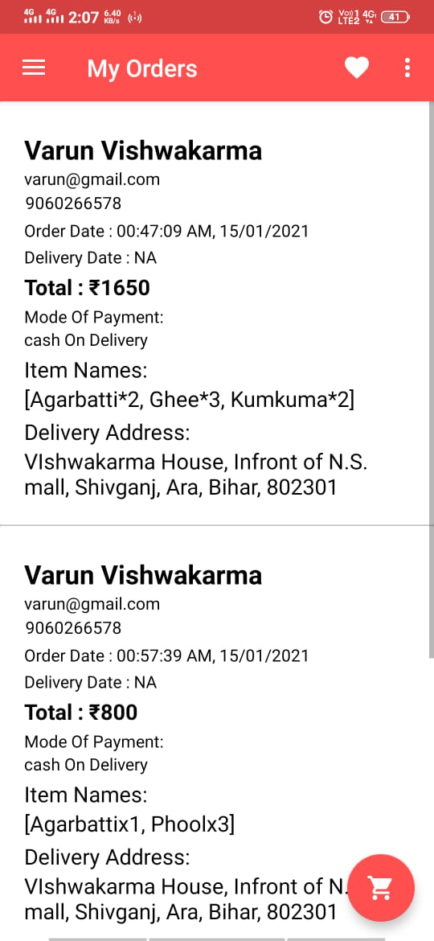
User wishlist
Wishlist your Favourite items

Slide 10
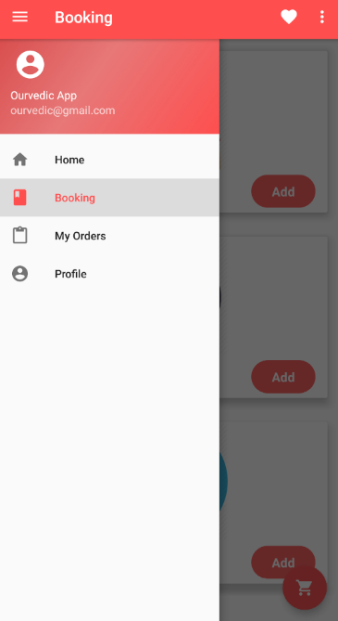
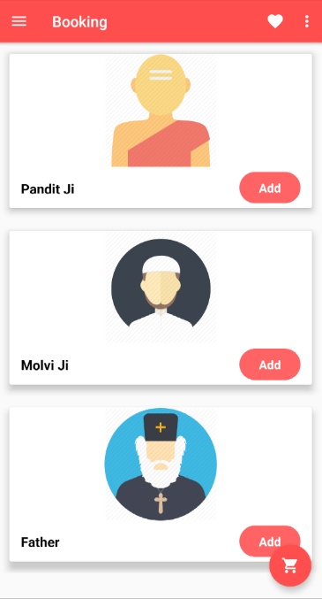
Book
Pandit Ji
Molvi Baba
Father

Slide 11
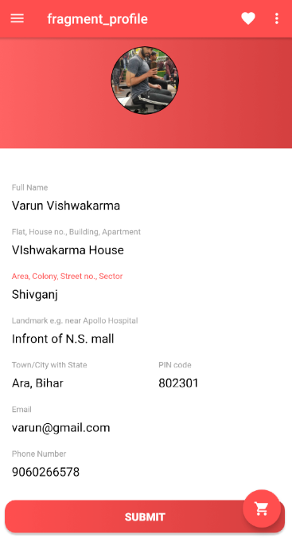
Profile & order history
Setup your profile
and check your order History

Slide 12

Upcoming features
Festival Package
Referrer and Earn
Point Earning
Premium Membership
Fully Featured Admin Panel
Advance Payment Gateway
Saved Payment Details
Saved Billing Address
Filters and Sort Buttons (using chip group)

Slide 13
Festival package
Upcoming Feature

Slide 14
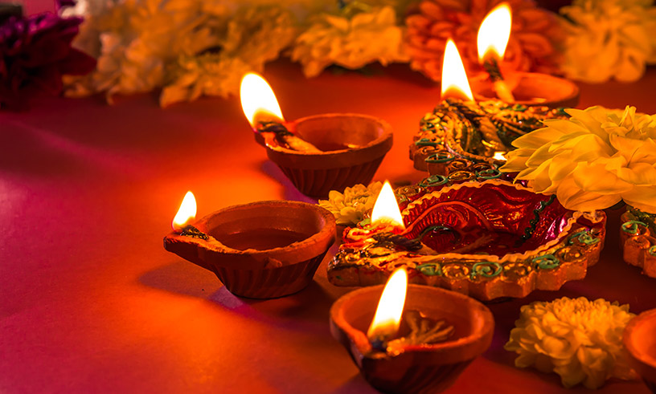
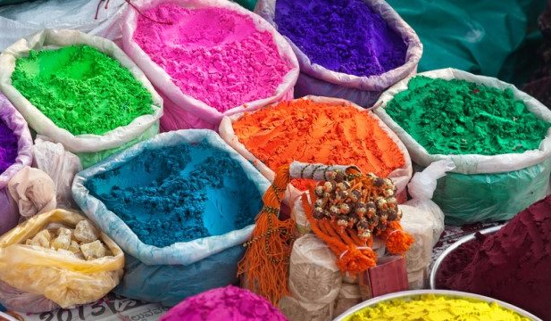
Diwali package
Includes :
Diwali diya with oil and candels
Lights
Decorative
All puja items for Diwali puja
Pandit (optional)
holi package
Includes :
Holi natural colors
Abir Natural
Water Balloons and pichkari
Decorative
All puja items for Holi puja
Pandit (optional)

Slide 15
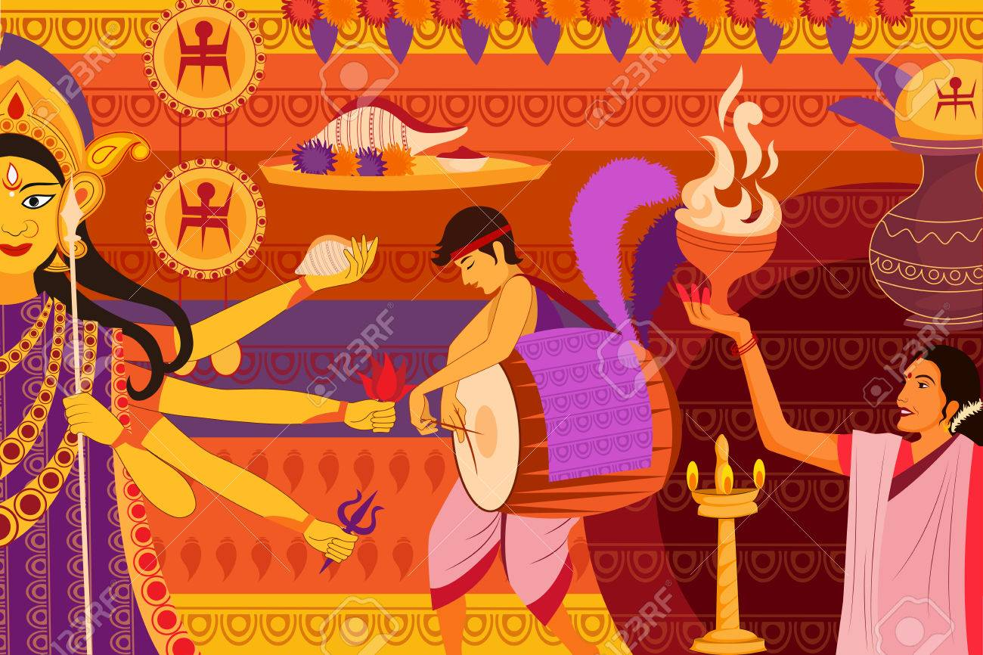

Durga puja package
Includes :
God Durga statue
Prashad
Decorative
All puja items for Durga puja
Pandit booking for 10 day
Janmastimi package
Includes :
God Krishna statue
Dahi handi program all needs
Decorative
All puja items for Janmastimi puja
Pandit (optional)

Slide 16


Eid package
Includes :
Itre (Perfume)
Praying Mat
Decorative
All items for Eid
Molvi Baba (optional)
Muharram package
Includes :
Itre (Perfume)
Praying Mat
Decorative
All items for Eid
Molvi Baba (optional)

Slide 17
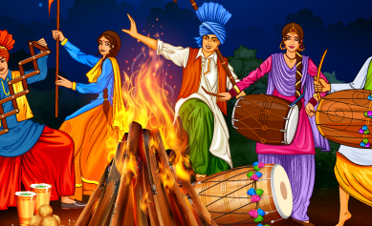

Lohri package
Includes :
Foods Lassi making item
Burring woods
Dhol
Decorative
All items for Lohri Puja
Christmas package
Includes :
Candles
Christmas Tree
Christmas Decorative
All items for Christmas

Slide 18
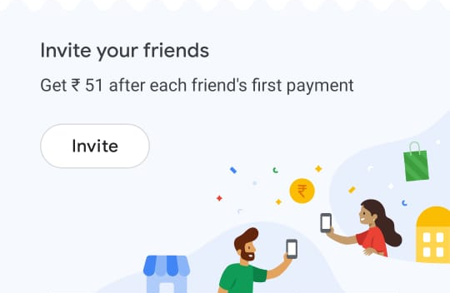
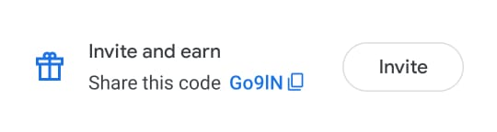
Refer and Earn
Refer a friend and earn points and exclusive offers

Slide 19
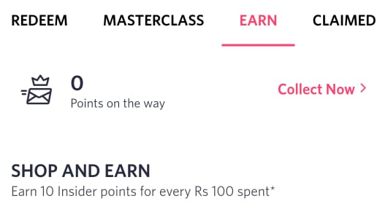
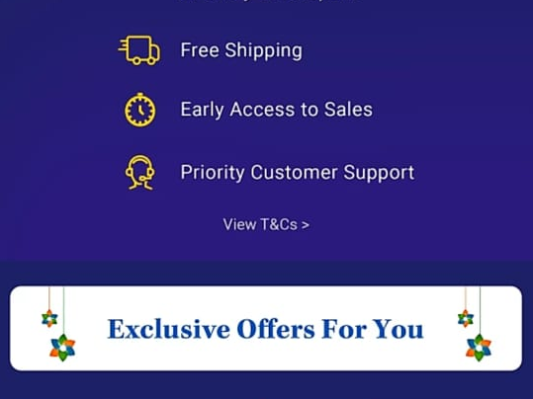
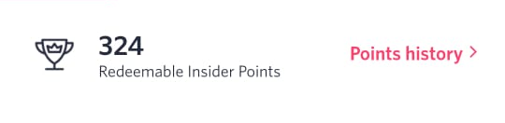
Points Earning System
Earn Points with purchase of any item

Slide 20


Premium Membership
Buy Premium membership or buy from points for Premium Features, Free and faster delivery

Slide 21
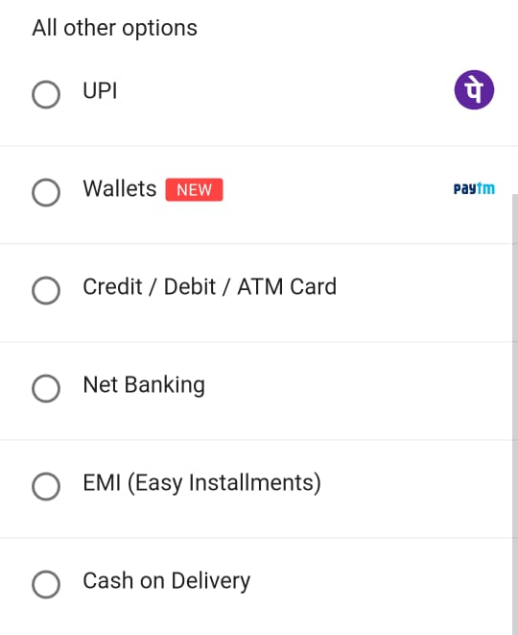
Advance Payment Gateway
Accept payment from all sources like cards, Internet Banking, UPI, Wallets

Slide 22
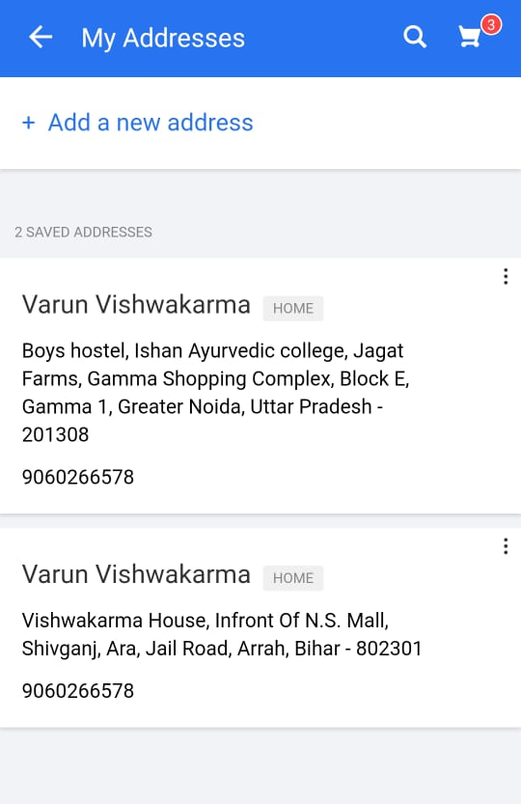
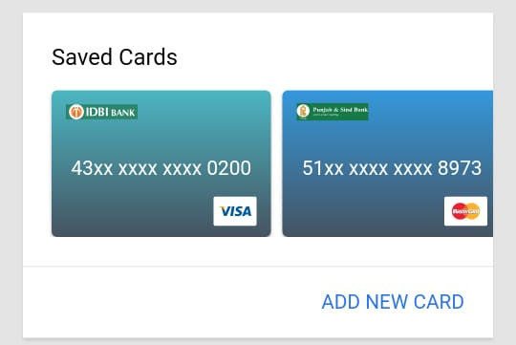
Saved Address and payment cards
Get the user pervious billing
Address and payment details

Slide 23
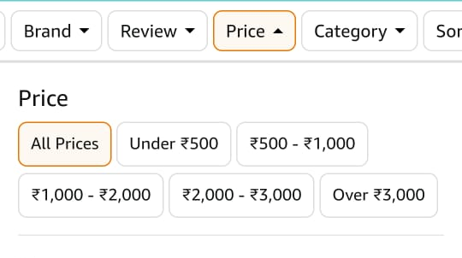
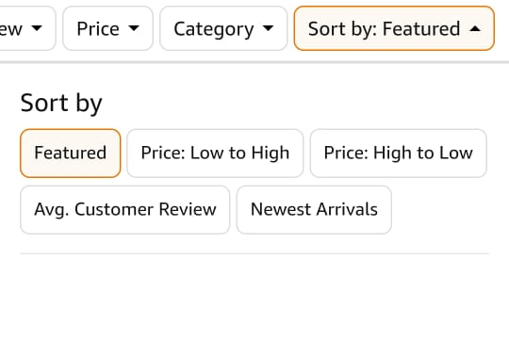
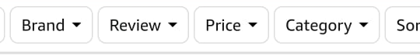
Filter and sorts
Get your specific item using filter and sort

Slide 24

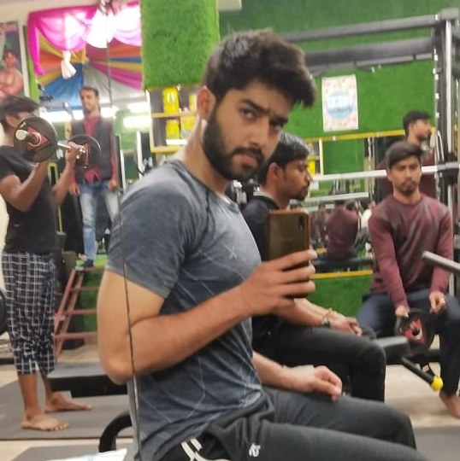
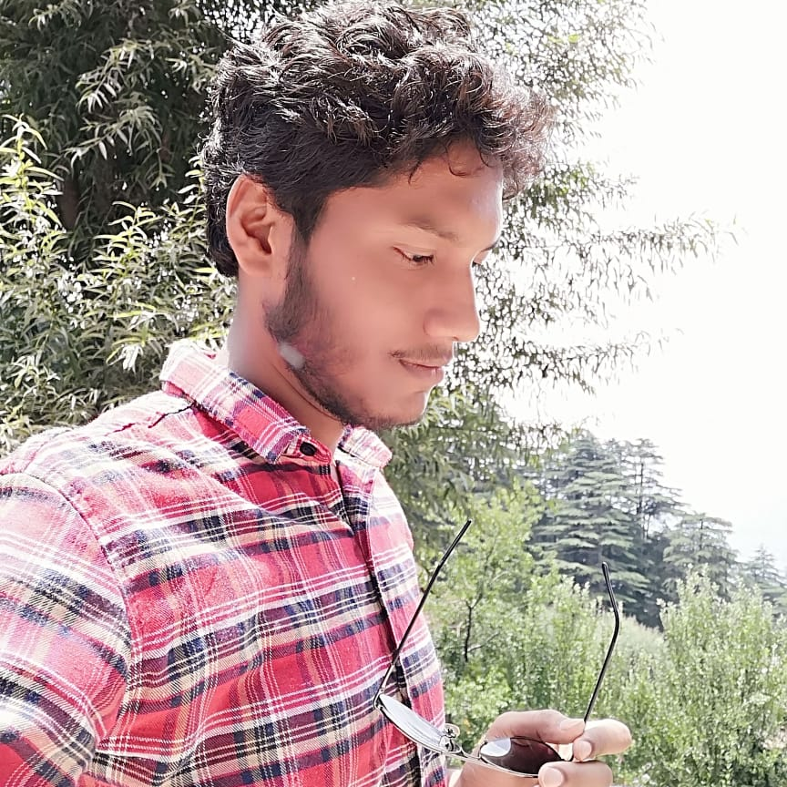
OUR android developer TEAM
Ankur
Varun
abhishek

Slide 25
Future offerings
Hire us again
We will take the app to the next level
A fully featured app

Slide 26
Roadmap
STAGE 01
Basic App development with ordering feature
Adding order history, current order, Wishlist.
STAGE 03
Adding fully featured admin panel and Category for items
STAGE 02
STAGE 04
STAGE 05
Adding saved payment and saved billing address.
Implementing Advance Payment gateway and adding filters and sorting buttons

Slide 27
Our proposal
Hire us again!
So that we can take the app to the next level.
Why hire us again?
We made the foundation of the app,
We understand the codes better than anyone can

Slide 28
Thank you

