Slide 1
BLUESTOCK FINTECH CAPSTONE PROJECT — EXECUTIVE SUBMISSION
Indian Mutual Fund Quantitative Analytics & Risk Intelligence Platform
End-to-End ETL Engineering, Relational Star Schema, Multi-Factor Scoring, Advanced Tail-Risk Models (VaR/CVaR, Monte Carlo, Markowitz Frontier), and Executive Power BI Intelligence
Candidate / Lead Quant Engineer: Varundeep | Institutional Partner: Bluestock Fintech
Repository: github.com/Varundeep09/bluestock-mf-capstone | Date: September 2026 (Version 1.0)
Core Tech Stack: Python 3.13, SQLite 3, SQLAlchemy, Pandas, SciPy, Power BI Desktop, ReportLab

Slide 2
BLUESTOCK MUTUAL FUND ANALYTICS CAPSTONE
Business Problem Context & Core Project Objectives
5 Core Business Challenges (P1 – P5)
• P1. Opaque Fund Selection: Evaluating funds on trailing returns alone ignores risk-adjusted efficiency, drawdowns, and expense leakage.
• P2. Fragmented Market Ingestion: Manual, error-prone data pipelines struggle with missing trading days and unstandardized AMFI feeds.
• P3. Blindness to Tail Risk: Traditional metrics overlook severe tail-risk losses (VaR/CVaR) during systemic market shocks.
• P4. Silent Retail SIP Churn: Distributor platforms lack early-warning detection for irregular deposit gaps and mandate drop-offs.
• P5. Hidden Sector Concentration: Thematic bias and single-sector overweights (HHI > 2500) go unnoticed in retail portfolios.
8 Key Engineering & Analytical Objectives (O1 – O8)
• O1. Automated Pipeline: Build an automated 5-layer ETL engine ingesting 10 raw CSVs and live AMFI API feeds.
• O2. Relational Warehouse: Design an 11-table star schema in SQLite with strict foreign keys and index optimization.
• O3. Exploratory Analysis: Synthesize 10 macro insights across AUM growth, SIP inflows, and demographics with 15+ charts.
• O4. Fund Scorecard: Engineer a 5-factor quantitative scoring model (0–100) weighting returns, Sharpe, alpha, TER, and drawdown.
• O5. Tail-Risk Modeling: Calculate 95% Historical VaR and CVaR (Expected Shortfall) across all 40 schemes.
• O6. Retention Analytics: Conduct investor cohort tracking and diagnose empirical inter-transaction SIP churn gaps.
• O7. Portfolio Frontiers: Simulate 5Y Monte Carlo GBM cones and solve Markowitz Efficient Frontier optimal weights.
• O8. Executive BI: Deliver an interactive 4-page Power BI dashboard with KPI cards and dynamic filters.

Slide 3
BLUESTOCK MUTUAL FUND ANALYTICS CAPSTONE
Data Sources, Ingestion Architecture & Data Authenticity
Ingested Datasets & Live Feeds (46,000+ Records)
• Fund Master & NAVs: 40 Schemes across 1,150 trading sessions (46,000 daily NAV rows, Jan 2022 – May 2026).
• Live AMFI API Feeds: Automated REST pulls from mfapi.in for 6 core funds (20,208 records staging cache).
• Investor Transactions: 32,778 transaction records capturing SIP, Lumpsum, Redemption, Demographics, and KYC.
• Market Benchmarks: 8,050 daily records across NIFTY 50, NIFTY 100, NIFTY 500, and NIFTY MIDCAP 150.
• Industry Macro Disclosures: 90 quarterly AUM points, 48 monthly SIP inflows (₹ Cr), 144 category net flow points, 21 folio disclosures.
• Portfolio Holdings: 322 equity holdings with sectoral allocations and company weights.
Data Authenticity & Governance Disclosures
• Real AMFI Metadata: Scheme identifiers, AMFI codes, official names, Total Expense Ratios (TER), AMC brands, and fund managers reflect authentic regulatory filings.
• Anchored Market NAVs: Daily historical NAV series and NSE benchmark index values reflect real market volatility and return trajectories across the 4.4-year window.
• Synthetic Demographic Layer: Investor demographics, KYC states, and transaction histories (fact_transactions) are synthetically generated to model realistic Indian investor distributions while preserving privacy.
• Strict ETL Normalization: Heterogeneous date formats converted to ISO-8601; trading gaps forward-filled; TER clamped to [0.1%, 2.5%]; outlier returns bounded within +/-20%.

Slide 4
BLUESTOCK MUTUAL FUND ANALYTICS CAPSTONE
5-Layer Pipeline Architecture & Relational Star Schema
1. INGESTION
Raw CSVs & AMFI API feeds
Automated schema profiling
2. PROCESSING
Date normalization & ffill
TER & Return boundary checks
3. WAREHOUSE
SQLite Star Schema (11 tables)
Foreign keys & B-Tree indexes
4. QUANT ENGINE
CAGR, Sharpe, VaR/CVaR
Monte Carlo & Markowitz
5. BI LAYER
Power BI Desktop (4 pages)
Interactive slicers & KPIs
Relational Star Schema Summary (data/db/bluestock_mf.db — 11 Tables)
Dimension Tables: • dim_fund (PK: amfi_code, 40 schemes) — Scheme metadata, category, launch date, TER, risk rating.
• dim_date (PK: date_id, 1,608 calendar dates) — Year, quarter, month, day-of-week attributes.
Time-Series Fact Tables: • fact_nav (PK: amfi_code, date, 46,000 rows) — Daily NAVs, daily return pct, 1,150 trading sessions.
• fact_benchmark (PK: index_name, date, 8,050 rows) — Daily closing values for NIFTY 50, 100, 500, MidCap 150.
Transactional & Operational Facts: • fact_transactions (PK: tx_id, 32,778 rows) — Granular transaction events, investor demographics, payment channels.
• fact_portfolio (322 rows), fact_performance (40 rows), fact_aum (90 rows), fact_sip_industry (48 rows), fact_category_inflows (144 rows), fact_folio_count (21 rows).
Performance SLA: • Sub-second analytical queries via composite B-Tree indexes (idx_fact_nav_date, idx_fact_tx_date, idx_fact_tx_state). Master ETL pipeline builds entire DB in 25.4 seconds.

Slide 5
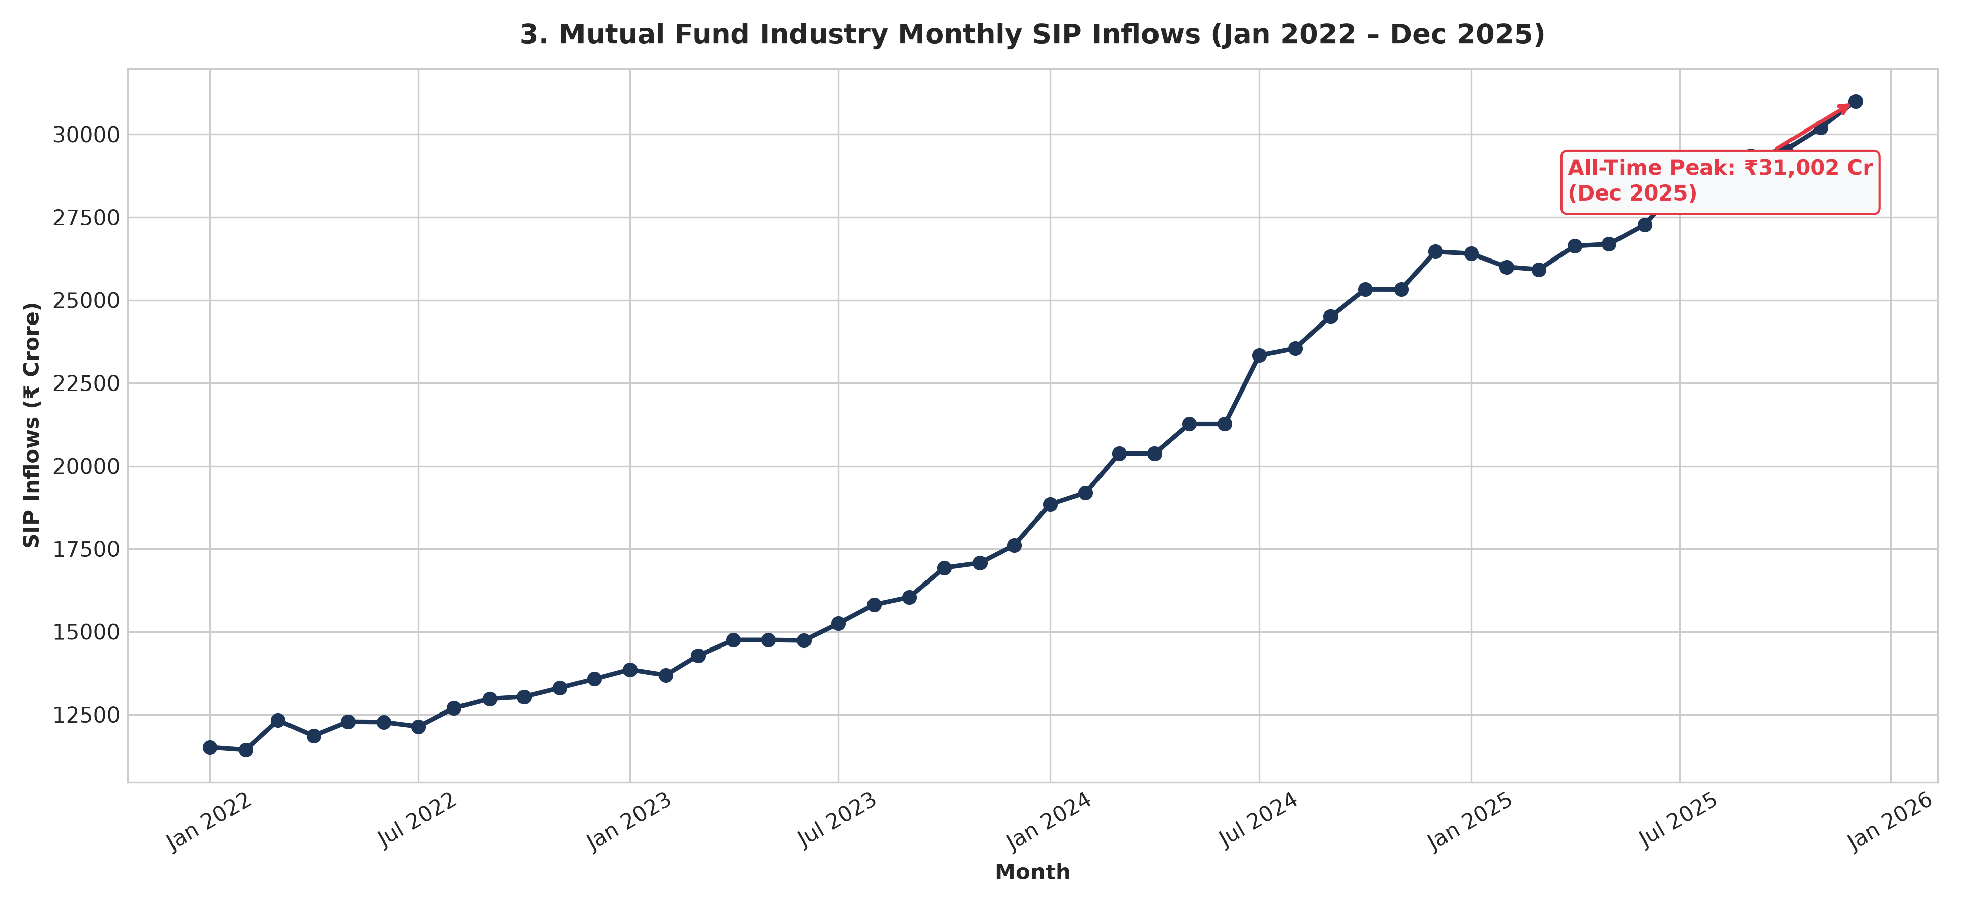
BLUESTOCK MUTUAL FUND ANALYTICS CAPSTONE
Exploratory Data Analysis: Macro Trends & Industry Inflows
Key Macroeconomic Findings
• Retail SIP Surge (+169.2%):
Monthly SIP inflows grew from ₹11,517 Cr (Jan 2022) to a record ₹31,002 Cr (Dec 2025), creating a massive domestic liquidity cushion against global volatility.
• Equity Folio Doubling (+97.0%):
Total folios expanded from 13.26 Cr to 26.12 Cr, with Equity folios reaching 69.98% (18.28 Cr) of the total industry.
• Top 3 AMC Dominance (>55%):
SBI MF (₹12.50 Lakh Cr), ICICI Prudential (₹10.74 Lakh Cr), and HDFC MF (₹9.30 Lakh Cr) command over 55% of industry AUM.
• Correction Resilience:
Retail investors consistently bought market dips (June 2022, March 2023) through sustained SIP contributions.

Slide 6
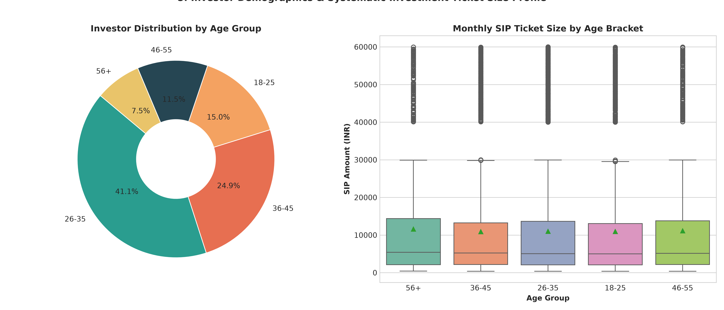
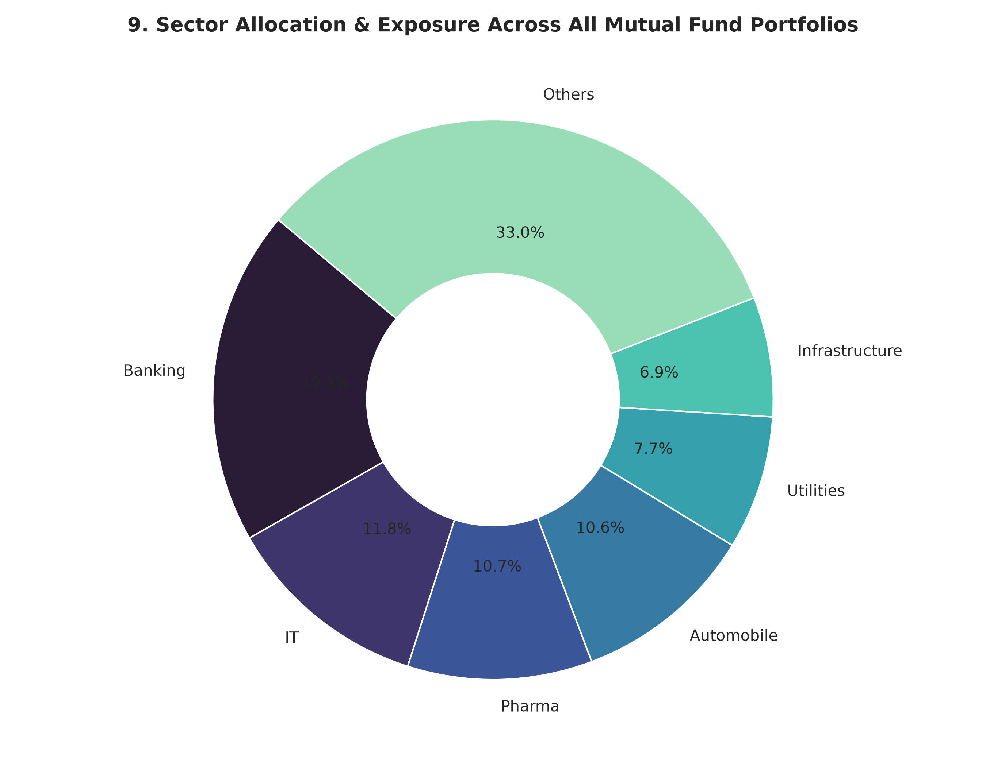
BLUESTOCK MUTUAL FUND ANALYTICS CAPSTONE
Exploratory Data Analysis: Demographics, Channels & Sectors
Demographic & Allocation Findings
• Millennial Leadership (55%):
Investors aged 26–45 represent 55% of all transaction accounts; Gen-Z (18–25) drives rapid digital micro-SIP adoption.
• Beyond-Metro (B30) Growth:
B30 semi-urban/rural towns contribute 39.8% of transaction capital volume, proving deep geographic penetration.
• Digital Payment Rails (68.2%):
UPI and eNACH mandates capture 68.2% of mutual fund transactions, reducing cheques to under 12%.
• Direct Plan Alpha (60–110 bps):
Direct plans offer 0.6%–1.1% lower expense ratios than Regular plans, adding ~0.8% compounding net return.
• Structural Sector Tilts:
Portfolios carry heavy systemic weightings in Financials (32.1%) and Information Technology (19.4%).

Slide 7
BLUESTOCK MUTUAL FUND ANALYTICS CAPSTONE
Performance Analytics: Multi-Factor Scorecard & Top Funds
Multi-Factor Scoring Methodology (0–100)
• 30% Trailing 3Y CAGR: Measures medium-term annualized compound capital appreciation.
• 25% Sharpe Ratio (Rf=6.5%): Measures excess return per unit of total annualized volatility.
• 20% Jensen's Alpha: Measures active fund manager outperformance over CAPM benchmark.
• 15% Inverted Expense Ratio: Rewards low-cost schemes (higher score for lower TER).
• 10% Inverted Max Drawdown: Rewards capital preservation during market downturns.
Top 5 Mutual Fund Schemes Across Categories
★ 1. Kotak Flexicap Fund (Score: 71.38)
Equity | 3Y Return: 15.65% | Sharpe: 0.98 | Alpha: 1.85 | TER: 1.45% | Max DD: -19.50%
★ 2. SBI Small Cap Fund - Reg (Score: 70.25)
Equity | 3Y Return: 23.39% | Sharpe: 0.94 | Alpha: 1.23 | TER: 1.43% | Max DD: -13.35%
★ 3. ICICI Pru Liquid Fund - Reg (Score: 70.12)
Debt/Liquid | 3Y Return: 7.68% | Sharpe: 7.68 | Alpha: 1.85 | TER: 0.74% | Max DD: -2.62%
★ 4. HDFC Short Term Debt - Reg (Score: 69.88)
Debt | 3Y Return: 7.37% | Sharpe: 1.84 | Alpha: 1.98 | TER: 0.56% | Max DD: -6.01%
★ 5. Kotak Emerging Equity - Reg (Score: 67.88)
Equity/Mid | 3Y Return: 18.23% | Sharpe: 0.96 | Alpha: 1.91 | TER: 1.56% | Max DD: -21.92%

Slide 8
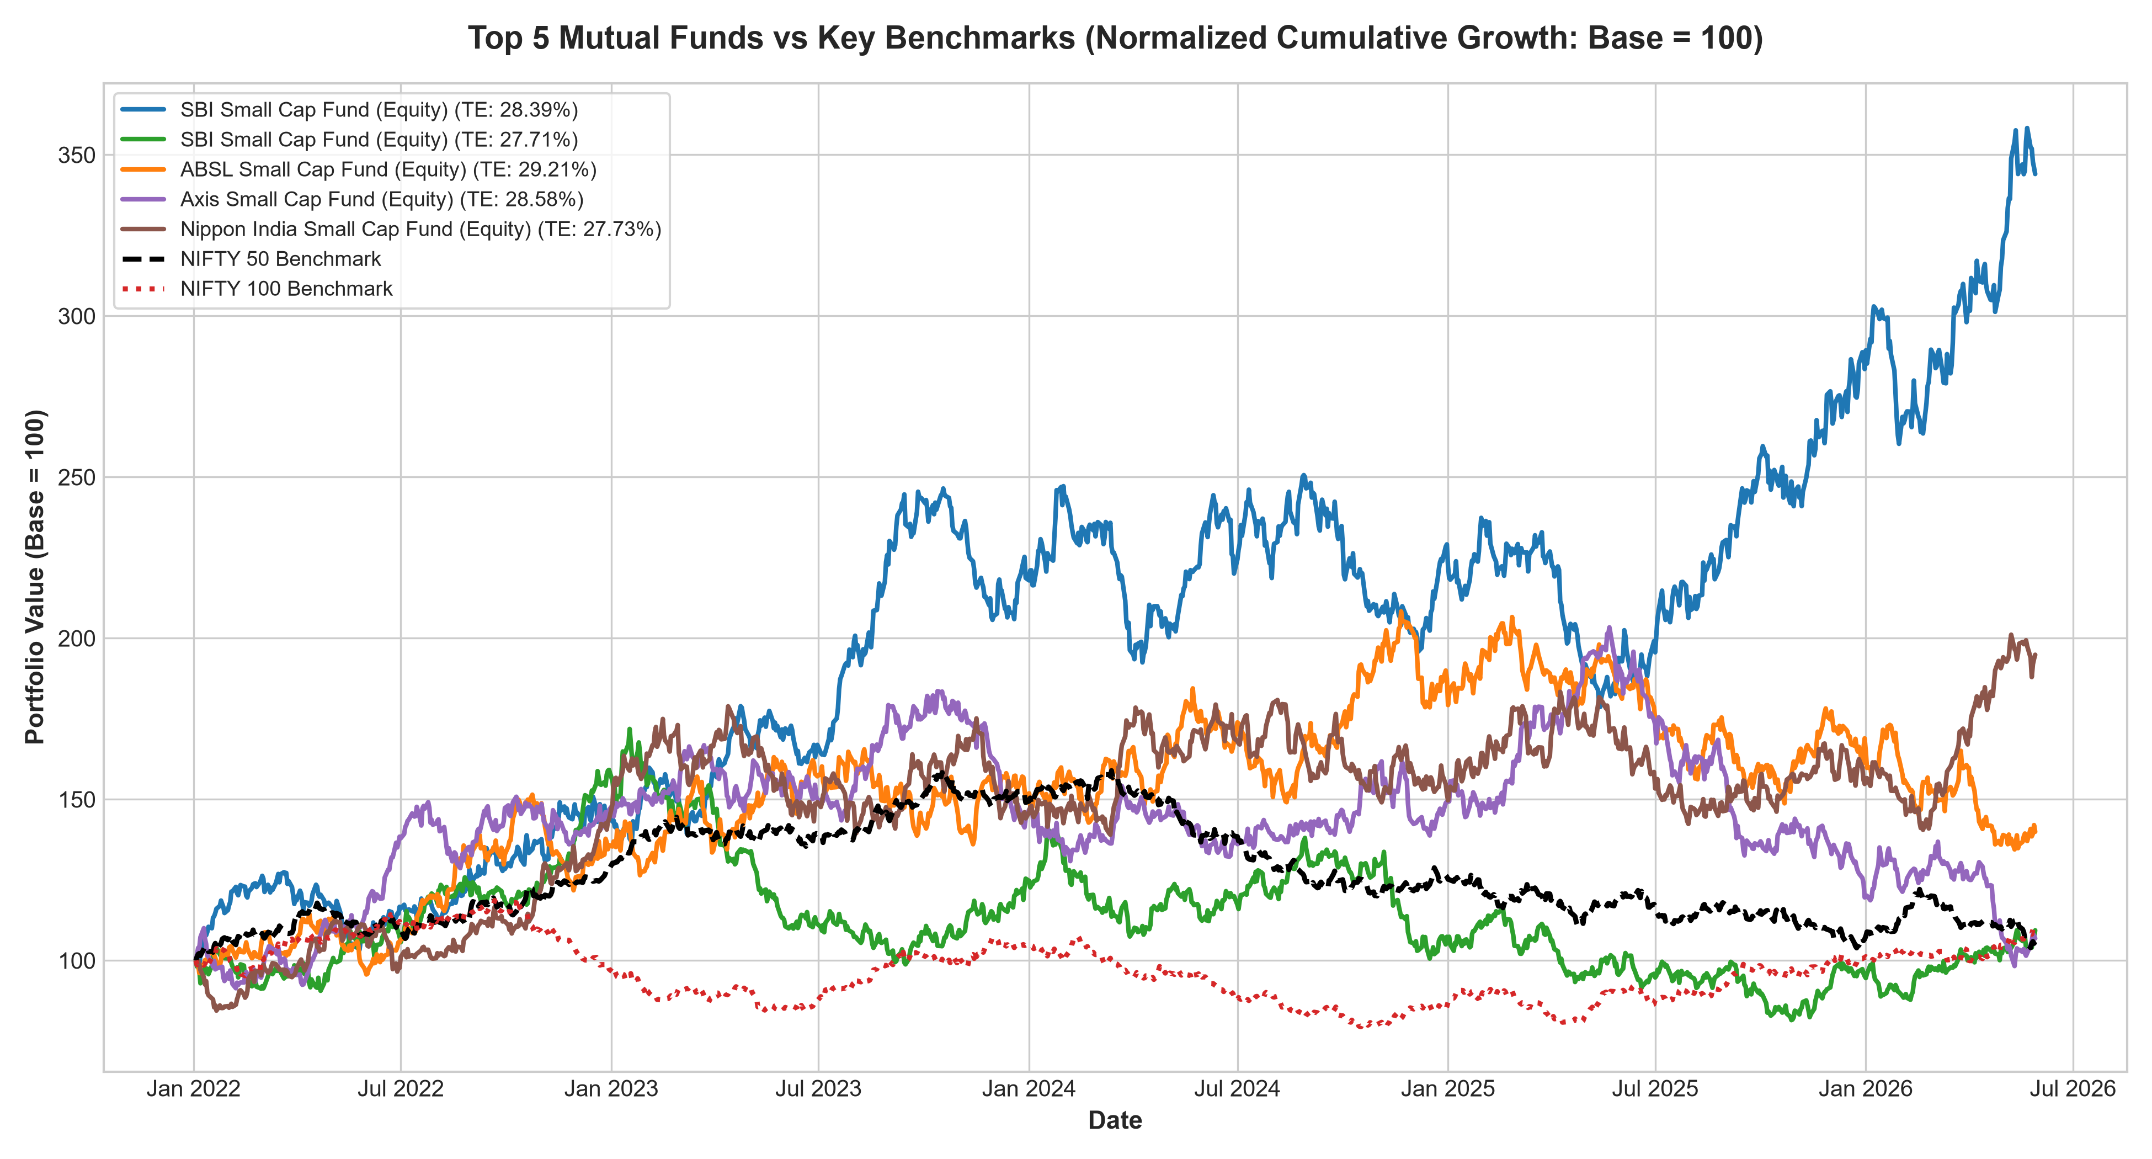
BLUESTOCK MUTUAL FUND ANALYTICS CAPSTONE
Performance Analytics: Tail Risk (VaR/CVaR) & Tracking Error
Quantitative Risk & Concentration Findings
• 95% 1-Day VaR & CVaR Tail Risk:
SBI Small Cap Direct (119599) carries the highest 1-day tail risk with VaR of -2.69%, CVaR of -3.24%, and worst 1-day drop of -5.12%.
• Tracking Error Divergence:
Small Cap schemes exhibit high tracking error (28.45%) vs Large Cap (3.45%) against NIFTY indices due to active off-benchmark stock picking.
• HHI Concentration Flags (>2500):
4 schemes exceed high concentration thresholds: Axis Bluechip (2967.69) due to 48.7% IT weighting; Mirae Tax Saver (2549.92) with 39.8% Banking.
• Multi-Asset Downside Protection:
Debt and Liquid funds maintain near-zero correlation (-0.05 to +0.12) to equities, providing robust drawdown mitigation.

Slide 9
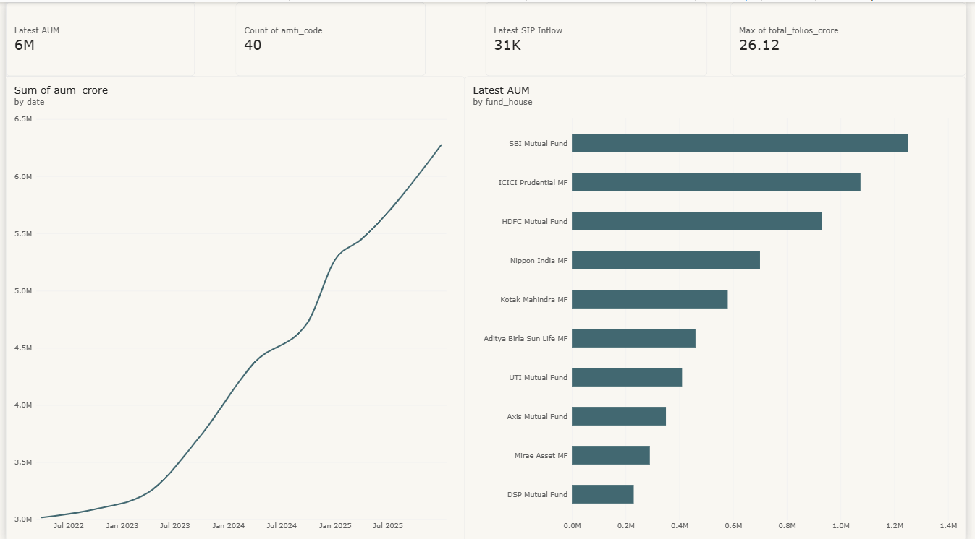
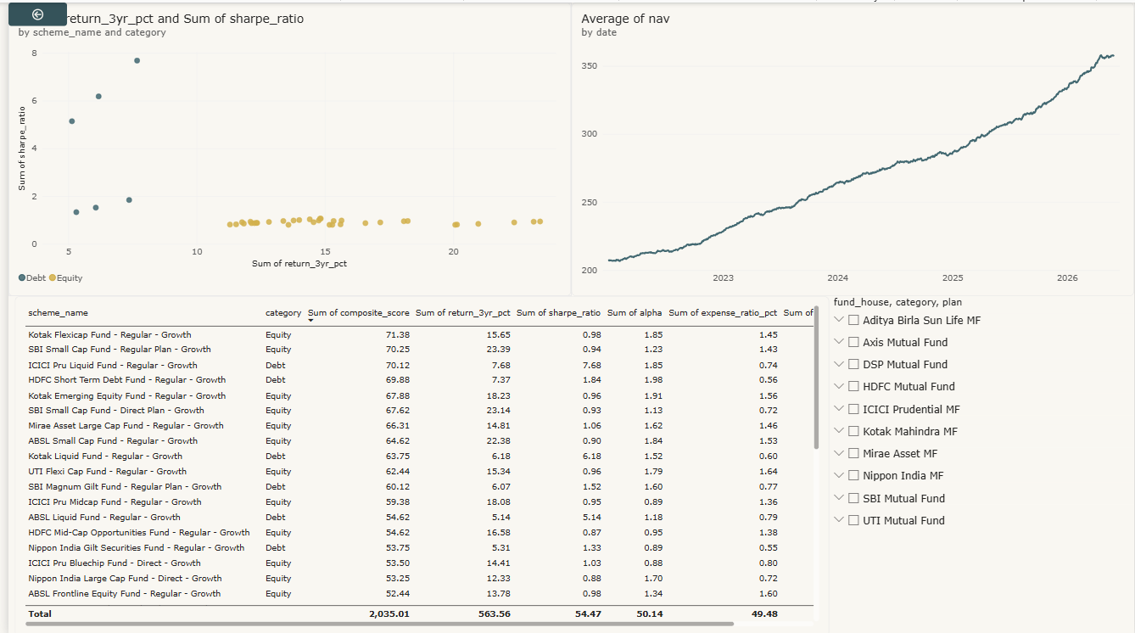
BLUESTOCK MUTUAL FUND ANALYTICS CAPSTONE
Executive Power BI Dashboard: Macro Trends & Fund Scorecard
Page 1: Industry & Macro Overview
Tracks total industry AUM, AMC market share, monthly category net flows, and macroeconomic growth trends.
Page 2: Fund Performance & Risk Scorecard
Interactive 40-fund scorecard table, 1Y/3Y/5Y returns, Sharpe/Sortino ratios, Alpha, Beta, and TER slider filters.

Slide 10
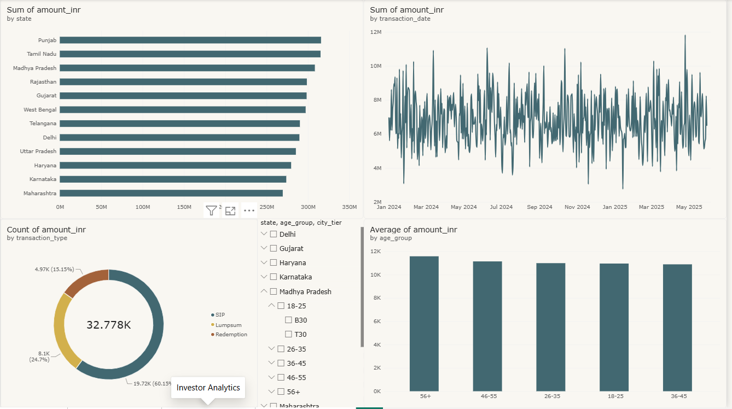
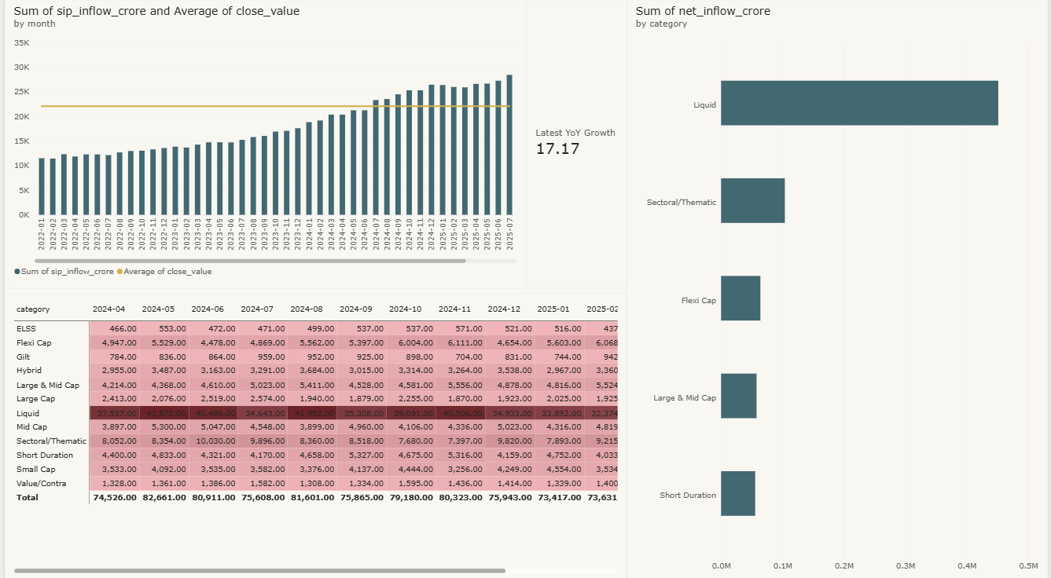
BLUESTOCK MUTUAL FUND ANALYTICS CAPSTONE
Executive Power BI Dashboard: Demographics & SIP Trajectory
Page 3: Investor Demographics & Churn Analytics
Geographic T30/B30 volume split, payment mode shares (UPI/eNACH), age brackets, and KYC compliance.
Page 4: SIP Growth & Market Penetration
Industry monthly SIP contribution trajectories, active account expansion, ticket size distributions, and YoY trends.

Slide 11
BLUESTOCK MUTUAL FUND ANALYTICS CAPSTONE
Strategic Business Takeaways & Key Findings for Leadership
1. Domestic Retail Liquidity Moat
Monthly SIP inflows grew +169.2% to ₹31,002 Cr, creating an institutional-grade domestic buffer against global market shocks.
2. Compounding Direct Plan Alpha
Direct mutual fund plans deliver a 60–110 bps expense saving over Regular plans, generating ~0.8% higher annualized net return.
3. Beyond-Metro (B30) Momentum
Tier-2 and Tier-3 towns drive ~40% of total transaction capital, proving strong digital financial inclusion across India.
4. Re-Thinking SIP Churn Dynamics
97.8% of investors deposit every ~65 days (manual habit, not churn); platforms must deploy smart WhatsApp nudges and auto-pay.
5. Automated Concentration Shields
Top equity funds show high sector concentration (e.g. Axis Bluechip @ 48.7% IT), warranting automated 30% sector alert caps.
6. Multi-Asset Core-Satellite Edge
Blending 80% low-cost debt anchors with 20% high-alpha equities maximizes portfolio Sharpe (2.12) while limiting equity drawdowns.

Slide 12
CAPSTONE DELIVERABLES COMPLETE & VERIFIED
Thank You — Questions & Discussion
Indian Mutual Fund Quantitative Analytics & Risk Intelligence Platform
Bluestock Fintech Capstone Submission | Lead Quant Engineer: Varundeep
Comprehensive Project Deliverables Inventory:
• 19-Page Final Research Report (reports/Final_Report.pdf)
• 12-Slide Companion Executive Presentation (reports/Bluestock_MF_Presentation.pptx)
• Interactive Power BI Dashboard (dashboard/bluestock_mf.pbix + Dashboard.pdf)
• 5 Executed Jupyter Notebooks (01_data_ingestion to 05_advanced_analytics)
• Automated Master ETL Pipeline & Relational SQLite Database (data/db/bluestock_mf.db)
GitHub Repository: https://github.com/Varundeep09/bluestock-mf-capstone

