Slide 1


K.RAMAKRISHNAN COLLEGE OF TECHNOLOGY
(AUTONOMOUS), TRICHY.
SUPER MARKET BILLING SYSTEM
SUPERVISOR
Mr.A.Malarmannan,M.E.,
AP/CSE.
PRESENTED BY:
Name of the Student: S.VARUNIKA
Reg No:2303811710422175
Notes:
1

Slide 2
PRESENTATION OVERVIEW
Objective
Project Introduction
Problem Statement
Methodologies (Programming concepts relevant to problem statement)
Architecture of the proposed system
List of Modules
Merits
Results and Discussion
Queries
Notes:
2

Slide 3
OBJECTIVE
The objective of the Supermarket Billing System project is to develop a professional and user- friendly application that simplifies the billing process in supermarkets. This system is designed to allow users to add products to a shopping cart, specify quantities, and automatically calculate the total amount, including applicable taxes, ensuring accuracy and efficiency in billing. The application provides real-time cart management, enabling users to view, update, or remove items from the cart seamlessly. It dynamically updates the total cost whenever changes are made, ensuring clarity during the checkout process. By offering an intuitive graphical interface built with Java Swing, the system aims to streamline supermarket operations, reduce human errors, and provide a smooth and hassle-free experience for both customers and staff.
Notes:
3

Slide 4
PROJECT INTRODUCTION
The Supermarket Billing System is a software application designed to simplify and automate the billing and inventory management processes in a supermarket. It provides an efficient and user-friendly interface for operators to handle tasks such as adding and removing products, managing stock, and generating customer bills. By replacing manual methods, this system ensures faster transactions, reduces errors, and improves customer satisfaction. The system also keeps the inventory up-to-date, enabling accurate tracking of stock levels. With features like dynamic product management, automatic bill calculation (including taxes and discounts), and streamlined operations, the Supermarket Billing System is an essential tool for modern retail businesses to enhance productivity and efficiency.
Notes:
4

Slide 5
PROBLEM STATEMENT
In traditional supermarket operations, the billing process and inventory management are often handled manually, leading to inefficiencies, errors, and delays. Manual methods can result in inaccurate calculations, mismanagement of stock, and poor customer experience due to increased waiting times. Additionally, the lack of an automated system makes it challenging to track inventory levels and update stock details in real time.
The Supermarket Billing System aims to address these challenges by developing a software solution that automates the billing process, manages inventory efficiently, and provides a user-friendly interface for operators. This system will ensure accurate billing, real-time stock updates, and smooth management of customer transactions, ultimately improving operational efficiency and customer satisfaction.
Notes:
5

Slide 6
METHODOLOGIES
Product Representation and Management : Utilizies the Product class to encapsulate product name and price. The ShoppingCart class stores and manages product quantities using a HashMap.
Interactive GUI Design : Implements a Swing-based graphical user interface with panels for product selection, cart overview, and billing.
Table Integration for Cart Display : Uses JTable and DefaultTableModel for displaying cart items, quantities, and calculated prices.
Billing and Tax Calculation : Calculates subtotal and applies a 10% tax, generating the bill with total pricing details.
Dynamic Cart Operations : Enables adding, updating, and removing products from cart while dynamically updating the total price.
Notes:
6

Slide 7
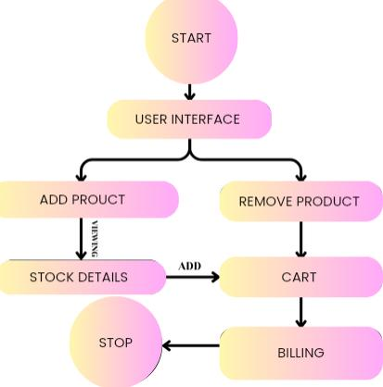
ARCHITECTURE OF THE PROPOSED SYSTEM
Notes:
7

Slide 8
LIST OF MODULES
Product Management Module: Manages product details like name and price using the Product class.Encapsulates data with private fields and public getters.
Shopping Cart Module: Handles adding/removing products and managing quantities.Uses HashMap for efficient product-quantity storage.Calculates subtotal and updates dynamically.
User Interface Module: Built with Java Swing for an interactive GUI.Uses components like JFrame, JPanel, and JTable.Ensures clean design with layout managers like Gridlayout.
Event Handling Module: Links GUI actions to functionality with event listeners.Handles user actions like adding/removing products.Includes error handling for invalid inputs.
Billing and Summary Module: Calculates final bill with tax (e.g., 10%).Formats and displays a detailed bill summary.Uses dialog boxes to show professional breakdowns.
Notes:
8

Slide 9
MERITS
Faster Checkout: Reduces customer wait time.
Error Reduction: Minimizes human errors in billing.
Inventory Management: Tracks stock in real-time.
Data Analytics: Provides sales reports and customer insights.
Increased Accuracy: Ensures correct pricing and discounts.
Loyalty Integration: Supports reward programs and promotions.
Payment Flexibility: Accepts multiple payment methods.
Notes:
9

Slide 10
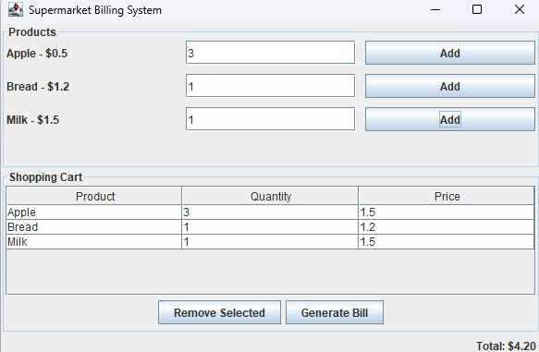
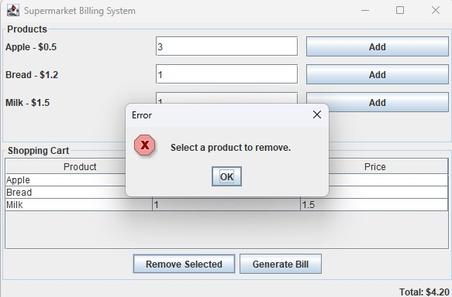
RESULTS AND DISCUSSION
ADD PRODUCT
REMOVE PRODUCT
Notes:
10

Slide 11
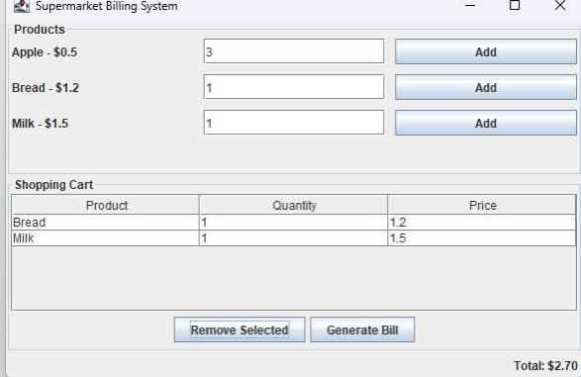
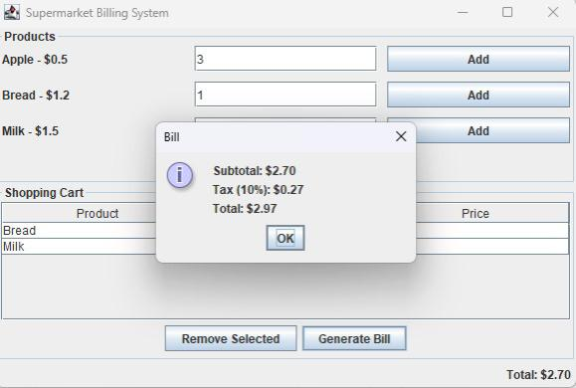
RESULTS AND DISCUSSION
VIEW PRODUCT
GENERATE TOTAL BILL

Slide 12
QUERIES ?
Notes:
12

