Slide 1
♻️
EcoDrop
AI-Based Smart Reverse
Vending Machine
Smarter Recycling.
Edge AI meets Sustainability.
Computer Architecture
Powered by YOLOv11 + Gemini AI
Raspberry Pi 5 · React PWA · FastAPI
Name
Varun U
Registration Number
24BVD1024
🌱 SDG 11 | SDG 12 | SDG 13
Subject
Computer Architecture

Slide 2
Problem Statement & Solution
EcoDrop | 24BVD1024
Why the world needs smarter recycling machines
⚠ Problem Statement
✅ Our Solution — EcoDrop
🌍
Global Waste Crisis
🧠
Dual-Mode AI Engine
The world generates 2.01 billion tonnes of municipal solid waste annually, with at least 33% not managed in an environmentally safe manner, threatening ecosystems and human health.
YOLOv11 runs entirely on-device (Raspberry Pi 5). When confidence < 85%, Gemini Flash is invoked via phone's cellular data — zero internet required on the machine.
🏙️
Inadequate Infrastructure
🎁
Gamified Incentive Engine
Most public recycling bins lack intelligence — they cannot distinguish waste types, leading to cross-contamination, low recyclability rates, and massive landfill overflow.
Users earn E-Coins based on item type, recyclability score, and condition. Coins are redeemable at campus canteens — driving sustained behavioural change.
📉
Low Recycling Incentives
📱
Instant PWA Interface
Without tangible rewards, citizens lack motivation to recycle consistently. SDG 11 (Sustainable Cities) and SDG 12 (Responsible Consumption) remain unmet goals globally.
A React Progressive Web App, served locally from the Pi, provides real-time camera preview, AI classification results, and wallet management — no app store needed.
🤖
Manual Sorting Costs
🌱
SDG-Aligned Impact
Traditional sorting relies on manual labour — expensive, inefficient, and error-prone. There is an urgent need for automated, AI-driven segregation at the point of deposit.
Directly addresses SDG 11, 12 & 13 by enabling intelligent, automated, incentivised waste diversion — reducing landfill load and promoting circular economy habits.

Slide 3
Literature Review
EcoDrop | 24BVD1024
State of the art vs. EcoDrop's novel approach
🏭 TOMRA — Industry Standard
🚀 EcoDrop — Our Novel Architecture
Technology
Optical sensors, pneumatic ejectors, barcode scanning
Technology
YOLOv11 custom-trained neural network (edge inference)
AI / ML
Rule-based sorting, no deep learning vision model
AI / ML
Dual-mode: local YOLO → Gemini Flash Vision fallback
Connectivity
Requires proprietary cloud infrastructure & internet
Connectivity
Zero internet on machine — phone acts as cellular bridge
VS
User Interface
Basic LED/LCD panel — no mobile integration
User Interface
React PWA served from Pi — full mobile app, no install
Deployment
Industrial-scale, high cost (€10,000–€80,000 per unit)
Deployment
~₹8,000 BOM — campus/SME deployable prototype
Item Coverage
Beverages only (cans, PET bottles) — very narrow scope
Item Coverage
6 classes: pen, notebook, cardboard, bottle, phone, mouse
Incentive
Cash/coupon printout — no digital wallet or gamification
Incentive
E-Coin digital wallet, real-time rewards, Supabase sync
Internet Need
Always-on cloud connectivity required
Internet Need
Completely offline capable; Gemini only when needed

Slide 4
Hardware Architecture
EcoDrop | 24BVD1024
Edge compute + vision + actuation
📷
Pi Camera Module V2
🖥️
Raspberry Pi 5 (4GB)
8MP Sony IMX219 sensor, 3280×2464 resolution. Fixed-focus wide-angle. Captures item image on demand via libcamera / Picamera2 API on trigger.
Quad-core Cortex-A76 @ 2.4GHz. 4GB LPDDR4X RAM. Runs YOLOv11 inference locally in <500ms. Hosts FastAPI server + serves React PWA over WiFi hotspot.
WiFi Hotspot Bridge
Servo Motor [Future Scope]
🌐
⚙️
Future Scope
Pi 5 creates 'EcoDrop-Machine' hotspot (192.168.0.x). Phone connects over WiFi. When YOLO confidence <85%, Pi sends JPEG to phone → phone calls Gemini Flash via 4G → result posted back.
Dual-channel servo actuator routes waste into correct bin slot (recycle / e-waste / general) based on AI classification result. Triggered via GPIO from Pi.
Spinner / Turntable [Future]
Future Scope
ESP32 MCU [Future Scope]
🔄
🔌
Future Scope
360° motorised platform enables uniform object capture — rotates item for optimal camera angle, reduces shadows, improves YOLO detection confidence.
Ultra-low-power WiFi+BT microcontroller. Will manage motor control, bin full-sensor, LED feedback, and power management, offloading GPIO from Pi.

Slide 5
System Architecture — Dual AI Pipeline
EcoDrop | 24BVD1024
🏆 Flagship Slide | Edge AI + Cloud Fallback via Phone Bridge
PHYSICAL LAYER
EDGE AI LAYER
DECISION LAYER
CLOUD LAYER
📦
Object Placed
📷
PiCam v2 Captures
🧠
YOLOv11 Inference
✅
High Confidence
• Item placed on platform
▶
• 8MP JPEG snapshot
▶
• Custom 6-class model
▶
• Conf ≥ 85%
• Sensor triggers capture
• Sent to Pi 5 CPU/NPU
• Confidence scored 0–100%
• Result finalised
• < 100ms
• < 500ms locally
• No internet needed!
Conf
<85%?
▼
📱
Phone Acts as Bridge
☁️
Gemini Flash API
📩
Result Posted Back
🎯
Final Classification
• Pi sends JPEG (~100KB)
• Phone calls Gemini
• Gemini returns JSON
• Coins calculated
• to connected phone
▶
• via 4G/5G data
▶
• Phone POSTs to Pi
▶
• Servo routes waste
• over local WiFi
• Vision + text prompt
• /cloud-result endpoint
• E-Coin wallet updated
■ Edge Path (≥85%)
■ Cloud Path (<85%)
■ Decision Gate
★ No cloud on machine

Slide 6
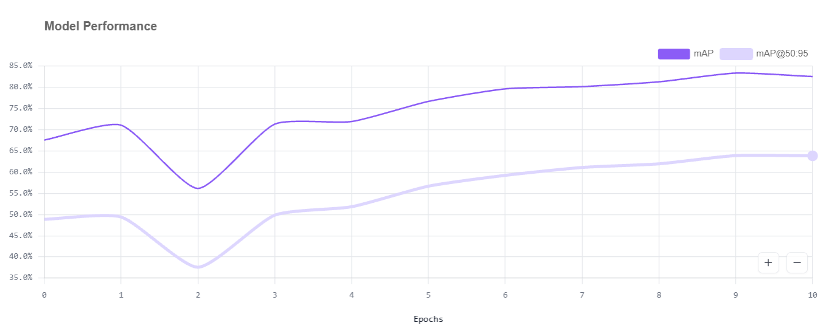
AI Model — YOLOv11 Custom
EcoDrop | 24BVD1024
Trained on Roboflow Universe | 6-Class Edge Classifier
🔬 Model Overview
📊 Model Performance Metrics
Framework
Ultralytics YOLOv11 (PyTorch)
76.8%
82.5%
Training Platform
Roboflow Universe
mAP@50
Precision
Dataset Size
24,600 images (public datasets)
76.2%
78.9%
Epochs
10 epochs
Recall
F1 Score
Classes
6 custom classes
Device
Raspberry Pi 5 (CPU inference)
Inference Time
< 500ms per image
Model File
ecodrop_yolov11.pt
📂 6 Detection Classes
🖊️ Pen / Marker
🍶 Water Bottle
📓 Notebook
📱 Mobile Phone
📦 Cardboard Box
🖱️ Computer Mouse

Slide 7
Software Stack
EcoDrop | 24BVD1024
React PWA + FastAPI + Supabase | Fully Pi-hosted
⚛️
React + Vite
🐍
FastAPI (Python)
☁️
Supabase Backend
🤖
Gemini Flash API
Progressive Web App built with React 18 + Vite 5. Zero-install — served directly from Pi. Installs to phone home screen via PWA manifest.
High-performance async REST API runs on Pi 5. Endpoints: /session, /item-detected, /cloud-result, /preview.jpg, /clear.
PostgreSQL cloud DB for user accounts, wallet sync, and transaction history. Syncs automatically when phone regains internet (offline-first).
gemini-3.5-flash-lite via Google AI Studio key. Called only when YOLO confidence < 85%. Phone acts as the internet bridge — Pi itself stays offline.
📡
Local Hosting
🎥
Live Camera Preview
🪙
E-Coin Formula
Pi 5 broadcasts 'EcoDrop-Machine' WiFi hotspot. FastAPI serves the React dist/ folder at http://10.42.0.1:8000. No router, no internet needed on the machine.
Phone polls /preview.jpg every 500ms. Pi returns latest PiCam frame as 60% JPEG (~12KB). User sees real-time viewfinder before capturing.
Coins = base_coins × condition_multiplier × recyclability_factor.
Example: Water bottle (base 15) × good (0.85) × recyclability (0.9) = 11 coins.
🎟️
Voucher / Wallet
🧹
PWA Cache Busting
🔒
Auth & Sync
Coins stored in Supabase wallet. User redeems via QR voucher at campus canteen POS. Offline transactions queued locally and synced when internet available.
Server exposes /clear endpoint — unregisters service worker, wipes all caches, force-reloads fresh app. Solves stale-cache issue on phone.
Supabase Auth (email/password). Session tokens stored in localStorage. All wallet transactions signed with user UUID — safe, offline-first architecture.

Slide 8
Conclusion
EcoDrop redefines the reverse vending machine — blending edge AI, cloud intelligence,
and gamified incentives into one affordable, campus-ready solution.
🧠
Dual-Mode AI
♻️
Broad Recyclable Coverage
💰
Gamified Engagement
YOLOv11 running on-device delivers sub-500ms classification with 82.5% precision. Gemini Flash bridges the gap for hard-to-classify items — no internet required on the machine.
6 custom-trained classes cover the most common campus recyclables — pens, notebooks, cardboard, plastic bottles, mobile phones, and computer mice.
E-Coin reward system with real redemption at campus canteens drives sustained recycling behaviour — turning environmental action into tangible student benefit.
📱
Zero-Friction UX
🌍
SDG-Aligned Impact
🚀
Scalable & Low-Cost
React PWA served from Pi — no app store, no download, no QR code scanning required. Instant access on any phone connected to the machine's WiFi.
Directly advances SDG 11 (Sustainable Cities), SDG 12 (Responsible Consumption), and SDG 13 (Climate Action) through automated, incentivised waste diversion.
~₹8,000 BOM with a roadmap for ESP32 actuation, servo bin-routing, and multi-machine fleet management — deployable across any campus or SME environment.
♻️
Varun U | 24BVD1024 | Computer Architecture | EcoDrop — AI Smart RVM

