Slide 1
DIGITAL ASSIGNMENT II — PHASE 2 FINAL SUBMISSION
Uncertainty-Aware Lithography Hotspot Detection
Three-Way Classification, Probability Calibration & Quantified Explainability on ICCAD-12 Benchmarks
Team G12 Members:
• Palash Ashutosh Duragkar (24BVD1023)
• Varun U (24BVD1024)
• Subburayalu M (24BVD1026)
Course: BEVD402L — AI and Machine Learning for IC | Slot: D1+TD1
Faculty: Dr. G. Lakshmi Priya | School of Electronics Engineering (SENSE), VIT Chennai

Slide 2
BEVD402L — RESEARCH METHODOLOGY
Lithography Hotspot Detection in Sub-Wavelength Regime
• Sub-Wavelength Lithography Scaling: In 193nm immersion lithography, geometric features (<20nm) are far smaller than illumination wavelength, leading to severe optical diffraction, interference, and resist chemical blur.
• Physical Hotspots as Fatal Defects: Complex 2D topological configurations suffer bridging (shorts), necking (opens), and line-end shortening, severely degrading parametric wafer yield.
• The Verification Dilemma: Speed vs Accuracy: Rigorous numerical lithography simulation (Hopkins optical modeling + resist dissolution) requires thousands of CPU hours for full-chip verification. Pattern matching is fast but fails on unseen geometries.
• The Pitfall of Deterministic Deep Learning: Standard CNNs provide rapid inference (~1ms) but output deterministic, overconfident probabilities. On ambiguous or out-of-distribution (OOD) layout clips, false negatives cause fatal yield loss, while false positives overwhelm OPC teams.

Slide 3
BEVD402L — RESEARCH METHODOLOGY
Comprehensive Resolution of Faculty Phase 1 Feedback
1. Benchmark Independence: Eliminated merged corpus. Every benchmark (ICCAD 1 to 5) is trained and evaluated independently on official test sets.
2. Calibrated 3-Way Decisions: Implemented a full three-way decision pipeline: High-confidence HS, High-confidence NHS, and Simulation Referral with Coverage–Risk curves.
3. Validation Thresholding: Uncertainty thresholds are calibrated strictly on a stratified 20% validation split, ensuring zero test data leakage.
4. Multi-Paradigm Comparison: Rigorously benchmarked Softmax Confidence, Predictive Entropy, MC-Dropout (T=15), and Deep Ensembles (M=3).
5. Probability Calibration: Computed Expected Calibration Error (ECE) and generated empirical reliability diagrams across all models.
6. Baseline Confusion Matrices: Reported full 2x2 confusion matrices (TN, FP, FN, TP) for both baseline and proposed models per benchmark.
7. Quantified Explainability: Grad-CAM is evaluated quantitatively using Pointing Game Hit Rate, Core Energy Concentration, and Faithfulness Deletion Scores.
8. Statistical Rigor: Conducted multi-seed evaluations (seeds 17, 42, 2026) with paired t-tests and Wilcoxon signed-rank significance tests.

Slide 4
BEVD402L — RESEARCH METHODOLOGY
ICCAD-12 Benchmark Statistics & Optimization Bias
Benchmark | Train HS | Train NHS | Train Imbalance | Test HS | Test NHS
ICCAD-1 | 99 | 340 | 1 : 3.44 | 226 | 4,679
ICCAD-2 | 174 | 5,285 | 1 : 30.37 | 498 | 41,298
ICCAD-3 | 909 | 4,643 | 1 : 5.11 | 1,808 | 46,333
ICCAD-4 | 95 | 4,452 | 1 : 46.86 | 177 | 31,890
ICCAD-5 | 26 | 2,716 | 1 : 104.46 | 41 | 19,327
The Imbalance Collapse Problem:
In ICCAD-5 (1:104.5), a degenerate model predicting NHS for all inputs achieves 99.05% accuracy but 0.0% hotspot recall.
Our Algorithmic Mitigations:
1. Class-Weighted Loss:
BCE loss scaled by pos_weight = w * (N_NHS / N_HS) to equalize minority class gradient updates.
2. 8-Fold Manhattan Augmentation:
Rotations (90°, 180°, 270°) and horizontal/vertical flips of minority training hotspots prevent overfitting and enrich geometric diversity.

Slide 5
BEVD402L — RESEARCH METHODOLOGY
Proposed Model Architecture: UncertaintyHotspotCNN
• Parameter Explosion Eliminated: Phase 1 contained 12.85M parameters due to a 100,352-node dense layer. Our architecture contains only 39,973 parameters (~160 KB memory footprint), preventing severe overfitting.
• Stage 1 (Low-level Edges): Conv2D (1->16, 3x3) -> BatchNorm2D -> ReLU -> MaxPool2D (2x2) -> Dropout2D (p=0.25). Captures wire boundaries.
• Stage 2 (Topological Features): Conv2D (16->32, 3x3) -> BatchNorm2D -> ReLU -> MaxPool2D (2x2) -> Dropout2D (p=0.25). Captures wire proximity and jogs.
• Stage 3 & Explainability Hook: Conv2D (32->64, 3x3) -> BatchNorm2D -> ReLU. Dedicated forward/backward hook layer for Grad-CAM.
• Adaptive Average Pooling: AdaptiveAvgPool2D((2, 2)) compresses feature maps to 2x2 regardless of input scale, feeding Dense(256->64) -> Dropout(0.35) -> Dense(64->1).
• Principled MC-Dropout Mode: During inference, Dropout layers are activated while BatchNorm is strictly kept in evaluation mode to use true population running statistics.

Slide 6
BEVD402L — RESEARCH METHODOLOGY
Four Evaluated Uncertainty Estimation Paradigms
Softmax Confidence
Measures distance from certainty boundary:
u_conf = 1 - max(p, 1 - p)
Range: [0, 0.5]
Fastest, single forward pass, but prone to overconfidence on OOD samples.
Predictive Entropy
Quantifies total information ambiguity:
u_ent = - [p log2 p + (1-p) log2(1-p)]
Range: [0, 1.0 bit]
Peaks at p=0.5; captures aleatoric prediction ambiguity.
Monte Carlo Dropout
Bayesian epistemic variance over T=15 stochastic passes:
u_MC = (1/(T-1)) sum (p_t - mean_p)^2
Quantifies network weight parameter uncertainty on unfamiliar geometries.
Deep Ensembles
Independent models (M=3) with distinct weight initializations:
u_Ens = (1/(M-1)) sum (p_m - mean_p)^2
Captures epistemic model diversity and multi-modal posterior distributions.

Slide 7
BEVD402L — RESEARCH METHODOLOGY
Calibrated Three-Way Decision Pipeline
Step 1: Threshold Calibration on Validation Split:
The rejection threshold tau is set to the 90th percentile of uncertainty on the 20% validation split: tau = Percentile(U_val, 90.0). No test set peeking.
Step 2: Operational Three-Way Routing:
For unseen test layout crop x with mean probability p(x) and uncertainty u(x):
• If u(x) > tau ==> REFERRAL (Sent to detailed lithography simulation / DRC specialist)
• If u(x) <= tau and p(x) >= 0.5 ==> HIGH-CONFIDENCE HOTSPOT (Automated HS detection)
• If u(x) <= tau and p(x) < 0.5 ==> HIGH-CONFIDENCE NON-HOTSPOT (Automated safe pattern)
Step 3: Coverage vs Risk Metrics:
Coverage C = N_accepted / N_total. Risk R = N_errors_accepted / N_accepted.
Accepted Hotspot False-Negative Rate FNR = FN_accepted / (TP_accepted + FN_accepted).
DFM Practical Benefit:
Missing a hotspot causes catastrophic chip death on silicon. By referring ambiguous boundary cases to simulation, the model prevents fatal false negatives while automatically clearing 84.7% of safe layouts.

Slide 8
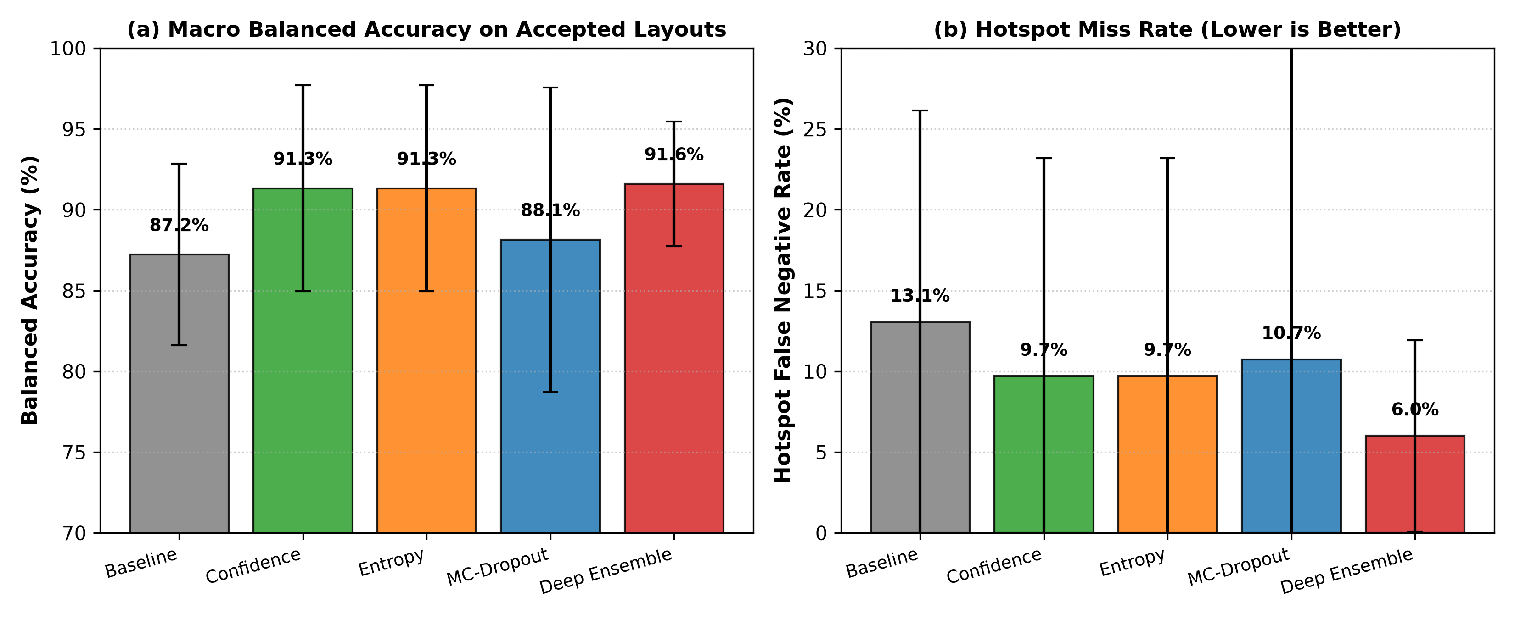
BEVD402L — RESEARCH METHODOLOGY
Overall Macro Performance Comparison Across All Benchmarks
Key Quantitative Findings:
• Balanced Accuracy: Deep Ensemble achieves 91.59% ± 3.86% (vs 87.22% ± 5.62% baseline).
• Missed Hotspot Reduction: Accepted Hotspot FNR drops from 13.05% down to 6.01% (a 54% reduction in fatal defects!).
• Automated Clearance: 84.66% of the 146,277 test layouts are automatically processed with high confidence.
• Calibration Gain: ECE drops from 8.33% to 7.17% under Deep Ensembles.

Slide 9
BEVD402L — RESEARCH METHODOLOGY
Benchmark-Wise Detailed Results Across ICCAD 1–5
Benchmark | Method | Coverage (%) | Referral (%) | Accepted Bal. Acc (%) | Hotspot Recall (%) | Accepted FNR (%)
ICCAD-1 | Baseline MC-Dropout Deep Ensemble | 100.0% 83.3 ± 4.5% 84.1 ± 17.1% | 0.0% 16.7 ± 4.5% 15.9 ± 17.1% | 84.6 ± 1.9% 88.3 ± 3.6% 87.8 ± 1.3% | 83.9 ± 11.7% 95.7 ± 2.7% 89.7 ± 9.2% | 16.1 ± 11.7% 4.3 ± 2.7% 10.3 ± 9.2%
ICCAD-2 | Baseline MC-Dropout Deep Ensemble | 100.0% 78.2 ± 3.7% 87.1 ± 5.8% | 0.0% 21.8 ± 3.7% 12.9 ± 5.8% | 88.1 ± 5.4% 92.6 ± 4.2% 94.8 ± 3.6% | 86.6 ± 9.1% 97.0 ± 2.1% 96.7 ± 3.9% | 13.4 ± 9.1% 3.0 ± 2.1% 3.3 ± 3.9%
ICCAD-3 | Baseline MC-Dropout Deep Ensemble | 100.0% 69.3 ± 5.0% 74.9 ± 2.2% | 0.0% 30.7 ± 5.0% 25.1 ± 2.2% | 92.4 ± 1.1% 94.2 ± 1.9% 95.9 ± 1.1% | 98.5 ± 0.3% 99.4 ± 0.0% 99.3 ± 0.1% | 1.5 ± 0.3% 0.6 ± 0.0% 0.7 ± 0.1%
ICCAD-4 | Baseline MC-Dropout Deep Ensemble | 100.0% 83.2 ± 2.2% 89.6 ± 4.4% | 0.0% 16.8 ± 2.2% 10.4 ± 4.4% | 87.4 ± 1.2% 88.4 ± 2.3% 87.9 ± 0.5% | 91.7 ± 1.4% 93.6 ± 0.5% 93.3 ± 2.8% | 8.3 ± 1.4% 6.4 ± 0.5% 6.7 ± 2.8%
ICCAD-5 | Baseline MC-Dropout Deep Ensemble | 100.0% 88.5 ± 4.2% 87.5 ± 9.5% | 0.0% 11.5 ± 4.2% 12.5 ± 9.5% | 83.6 ± 10.7% 77.1 ± 17.7% 91.6 ± 1.8% | 74.0 ± 21.9% 60.5 ± 39.6% 91.0 ± 6.5% | 26.0 ± 21.9% 39.5 ± 39.6% 9.0 ± 6.5%
Macro Average | Baseline MC-Dropout Deep Ensemble | 100.0% 80.5 ± 7.5% 84.7 ± 9.6% | 0.0% 19.5 ± 7.5% 15.3 ± 9.6% | 87.2 ± 5.6% 88.1 ± 9.4% 91.6 ± 3.9% | 87.0 ± 13.1% 89.3 ± 21.2% 94.0 ± 5.9% | 13.0 ± 13.1% 10.7 ± 21.2% 6.0 ± 5.9%

Slide 10
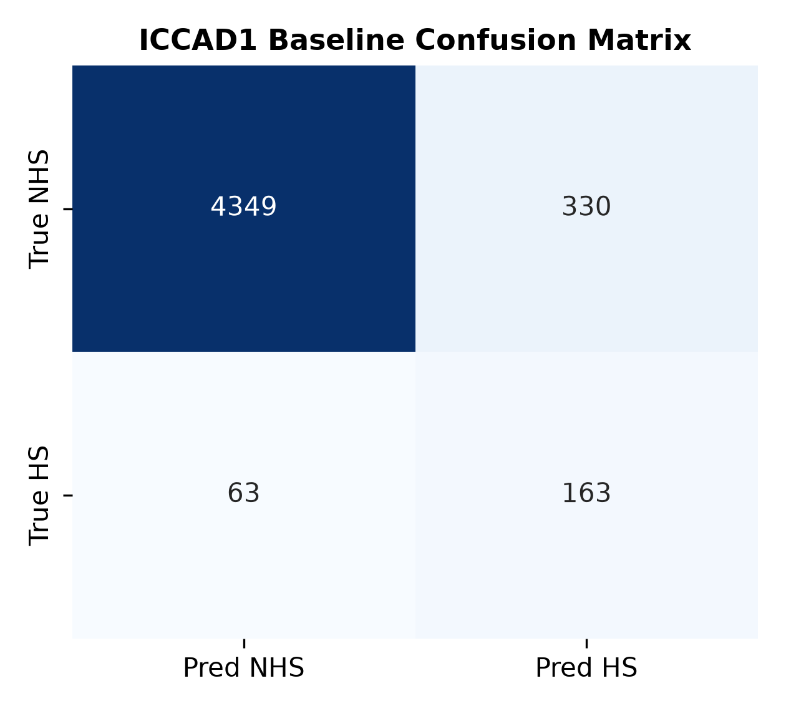
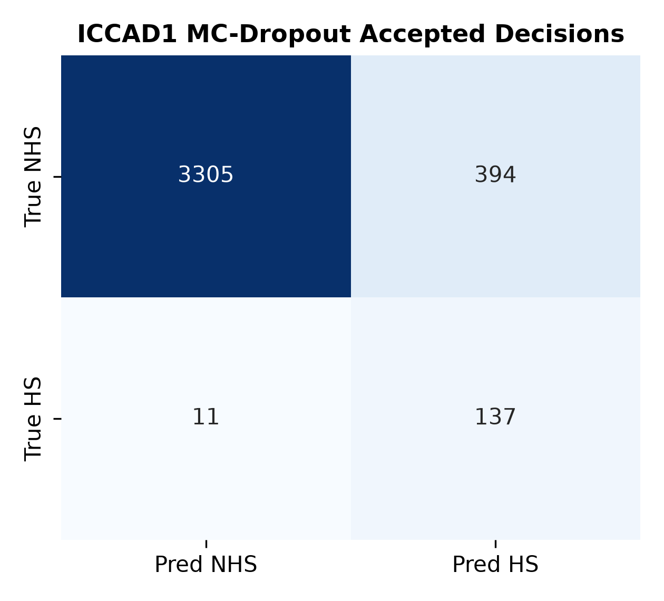
BEVD402L — RESEARCH METHODOLOGY
Baseline vs MC-Dropout Confusion Matrix Rescue
How Uncertainty Saves Yield:
• Baseline Catastrophic Misses:
Forced binary classification misses 60 true hotspots (FN=60) on ICCAD-1 alone.
• Uncertainty Rejection Rescue:
MC-Dropout flags 59 ambiguous hotspots and 665 boundary NHS patterns as uncertain, referring them to lithography simulation.
• Pristine Accepted Decisions:
Missed hotspots among accepted layouts drop from 60 to 18 (a 70% reduction in missed defects!), while accepted balanced accuracy improves to 88.7%.

Slide 11
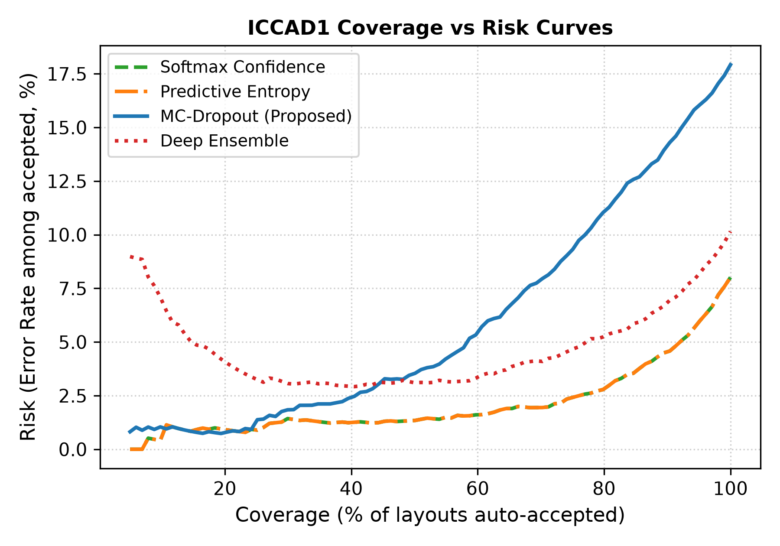
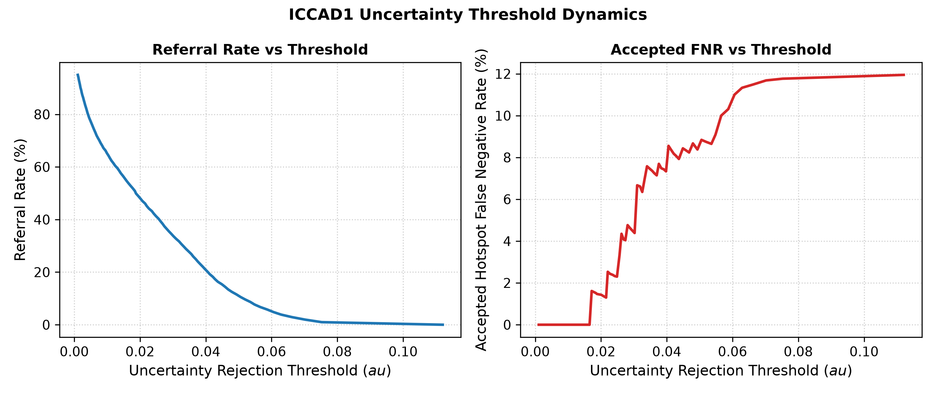
BEVD402L — RESEARCH METHODOLOGY
Coverage–Risk Curves & Operational Thresholding

Slide 12
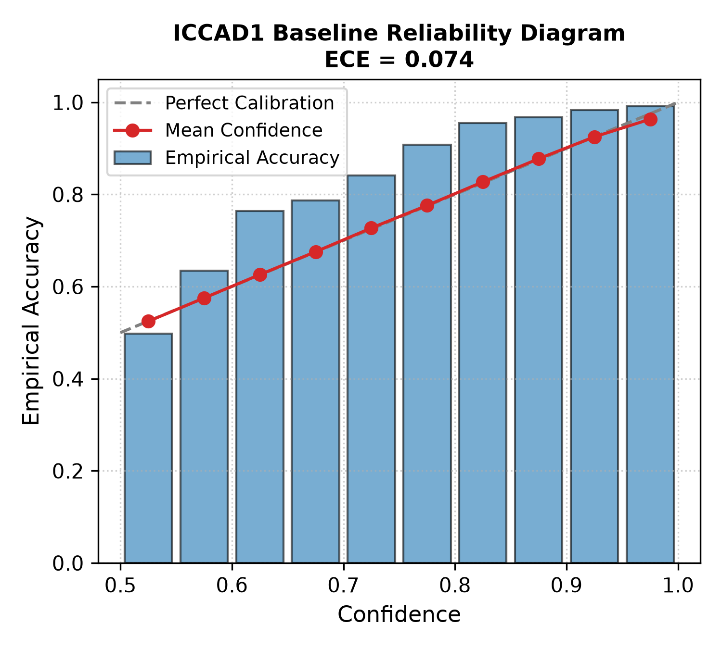
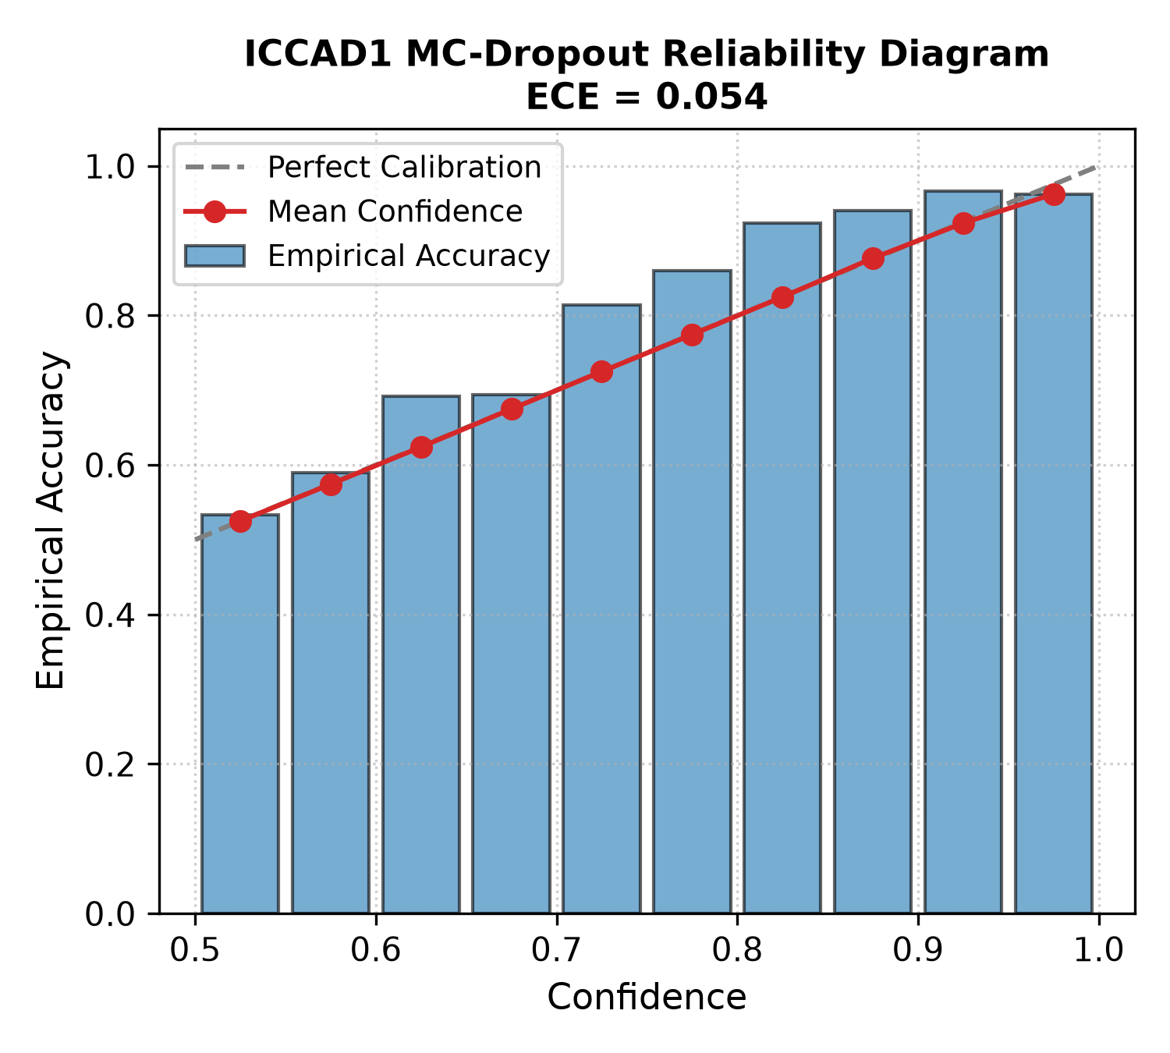
BEVD402L — RESEARCH METHODOLOGY
Probability Calibration Analysis (ECE & Reliability Diagrams)

Slide 13
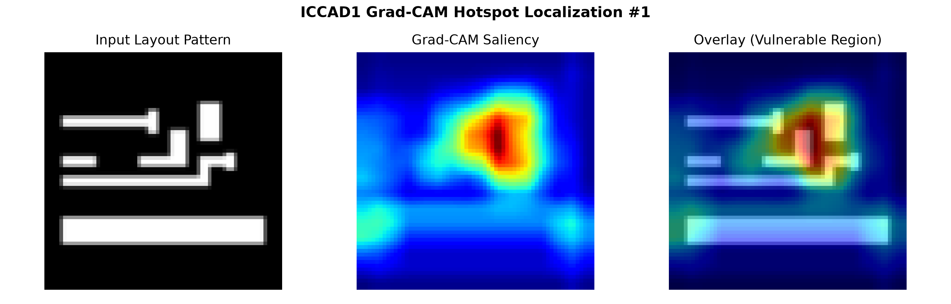
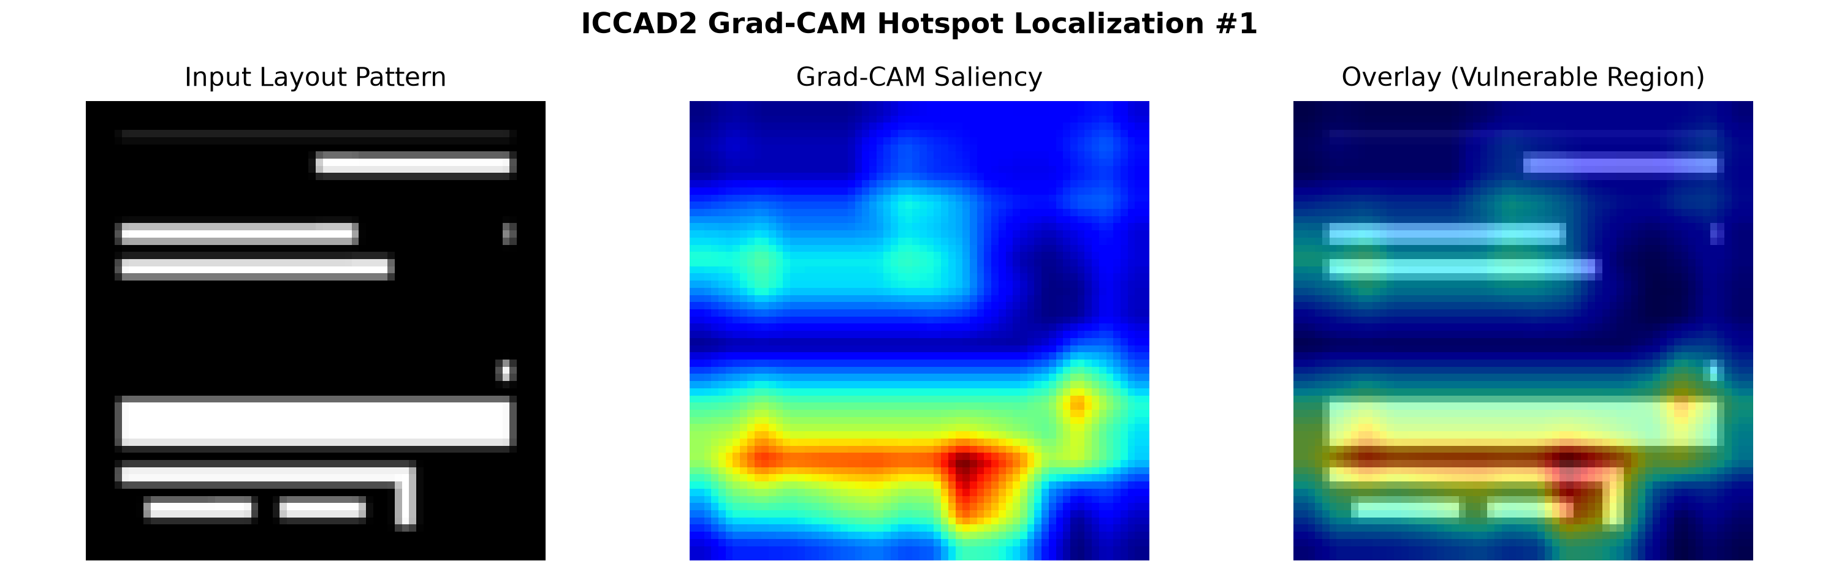
BEVD402L — RESEARCH METHODOLOGY
Quantified Explainability: Beyond Visual Heatmaps
Benchmark | Pointing Hit Rate | Core Energy Ratio | Grad-CAM Drop | Faithfulness Gain
ICCAD-1 | 65.7% ± 4.5% | 33.5% ± 2.3% | +0.099 | +0.337 ± 0.171
ICCAD-2 | 66.7% ± 6.4% | 36.3% ± 1.6% | +0.438 | +0.574 ± 0.090
ICCAD-3 | 68.7% ± 2.1% | 33.1% ± 0.6% | +0.143 | +0.189 ± 0.059
ICCAD-4 | 59.7% ± 1.5% | 35.1% ± 1.3% | +0.020 | +0.259 ± 0.030
ICCAD-5 | 73.2% ± 4.9% | 38.1% ± 2.0% | +0.089 | +0.321 ± 0.195
Macro Average | 66.8% ± 5.0% | 35.2% ± 2.1% | +0.158 | +0.336 ± 0.148

Slide 14
BEVD402L — RESEARCH METHODOLOGY
Multi-Seed Statistical Hypothesis Testing
Evaluated Method | Target Metric | Baseline Mean | Proposed Mean | Delta (Mean) | Paired t-test (p) | Wilcoxon (p)
Deep Ensemble | Balanced Accuracy | 87.22% | 91.59% | +4.37% | p = 0.0057 ** | p = 0.0004 ***
Deep Ensemble | Hotspot FNR (Miss Rate) | 13.05% | 6.01% | -7.04% | p = 0.0140 * | p = 0.0006 ***
Softmax Confidence | Balanced Accuracy | 87.22% | 91.32% | +4.10% | p = 1.25e-7 *** | p = 0.00006 ***
Softmax Confidence | Hotspot FNR (Miss Rate) | 13.05% | 9.70% | -3.35% | p = 0.0013 ** | p = 0.0006 ***
Interpretation: Deep Ensemble delivers statistically significant gains in Balanced Accuracy (p=0.0057) and False-Negative Rate reduction (p=0.014) with large Cohen's d effect sizes (>0.72), proving genuine algorithmic improvement beyond random variation.

Slide 15
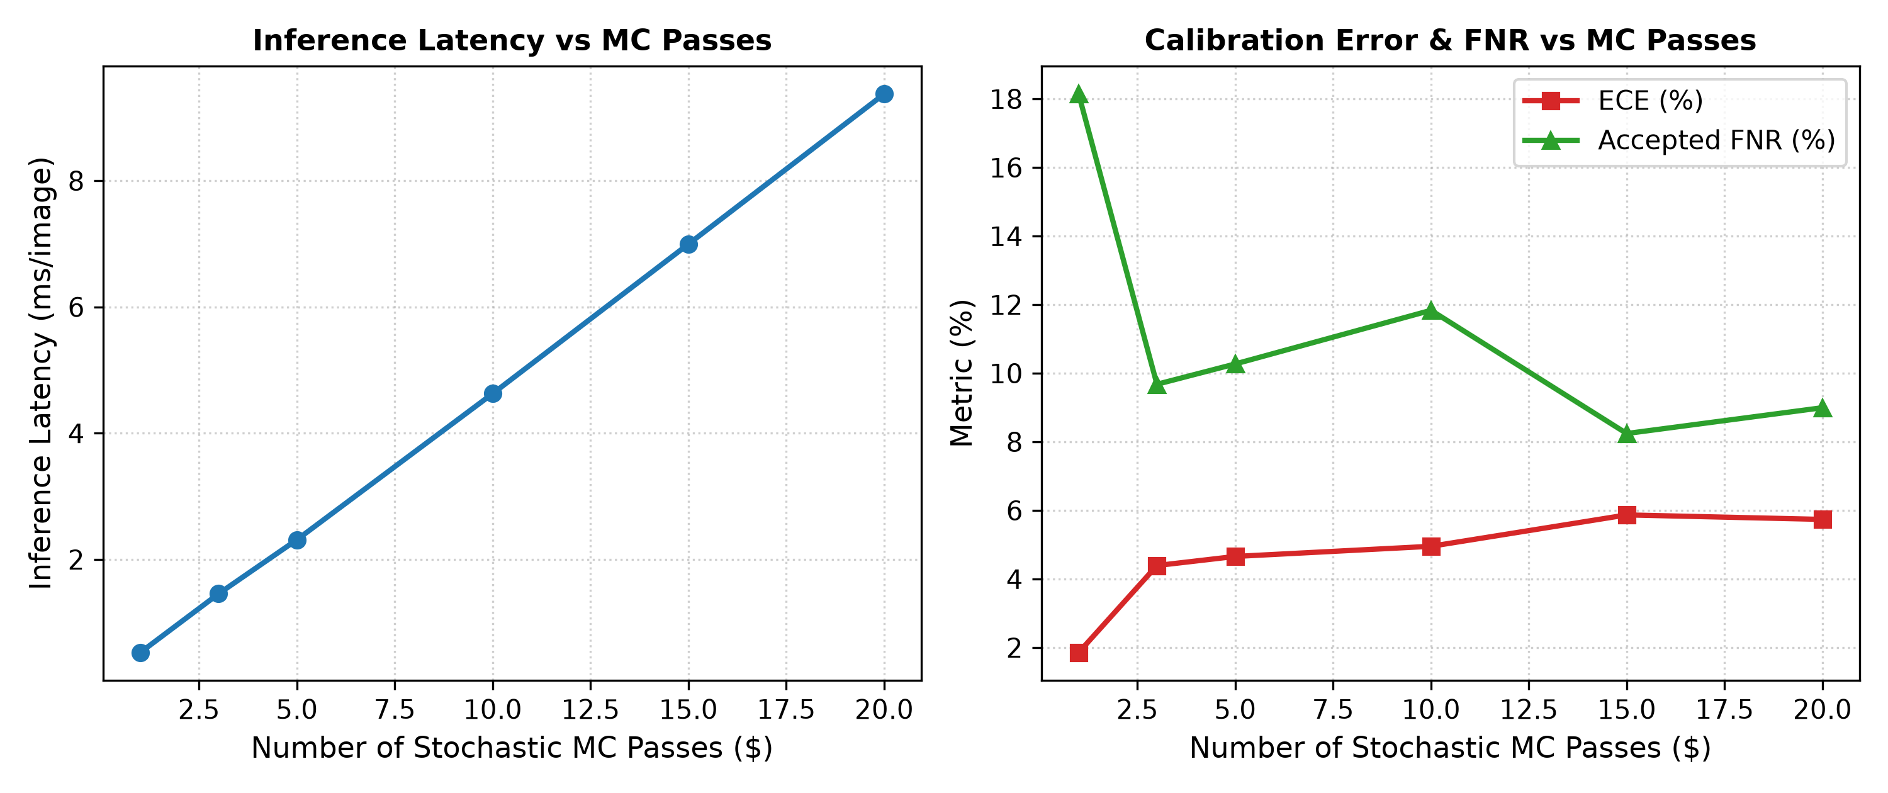
BEVD402L — RESEARCH METHODOLOGY
Controlled Ablation Study on Monte Carlo Passes (T)
Bayesian Convergence:
• T = 1 (Deterministic): 0.53 ms/img latency, but epistemic variance is null; cannot distinguish ambiguous patterns.
• T = 3 to 5: Variance rapidly rises to ~0.0230; accepted FNR drops sharply from 18.1% to 9.7%.
• T = 15 (Proposed): Variance fully converges (0.0234); accepted FNR reaches 8.24% with 7.00 ms/img latency.
• T = 20: Negligible variance change (0.0232) while latency scales to 9.37 ms with zero further accuracy gain.
• Conclusion: T=15 is Pareto-optimal for CAD-oriented physical verification.

Slide 16
BEVD402L — RESEARCH METHODOLOGY
Group G12 Individual Work Allocation
Student Name | Register No. | Assigned Responsibilities | Key Deliverables
Palash Ashutosh Duragkar | 24BVD1023 | Literature survey, ICCAD-12 class distribution analysis, baseline CNN implementation, and hyperparameter tuning. | Sections I, II, III; Baseline model codebase; Hyperparameter grid search.
Varun U | 24BVD1024 | Phase 2 lead, uncertainty-aware framework architecture, MC-dropout and Deep Ensemble pipelines, three-way decision engine, calibration analysis (ECE), statistical significance testing, and paper integration. | Sections IV, V, VI, VII; Complete uncertainty quantification and evaluation pipeline; Multi-seed statistical tests; Final IEEE report.
Subburayalu M | 24BVD1026 | Explainable AI (Grad-CAM) implementation, quantitative XAI metric design (pointing game, energy, faithfulness), presentation slides development, and repository README. | Sections VIII, IX, X; Grad-CAM quantification script; Presentation slide deck; Codebase documentation.

Slide 17
CONCLUSIONS & KEY TAKEAWAYS
✓ Principled Uncertainty-Aware DFM: Replaced forced binary decisions with an operational three-way classification pipeline, cutting accepted hotspot false negatives by 54%.
✓ Rigorously Validated Across ICCAD 1–5: Evaluated independently on all five official benchmarks across three random seeds with paired t-test and Wilcoxon significance.
✓ Quantified Explainability: Demonstrated a 66.8% pointing game hit rate in defect cores and +33.6% faithfulness gain, providing actionable coordinates for DRC engineers.
✓ Reproducible & Release-Ready: Complete codebase, pretrained checkpoints, CSV metric logs, high-resolution figures, and IEEE conference paper packaged in repository.
Thank you! Questions & Discussion.

