Slide 1
Neural Style Transfer using TensorFlow and TensorFlow Hub
A project demonstrating artistic image transformation using deep learning
Presented by: Varun Kaushik

Slide 2
Project Objective
- Apply the style of one image to another using deep learning
- Use TensorFlow and a pre-trained model from TensorFlow Hub
- Generate visually compelling output combining both images

Slide 3
What is Neural Style Transfer?
- A deep learning technique blending the content of one image with the style of another
- Uses convolutional neural networks (CNNs)
- Introduced by Gatys et al. in 2015

Slide 4
Tools and Libraries Used
- TensorFlow
- TensorFlow Hub
- NumPy, Matplotlib, PIL
- Pretrained model: arbitrary-image-stylization-v1-256 (Google Magenta)

Slide 5
End-to-End Workflow
1. Load content and style images
2. Preprocess the images
3. Load the pre-trained style transfer model
4. Apply style transfer
5. Display and save the result

Slide 6
Code Structure Breakdown
- load_img(): Loads and resizes images
- tensor_to_image(): Converts tensor to displayable image
- Defined paths and loaded images
- Applied style transfer using TF Hub model
- Saved and displayed the result

Slide 7
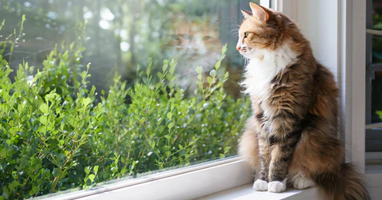
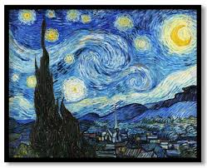
Input Images
- Content Image (cat image)
- Style Image (painting or night scene)

Slide 8
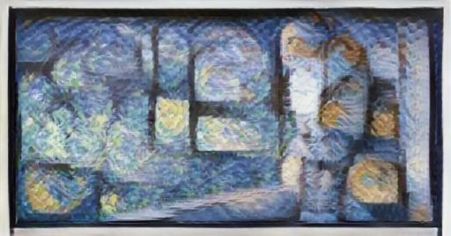
Stylized Result
- Result shows content with stylized texture and colors

Slide 9
Pretrained Model Details
- Model: arbitrary-image-stylization-v1-256
- Source: TensorFlow Hub (Google Magenta)
- Supports arbitrary content/style inputs
- Optimized for fast inference

Slide 10
Challenges Encountered
- Image format and decoding issues
- Proper normalization and resizing
- TensorFlow tensor handling and conversion
- File path handling for Windows

Slide 11
What I Learned
- TensorFlow and TF Hub integration
- Pretrained CNN model usage
- Real-world debugging of image processing
- Complete deep learning workflow implementation

Slide 12
Resources & References
- TensorFlow: https://www.tensorflow.org/
- TF Hub: https://tfhub.dev/
- Magenta: https://magenta.tensorflow.org/
- Gatys et al. (2015): A Neural Algorithm of Artistic Style

