Slide 1
Predicting Renewable Energy Generation, Shortfalls, and Anomalies Using Machine Learning
Group Name: Team 7
ADTA 5340 Section 003
Group Members
Varun Kumar Atkuri – 11694018
Irfan Ahmed Shaik – 11641210
Manasa Dontireddy – 11810613
Prudhvi Kolli – 11746825
Shree Sai Charan Rekala– 11702041

Slide 2
Agenda
Introduction
Business Problem
Dataset Overview
Methodology
Challenges
Model 1- Next-Day Wind Prediction
Model 2 – Shortfall Prediction
Model 3 – Anomaly Detection in Energy Pattern
Visualizations
Advantages
Future Work
Conclusion

Slide 3
Introduction
Increasing global population depends on renewable energy sources.
Wind and Solar renewable energy are highly unstable.
Accurately predicting demand and supply is very crucial.
To manage resources and avoid shortages, grid operators require effective tools.
Our project work provides predictive models to help energy planning better.

Slide 4
Business Problem
Three key goals of the project:
Accurately predicting next day wind generation.
Predicting wind energy shortfall before it occurs.
Identifying outlier in energy pattern.

Slide 5
Dataset Overview
Source: Open Power System Data (OPSD).
Timeline: 2015 – 2020.
Interval: Every 15 minutes.
Rows: 201604, Columns: 61
Countries: Germany (main focus), Austria, Netherlands, Belgium, Hungary, and Luxembourg.
Features: wind and solar generation, energy consumption, forecasts and prices.

Slide 6
Methodology
We followed CRISP-DM methodology throughout the project analysis.
Steps Involved:
Business Understanding: What we are going to predict
Data Understanding: Explore and clean the dataset
Data Preparation: Feature engineering
Modeling: Regression, Classification and Clustering
Evaluation: Validate the results

Slide 7
Challenges
Weather condition changes frequently.
Renewable energy heavily depends on seasonal trend. Eg. Solar energy drop in winter, peak in summer.
Inaccurate forecasts may result in expensive backups or outages.
Balancing grid load vs renewable energy supply is complex
Advantages of robust machine learning methods

Slide 8
Model 1 – Next-Day Energy Prediction
Wind energy generation is highly unstable and difficult to predict.
Developed Random Forest Regression model by using historical data and time-based features.
Metric | Value
Mean Absolute Error (MAE) | 237.95 MW
Root Mean Squared Error (RMSE) | 330.17 MW
Mean Wind Generation | 14314 MW
% MAE | 1.66%
% RMSE | 2.31%

Slide 9
Model 1
Helps grid operators to plan energy resources in advance.
Decrease heavily depending on costly backup energy.
For example, our model predicts wind energy generation in Germany tomorrow will be 10% more than usual. This helps energy companies to plan their supply a day earlier.

Slide 10
Model 2 – Shortfall Prediction
Renewable falls below expected level, impact business operation.
Implemented a random forest classification model, which trigger alerts when production drops expected threshold.
Model achieved : 85% accuracy and F1 score : 90% (Normal Class) , 73% (Shortfall Class)
Early warning system allow grid operators to act before it occur.
Increases productivity in energy management.
If there is huge energy usage in weekend, then our model provide alert before it happen. So, grid operators can arrange their backup energy sources.

Slide 11
Model 3 -Anomaly Detection in Energy Pattern
Unexpected behavior in energy generation and load can cause destruction.
Applied DBSCAN method to detect unusual outliers.
Rare outliers detected from the data.
Total sample : 201499 , outliers : 3
Helps proactively identify errors and reduce in outages.
For example, if there is any unexpected high and low spikes in energy load and generation, our model alerts the team before turning into outage.

Slide 12
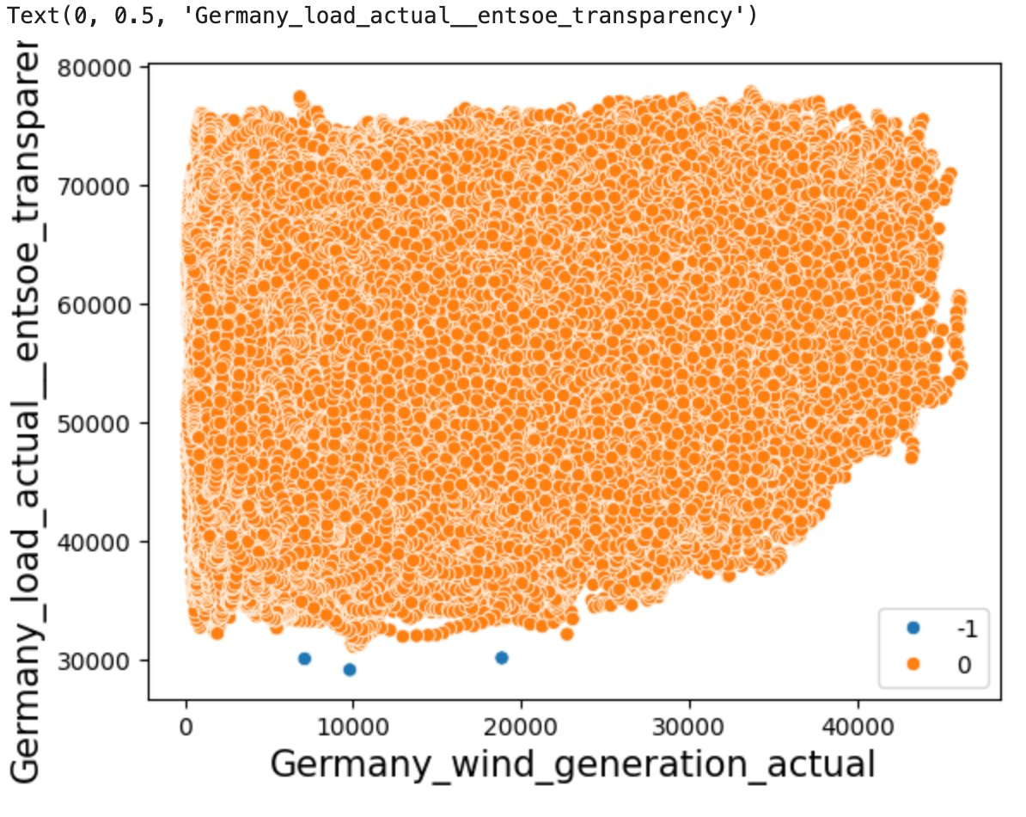
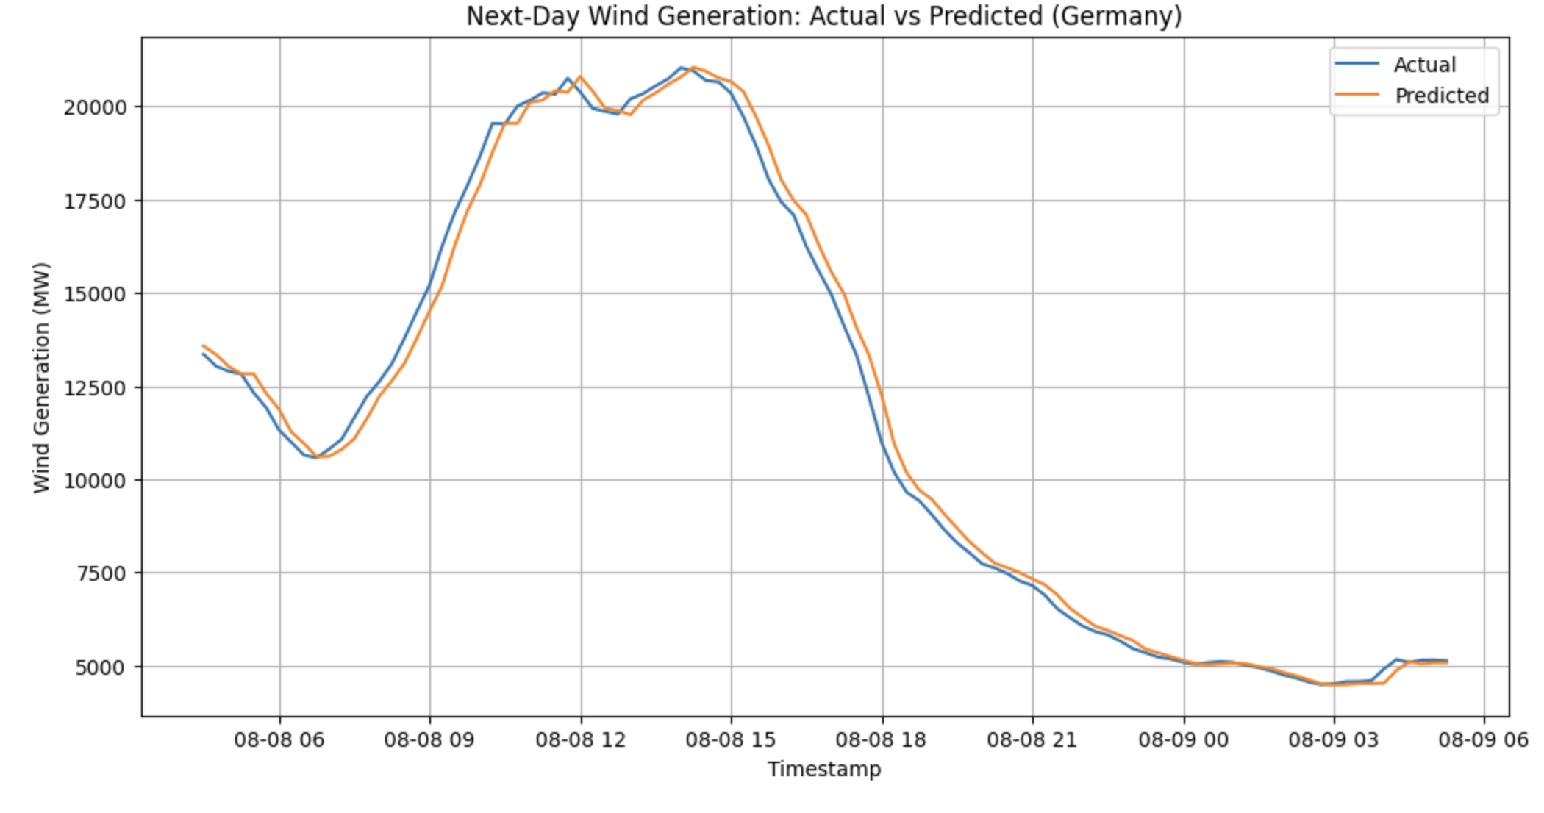
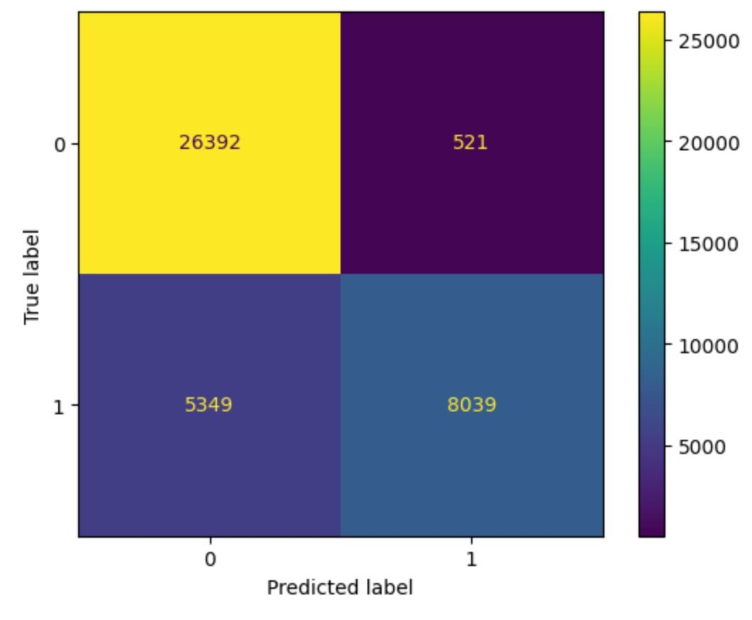
Visualizations

Slide 13
Advantages
Models help to improves productivity and stability in grid operations.
Early detection of shortfall allows better backup planning.
Reduce unnecessary cost for emergency energy sources.
Supports sustainability and clean energy goals.
Minimize the risk of confusion in energy generation.
Strengthens investors and customers confidence.

Slide 14
Future Work
Integrate with real time weather data will provide more accurate results.
Dynamic threshold for early shortfall prediction based on market and seasonal trend.
Extend the model to other renewable energy resources.
Real-time streaming pipeline will predict new data once it arrived.
Real-time monitoring dashboard to detect outliers.

Slide 15
Conclusion
Successfully predicted next day wind generation with high accuracy.
Effectively detected shortfall to provide required action.
Correctly identifying anomalies for constant production.
Provided clear picture for stakeholders, investors and energy providers.
Clear path for eco-friendly and reliable energy systems.

Slide 16
Thank You

