Slide 1
Implementation

Slide 2
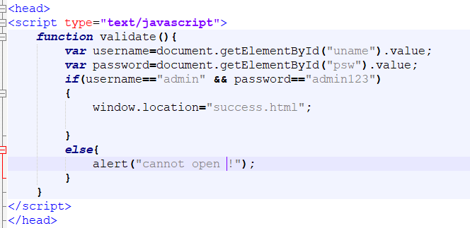
We have done validation of login credentials for admin using javascript.
This is done using client side scripting .
If the login credentials are correct then , it will load the next page.
Otherwise , it pops up an error message.

Slide 3
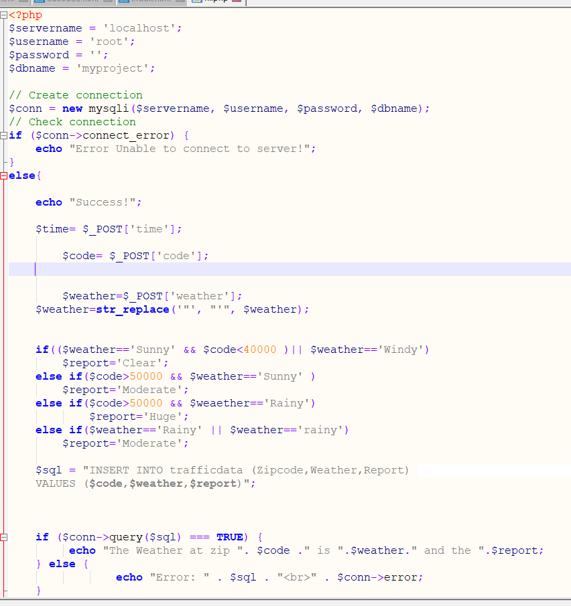
We have used Xampp server which contains tomcat, mysql database and apache server.
For server side scripting we have used php programming to connect the server .
In the given code, if connection fails to connect the server then it pops up a message saying an error.
Otherwise , the traffic report is generated according to the given weather data and zip code by the user.

Slide 4
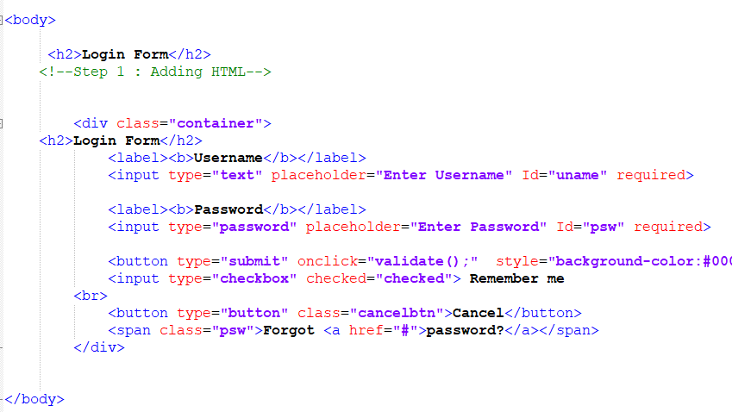

Slide 5
We have designed the frontend login page using HTML5 and CSS.
We have also included the functionality for “forgot password” in a simply way.

Slide 6
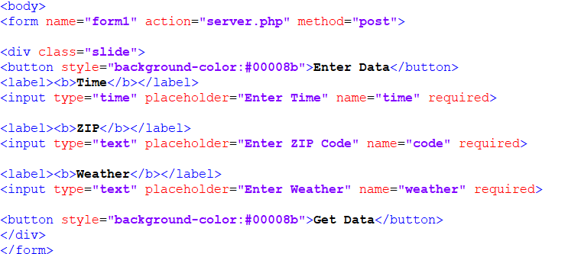

Slide 7
In the feature where user enters zip code and weather data to get the traffic report, we used an element called “<form>” where it transfers the entered data to the server for generating the report.
We have used Post method in the “<form>” element as it is more secure to transfer data from end user to the server. This improves security during data transmission.

Slide 8
Here we have used Xampp server v3.2.4. We have used Apache , MySql and Tomcat which uses ports 80, 3306, 8080 as default.
We have also used phpMyAdmin for creating an Sql database with the name as “myproject”.
The server runs as localhost.

Slide 9
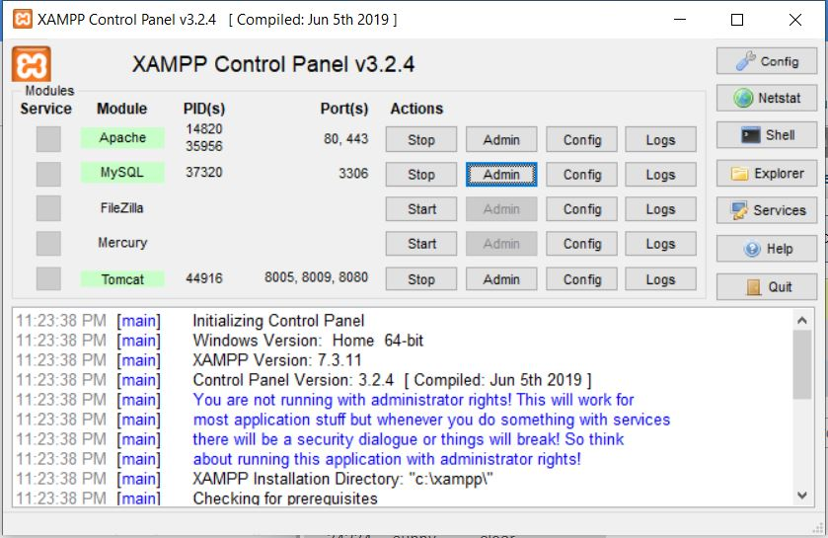
Implementation using Xampp server.

