Slide 1
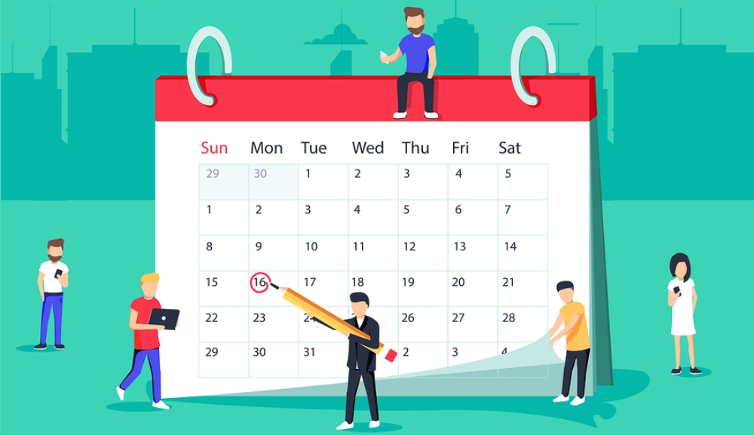
Scheduling:
Notes:
Varun Lingabathini:
Scheduling of a project plays a crucial role. This acts as a map for the project. We can record and report the status of each part of the project.
This also servers as a road map to our goals in the project.
Without a schedule, we never know whether we are reaching our goals or meeting client requirements and deadlines.
A successful project should always be delivered on time to the client, for that every action should be on record and we should know our deadlines.
All those things can be collectively provided in scheduling chart.
We can see the scheduling chart which we used in our project at some part of time in project.

Slide 2
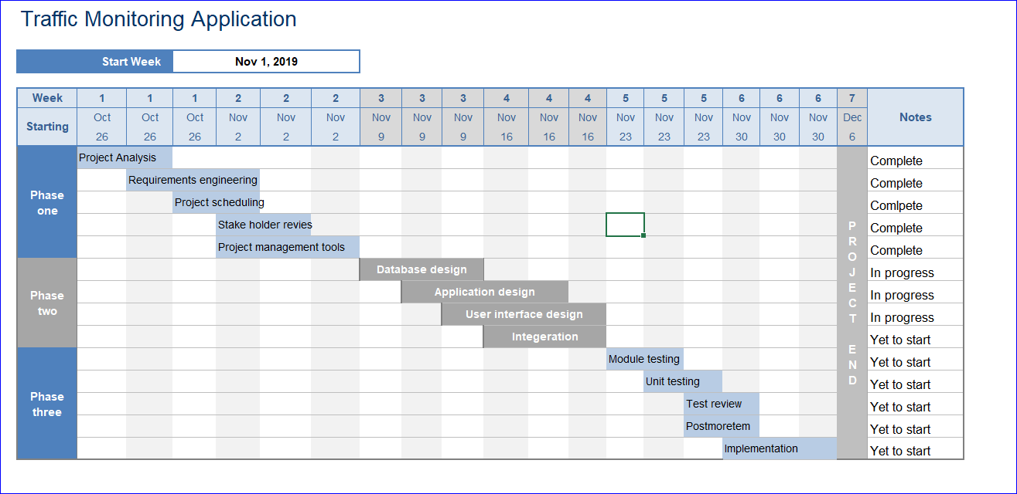
Scheduling:
Notes:
Varun Lingabathini:
The scheduling of this project is displayed in this slide.
We tried to give an overview of the schedule in a pictorial way. We divided the project in to three phases.
Phase one is for Project Analysis, Requirements, Scheduling and Stake holders' reviews. This phase is scheduled for two weeks.
Phase two is Database and Application design, User Interface design and Integration. This phase is scheduled for two weeks like phase one.
Phase three is for module testing, unit testing and postmortem. This phase is scheduled for three weeks, the first day of third week is end of the project and the D-day. The Deployment day.
This snapshot was taken in the third week of the project. We are using this snap to show the management of scheduling. We update the notes in this sheet every week or every part of project. Once we start a module/part of project we will change the status to “In progress”

Slide 3
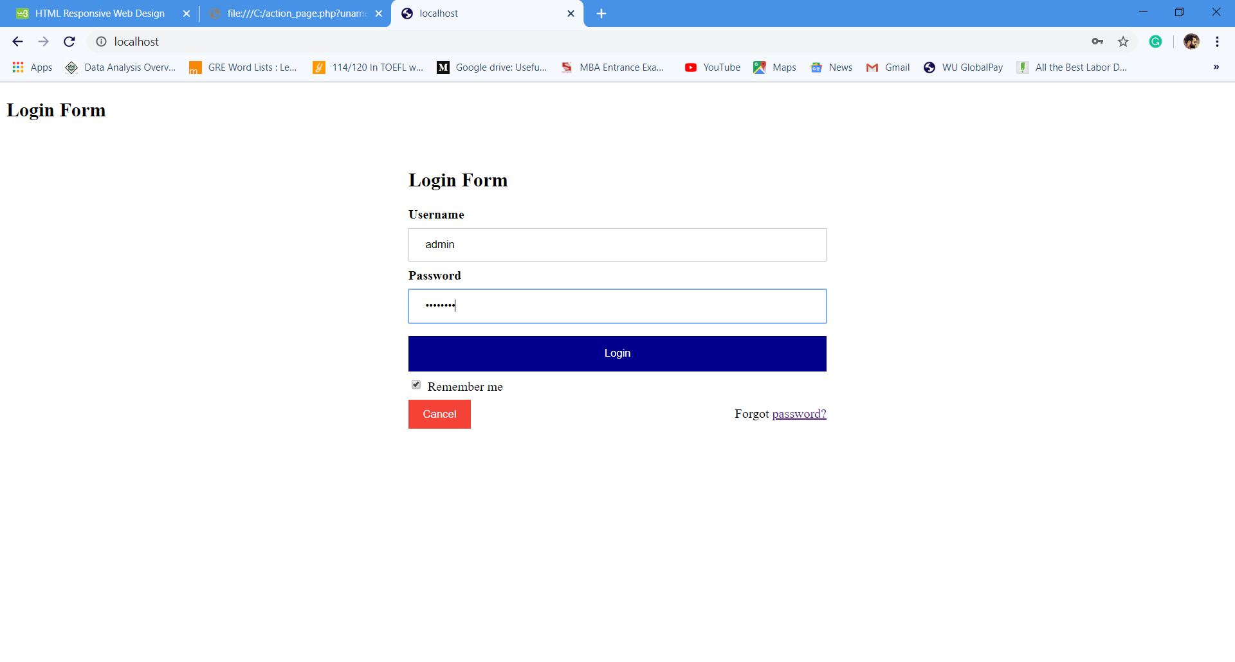
Login Page:
Notes:
Varun Lingabathini:
We have designed login page. We here pasted a copy of login page for administrator. The similar page will be provided to the users too.
The username and password can be created by users during the first signup. Users need to register to the app. We didn’t created signup due to time constraints for the project.
Once users are registered for this application, they can provide username and password to enter the application. We provided an option for forgot password, where users can reset their passwords.

Slide 4
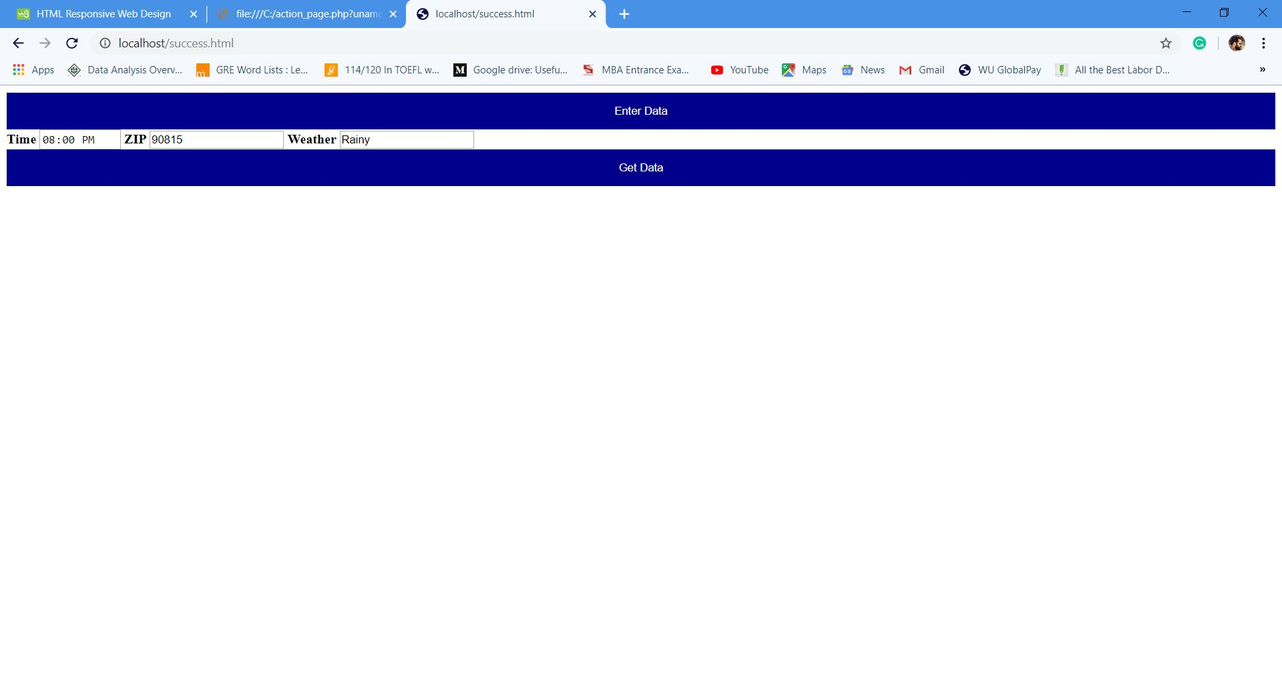
Home Page:
Notes:
Varun Lingabathini:
So this is the homepage of the app we created(this module).
Providing three inputs for the user.
Time (12 Hours standard)
ZIP code
Weather
For this module, we provided few options for whether such as Rainy, fog, humid, snow. User needs to enter something like this.
For time, we provided this a 12-hour format. If user provides a 24-hour format, an error will be thrown to user to change format to 12 hour one.
For ZIP code, user need to enter a valid Zip code in united states as we limited this to united states.
We provided a button “Get data”, once user provides the required data. User will be routed to the “Traffic update” page.

Slide 5

Traffic update:
Notes:
Varun Lingabathini:
Specific to this module, as already explained about the time constraint we developed a small update providing a statement about the traffic report.
We can add images, graphics to the output for easy understanding of the overall traffic report.
For example, providing images or graphs about the traffic history in that zip code.

Slide 6
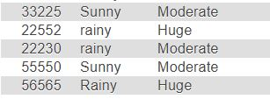
Database:
Notes:
Varun Lingabathini:
This is how the database looks for this module.
We just implemented this module with minimal data, database just has three columns with limited data.
The data entered by the user will be mapped and report will be fetched form live database in production environment.

