Slide 1
NUMA-Aware Mutual Exclusion Locks
-By P.Sai Krishna(13B81A1271)
L.Varun(13B81A12B0)
P.V.Saideep(13B81A12B4)
Project Guide:
Mr. B.Vikranth

Slide 2
Introduction to NUMA
The NUMA(Non-Uniform Memory Access) architecture was designed to surpass the scalability limits of the SMP(Symmetric Multiprocessing Systems) architecture.
SMP works relatively fine until the no. of CPUs goes past 8-12 CPU’s.
NUMA alleviates the performance bottlenecks that we encounter in SMP, by limiting the number of CPUs on any one memory bus, and connecting the various nodes by means of a high speed interconnect.

Slide 3
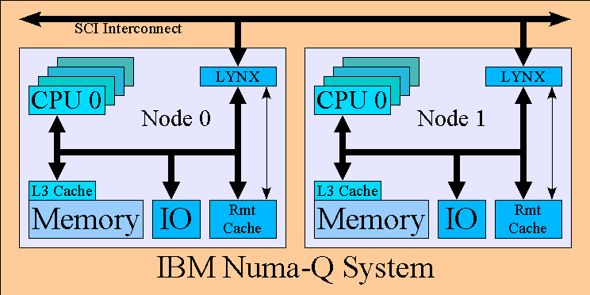
Notes:
scalable coherent interface (SCI)

Slide 4
Each NUMA node has locally attached memory, a local cache and multiple processing cores.
The set of cache-coherent communications channels between nodes is referred to collectively as the interconnect.
To decrease latency and to conserve interconnect bandwidth, NUMA-aware policies encourage intra-node communication over inter-node communication.
Notes:
Cache coherence equals consistency and uniformity of shared resources.

Slide 5
Spinlocks
Spinlock is a lock which causes a thread trying to acquire it to simply wait in a loop(“spin”) while repeatedly checking if the lock is available.
Since the thread remains active but is not performing a useful task, the use of such a lock is a kind of busy waiting.
Spinlocks are efficient if threads are likely to be blocked for only short periods because they avoid operating system overheads.

Slide 6
Mutex Locks
Mutex is a lock that we set before using a shared resource and release after using it.
When the lock is set, no other thread can access the locked region of code.

Slide 7
Existing Mutex lock methods
#include <pthread.h>
int pthread_mutex_init(pthread_mutex_t *mutex, const pthread_mutexattr_t *mutexattr);
int pthread_mutex_lock(pthread_mutex_t *mutex));
int pthread_mutex_unlock(pthread_mutex_t *mutex);
int pthread_mutex_destroy(pthread_mutex_t *mutex);

Slide 8
Proposed system
Address the locality of lock objects among NUMA multi core processors.
Migrate lock objects onto the node where the thread is bound to.
While creation of lock object itself the lock object locality is specified using numactl library.

Slide 9
Proposed Lock API
Module 1:
Numa_mutex_init(mutex_t * lock , int node);
Numa_mutex_lock( mutex_t * lock );
Numa_mutex_unlock( mutex_t *lock);
Module 2:
Numa_spin_init ( spin_lock_t *lock , int node );
Numa_spin_lock( spin_lock_t * lock );
Numa_spin_unlock( spin_lock_t *lock );
Notes:
Thread Affinity API==location of thread.

Slide 10
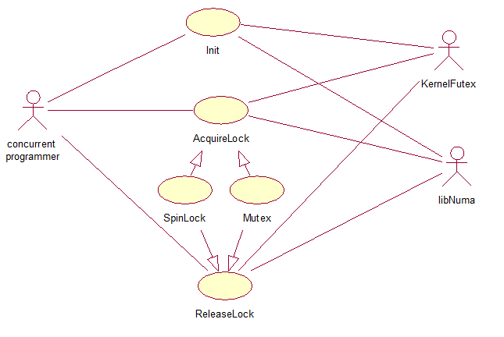
UseCase diagram illustrating usage of proposed lock API

Slide 11
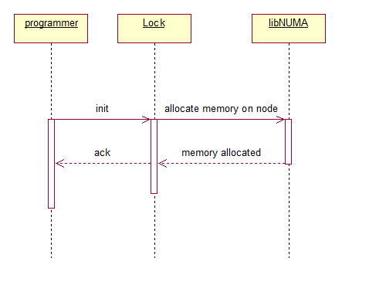
Sequence diagram to illustrate numa_x_lock_init()

Slide 12
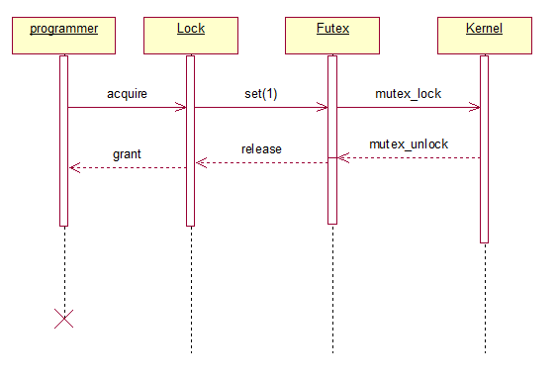
Sequence diagram to illustrate mutex lock and unlock.

Slide 13
Performance Analysis
We evaluate the efficiency of our new family of NUMA aware locks with the use of NUMA Micro-Benchmarks Suite.
NUMA Micro-Benchmarks suite is used to test the memory throughput of a single thread at different cores and over the whole range of memory addresses.
This is an assortment of micro-benchmarks for understanding the performance behavior of NUMA systems and for exploring the Linux NUMA API.

