Slide 1

SMART TRAFFIC LIGHT MANAGEMENT SYSTEM
Presented by
SUNIL DANAPPA BIRADAR
THRINESH S
VARUN M
SHILPASHREE S P
1SI20EC097 1SI20EC102
1SI20EC107
1SI20EC112
Under the guidance of
Dr. Y Harshalatha
Assistant Professor Department of E&CE
DEPARTMENT OF ELECTRONICS AND COMMUNICATION
SIDDAGANGA INSTITUTE OF TECHNOLOGY, TUMKUR - 572 103
1

Slide 2
Contents:
Motivation
Objectives
Introduction
Literature Review
Methodology
Hardware Description
Software Description
Algorithm
Flow chart
Results
Budget Details
Conclusion
Future Scope
References
1

Slide 3
Motivation:
The number of vehicles is increasing rapidly in urban areas and metropolitan cities.
The conventional traffic signaling system is not adaptable to changes in the amount of traffic.
Traffic jam harms the economy, causes serious air pollution and noise pollution.
To overcome all these problems, a proper smart signaling system is critically needed to be developed.
2

Slide 4
Objectives:
To measure the vehicle count using YOLO model and to control the traffic signals accordingly.
To upload traffic density information to the cloud for future analysis.
3
4

Slide 5
Introduction:
The problem of traffic congestion needs to be addressed in an efficient way.
The present traffic control systems that are used are:
Manually controlled which requires man power and is less efficient.
Automatically controlled with static time allocation irrespective of traffic density.
4

Slide 6
Introduction (contd..):
Even though the road is free the vehicles are made to wait to match the allocated time.
This results in wastage of time and fuel.
The intended project makes traffic light control more efficient.
This system will intelligently decide when to alter signals based on the total traffic on each road.
5

Slide 7
Literature Review :
Author | Title and journal/conference details | Year | Remarks
Prithvinath Manikonda, AnilKumar Yerrapragada, Sai Sasank Annasamudram . | Intelligent Traffic Management System, IEEE Conference on Sustainable Utilization and Development in Engineering and Technology (STUDENT) The University of Nottingham, Semenyih, Selangor, Malaysia. | 2011 | Capable of providing practically important real-time data. Using RFID technology, the system calculates the average speed of the vehicles.
Zhijun Li. Chunxiao, LiYananZhang, Xuelong Hu | Intelligent Traffic Light Control System Based on Real Time Traffic Flows, 14th IEEE Annual Consumer Communications & Networking Conference (CCNC). | 2017 | Software Programming Model Ultrasonic Sensor as traffic density detector. Traffic signal duration adjusting.
Anam Firdous, Indu, Vandana Niranjan. | Smart Density Based Traffic Light System, 8th International Conference on Reliability, Infocom Technologies and Optimization(ICRITO), Amity University, Noida. | 2020 | Manages the traffic automatically based on the traffic density. Arduino has been used with a technique called port manipulation.
6

Slide 8
Literature Review (contd..):
Author | Title and journal/conference details | Year | Remarks
Rohit Prasad, Himanshu Yadav , Devarsh kumar , Sachin pandey , Abhimanyu Yadav. | Smart Traffic Monitoring and Controlling, JETIR, Volume 8, Issue 6. | 2021 | IR Sensors are used to measure the traffic density. Integrated TCP/IP Protocol for cloud computing.
U. E. Prakash, K. T. Vishnupriya, A. Thankappan and A. A. Balakrishnan | "Density Based Traffic Control System Using Image Processing,” International Conference on Emerging Trends and Innovations In Engineering And Technological Research (ICETIETR), Ernakulam, India, | 2020 | Makes use of binary images captured at real-time and a reference image stored in the system. The suitable output will be obtained by comparison.
D. Ijeri, P. Maidargi and R. Sunagar, | "Traffic Control System Using Image Processing,“ IEEE Bangalore Humanitarian Technology Conference (B-HTC), Vijiyapur, India, | 2020 | Takes four captured images and four reference images of four lanes as input. Image matching is done and traffic density is calculated.
7

Slide 9
Literature Review (contd..) :
Author | Title and journal/conference details | Year | Remarks
S. Chen and W. Lin | "Embedded System Real-Time Vehicle Detection based on Improved YOLO Network,” IEEE 3rd Advanced Information Management, Communicates, Electronic and Automation Control Conference (IMCEC), Chongqing, China. | 2019 | YOLO v3-live is used which performs real-time detection of vehicles in embedded devices. The detection performance is improved compared with YOLO v3-tiny.
Y. Miao, F. Liu, T. Hou, L. Liu and Y. Liu | "A Nighttime Vehicle Detection Method Based on YOLO v3,“ Chinese Automation Congress (CAC), Shanghai, China. | 2020 | YOLO v3 based nighttime vehicle detection method is proposed. A nighttime vehicles dataset is established to train a pre-trained YOLO v3 network.
M. A. Bin Zuraimi and F. H. Kamaru Zaman | "Vehicle Detection and Tracking using YOLO and DeepSORT,”IEEE 11th IEEE Symposium on Computer Applications and Industrial Electronics (ISCAIE), Penang, Malaysia. | 2021 | Deep learning algorithm YOLO is used for vehicle detection. The model then uses different framework named TensorFlow.
8

Slide 10
Summary of Literature Review:
To address the challenges related to ultrasonic and IR sensors in traffic monitoring and control systems.
By incorporating image processing, these systems aim to enhance accuracy and overcome limitations of traditional sensor-based approaches.
Smart traffic light management systems leverage image processing techniques to calculate traffic density and allocate signal timings based on captured images and reference images.
The application of machine learning and deep learning algorithms in traffic management leads to improved accuracy and efficiency in vehicle detection.
9

Slide 11
Methodology:
Block Diagram:
Cloud
YOLO Model
Raspberry Pi
Image Pre-Processing
Image Input

Slide 12
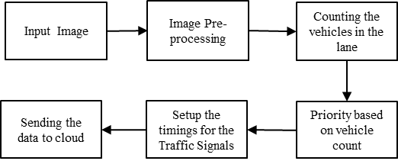
Methodology (contd..):
Flowgraph:
11

Slide 13
Methodology (contd..):
Input the images and apply a binary mask to the image.
Using OpenCV to process the images for filtering, or enhancing the image quality.
Apply the YOLOv8 model for accurate and efficient vehicle detection on the captured images.
Visualize the data by drawing bounding boxes around the detected vehicles on the original image.
Additionally, Identify patterns in traffic flow.

Slide 14
Methodology (contd..):
YOLO Algorithm:
YOLO was introduced in the paper "You Only Look Once: Unified, Real-Time Object Detection" by Joseph Redmon, et al.
YOLO treats object detection as a regression problem and divides the input image into a grid.
Each grid cell predicts multiple bounding boxes and their corresponding class probabilities.
To use YOLO for vehicle detection, a trained YOLO model specifically trained on a dataset that includes vehicle images is needed.
13

Slide 15
Methodology (contd..):
YOLO Algorithm (contd..):
The training process involves providing annotated images with bounding box annotations and class labels for vehicles.
The model learns to predict bounding boxes and class probabilities based on this training data.
The model will output the bounding box coordinates and class probabilities for any detected vehicles in the image.
YOLO has evolved over the years, and there are different versions of the algorithm each with improvements in accuracy and speed.
14

Slide 16
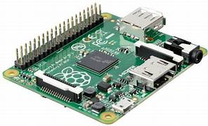
Hardware Description:
Raspberry Pi-3:
The Raspberry Pi 3 is a versatile and capable single-board computer suitable for a wide range of projects and applications.
A CPU of 1.2GHz clocking frequency with 64-bit quad-core ARM Cortex-A53 processor.
The GPIO pins can be used with a variety of alternative functions, some are available on all pins, others on specific pins..
15

Slide 17
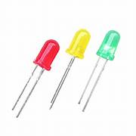
Hardware Description (contd..):
LED’s:
LED is a semiconductor device that emits infrared or visible light when charged with an electric current.
Visible LEDs are used in many electronic devices as indicator lamps, in automobiles as rear-window and brake lights.
In this case, we are employing to guide the automobiles.
16

Slide 18

Software Description:
Thonny IDE:
Thonny is a free Python Integrated Development Environment(IDE) for writing and testing Python code.
Well-suited for developing software components like data processing, image analysis, and machine learning, all of which are useful for implementing traffic management algorithms.
17

Slide 19

Software Description (contd..):
VNC Viewer:
VNC Viewer is a remote desktop software that allows you to access and control a remote computer or device from another location.
It provides a graphical user interface (GUI) to remotely interact with the target system.
18

Slide 20
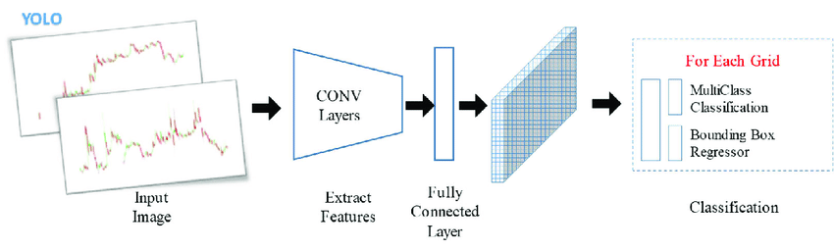
Software Description (contd..):
YOLO Model:
YOLO (You Only Look Once) is a popular object detection algorithm and model for computer vision tasks, including real-time object detection.
YOLOv8 is the newest YOLO model that can be used for object detection, image classification, and instance segmentation tasks.
Single stage CNN network.
Here, it is used to detect vehicles in real-time, facilitating traffic monitoring.
19

Slide 21

Software Description (contd..):
Open CV:
OpenCV (Open Source Computer Vision Library) is an open-source computer vision and machine learning software library.
OpenCV offers a rich set of image processing functions, filtering, edge detection and color manipulation.
20

Slide 22

Software Description (contd..):
Google colab:
Google Colab is a cloud-based Jupyter notebook environment.
Colab provides a free computing resource (with limitations) and comes with pre-installed libraries and packages.
Commonly used in data analysis, machine learning, and artificial intelligence.
21

Slide 23
Algorithm:
Import the required libraries and modules for object detection, image processing, and network requests.
Load the pre-trained YOLO model.
Set up the necessary credentials and configuration for the cloud server or API you want to send the count data.
Read the input images and their corresponding masks.
Preprocess the masks to extract the regions of interest using thresholding.
Define a function for performing object detection and counting.
22

Slide 24
Algorithm (contd..):
Process each image and its corresponding mask using the YOLO model and the counting function. Store the vehicle counts for each image.
Send the count data to the cloud server or API using the appropriate URL parameters to include the count values.
Adjust the traffic signaling according to the count of vehicles on each lane prioritizing the highest count of vehicles.
Display the processed images with bounding boxes or any other desired visualizations.
23

Slide 25
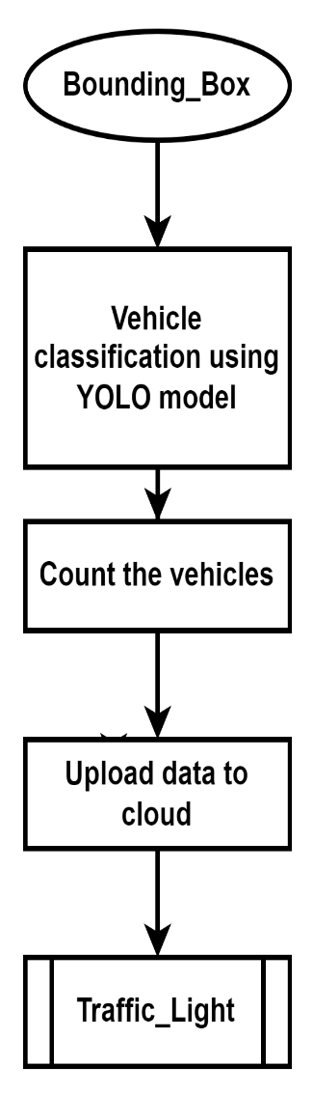
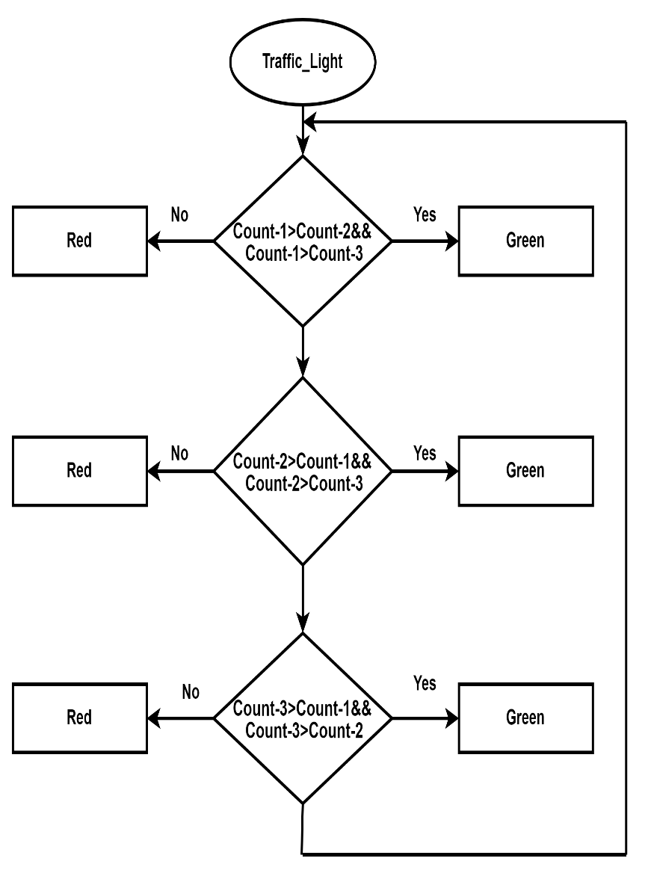
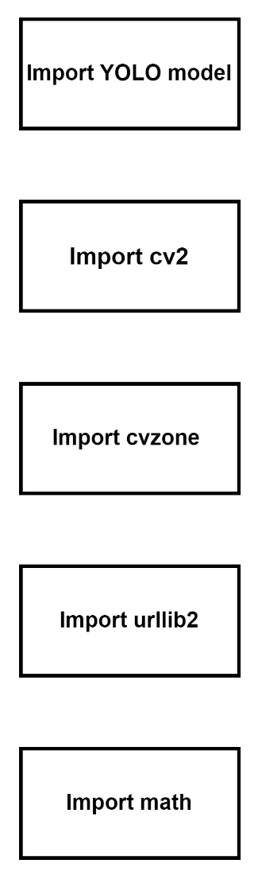
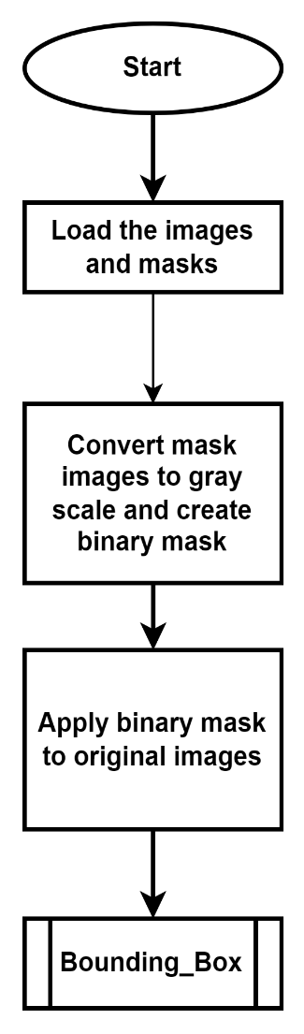
Flow chart:
24

Slide 26
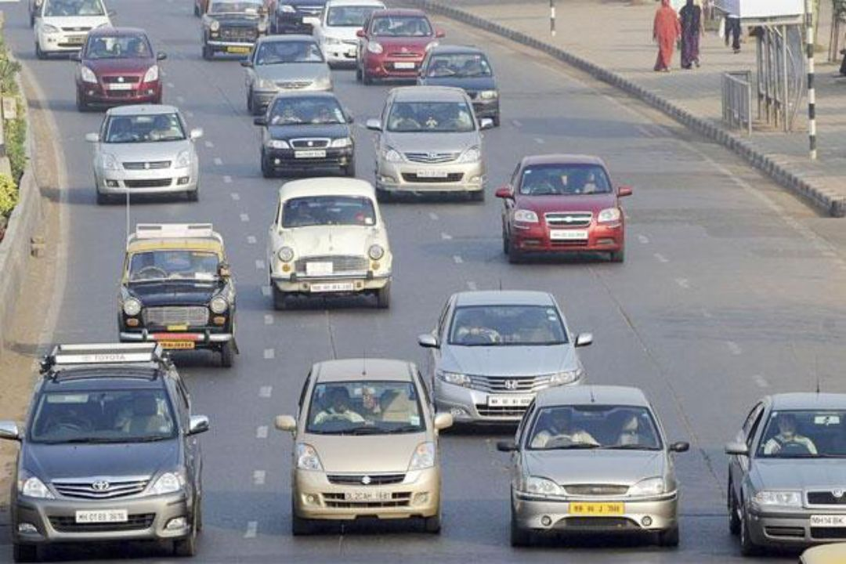
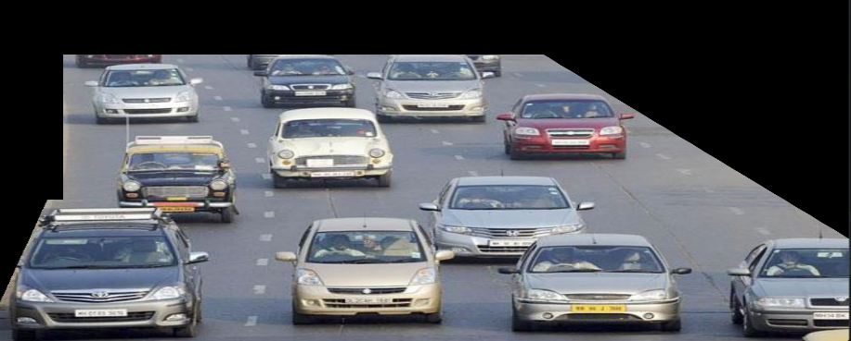
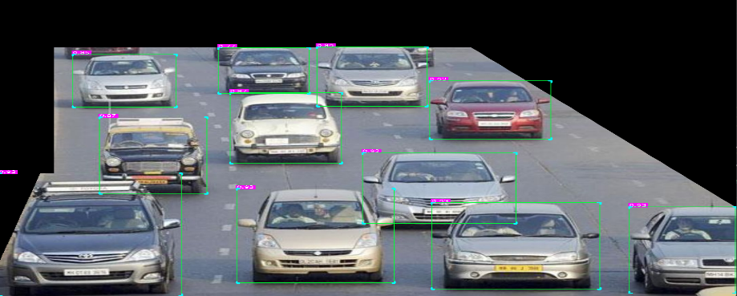
Results:
Normal condition:
Input Image
Masked Image
Vehicle detected image
25

Slide 27
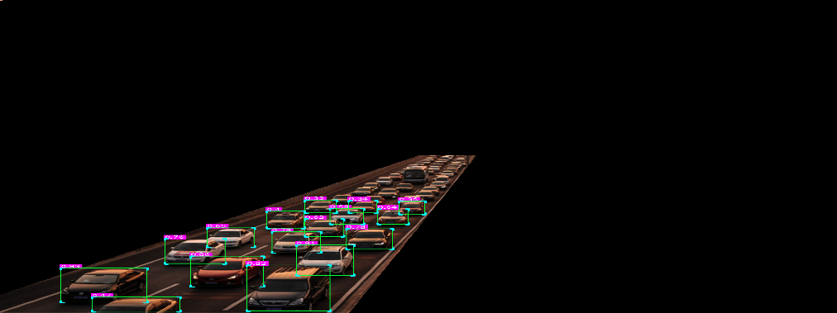
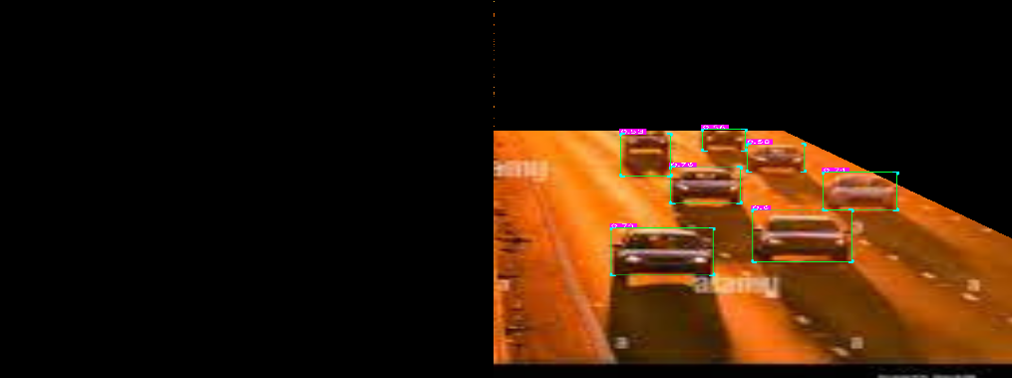
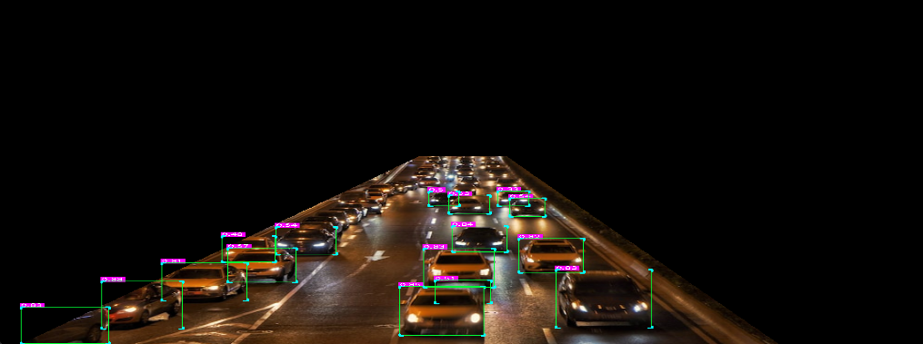
Results (contd..):
Low light condition
Low light with blurred condition
Night time condition
26

Slide 28
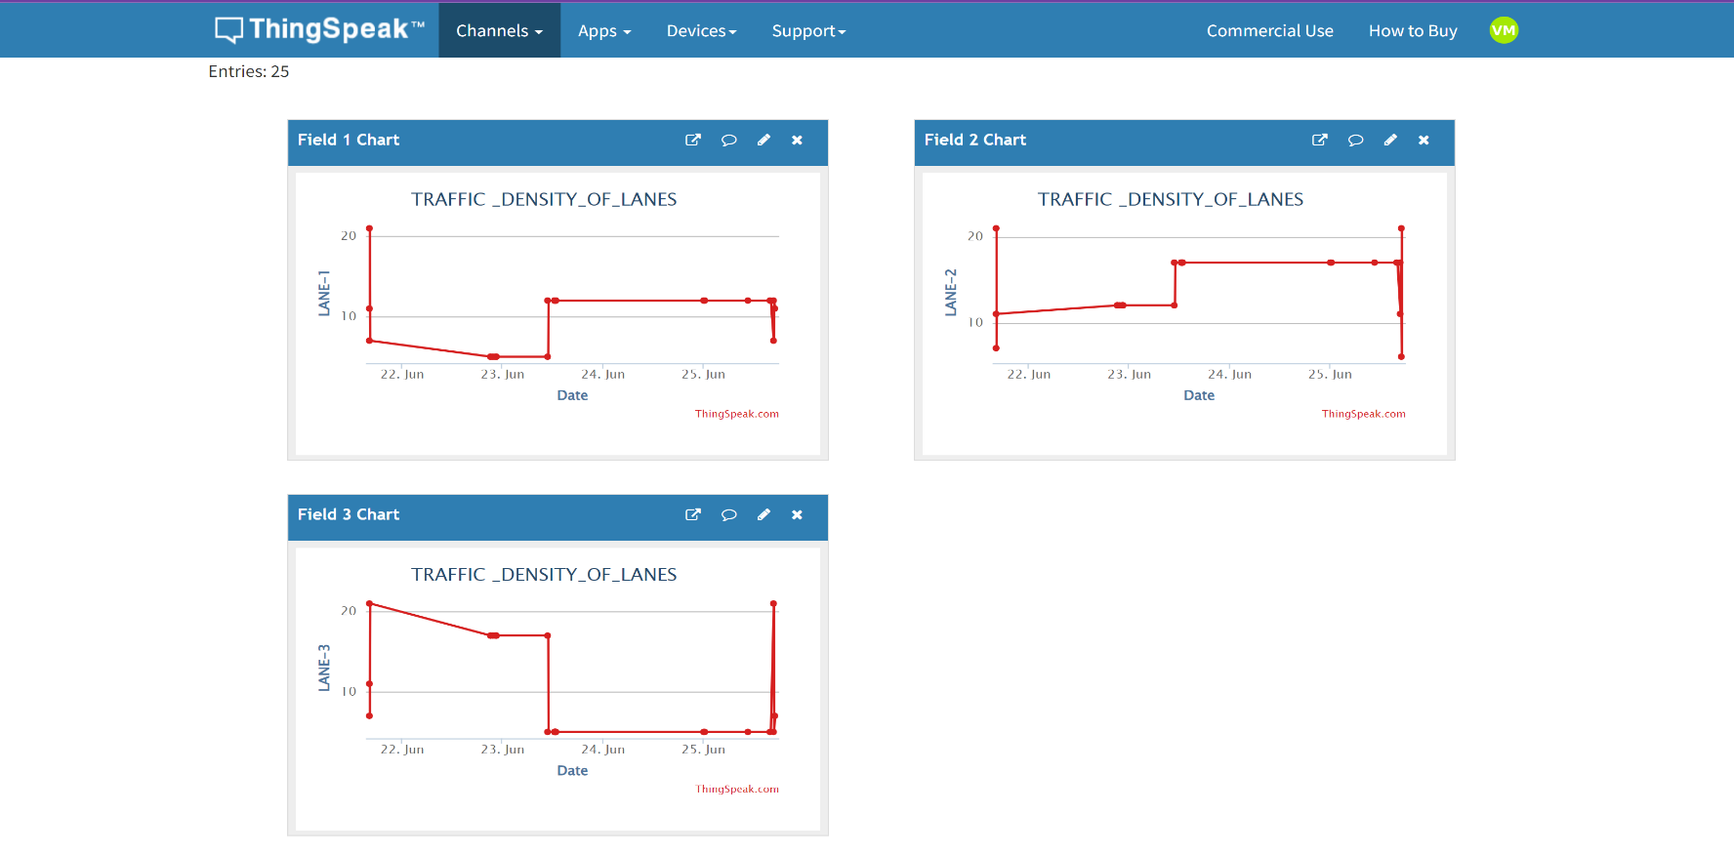
Results (contd..):
Measure of traffic in ThingSpeak cloud.
27

Slide 29
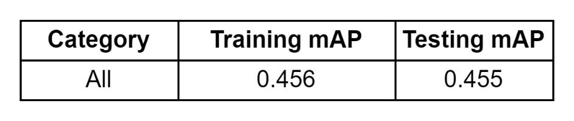
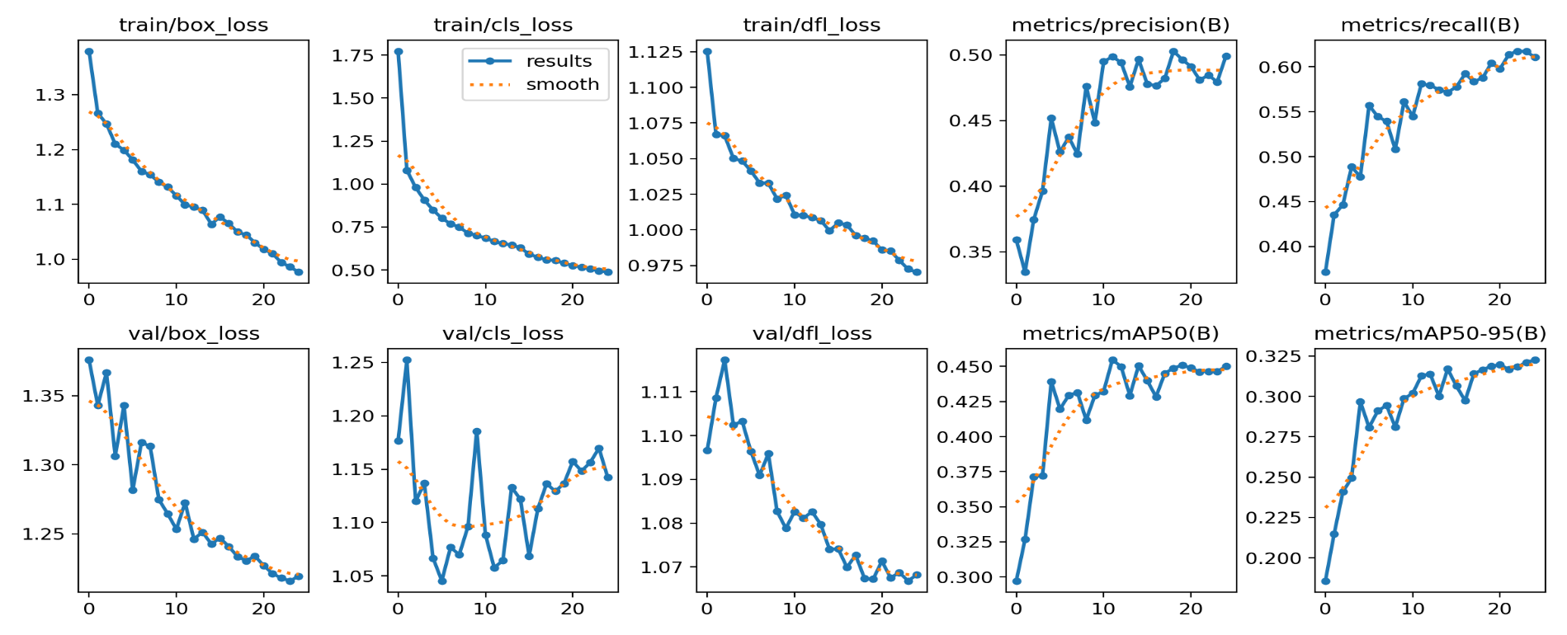
Training and validation results:
Results (contd..):
Metrics graph of trained model:
28

Slide 30
Budget Details:
Components | Cost
Raspberry Pi-3 | ₹4000
SD Card | ₹350
LED | ₹20
Total | ₹4370
29

Slide 31
Conclusion:
The project titled “Smart Traffic Light Management System” is designed using Image processing, YOLOv8 model and Raspberry-Pi.
The YOLOv8 model is used for detection and counting of vehicles. The system controls the traffic signal based on vehicle count.
30

Slide 32
Future Scope:
Enhanced Vehicle Detection.
Multi-Modal Traffic Analysis.
Smart Traffic Signal Optimization.
31

Slide 33
References:
[1] P. Manikonda, A. K. Yerrapragada and S. S. Annasamudram, "Intelligent traffic management system," 2011 IEEE Conference on Sustainable Utilization and Development in Engineering and Technology (STUDENT), Semenyih, Malaysia, 2011, pp. 119-122, doi: 10.1109/STUDENT.2011.6089337.
[2] Z. Li, C. Li, Y. Zhang and X. Hu, "Intelligent traffic light control system based on real time traffic flows," 2017 14th IEEE Annual Consumer Communications & Networking Conference (CCNC), Las Vegas, NV, USA, 2017, pp. 624-625, doi: 10.1109/CCNC.2017.7983196.
[3] A. Firdous, Indu and V. Niranjan, "Smart Density Based Traffic Light System," 2020 8th International Conference on Reliability, Infocom Technologies and Optimization (Trends and Future Directions) (ICRITO), Noida, India, 2020, pp. 497-500, doi: 10.1109/ICRITO48877.2020.9197940.
[4] "SMART TRAFFIC MONITORING AND CONTROLLING", International Journal of Emerging Technologies and Innovative Research (www.jetir.org), ISSN:2349-5162, Vol.8, Issue 6, page no.f744-f748, June-2021,
32

Slide 34
References:
[5] M. A. Bin Zuraimi and F. H. Kamaru Zaman, "Vehicle Detection and Tracking using YOLO and DeepSORT," 2021 IEEE 11th IEEE Symposium on Computer Applications and Industrial Electronics (ISCAIE), Penang, Malaysia, 2021.
[6] S. Chen and W. Lin, "Embedded System Real-Time Vehicle Detection based on Improved YOLO Network," 2019 IEEE 3rd Advanced Information Management, Communicates, Electronic and Automation Control Conference (IMCEC), Chongqing, China, 2019.
[7] Y. Miao, F. Liu, T. Hou, L. Liu and Y. Liu, "A Nighttime Vehicle Detection Method Based on YOLO v3," 2020 Chinese Automation Congress (CAC), Shanghai, China, 2020.
[8] U. E. Prakash, K. T. Vishnupriya, A. Thankappan and A. A. Balakrishnan, "Density Based Traffic Control System Using Image Processing," 2018 International Conference on Emerging Trends and Innovations In Engineering And Technological Research (ICETIETR), Ernakulam, India, 2018.
[9] D. Ijeri, P. Maidargi and R. Sunagar, "Traffic Control System Using Image Proccesing," 2020 IEEE Bangalore Humanitarian Technology Conference (B-HTC), Vijiyapur, India, 2020.
33

Slide 35


