Slide 1

TravelPlanner Pro
AI-Powered Intelligent Travel Planning
Powered by IBM watsonx.ai (Granite Model) & Flask
PRESENTED BY VARUN RAJ S
Notes:
1

Slide 2
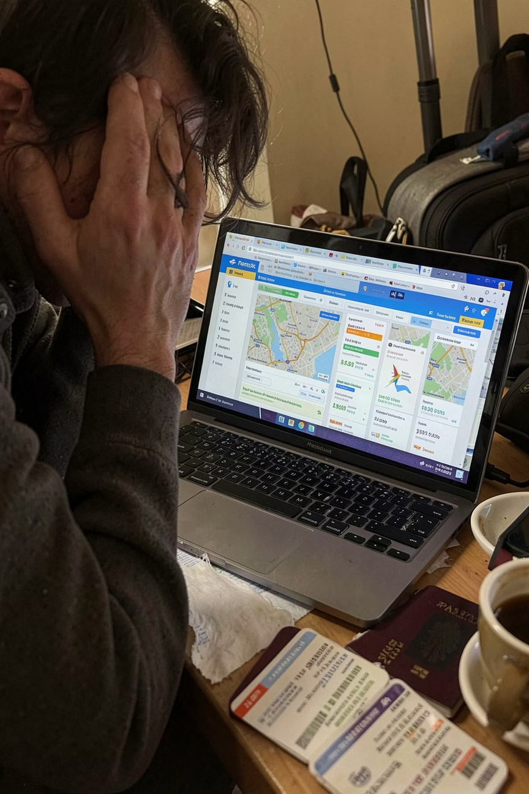

The Problem with Modern Travel Planning
Planning a trip today means juggling dozens of websites — transportation, hotels, attractions, food, safety guidelines, and budgets — all scattered across the web. The result? A time-consuming, fragmented, and often confusing experience.
Our Objective: Build an AI-powered travel assistant that generates a complete, personalized travel plan in one place — powered by IBM watsonx.ai.
Notes:
2

Slide 3






Project Objectives
TravelPlanner Pro is designed to simplify every stage of travel planning through intelligent automation.
Personalized Itineraries
Transport & Accommodation
Generate day-by-day travel plans tailored to user preferences and destinations.
Recommend optimal transport modes and lodging options based on budget.
Budget Estimation
Food & Culture
Provide accurate, itemized cost breakdowns for the entire trip.
Suggest local cuisine, cultural etiquette, and money-saving tips.
Safety & Emergency Info
Generative AI Experience
Deliver real-time safety guidelines and emergency contact details.
Enhance user experience with intelligent, conversational AI support.
Notes:
3

Slide 4
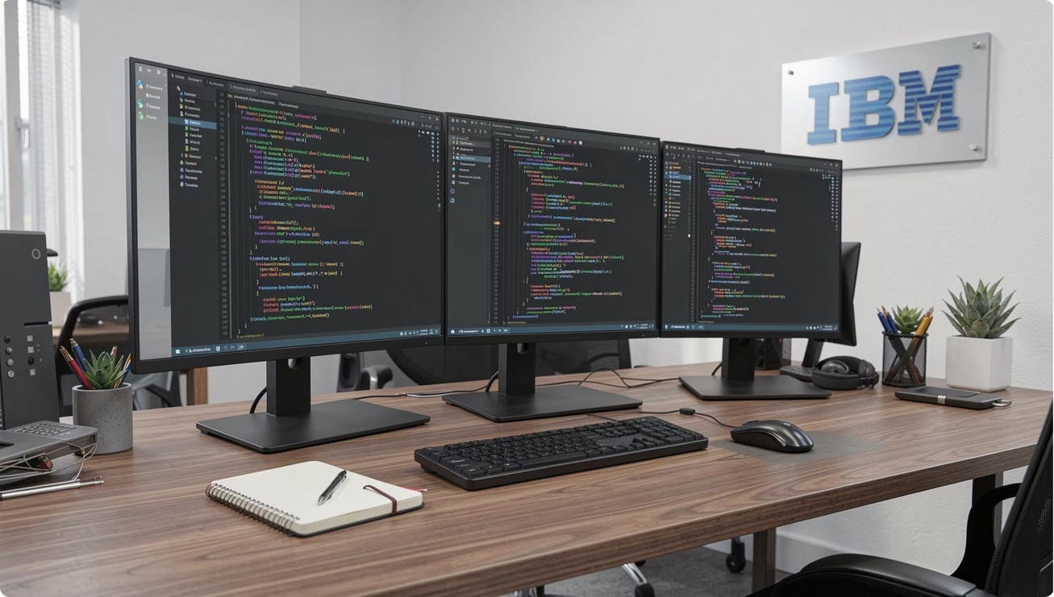
Technology Stack
AI & Backend
IBM watsonx.ai — Granite Large Language Model for intelligent content generation
Python Flask — Lightweight, flexible web framework
SQLite — Embedded database for data persistence
Frontend
HTML & CSS — Responsive, clean UI structure
JavaScript — Dynamic interactivity
Bootstrap — Mobile-first responsive design
Notes:
4

Slide 5

System Architecture
User Input
Flask App
Granite Model
Travel Plan
Dashboard
The architecture follows a clean, linear pipeline — user inputs are validated by Flask, processed by IBM's Granite LLM, and returned as a structured, interactive travel report.
Notes:
5

Slide 6

Application Workflow
01
02
03
User Enters Trip Details
Flask Validates Inputs
Prompt Sent to IBM watsonx.ai
Destination, dates, budget, and preferences are submitted via the form.
Backend performs validation and sanitization before processing.
A structured prompt is dispatched to the Granite model API.
04
05
AI Generates Recommendations
Travel Report Displayed
Granite model produces personalized travel content in real time.
Formatted response is rendered in the interactive dashboard for the user.
Notes:
6

Slide 7
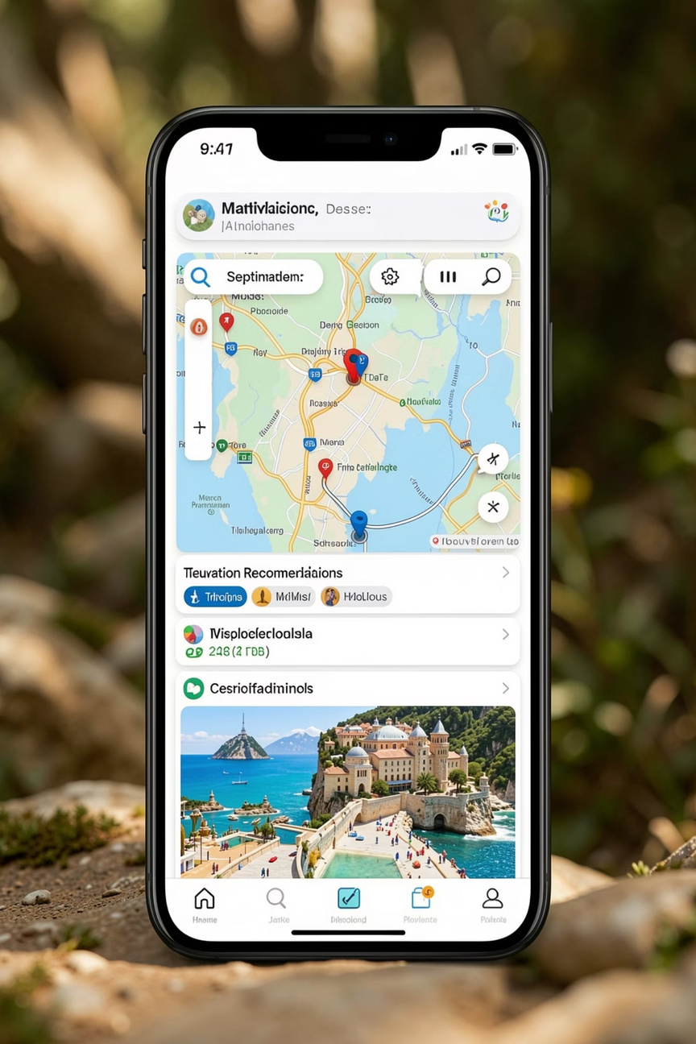
Key Features
🗺️ Planning Core
Day-wise itinerary
Tourist attractions
Best time to visit
Packing checklist
🏨 Logistics
Transportation plan
Accommodation suggestions
Budget estimation
Money-saving tips
🍽️ Local Experience
Food recommendations
Local culture & etiquette
AI chat assistant
🛡️ Safety
Safety tips
Emergency contacts
Executive summary
Notes:
7

Slide 8
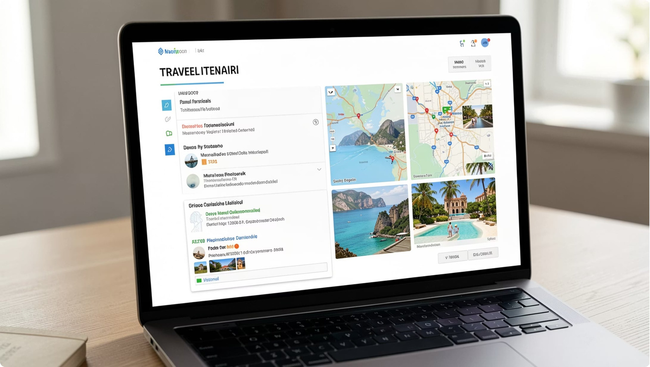

Results
What TravelPlanner Pro Delivers
Instant personalization — complete itineraries generated within seconds
Accurate budget estimation — itemized costs for informed decisions
Organized recommendations — structured, easy-to-follow travel reports
Intuitive interface — clean, responsive design for all users
AI-powered decision support — intelligent suggestions backed by Granite LLM
Notes:
8

Slide 9




Future Enhancements
TravelPlanner Pro is built to scale. The following enhancements are planned for upcoming versions.
Live Integrations
Voice & Language
Export & History
Weather APIs, Google Maps, Flight & Hotel Booking APIs for real-time data.
Voice assistant support and multi-language capabilities for global users.
PDF export of travel reports and user login history for saved itineraries.
Notes:
9

Slide 10
Conclusion
TravelPlanner Pro demonstrates how IBM watsonx.ai can transform a fragmented, time-consuming process into a seamless, intelligent experience. By generating personalized, comprehensive itineraries in seconds, it reduces planning effort and elevates the overall travel journey through the power of Generative AI.
IBM watsonx.ai
Granite LLM
TravelPlanner Pro
Enterprise-grade AI at the core
Intelligent, context-aware generation
Your complete AI travel companion
Thank You
Questions & Answers
VARUN RAJ S
IBM SKILLSBUILD PROJECT
Notes:
10

