Slide 1
SIH 26099 · MINISTRY OF PETROLEUM & NATURAL GAS · CPCL
UnifyMat
One Nation · One Material Code
AI-driven standardization and harmonization of material codes across CPSEs
403
267
100%
0
records · 5 CPSEs
national codes issued
auto-merge precision
near-miss merges
Smart India Hackathon 2026 · Team presentation

Slide 2
THE PROBLEM
The same bolt lives five lives across five ERPs
CPSE
ERP CODE
HOW THE ERP DESCRIBES IT
UOM
RATE
CPCL
MAT100006
HEX BOLT BLK OX, 8.8, M20x80
NOS
₹ 19
₹ 16
–
₹ 21
IOCL
RM-00006
Hex Bolt – Black Oxide – DIN 933 – 8.8 – M20 X 80
EA
₹ 19
NTPC
EGW000004
Hex Bolt, M20 x 80 mm, Blk Oxide, Gr.8.8, DIN 933
NOS
₹ 21
price spread
on one bolt
SAIL
S100028
HEX BOLT / DIN-933 / M20x80MM / BLACK / 8.8 GR
NUM
₹ 16
GAIL
GLM-HB-0001
HEX BOLT M20X80 GR 8.8 BLACK DIN 933
NOS
₹ 18
No aggregate demand
Duplicate inventory
No spend visibility
each CPSE buys the same bolt separately — losing bulk pricing
one material stocked many times across warehouses
Ministry cannot answer “how much steel do we buy?”
Source: synthetic multi-CPSE dataset built for SIH 26099 (records generated to mirror real ERP description styles)
UnifyMat · SIH 26099 · Smart Automation
02

Slide 3
THE SOLUTION
A three-stage harmonization pipeline
1
Normalize & extract
2
Match — with a veto
3
Standardize & code
Tames every house style into canonical text, then regex-extracts ~35 engineering attributes (grade, class, schedule, size, material).
→
Blocks by category, ranks candidates by sentence-embedding similarity, then hard-vetoes any conflicting attribute. Missing identity data goes to an officer, never auto-merged.
→
Deterministic standardized description + stable National Material Code + full legacy-code mapping and audit trail.
In: MAT100006 · RM-00006 · EGW000004 · S100028 · GLM-HB-0001 Out: NMC-FAST-BOLT-DEE61ADC — one national material, five traceable legacy codes
UnifyMat · SIH 26099 · Smart Automation
03

Slide 4
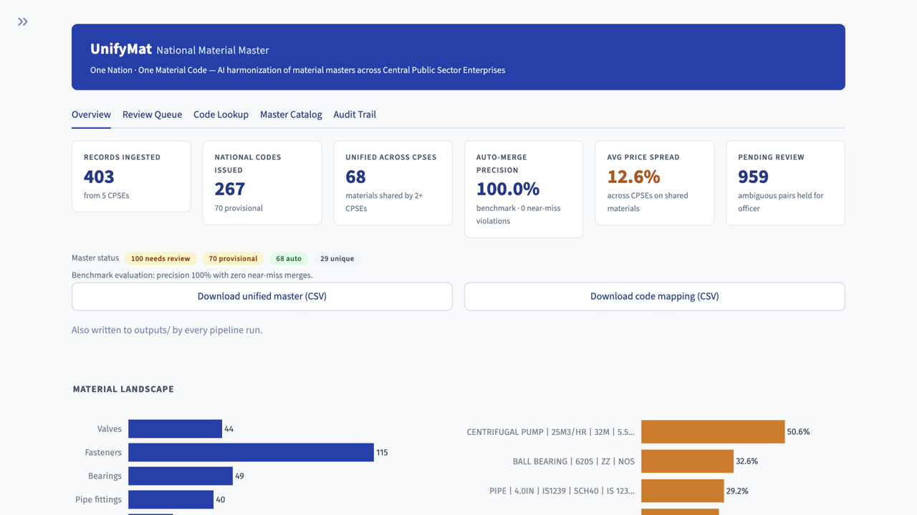
WORKING PROTOTYPE
Live in the dashboard
1
Same-bolt match
side-by-side CPSE descriptions resolved to one NMC
2
Near-miss refusal
butterfly vs gate valve at 0.63 similarity — vetoed on 5 attributes
3
Officer approval
human-in-the-loop decision, logged with name & timestamp
4
5th CPSE upload
pre-flight quality check, then live ingest — numbers update on screen
5
Price spread
negotiation-ready spread on 68 shared materials
Overview tab — verified capture of the running app
UnifyMat · SIH 26099 · Smart Automation
04

Slide 5
EVIDENCE
Precision first — the system never guesses
100%
0
89.7%
388
AUTO-MERGE PRECISION
NEAR-MISS VIOLATIONS
POTENTIAL RECALL
RECORDS EVALUATED
every auto-merged pair is correct
grade 8.8 vs 10.9 never merged
after officer approval of flagged pairs
vs ground truth, 4 CPSEs
THE TRAP THAT MUST NEVER SLIP THROUGH
CPCL MAT100050 “BUTTERFLY VALVE 6″, WAFER, CL 150, CI”
CPCL MAT100044 “GATE VALVE CL 800, FS, SW, 1.5″”
0.63 similarity → REJECTED. Five conflicting attributes: class, end, inch, material, type.
Checked automatically across 7,951 candidate pairs · 2,798 attribute vetoes issued · Source: outputs/rejected_pairs.csv, pipeline run of 04 Sep 2026
UnifyMat · SIH 26099 · Smart Automation
05

Slide 6
GOVERNANCE BY DESIGN
AI proposes, hard facts dispose, humans approve
AI
VETO
OFFICER
PROPOSES
DISPOSES
APPROVES
embedding similarity + attribute agreement produce a suggested NMC and confidence score
→
any single conflicting hard attribute (grade, schedule, seal, size…) kills the merge — no exceptions
→
records missing identity attributes land in the review queue; every decision is logged with name and timestamp
Every action leaves a trail. Cluster creations, officer approvals and rejections persist to outputs/audit_log.csv and review_decisions.csv — the audit trail the problem statement demands. Nothing is a black box: same inputs always produce the same codes.
UnifyMat · SIH 26099 · Smart Automation
06

Slide 7
THE SAVINGS STORY
Price spread on materials shared across CPSEs
Difference between the highest and lowest CPSE rate for the identical material
Centrifugal pump
50.6%
12.6%
Ball bearing 6205
32.6%
AVERAGE PRICE SPREAD
on 68 materials shared by 2+ CPSEs
Pipe 4″ SCH40
29.2%
What one national code unlocks:
Aggregate demand across CPSEs into single, bulk tenders
Flag over-paying CPSEs against peers on identical materials
Give the Ministry a true total-spend picture per material
Tee 2″ SCH40
27.4%
Flat washer M16
25.0%
Lithium grease NLGI-3
24.3%
identical material, bought at up to 1.5× the lowest CPSE rate
Source: outputs/unified_master.csv — min/max last-rate per NMC on shared materials (rates in ₹)
UnifyMat · SIH 26099 · Smart Automation
07

Slide 8
BUILT TO SCALE
From 400 records to a national registry
Today — verified
Near term
National rollout
403 records · 5 CPSE house styles ingested live
FAISS approximate-nearest-neighbour index for millions of rows
NMC issued alongside legacy codes — zero ERP migration risk
Blocking keeps comparisons within category — O(n·k), not O(n²)
Batch ERP connectors — scheduled CSV/API pulls from each CPSE
GeM / SAP integration via the mapping layer
Offline mode: TF-IDF fallback matches with zero internet
Officer worklist with roles, comments and sign-off levels
Department-wise spend dashboards on live procurement data
Architecture is data-agnostic: any CSV with material code, description and UOM can be harmonized — the ERP export every CPSE already produces.
UnifyMat · SIH 26099 · Smart Automation
08

Slide 9
ONE NATION · ONE MATERIAL CODE
Every material a single code.
Every code fully traceable.
CPSE legacy codes
→
National Material Code
→
Standardized description
→
Officer-approved audit trail
Legacy codes never die — the NMC is the join key between them.
Team UnifyMat · Smart India Hackathon 2026 · github.com/Varunsai1930/SIH

