Slide 1


PROJECT ON SUSTAINABLE FASHION: ECO-FRIENDLY TRENDS
Presented By:
B. Varun Sai
Pavankalyan Burri
S. Shabana

Slide 2
About me
Background (B-tech or M-tech): My name is B Varun Sai. I have completed my B.Tech in Electronics and Instrumentation Engineering.
Why you want to learn Data Science: I want to learn Data Science because it helps in analyzing data, finding patterns, and making predictions. Data Science allows me to combine programming, statistics, and problem-solving skills to solve real-world problems. It also offers strong career growth and learning opportunities.
Any work experience: I am a fresher and currently do not have formal work experience. I am focusing on learning Data Science concepts and building practical skills.

Slide 3
About me
Background (B-Tech or M-Tech): My name is Pavankalyan Burri. I have completed my B.Tech in Computer Science and Engineering (CSE).
Why do you want to learn Data Science? I want to learn Data Science to analyze data and build a strong IT career.
Any work experience: I am a fresher.

Slide 4
About me
Background (B-Tech or M-Tech): My name is Syeed Shabana. I am currently pursuing my M.Tech in Computer Science and Engineering (CSE).
Why do you want to learn Data Science? I’ve always been interested in computers, and during my B.Tech I became fascinated by how data can be analyzed to derive insights. That curiosity led me to choose Data Science as my career path.
Any work experience: I am a fresher.

Slide 5
DATASET OVERVIEW
Dataset Name: Sustainable Fashion Trends – 2024
Domain: Fashion Industry & Sustainability
Total Records: 5,000 fashion brands
Total Columns: 15 attributes
Data Types:
Categorical variables (brand details, sustainability indicators, market trend)
Numerical variables (environmental impact metrics and pricing)
Focus Areas: Sustainability practices, environmental impact, and market performance

Slide 6
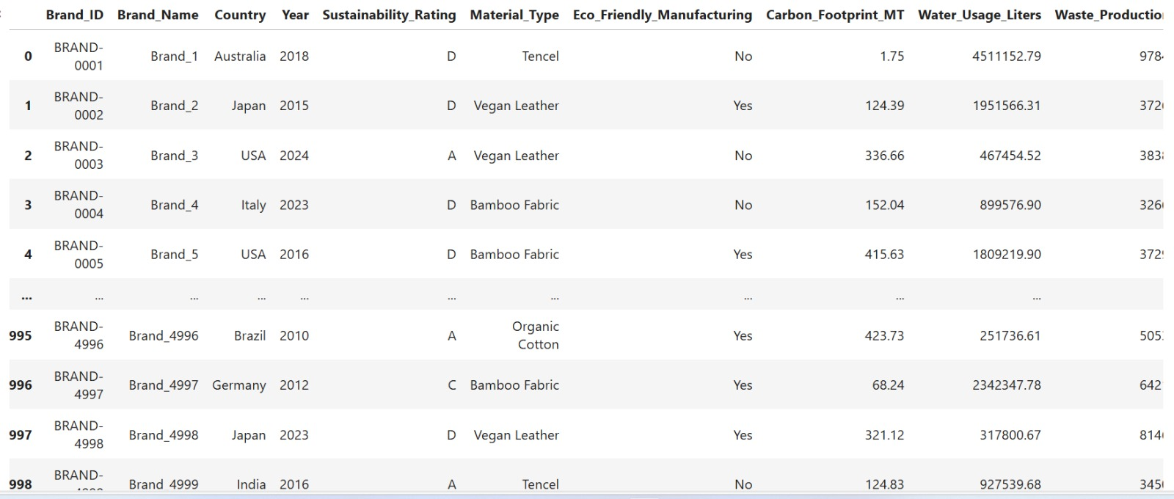
READING THE DATASET

Slide 7
COLUMN DESCRIPTION
Brand ID – Unique brand identifier
Brand Name – Name of the brand
Country – Operating country
Sustainability Rating – Low / Medium / High
Material Type – Primary material used
Eco-Friendly Manufacturing – Yes / No
Recycling Programs – Recycling initiatives status
Certifications – Sustainability certifications
Carbon Footprint – Emissions (metric tons)
Water Usage – Water consumption (liters)
Waste Production – Waste generated (kg)
Product Lines – Number of product categories
Average Price – Mean product price (USD)
Market Trend – Growing / Stable / Declining

Slide 8

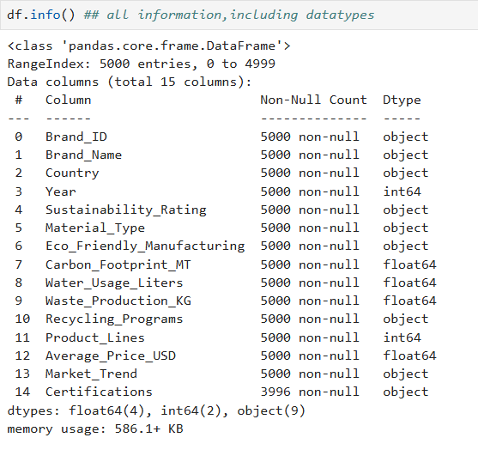
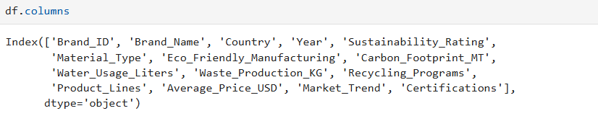
BASIC DATA CHECKS
Shows number of rows and columns
Displays column names and data types
Helps identify categorical and numerical columns

Slide 9
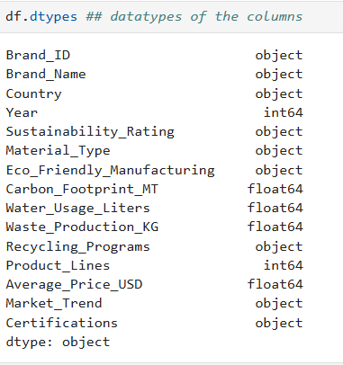
BASIC DATA CHECKS

Slide 10
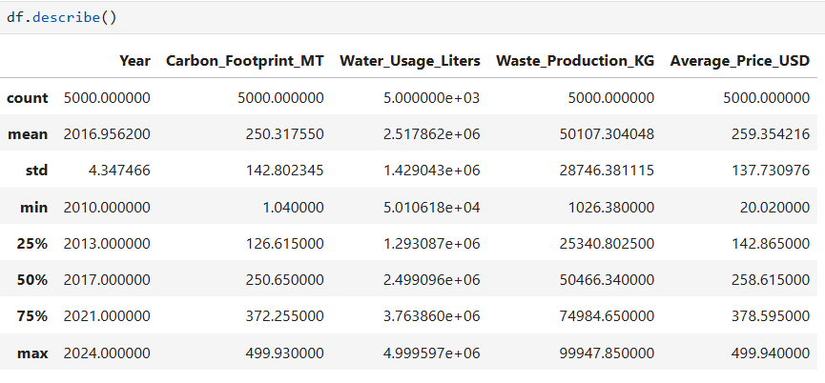
Describing the data
Provides summary statistics for numerical data
It only gives for numerical columns
Guides preprocessing decisions

Slide 11
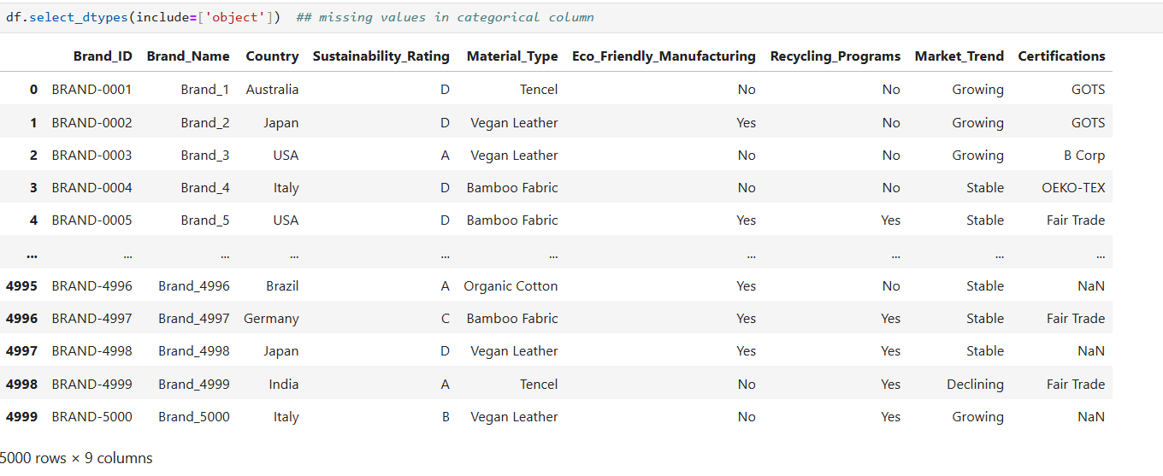
MISSING VALUES(Categorical)
• Missing values in sustainability-related categorical fields were identified.
• Appropriate replacements were applied to preserve patterns in sustainable fashion practices.

Slide 12


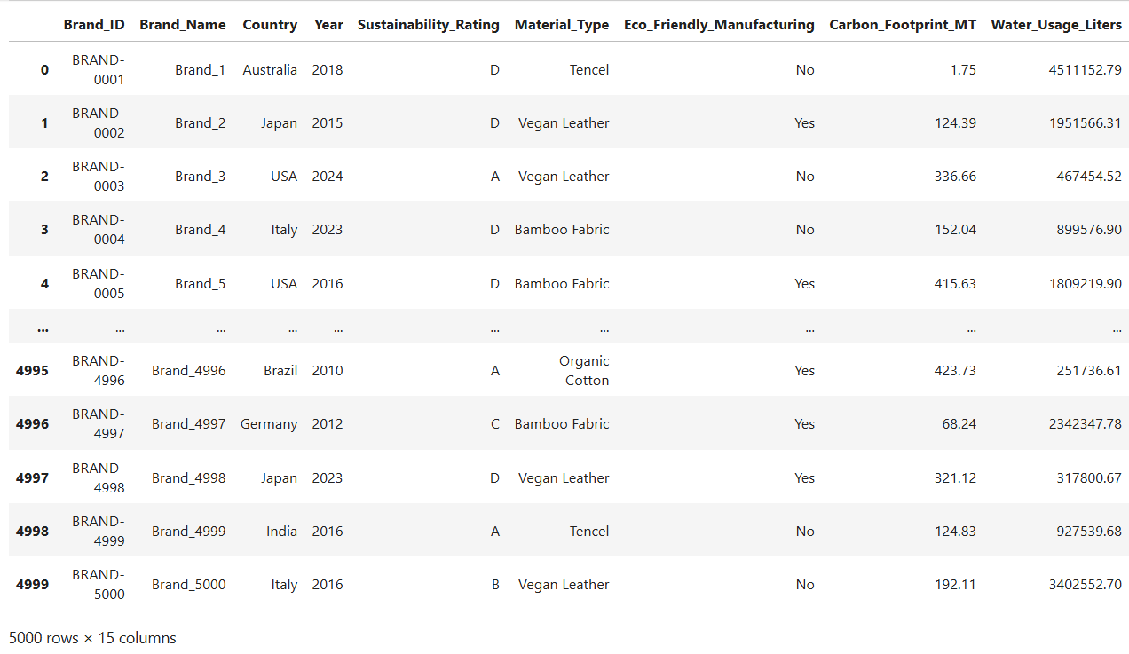
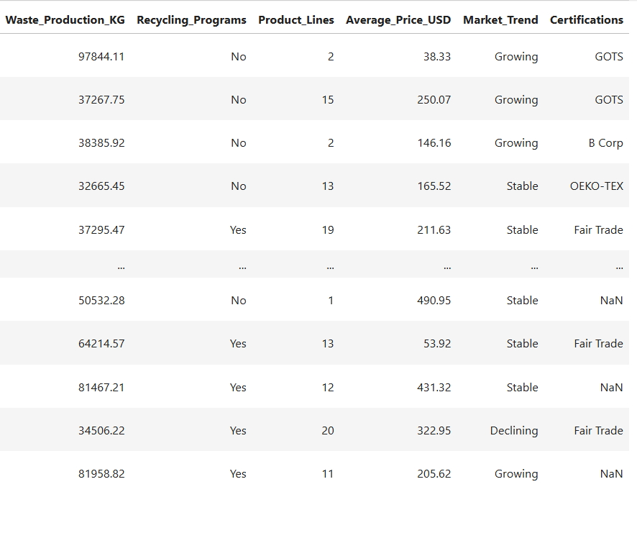
Duplicate Records Check & Removal
Detects duplicate records
Removes duplicates to avoid biased analysis
Ensures data integrity

Slide 13
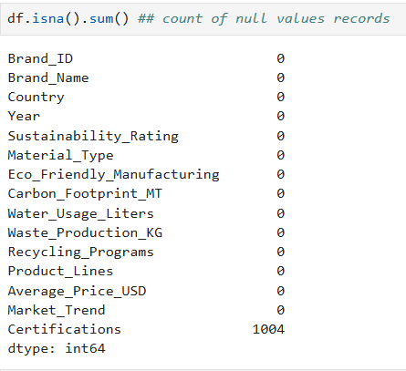
PREPROCESSING TECHNIQUES AND DATASET INDIVIDUAL COLUMNS
1 Columns have missing values
There are 1004 duplicate records in the dataset
Now I want to perform preprocessing techniques on columns like
Handling missing values and duplicates
Handling inconsistencies in Data
Data Type conversions

Slide 14
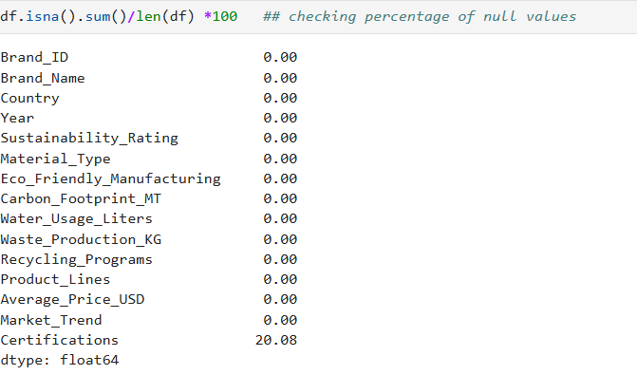
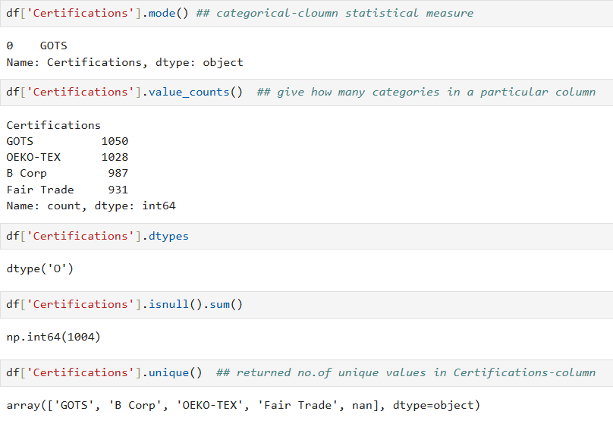
Missing values percentage for all columns of the dataset
Calculated percentage of missing data.
Analyzed categorical distribution using mode and value counts.
Used findings to guide preprocessing decisions. missing values for all columns.
Identified Certifications as the only column with significant

Slide 15
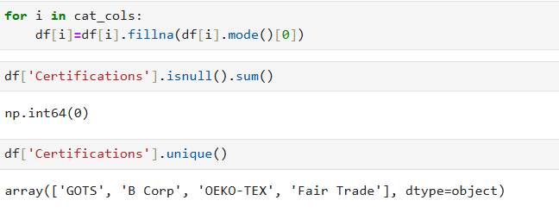
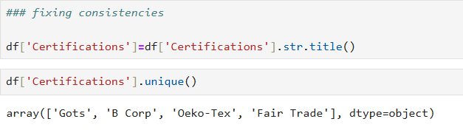
Handled missing categorical values using mode.
Verified absence of null values in Certifications.
Standardized text inconsistencies in categorical data.
Ensured uniform and clean data for EDA.

Slide 16
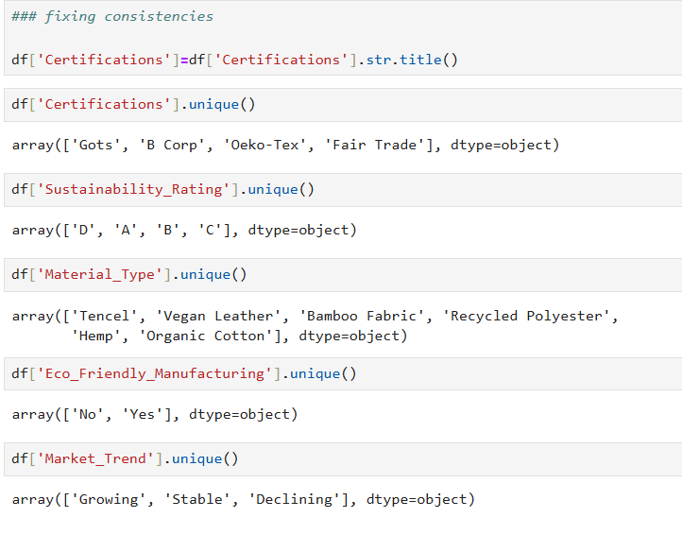
Fixing Consistencies
Fixes inconsistent capitalization
Uses domain logic for missing values
Avoids incorrect AI risk assignment

Slide 17
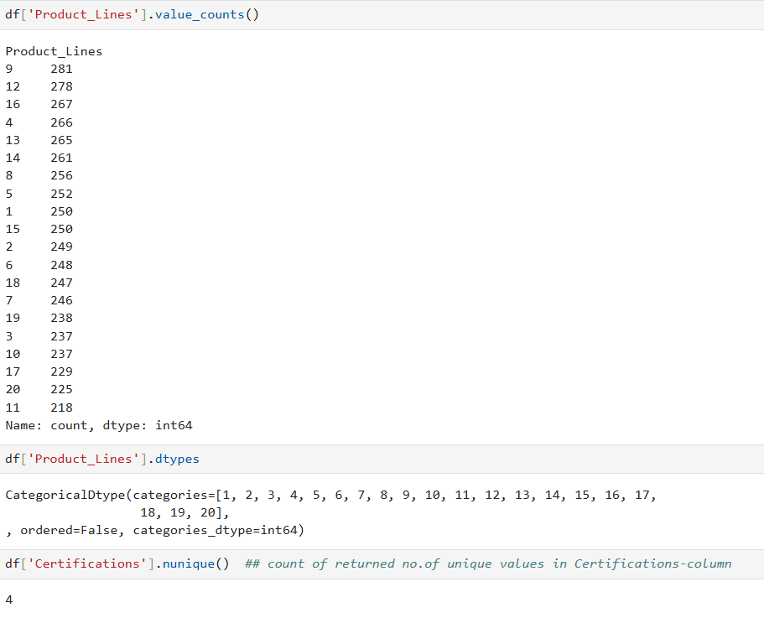
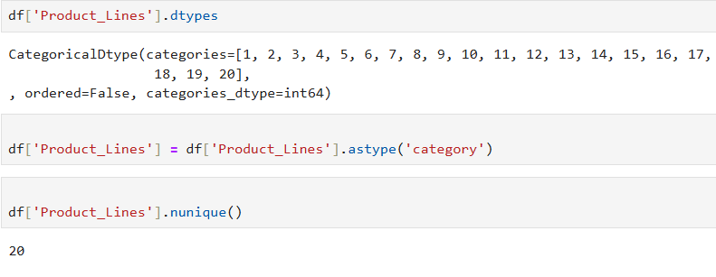
TYPE CONVERSION OF COLUMN
Used to verify the data type of individual column
Applied data type conversion to ensure correct representation.
Used to verify the number of unique values in the column.

Slide 18
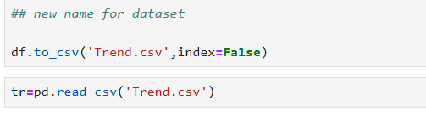
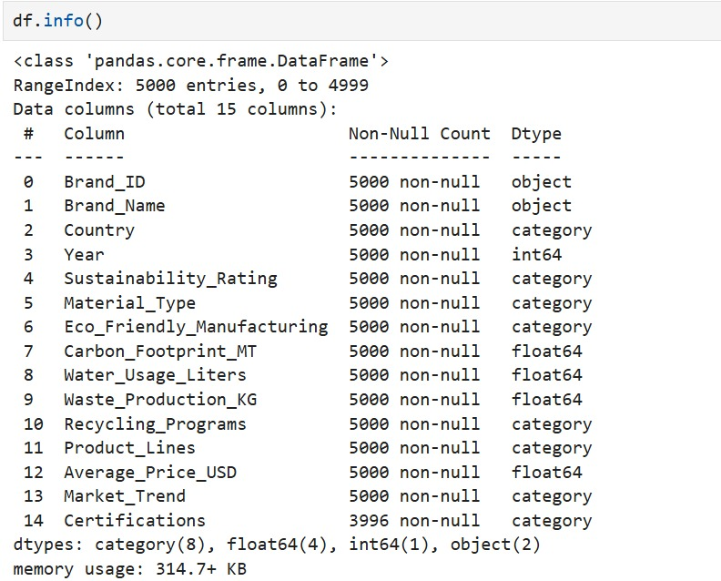
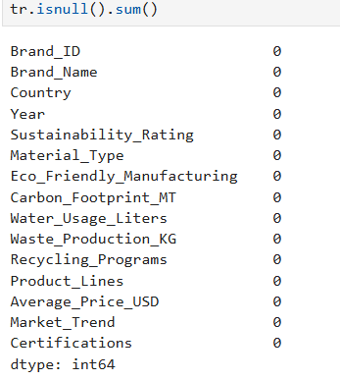

Slide 19
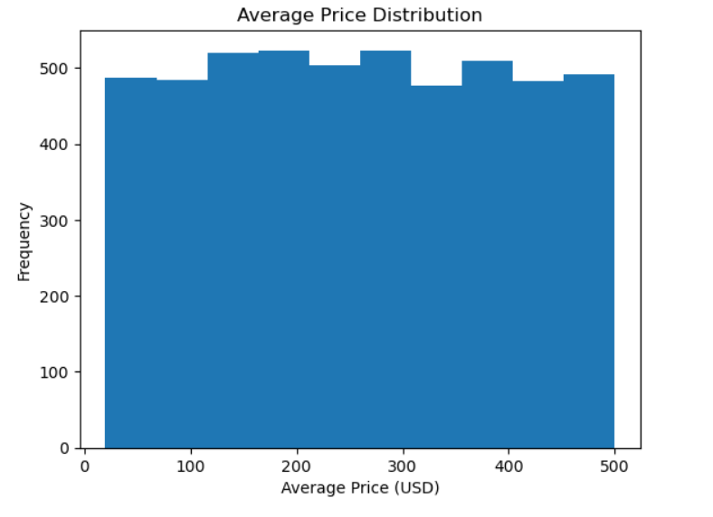
UNIVARIATE ANALYSIS
• The histogram shows the distribution of average product prices across brands
• Prices are spread across a wide range, indicating variability in pricing strategies
• Most brands fall within the mid-price range, with fewer brands at extreme low or high prices
• This suggests the presence of budget, mid-range, and premium brands in the dataset

Slide 20
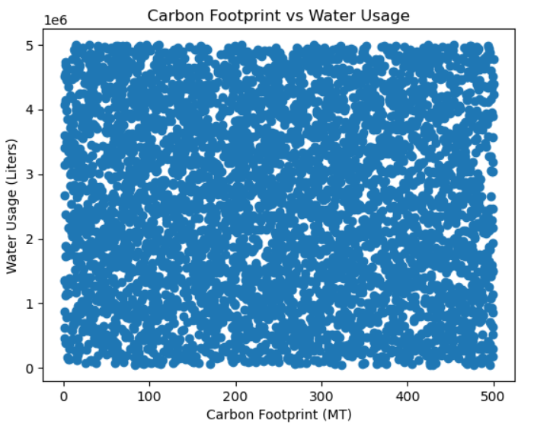
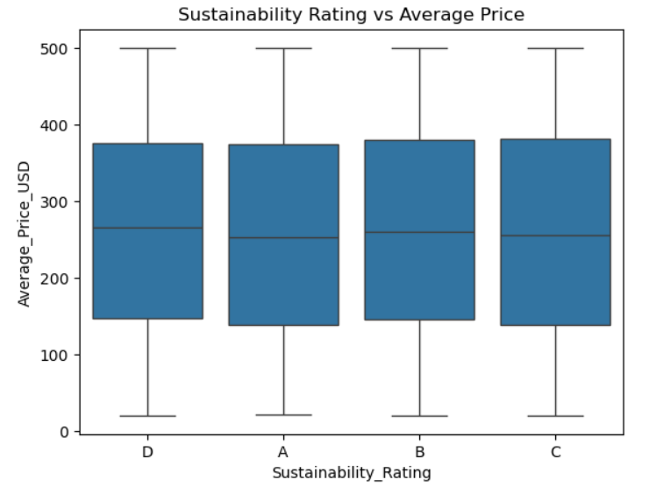
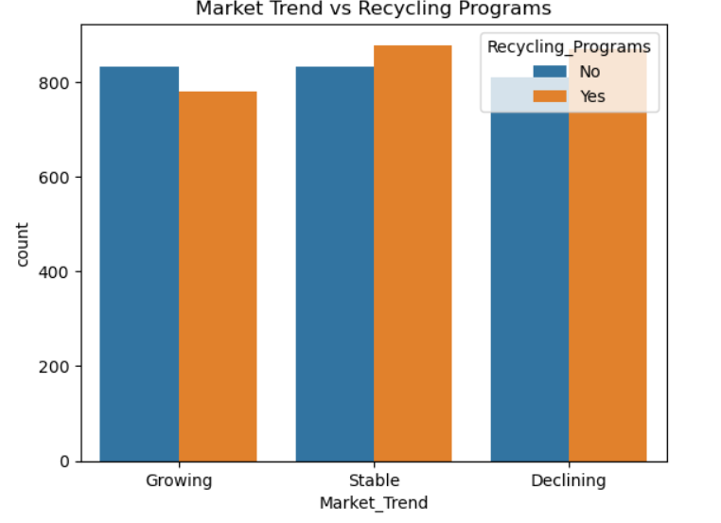
BIVARIATE ANALYSIS
Numerical vs Numerical
Categorical vs Numerical
Categorical vs Categorical
Analyzes environmental impact metrics in sustainable fashion brands.
Helps understand how carbon emissions relate to water consumption.
Evaluates the impact of recycling initiatives on market performance.
Shows how sustainability practices relate to market trends.
Examines how sustainability ratings influence product pricing.
Highlights pricing differences across sustainability levels.

Slide 21
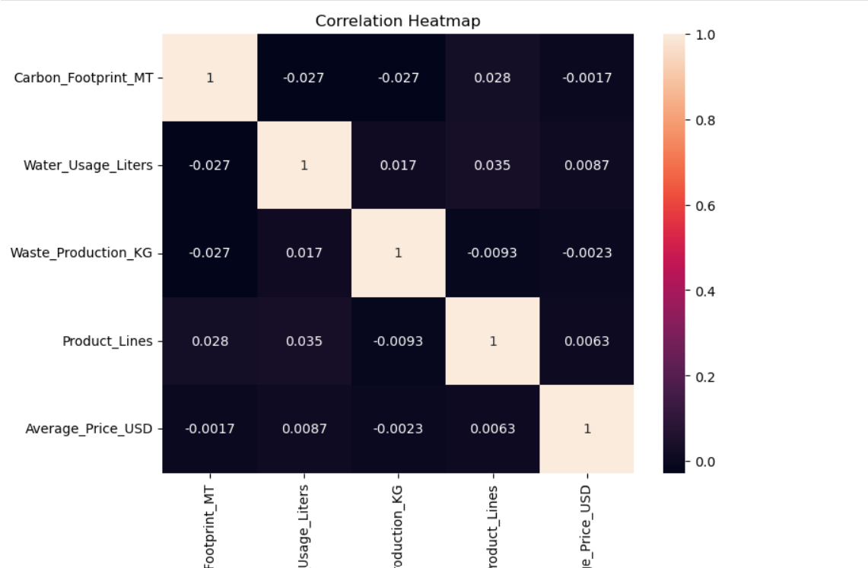

MULTIVARIATE ANALYSIS
Shows relationships between environmental impact measures and product pricing in sustainable fashion.
Results suggest sustainability does not strongly depend on pricing factors.

Slide 22
SUMMARY
The sustainable fashion dataset was explored to understand its structure, features, and data types.
Basic data checks were performed to verify dataset size, column information, and overall data quality.
Missing values, duplicate records, and inconsistencies were identified and handled before analysis.
Suitable preprocessing techniques such as mode and median imputation were applied to categorical and numerical columns.
Data type conversions and standardization ensured data consistency and reliability.
Univariate analysis examined the distribution of individual sustainability, pricing, and environmental variables.
Bivariate analysis explored relationships between sustainability indicators and business-related factors.
Multivariate analysis assessed interactions among environmental impact metrics and pricing variables.
The analysis revealed limited strong correlations, indicating sustainability metrics often operate independently.
Overall, the EDA provided meaningful insights to support data-driven decision-making in sustainable fashion.

Slide 23
CONCLUSION
The analysis shows that sustainable practices significantly reduce environmental impact.
Brands with higher sustainability ratings tend to perform better in market trends.
Slightly higher prices for sustainable products are accepted by consumers.
Sustainability emerges as both an environmental responsibility and a business advantage.
EDA proved to be an effective approach for deriving meaningful, data-driven insights.

Slide 24
THANK YOU

