Slide 1


Slide 2

Elasticsearch is a search engine based on Apache Lucene. It provides a distributed, multitenant-capable full-text search engine with an HTTP web interface and schema-free JSON documents.
Elasticsearch is a search and analytics engine designed for fast, real-time searches and data retrieval. It is widely used for searching, analyzing, and visualizing large amounts of data.

Slide 3
What is ELK Stack ?
The Elastic Stack, often referred to as the ELK Stack, is a collection of open-source tools designed to help users search, analyze, and visualize data in real time.
components of the Elastic
Elasticsearch
A distributed, RESTful search and analytics engine.
Stores data and performs searches, aggregations, and complex queries efficiently.
Logstash
A data processing pipeline that ingests, transforms, and sends data to Elasticsearch.
Supports input from multiple sources and output to various destinations.
Kibana
A visualization tool that works on top of Elasticsearch.
Allows users to create dashboards, graphs, and charts to analyze data.
Beats
Lightweight data shippers that send data from edge systems to Logstash or Elasticsearch.
Examples: Filebeat (logs), Metricbeat (metrics), Packetbeat (network data).

Slide 4
Key Features:
Centralized Logging:
Useful for aggregating logs from various
sources for debugging and monitoring.
Real-Time Analytics:
Enables instant insights with fast searches
and aggregations.
Scalability:
Handles large volumes of structured and unstructured data.
Customization:
Dashboards and visualizations can be tailored for specific use cases.
Security:
Role-based access control (RBAC), encryption, and auditing.
Common Use Cases:
Application Performance Monitoring (APM).
Log Management.
Security and Threat Detection.
Business Intelligence..

Slide 5
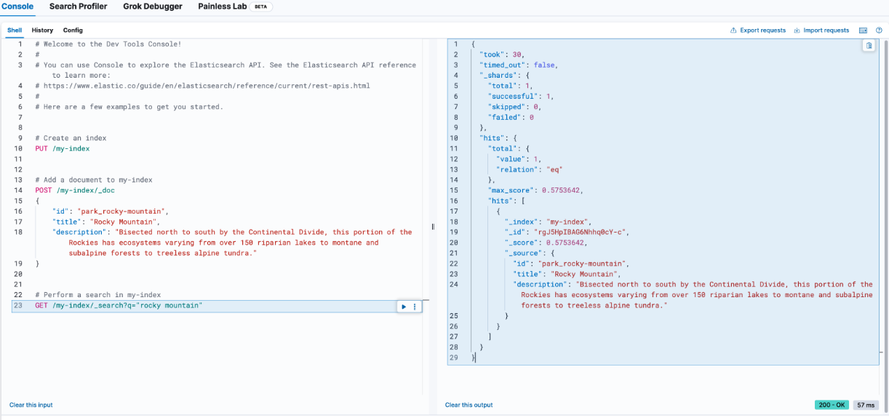

Slide 6
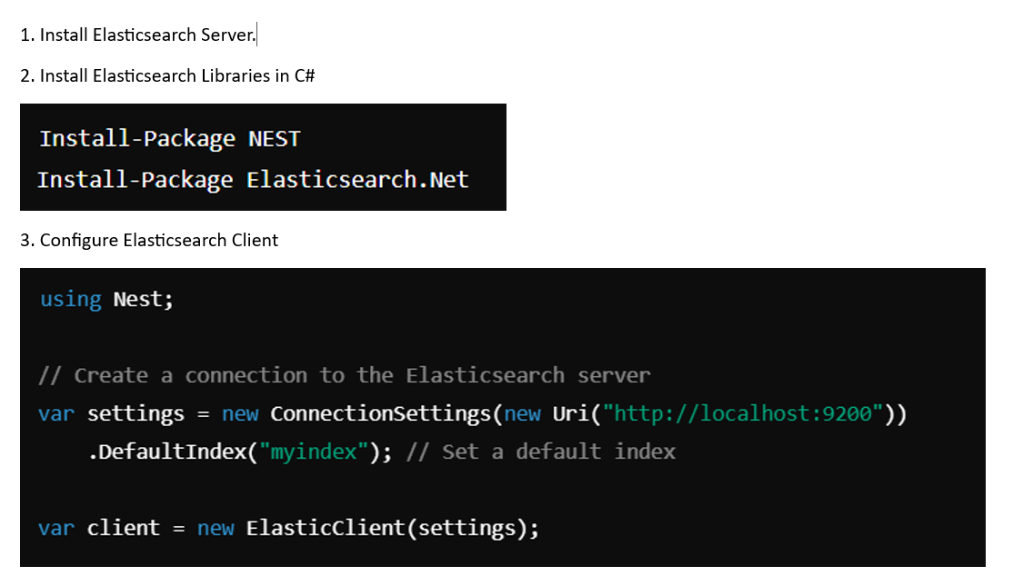
Elasticsearch in C#

Slide 7
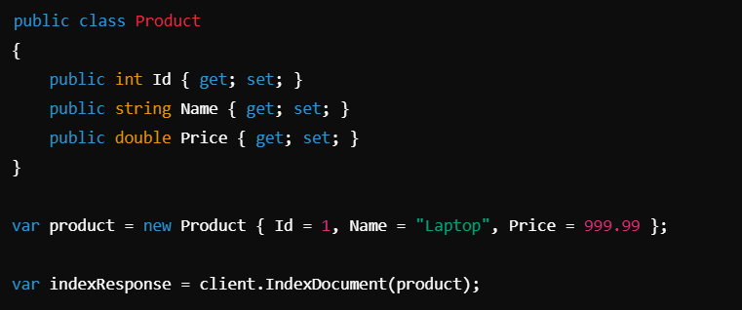
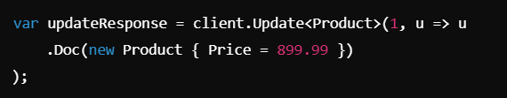
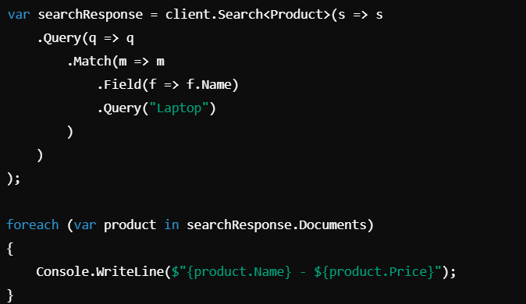

4. Index Documents
6. Update Documents
5. Search Documents
7. Delete Documents

Slide 8
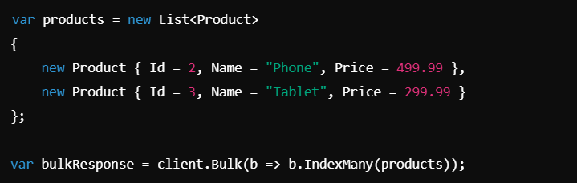
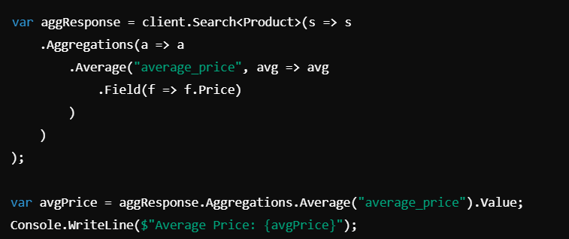
8. Advanced Features
Bulk Indexing:
Aggregations: Aggregate data for analytics.

Slide 9
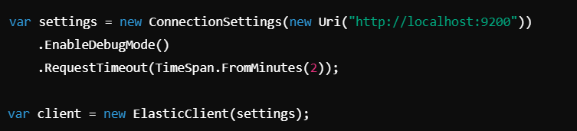
9. Handling Connection Issues

Slide 10
END

