Slide 1
Custom Connector - Talend
SPRINT-2 3W-4W AUG 21
DEMO

Slide 2
Agenda
Talend connector deployment review
Metadata structure & mapping overview
Setup datasource using Talend connector
Configuration parameters overview
Live demo
Open questions
SPRINT-2 3W-4W AUG 21

Slide 3
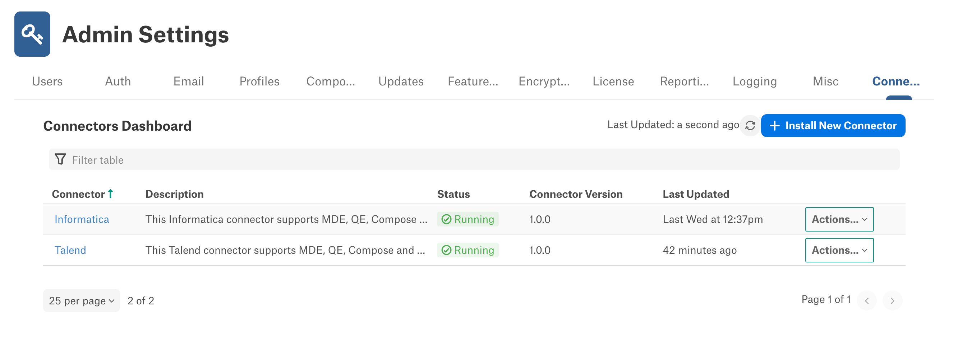
1. Connector Deployment
SPRINT-2 3W-4W AUG 21

Slide 4
2. Metadata structure & mapping overview
SPRINT-2 3W-4W AUG 21

Slide 5
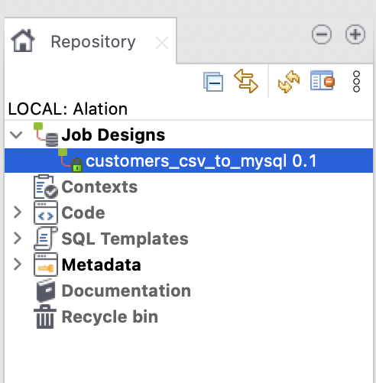
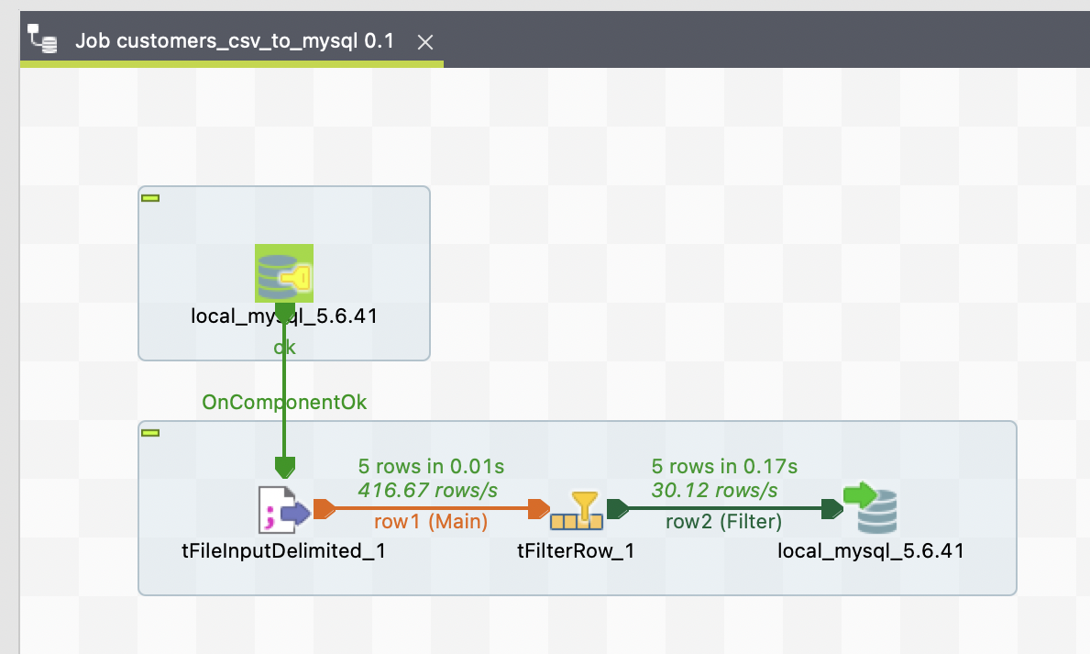
Talend Metadata
Jobs
Components
SPRINT-2 3W-4W AUG 21

Slide 6
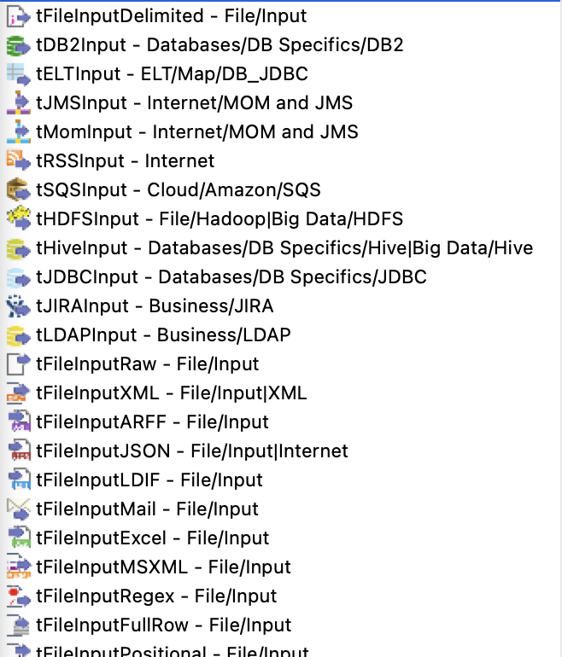
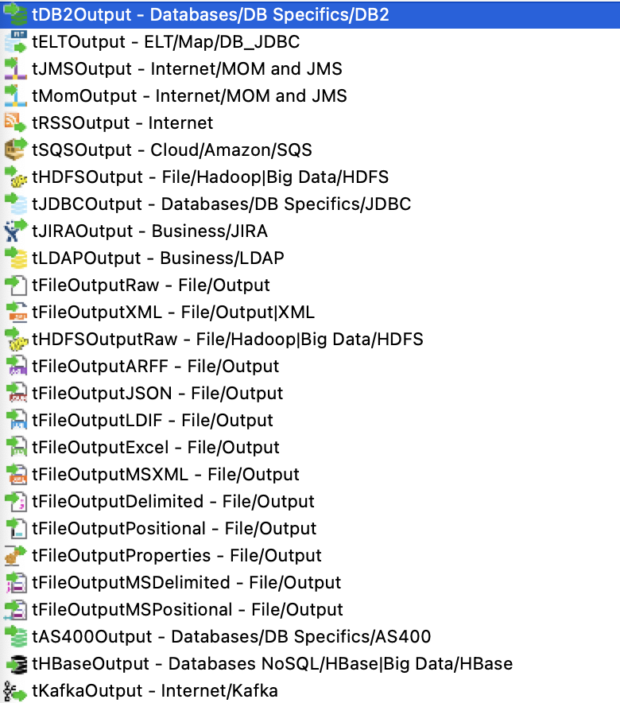
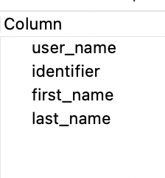
Talend Metadata
Input Components
Output Components
Columns
SPRINT-2 3W-4W AUG 21
*Only Input & Output components are covered in SPRINT2 scope

Slide 7
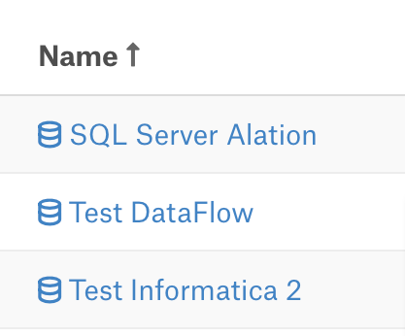
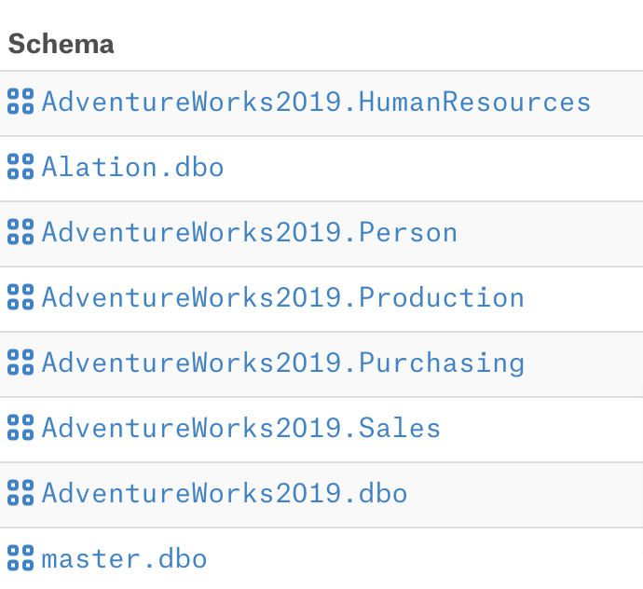
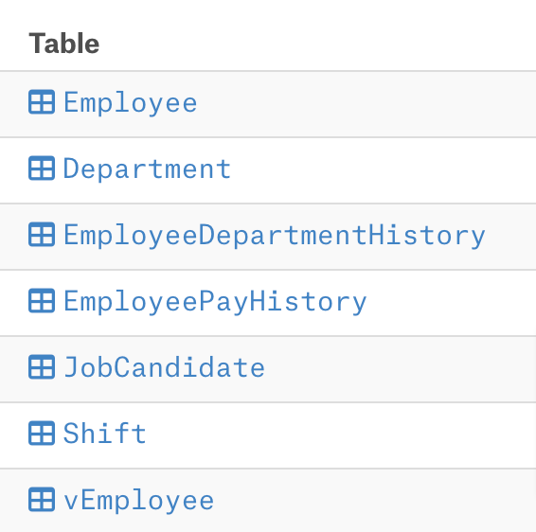
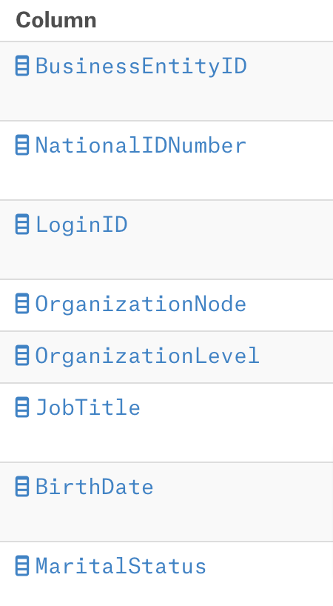
Alation Metadata
Data Sources
Schemas
Tables
Columns
SPRINT-2 3W-4W AUG 21

Slide 8
Metadata Mapping
Talend Job
Alation Datasource
Job
Schema
Input/Output Component
Table
Column
Column
Contains Relation
Mapping
SPRINT-2 3W-4W AUG 21

Slide 9
3. Setup Alation datasource using the
Talend OCF connector
SPRINT-2 3W-4W AUG 21

Slide 10
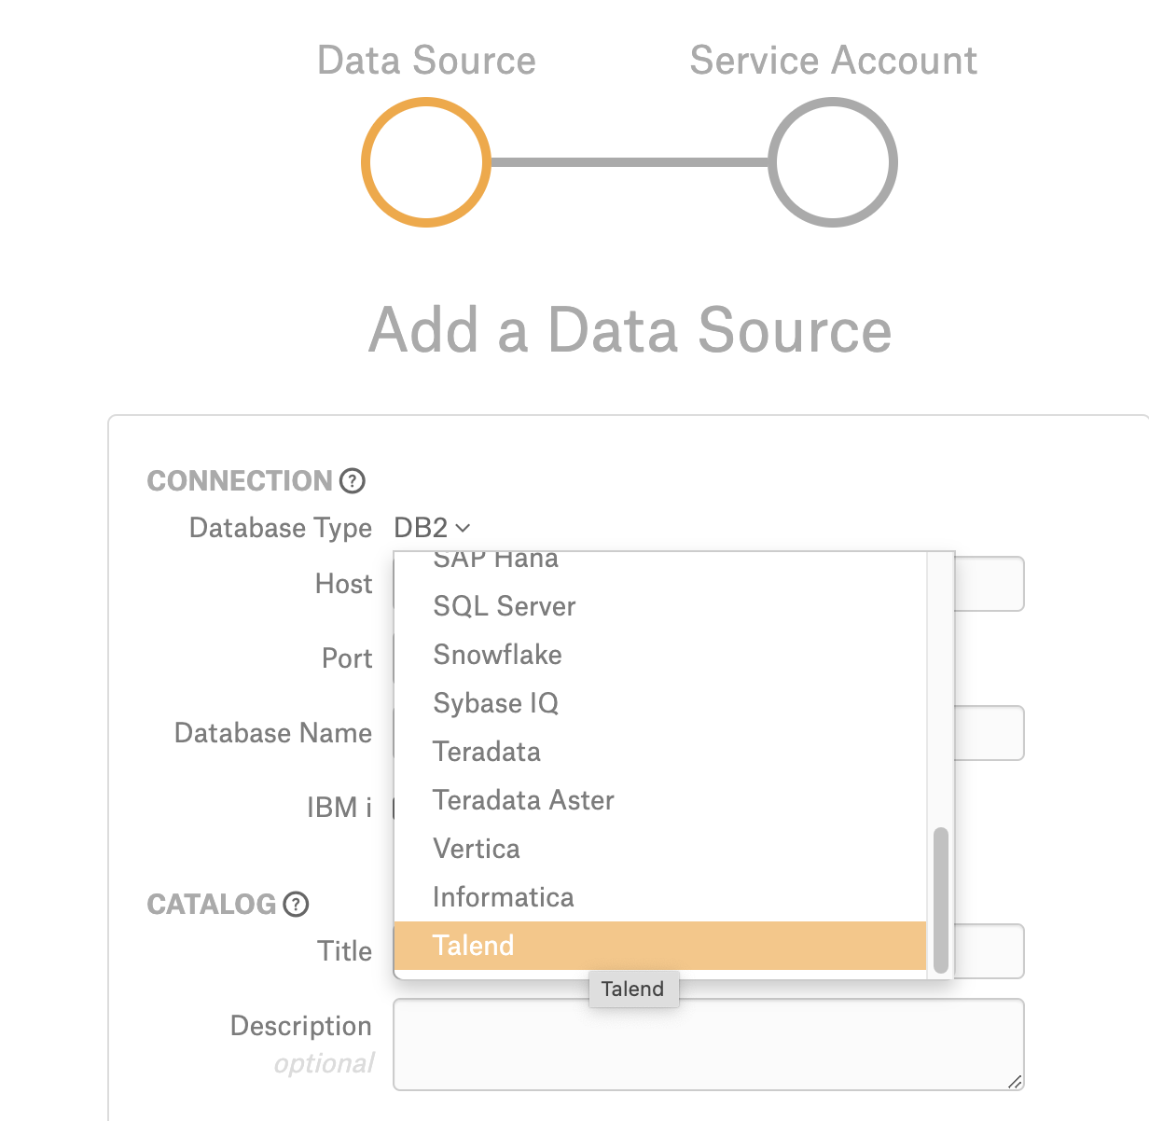
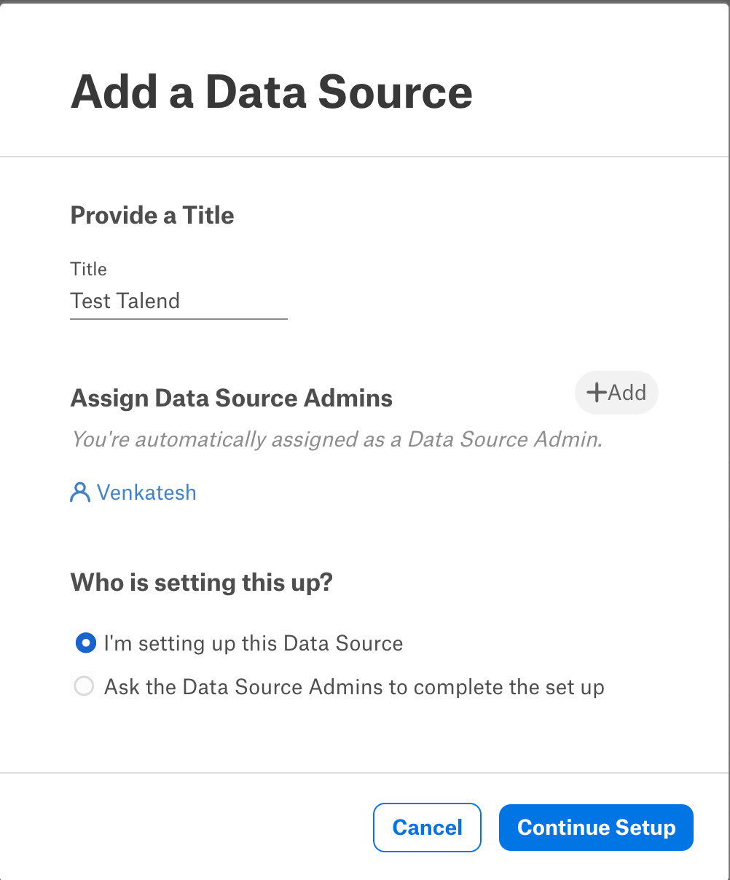
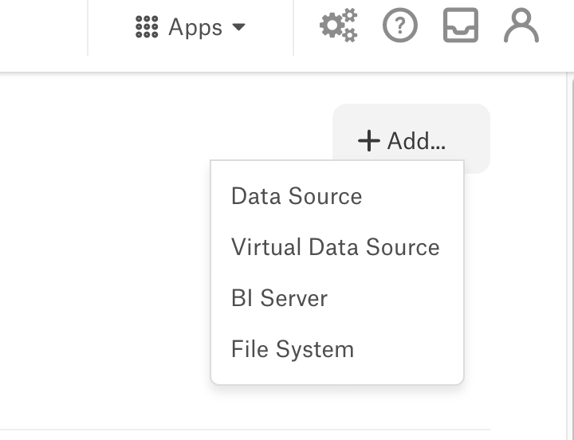
Setting up a datasource
SPRINT-2 3W-4W AUG 21

Slide 11
4. Configuration parameters overview
SPRINT-2 3W-4W AUG 21

Slide 12
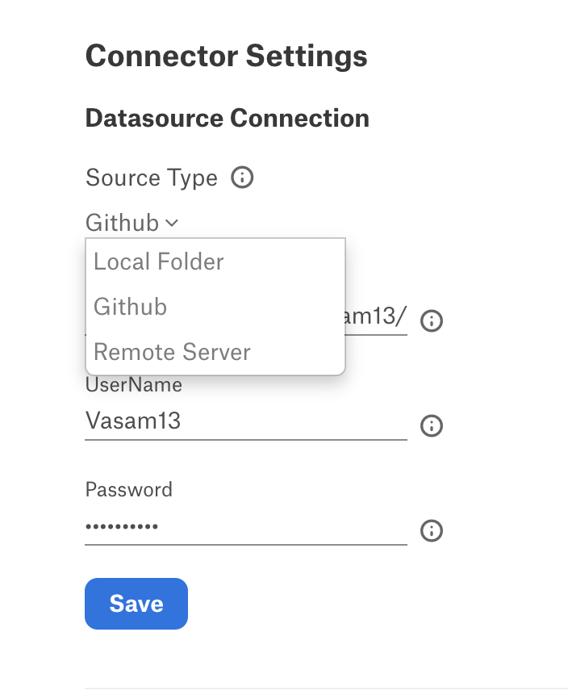
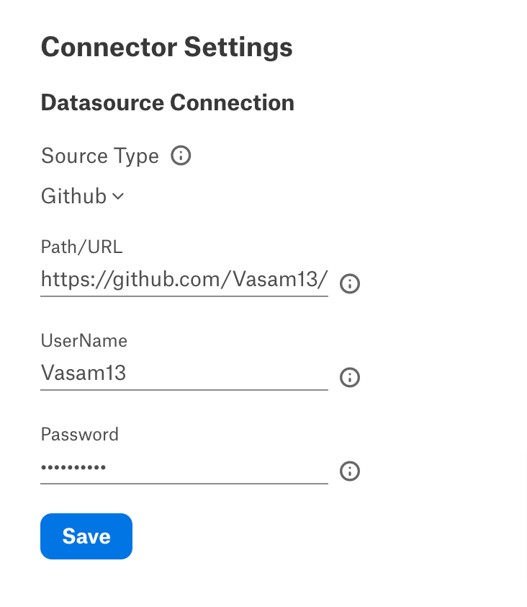
Configuration Parameters
SPRINT-2 3W-4W AUG 21

Slide 13
5. Metadata extraction overview
SPRINT-2 3W-4W AUG 21

Slide 14
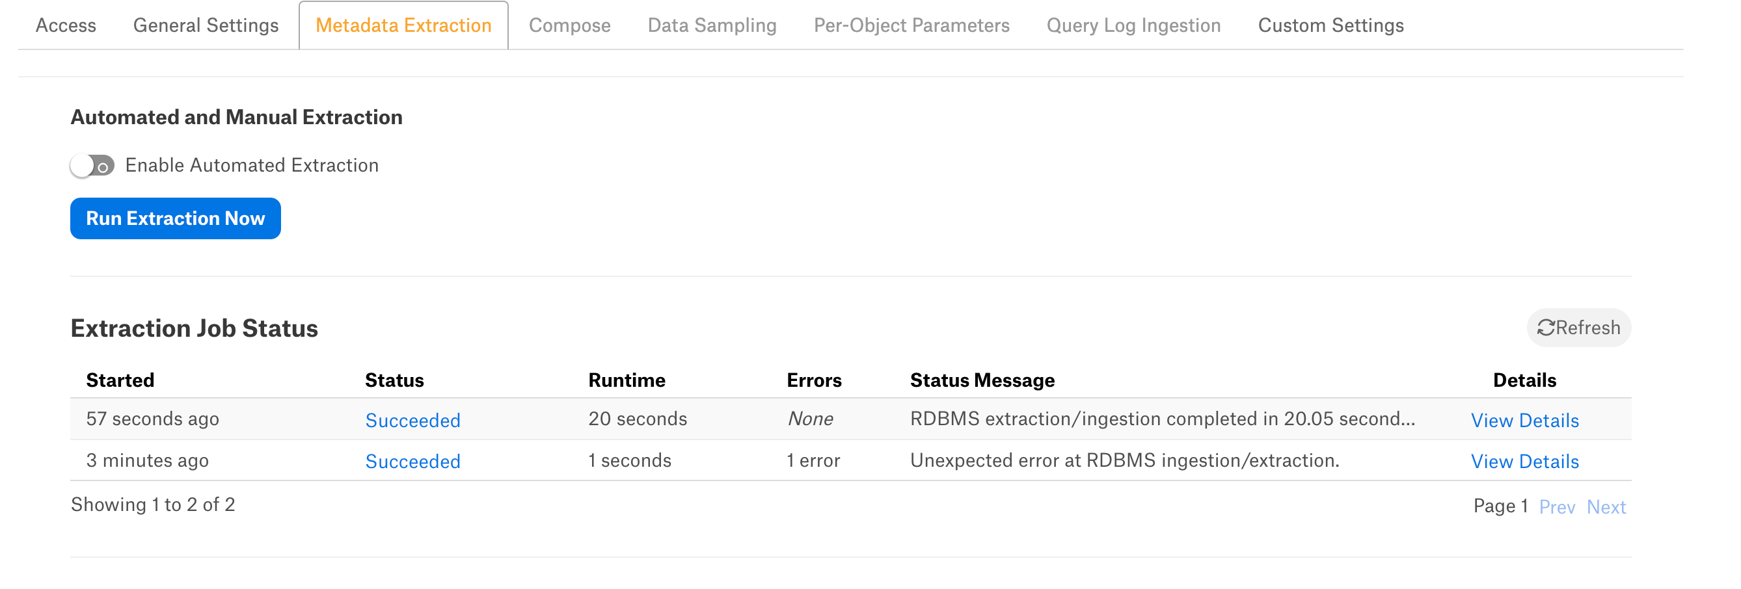
Run Metadata Extraction
SPRINT-2 3W-4W AUG 21

Slide 15
6. LIVE DEMO
SPRINT-2 1W-2W AUG 21

Slide 16
Q & A
How to map the connection parameters of the Talend source/target into the Alation tables (Maintaining table level connection parameters)
How to extract the sample data for a given Talend source/target
How to extract the sample data in the case of heterogeneous database types (The sources/targets derived from CSVs, SQL Servers, MySQL etc..)
How to handle Flat Files data sources like CSV
How create a Datasource Level Lineage/Transformation components using OCF Connector***
SPRINT-2 3W-4W AUG 21

