Slide 1
MACHINE LEARNING / CLINICAL DECISION SUPPORT / SMALL-DATA CASE
Cascade-Based Input-Doubling Classifier
& Linear Regression Pipeline
Predicting survival in pediatric allogeneic bone marrow transplantation
A small-data, class-imbalanced clinical ML study
Reference: Izonin, Tkachenko, Hovdysh, Berezsky, Yemets & Tsmots (2025). Computation 13(3):80, MDPI Open Access.
Reproducible pipeline - benchmarked models - FastAPI clinical web application

Slide 2
CONTENTS
What this deck covers
01
Problem & Motivation
Small data + class imbalance in transplantology
02
Research Foundation
Algorithm 1 - Cascade Input-Doubling (Izonin 2025)
03
Pipeline Architecture
Corruption -> Cleaning -> Two Models -> Benchmark
04
Model 1 - OLS Regression
Bootstrapped least squares baseline
05
Model 2 - Cascade Classifier
PNN expansion, input doubling, RF meta + voting
06
Results & Diagnostics
Metrics, confusion matrices, feature importance
07
Production Web App
FastAPI + interactive dashboard
08
Findings, Limits & Ethics
Conclusions and responsible-use notes
Cascade Input-Doubling Pipeline | Izonin et al. (2025), Computation 13(3):80
2

Slide 3
01 - MOTIVATION
The small-data problem in transplantology
Clinical constraints
Why this project
• Datasets are strictly limited in size - here N=157 training patients.
• Marked class imbalance: survival outcome is the minority event of interest.
• Heavy right-censoring and heterogeneous donor/recipient attributes.
• High-stakes decisions - a wrong call has real human cost.
Consequence: deep nets and complex non-linear classifiers overfit and fail to generalize.
• Implement Algorithm 1 end-to-end and test its small-data claims.
• Pair it with a transparent OLS + bootstrapping baseline.
• Evaluate on a strictly held-out clean test cohort.
• Ship it as a reproducible pipeline + interactive web app.
Thesis: neural probability projection enriches low-dimensional clinical feature spaces.
Cascade Input-Doubling Pipeline | Izonin et al. (2025), Computation 13(3):80
3

Slide 4
02 - RESEARCH FOUNDATION
Algorithm 1: three-stage cascade
STAGE 1
PNN Probability
Expansion
STAGE 2
Quadratic
Input-Doubling
STAGE 3
Random Forest
Meta-Classifier
• Euclidean, Chebyshev & Cosine distances to support vectors
• Gaussian kernel with smooth factor sigma
• Appends probabilities: [x, P_E, P_Cheb, P_Cos]
• Form sample pairs (x_i, x_j) and concatenate them
• Target becomes the difference z = y_i - y_j in {-1, 0, 1}
• Small N -> thousands of informative comparisons
• Trained on the doubled feature space
• Plurality voting over reference training vectors
• Final discrete class from ensemble votes
➜
➜
Cascade Input-Doubling Pipeline | Izonin et al. (2025), Computation 13(3):80
4

Slide 5
03 - ARCHITECTURE
End-to-end pipeline
RAW DATA
157 train + 30 test
➜
STEP A
Artificial corruption
➜
STEP B
Cleaning & preprocessing
➜
MODELS
OLS + Cascade classifier
➜
BENCHMARK
Metrics, plots, exports
Engineering principles
Strict train/test isolation. Every preprocessing artifact (imputers, IQR caps, scaler, encoder) is fitted on the training split only and then applied to test - eliminating data leakage.
Reproducibility. Fixed random seeds and a single master script (pipeline.py) regenerate every CSV, metric and figure.
Modular source. Corruption, cleaning, regression, cascade classifier, evaluation and visualization live in separate, testable modules under src/.
Dual deliverables. A batch research pipeline and an executable Jupyter notebook + FastAPI web application.
Cascade Input-Doubling Pipeline | Izonin et al. (2025), Computation 13(3):80
5

Slide 6
03 - ARCHITECTURE
Step A - Artificial data corruption
Injected distortions
Corruption -> cleaning contract
• Random 10-15% NaN missingness across numerical features.
• Synthetic duplicate rows to simulate dirty clinical records.
• Non-standard string casing & whitespace injection in Disease.
• Extreme numerical outliers inserted (CD34 dosage, donor/recipient weights and ages).
Purpose: stress-test the cleaning pipeline under realistic hospital-data degradation before any model sees the data.
Output dirty_dataset.csv
Missingness 12% of numeric cells
Duplicates 14 injected rows
Outliers 8 extreme points
String noise casing + whitespace
Seed random_state = 42
Why corrupt on purpose? It makes the robustness of the cleaning stage measurable and keeps the experiment reproducible, rather than silently assuming clean inputs.
Cascade Input-Doubling Pipeline | Izonin et al. (2025), Computation 13(3):80
6

Slide 7
03 - ARCHITECTURE
Step B - Cleaning & preprocessing
STEP 1
Deduplicate
Drop exact duplicate rows injected in Step A.
STEP 2
Outlier capping
IQR clipping to [Q1 - 3*IQR, Q3 + 3*IQR].
STEP 3
Imputation
Median (numeric) & mode (categorical).
STEP 4
Encode & scale
One-hot categoricals + StandardScaler.
No-leakage guarantee
• BoneMarrowPreprocessor.fit() is called ONLY on the corrupted training set.
• transform() is then applied independently to train and to the clean 30-patient test cohort.
• Median/mode statistics, IQR bounds, scaler mean/std and encoder categories are all frozen from training.
• Result: the test cohort is never seen during fitting - benchmark metrics are honest.
Artifacts: cleaned_dataset.csv - cleaned_test_dataset.csv
Cascade Input-Doubling Pipeline | Izonin et al. (2025), Computation 13(3):80
7

Slide 8
04 - MODEL 1
OLS linear regression + bootstrapping
What it does
Exports & diagnostics
• Ordinary Least Squares fit of survival_status on cleaned features.
• 100-iteration bootstrap resampling for coefficient stability.
• Per-coefficient standard errors, 95% confidence intervals and p-values.
• Residual diagnostics (absolute & squared error tables).
• Continuous output thresholded for binary classification.
Role: transparent, interpretable baseline - the yardstick every cascade gain is measured against.
• bootstrapped_coefficients.csv
• regression_errors.csv
• Bootstrapped regression fits with 95% CI band (figure).
Bootstrapping in one line
Resample the training set with replacement, refit OLS, and record coefficients. Repeating 100x yields an empirical sampling distribution, so uncertainty can be reported without distributional assumptions.
Cascade Input-Doubling Pipeline | Izonin et al. (2025), Computation 13(3):80
8

Slide 9
05 - MODEL 2 / STAGE 1
PNN probability expansion
Distance & kernel mechanics
Implementation
• Three distance matrices to the training support set:
  • Euclidean - Chebyshev - Cosine
• Gaussian kernel K = exp( -d^2 / (2*sigma^2) ) with smooth factor sigma.
• For each metric, posterior for class 1 = mean(K | class 1) / (mean(K | class 0) + mean(K | class 1)).
• Outputs three probabilities appended to the original vector: [x | P_E, P_Cheb, P_Cos].
Effect: the classifier sees a richer, non-linear projection of a low-dimensional clinical space - the core thesis of Izonin et al. (2025).
class PNNProbabilityExpander:
def fit(X, y) -> self
def transform(X) -> (N, 3)
[P_euclid,
P_cheb,
P_cosine]
def expand_features(X)
-> hstack([X, probs])
Cascade Input-Doubling Pipeline | Izonin et al. (2025), Computation 13(3):80
9

Slide 10
05 - MODEL 2 / STAGE 2
Quadratic input-doubling
Augmentation recipe
Why it mitigates small data
• For each sample i, pair it with a random subset of other samples j.
• Concatenate the two expanded vectors: [ x_exp_i | x_exp_j ].
• The learning target becomes the class difference: z = y_i - y_j in {-1, 0, +1}.
• Up to 8,000 pairs generated (stratified), capped for tractability.
• Turns N=157 rows into thousands of informative pairwise comparisons.
1. Effective sample-size expansion without fabricating labels - every pair is grounded in two real patients.
2. Pairwise difference targets capture ordinal structure and reduce sensitivity to class imbalance.
3. The doubled space exposes relative (rather than absolute) clinical signatures to the meta-learner.
4. Regularization by construction: redundant pairs average out idiosyncratic noise.
Cascade Input-Doubling Pipeline | Izonin et al. (2025), Computation 13(3):80
10

Slide 11
05 - MODEL 2 / STAGE 3
Random Forest meta-classifier & voting
Meta-learner
Inference: plurality voting
• RandomForestClassifier trained on the doubled feature space.
• Learns the difference function z = y_i - y_j.
• Gini feature importance aggregated back to original + PNN features.
• n_estimators and max_depth tuned by global optimization.
• Select fixed reference training vectors (support set).
• Pair each test sample with every reference -> predict z_hat.
• Derive a vote: y_test = y_ref + z_hat, clipped to {0, 1}.
• Class 1 probability = fraction of references voting Deceased.
• Final label by plurality of votes - robust to single-pair errors.
Benefit: ensemble of many relative judgments instead of one brittle absolute prediction.
Cascade Input-Doubling Pipeline | Izonin et al. (2025), Computation 13(3):80
11

Slide 12
05 - MODEL 2
Hyperparameter optimization - Dual Annealing
Search setup
Dist. | Trial | Sigma | n_est | Depth | CV F1 | CV MCC
E,C,Cos | 3 | 3.2183 | 80 | 9 | 0.8120 | 0.6504
E,C,Cos | 9 | 2.2774 | 70 | 8 | 0.8071 | 0.6383
E,C,Cos | 14 | 2.1533 | 50 | 4 | 0.7812 | 0.6007
E,C,Cos | 8 | 1.2460 | 105 | 12 | 0.7674 | 0.5703
E,C,Cos | 5 | 1.4686 | 93 | 11 | 0.7652 | 0.5603
• scipy.optimize.dual_annealing - global, derivative-free search.
• Objective: maximize mean_F1 + 0.5 * mean_MCC under 3-fold Stratified CV.
• Bounds: sigma in [0.2, 3.5] | n_estimators in [50, 150] | max_depth in [4, 14].
• 15 evaluated trials logged with CV F1 and MCC per trial.
Optimal configuration
sigma = 3.2183 - n_estimators = 80 - max_depth = 9
Top 5 of 15 Dual Annealing trials (E = Euclidean, C = Chebyshev, Cos = Cosine). Trial 3 is the global optimum.
Cascade Input-Doubling Pipeline | Izonin et al. (2025), Computation 13(3):80
12

Slide 13
06 - RESULTS
Benchmark on the held-out test cohort
Independent clean test set - 30 patients (20 survived, 10 deceased), never seen during training or tuning.
Model | Acc. | Prec. | Recall | F1 | MCC | Kappa | RMSE | MAE
Linear Regression (OLS) | 0.9333 | 0.8333 | 1.0000 | 0.9091 | 0.8660 | 0.8571 | 0.3186 | 0.2597
Hybrid Cascade (Algorithm 1) | 0.9333 | 1.0000 | 0.8000 | 0.8889 | 0.8528 | 0.8421 | 0.2165 | 0.0637
Combined Ensemble Blend | 0.9333 | 1.0000 | 0.8000 | 0.8889 | 0.8528 | 0.8421 | 0.2083 | 0.1408
MAE reduction
RMSE reduction
Zero false positives
75.5%
0.2597 -> 0.0637 vs OLS baseline
32.1%
0.3186 -> 0.2165 vs OLS baseline
Prec 1.00
Specificity 1.00 - no healthy patient flagged
Cascade Input-Doubling Pipeline | Izonin et al. (2025), Computation 13(3):80
13

Slide 14
06 - RESULTS
Confusion matrices & the OLS trade-off
Model | TP | FP | TN | FN | Sens. | Spec. | PPV | NPV
Linear Regression (OLS) | 10 | 2 | 18 | 0 | 1.000 | 0.900 | 0.833 | 1.000
Hybrid Cascade (Algorithm 1) | 8 | 0 | 20 | 2 | 0.800 | 1.000 | 1.000 | 0.909
Combined Ensemble Blend | 8 | 0 | 20 | 2 | 0.800 | 1.000 | 1.000 | 0.909
OLS: sensitive but over-flags
Cascade: precise, zero false positives
• Catches every deceased patient (recall = 1.00).
• But 2 false positives - healthy survivors flagged as deceased.
• In transplant triage, false alarms drive unnecessary invasive work-ups.
• No false positives (FP = 0), specificity & precision = 1.00.
• Trades 2 missed deceased (FN) for eliminating false alarms.
• Better calibrated for high-stakes, precision-first decisions.
Cascade Input-Doubling Pipeline | Izonin et al. (2025), Computation 13(3):80
14

Slide 15
06 - RESULTS
Feature importance - the PNN signal dominates
PNN_Euclid
0.3560
survival_time
0.1981
PNN_Cosine
0.1153
PNN_Chebyshev
0.0794
CD34kgx10d6
0.0214
CD3dCD34
0.0191
Recipientage
0.0168
PLTrecovery
0.0162
Insight: the PNN probability projection (Euclid + Cosine + Chebyshev) is the single strongest learned signal - empirically supporting the paper's core feature-enrichment hypothesis.
Cascade Input-Doubling Pipeline | Izonin et al. (2025), Computation 13(3):80
15

Slide 16
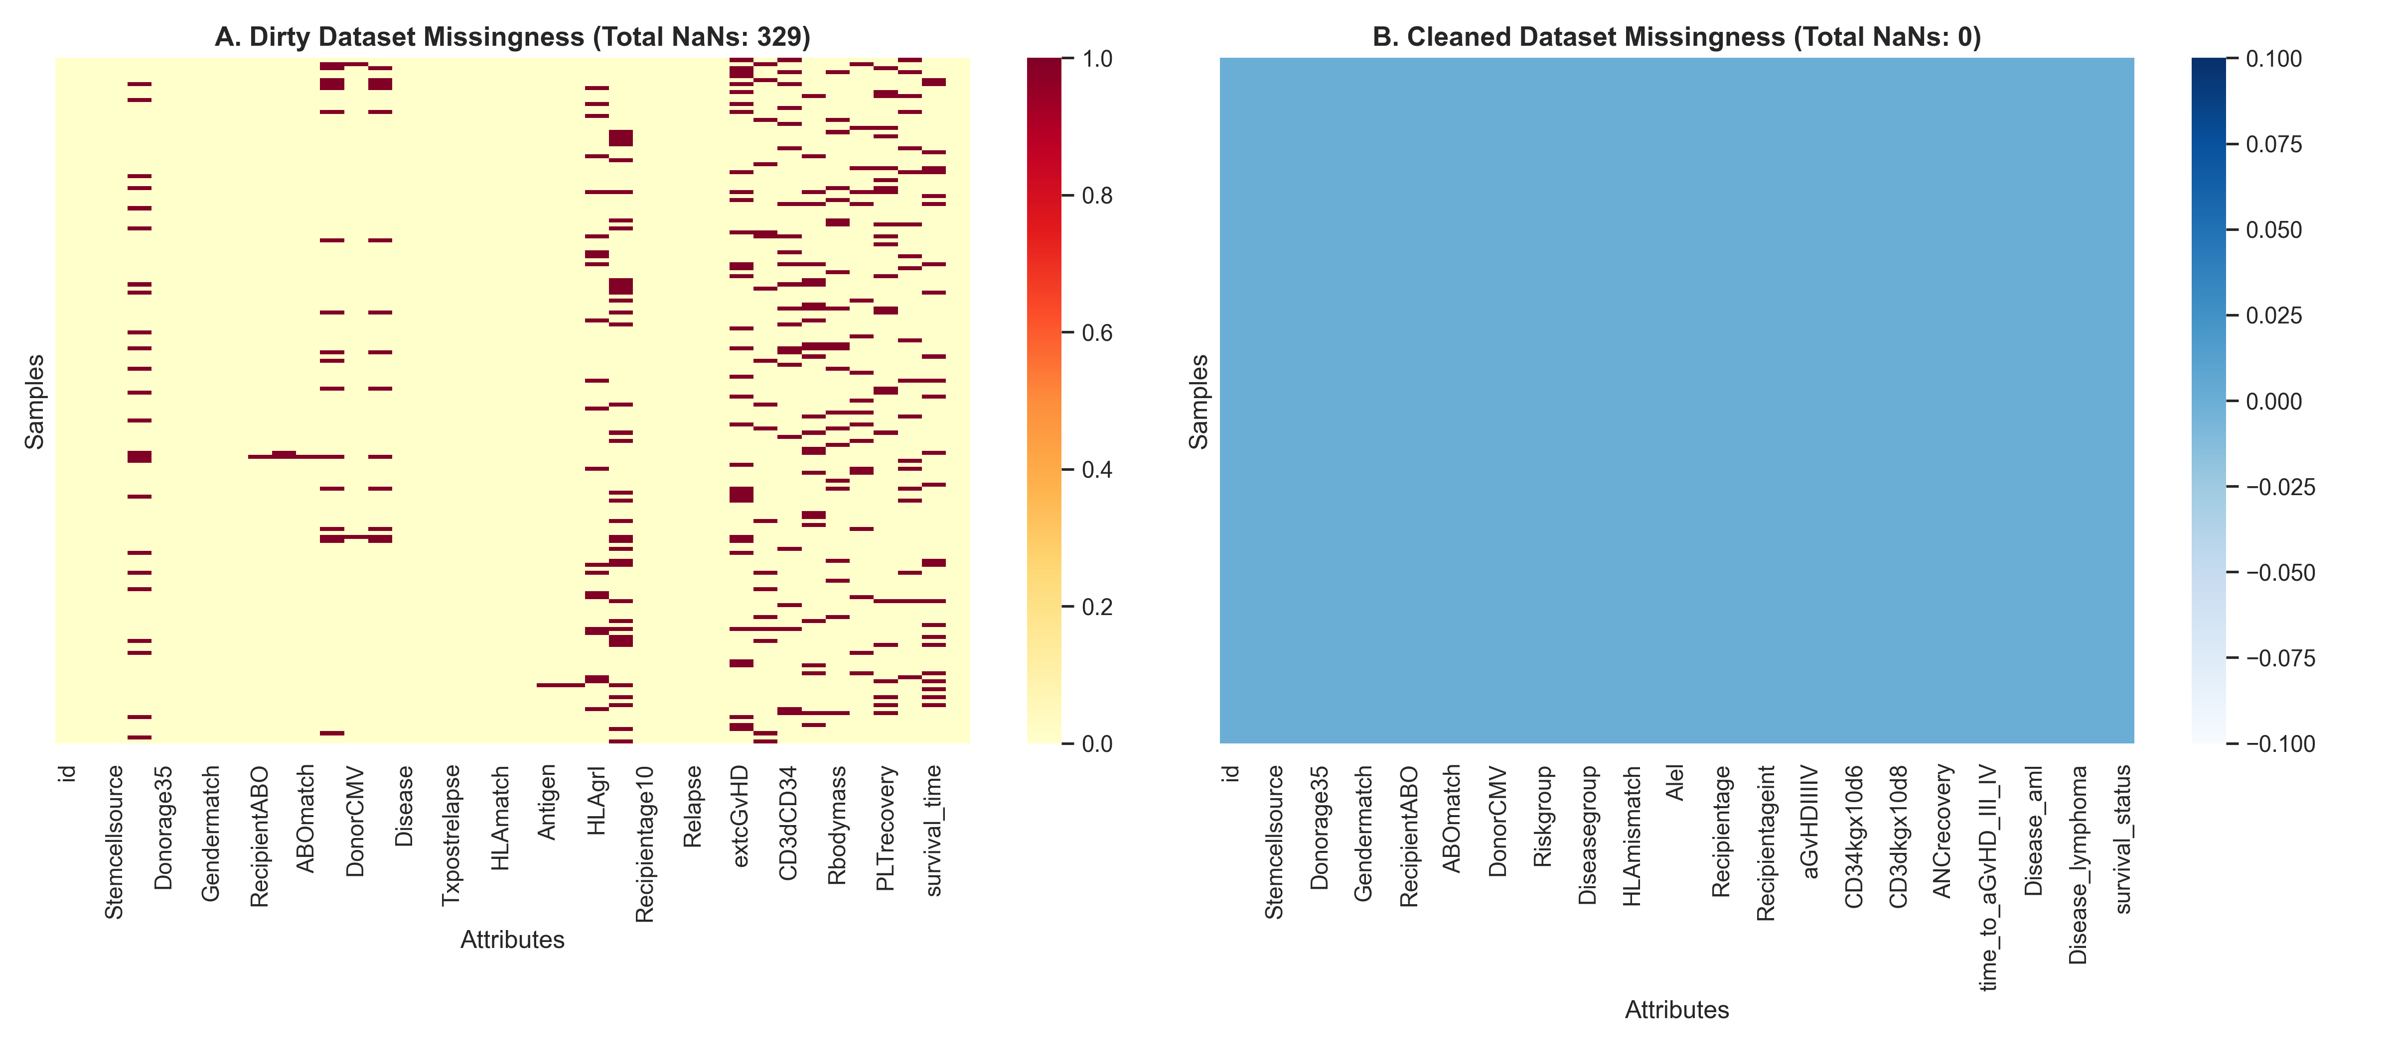
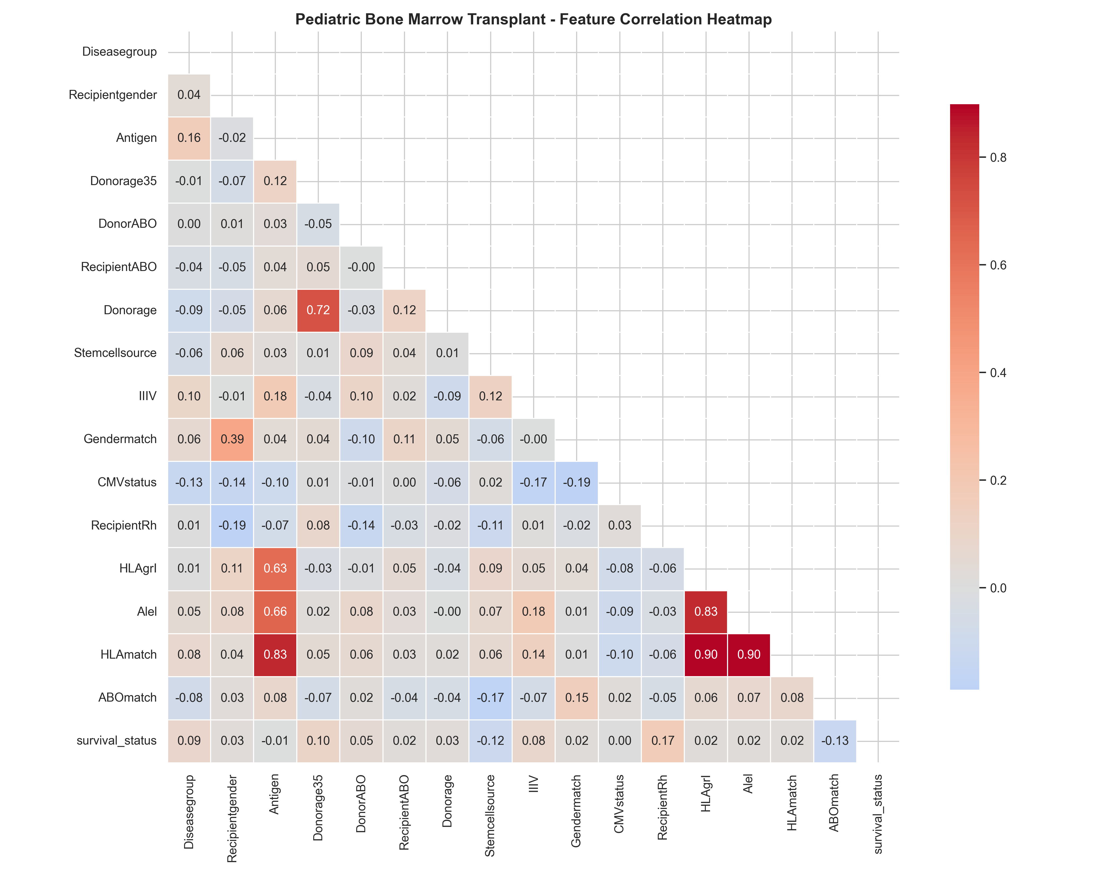
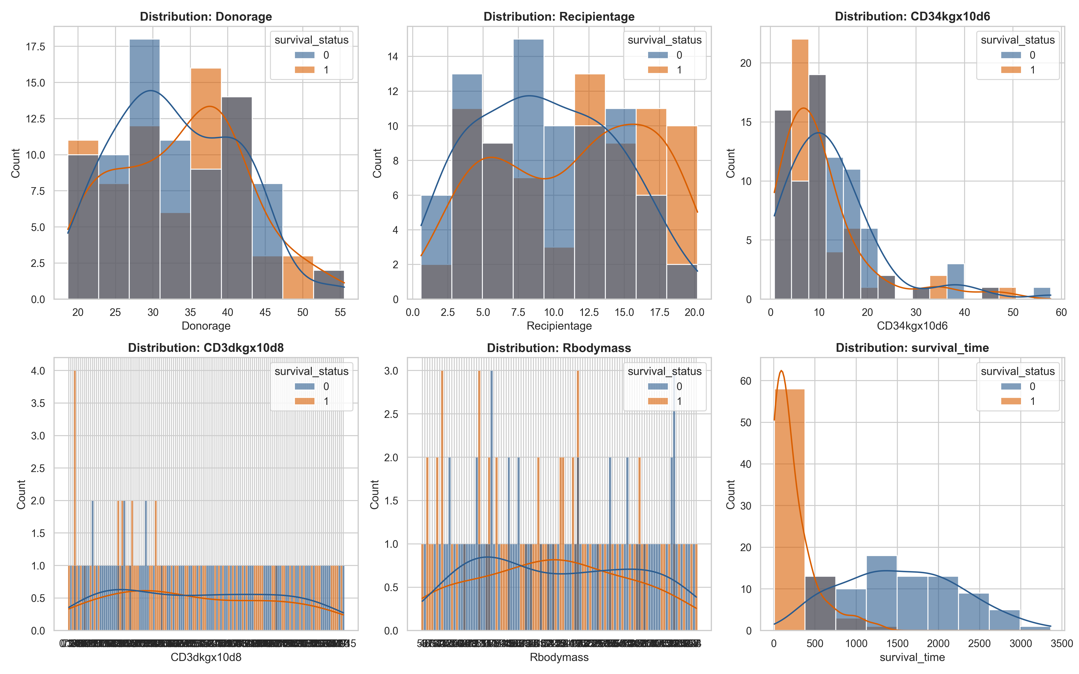
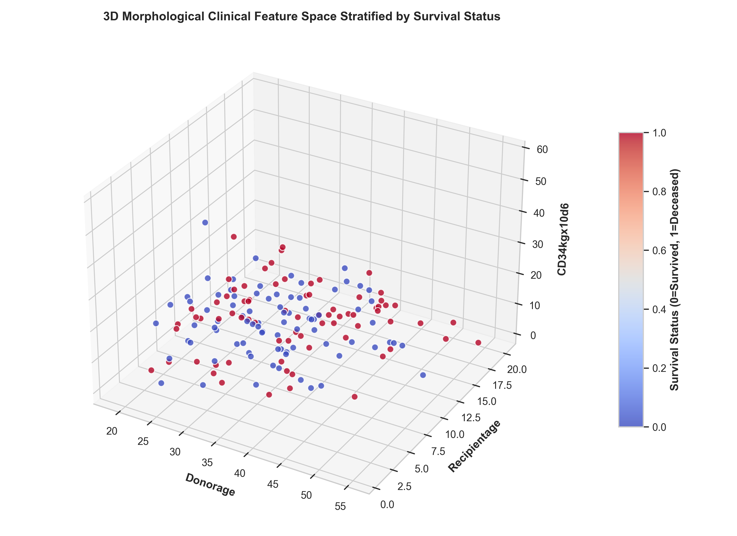
06 - DIAGNOSTICS
Data quality & exploratory analysis
Missingness: dirty vs. clean
Clinical correlation heatmap
Feature distributions
3D feature space
Cascade Input-Doubling Pipeline | Izonin et al. (2025), Computation 13(3):80
16

Slide 17
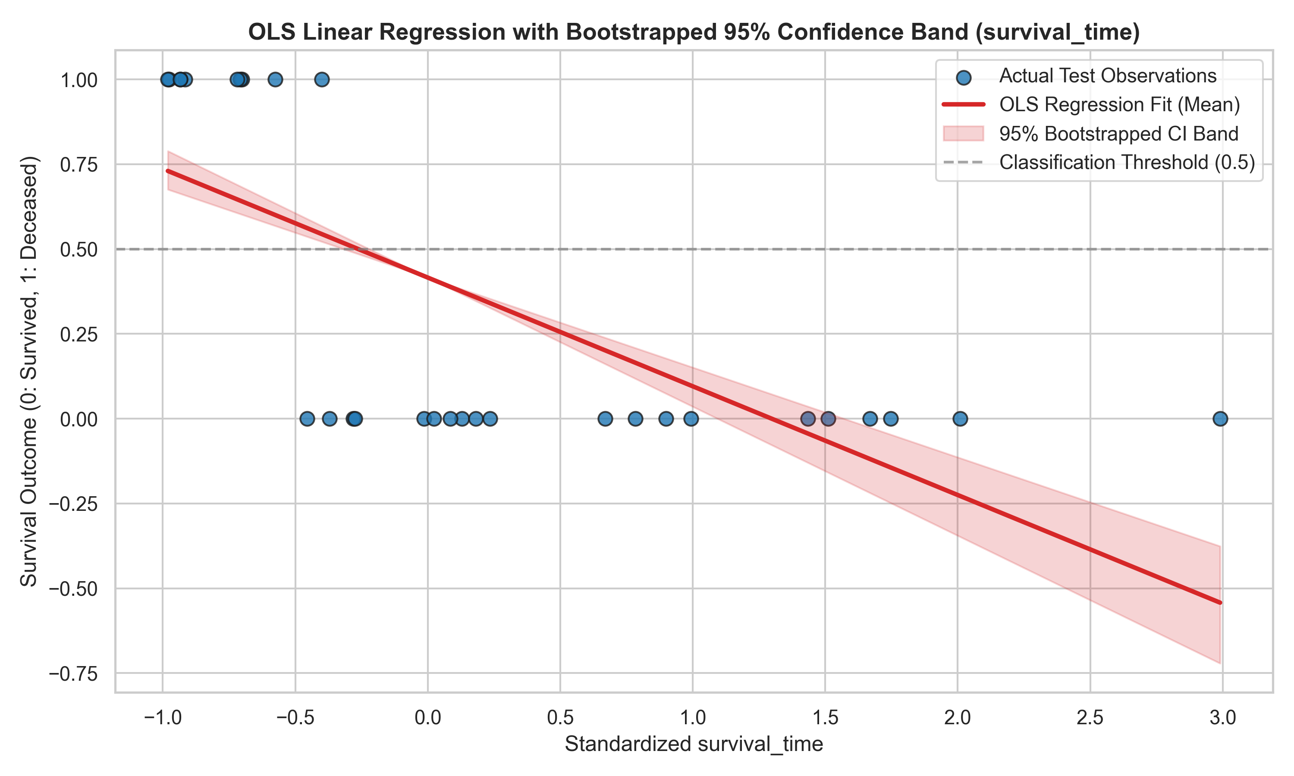
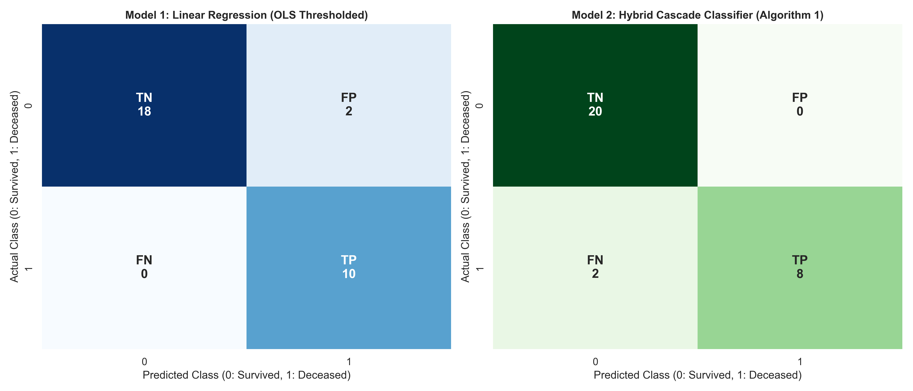
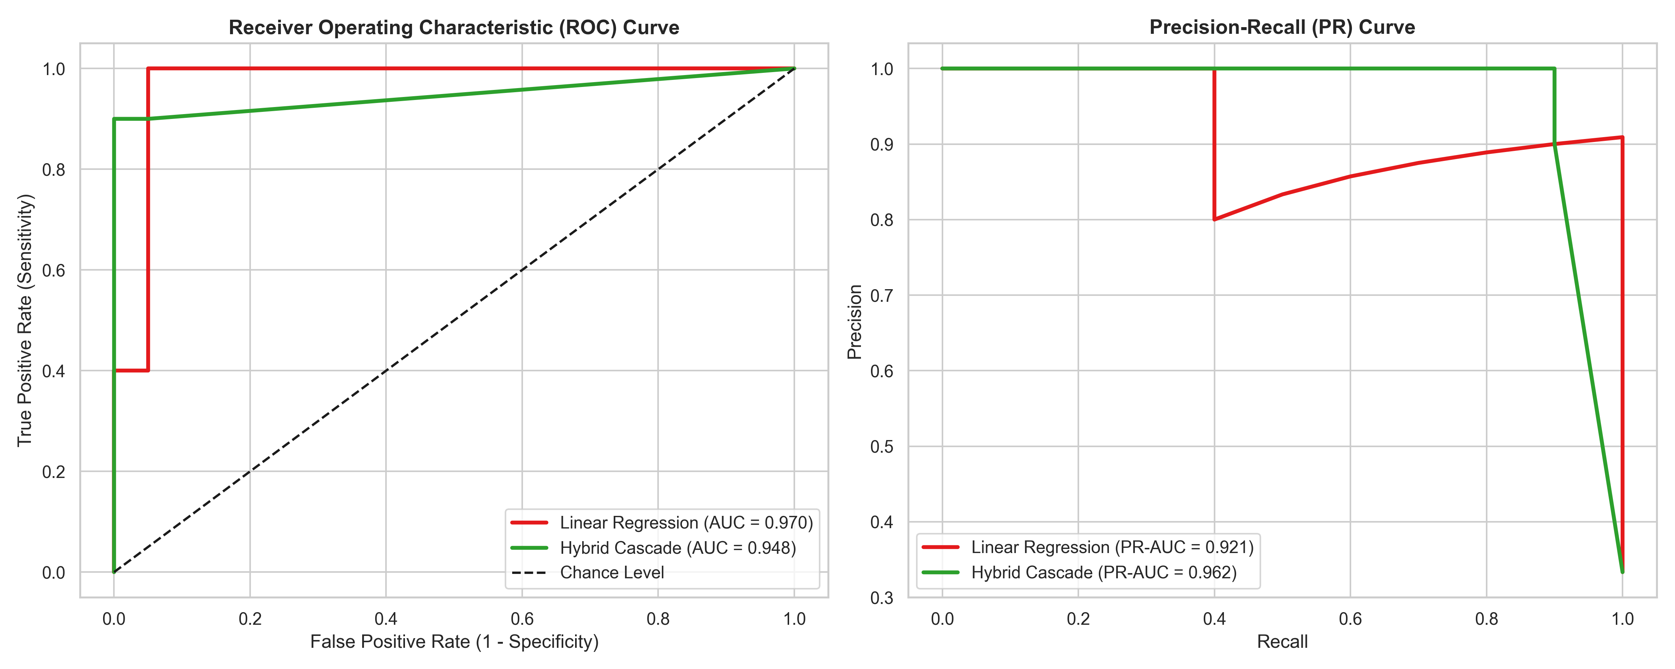
06 - DIAGNOSTICS
Model evaluation figures
Confusion matrices - side by side
ROC-AUC & Precision-Recall curves
OLS with 95% bootstrap CI band
Cascade Input-Doubling Pipeline | Izonin et al. (2025), Computation 13(3):80
17

Slide 18
07 - PRODUCTIONIZATION
Interactive clinical ML web application
Stack & architecture
Product surface
• FastAPI backend with REST + auto Swagger/ReDoc docs.
• Singleton model service loading persisted joblib artifacts.
• Responsive 7-tab dark dashboard (vanilla JS + Chart.js).
• 9-case automated unittest suite for API + inference + validation.
• CSV export center with formula-injection sanitization.
Two distinct models, kept distinct: Ridge regression targets survival_time (days); the cascade classifies survival_status (0/1).
Endpoints - POST /predict, /compare, GET /health, /meta
Features - 35 de-leaked baseline clinical attributes
Sections - Demographics, disease, HLA, cell dose, serology, regimen
Outputs - Predicted class + calibrated probability; time + CI
Docs - 127.0.0.1:8000/docs (Swagger UI)
Cascade Input-Doubling Pipeline | Izonin et al. (2025), Computation 13(3):80
18

Slide 19
08 - CONCLUSIONS
Key findings
01
Prediction error slashed
Cascade cut MAE by 75.5% (0.2597 -> 0.0637) and RMSE by 32.1% vs the OLS baseline.
02
Zero false positives
Specificity and precision both 1.00 - no healthy patient was flagged, critical for avoiding unnecessary interventions.
03
PNN expansion is the signal
PNN_Euclid is the #1 feature at 35.6% importance, validating the paper's feature-enrichment thesis.
04
Input doubling beats small N
Pairwise differences turn 157 rows into thousands of grounded comparisons, stabilizing learning under class imbalance.
05
Reproducible by design
Seeded, modular, leak-free pipeline plus notebook and web app - every number regenerates from source.
Cascade Input-Doubling Pipeline | Izonin et al. (2025), Computation 13(3):80
19

Slide 20
08 - CONCLUSIONS
Limitations & responsible use
Statistical caveats
Ethical disclaimer
• Test cohort is tiny (N=30); single-split metrics carry wide uncertainty.
• Reported benchmarks vary across runs/seeds - the pipeline export and the README/web-app summaries differ.
• The cascade's precision-first bias trades recall for specificity - model choice must follow the clinical objective.
• survival_time regression is heavily right-censored; R^2 is near zero, so day-level prediction is not reliable.
• Research and educational demonstration ONLY.
• NOT evaluated in clinical trials, NOT FDA-approved, NOT CE-marked.
• Must NEVER guide diagnosis, prognosis or treatment.
• No PHI: only de-identified public benchmark data is processed.
Bottom line: a rigorous methods showcase - not a medical device.
Cascade Input-Doubling Pipeline | Izonin et al. (2025), Computation 13(3):80
20

Slide 21
Thank you
Questions & discussion
Attribution
Method: Izonin, I., Tkachenko, R., Hovdysh, N., Berezsky, O., Yemets, K. & Tsmots, I. (2025). Cascade-Based Input-Doubling Classifier for Predicting Survival in Allogeneic Bone Marrow Transplants: Small Data Case. Computation 13(3):80.
Data: Pediatric Bone Marrow Transplantation benchmark dataset.
Stack: Python, scikit-learn, SciPy, statsmodels, pandas, matplotlib/seaborn, FastAPI, Chart.js.
License: MIT License.
Repository: bone_marrow_cascade_pipeline - run python pipeline.py to reproduce

